Slide 1
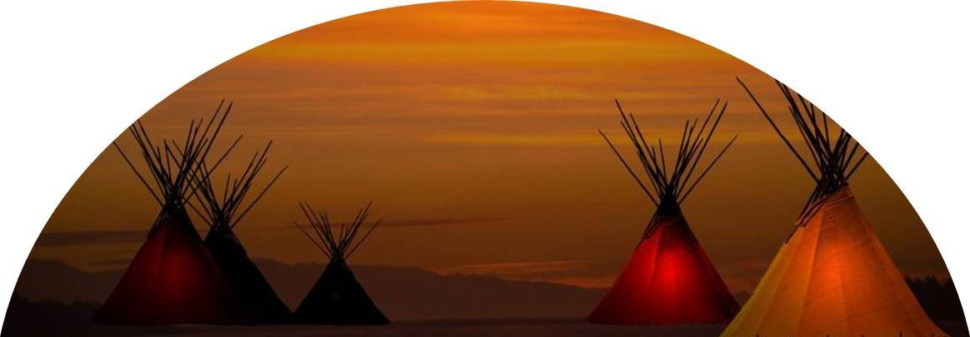
Little River Band of Ottawa Indians
Department of Public Safety
Robert R Medacco
Director of Public Safety

Slide 2
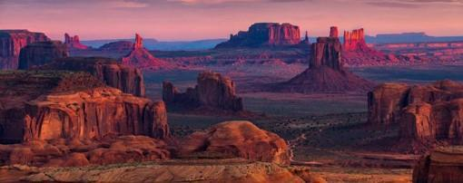
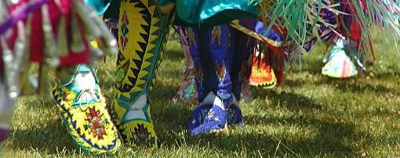
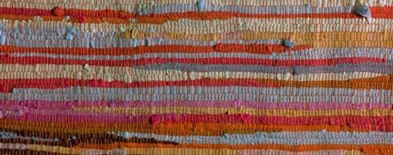
Agenda
Tribe History
Department History
Department Breakdown
Jurisdiction
Partnerships

Slide 3
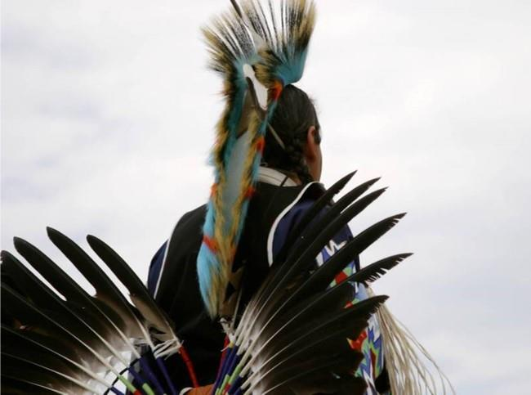
LRBOI History
The Little River Band of Ottawa Indians are a specific band of Ottawa Indians which resided along the shores of the river systems between Kent and Manistee Counties. The tribe is recognized the 1836 and 1855 treaties. Little River celebrates September 21st as Tribal Reaffirmation Day.
The Ottawa are known as the "Traders". The other tribes Potawatomi and Chippewa.
The nine feathers on the tribal logo represent the original nine families and chiefs.

Slide 4
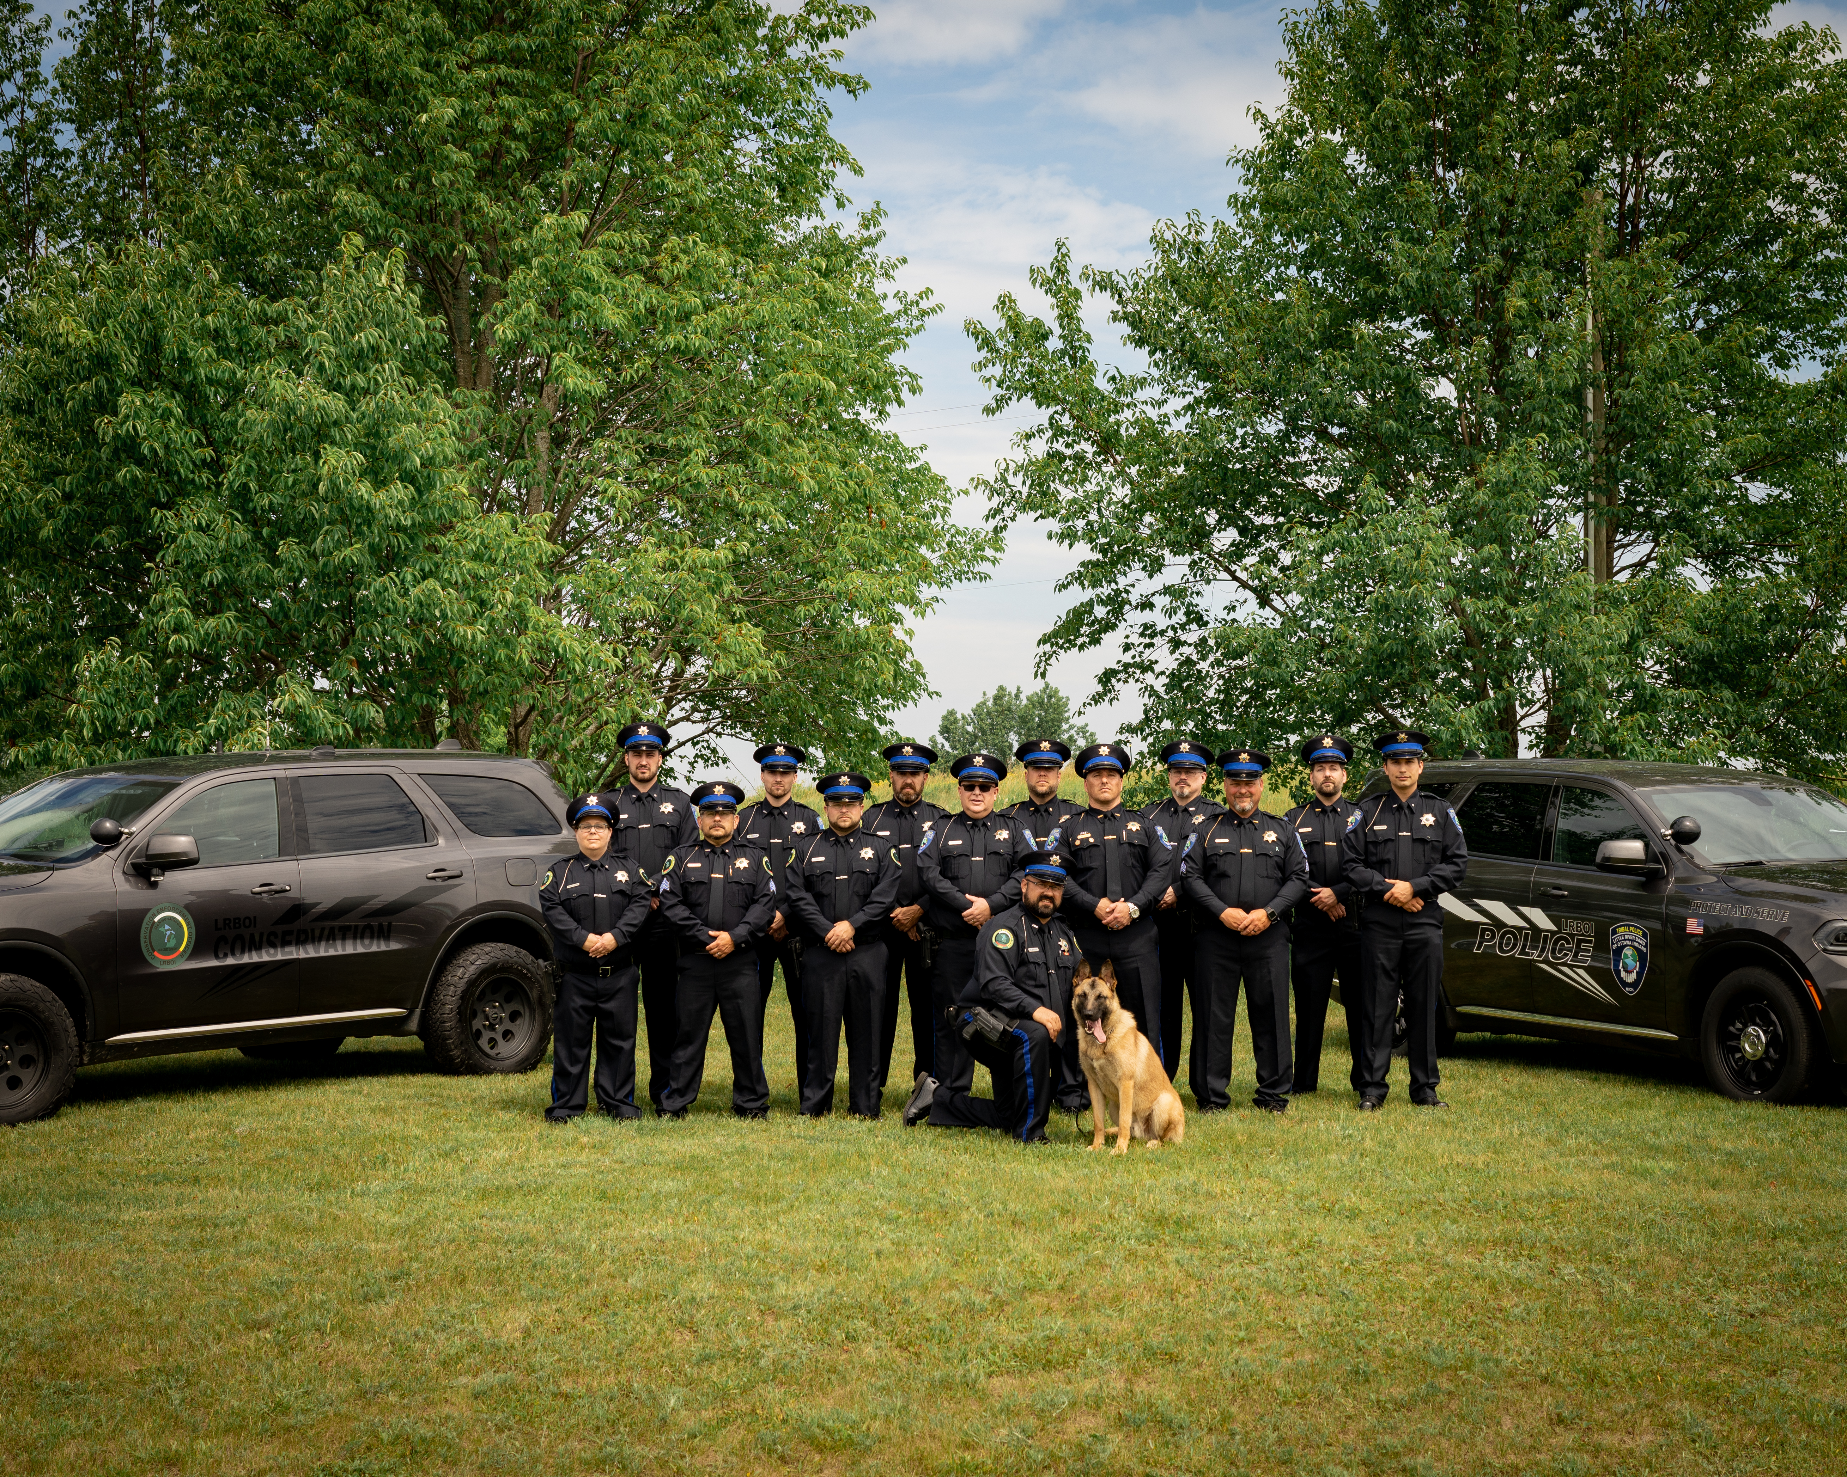
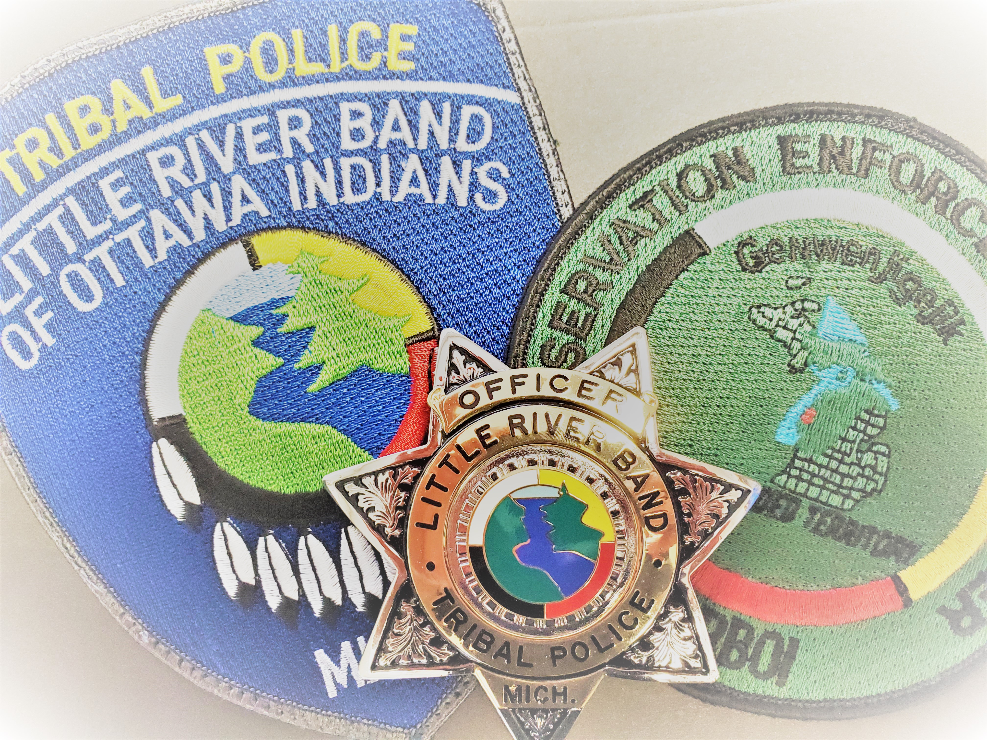
Little River Band of Ottawa Indians Department of Public Safety
Established in the late 1990s
Comprised of:
Tribal Police
Conservation Enforcement
Court Security

Slide 5

The Matrix

Slide 6
Jurisdiction
Tribal
Federal
State
NA vs NA or Native American-owned business.
NA-Victimless crime
NA-hunting, fishing, trapping, or gathering violations which occur in the 36 counties identified in the 1836 Treaty
NA vs NA-Major Crime
NA vs Non-NA
Non-NA vs NA
NA victimless (certain cases)
Certain hunting violations
Have to take place on Trust Land
Non-NA vs Non-NA
Non-NA victimless

Slide 7
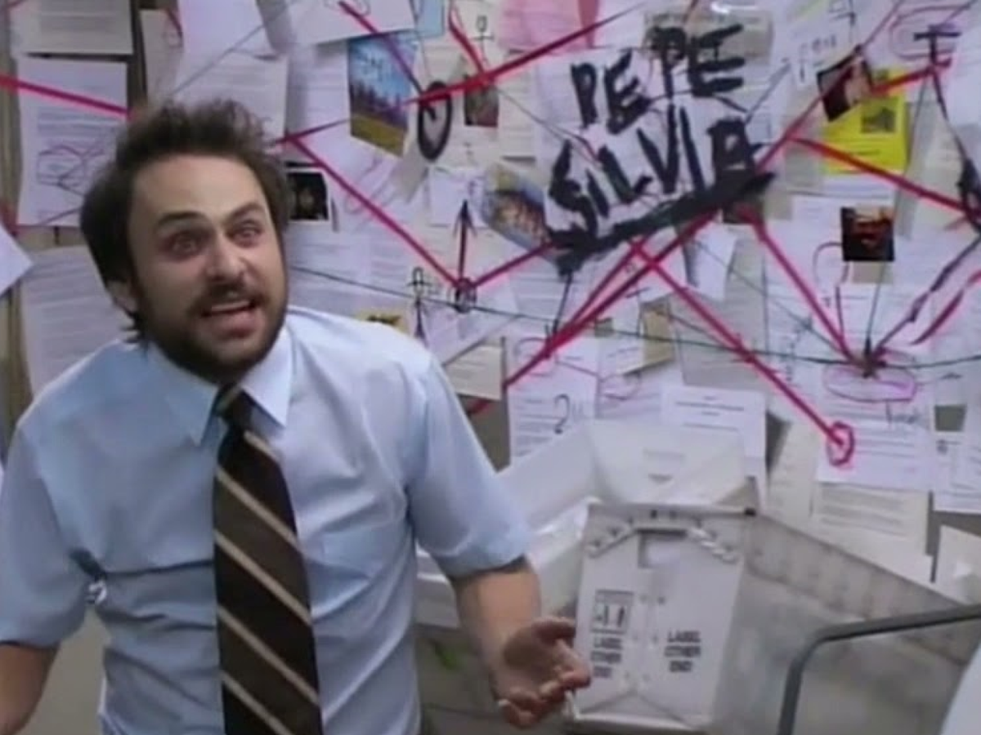
The Matrix Defined
Non-NA vs Non-NA DV at the casino?
NA vs NA Felonious Assault on Reservation?
NA vs Non-NA simple assault 1st Street Beach?
Non-NA possession of marijuana LRCR hotel?
NA retail theft Trading Post Gas Station?

Slide 8
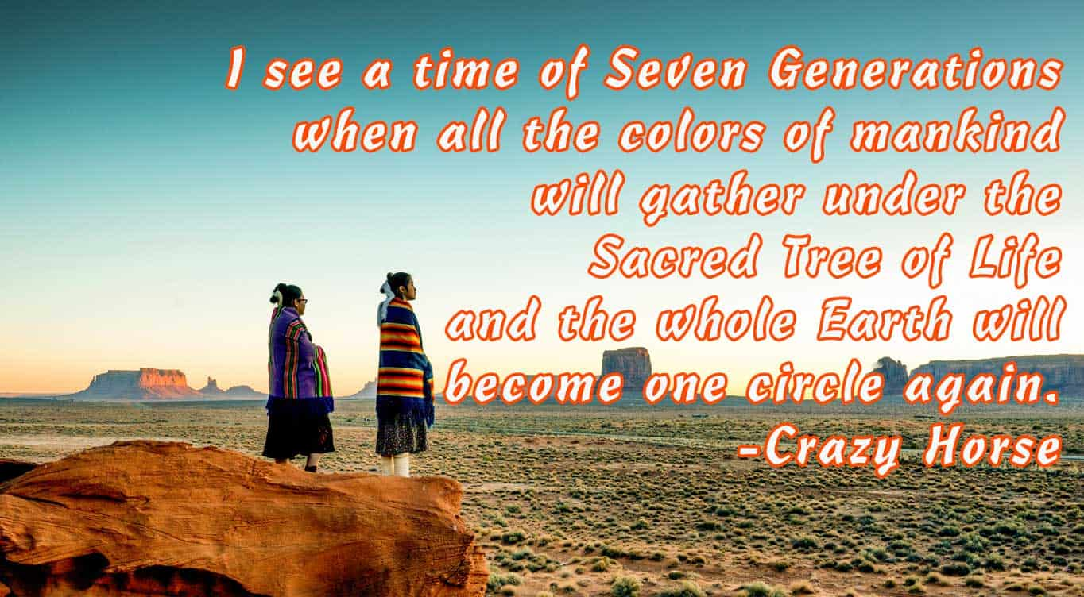

Slide 9
Collaborations
State Partners-MCSO, MPD, MSP
Tribal Partners-MITLEA
Federal Partners-BIA, FBI, US Attorneys Office, DEA, ATF
Others-USCG, USFW, NAFW, Fire, EMS, Emergency Management

Slide 10
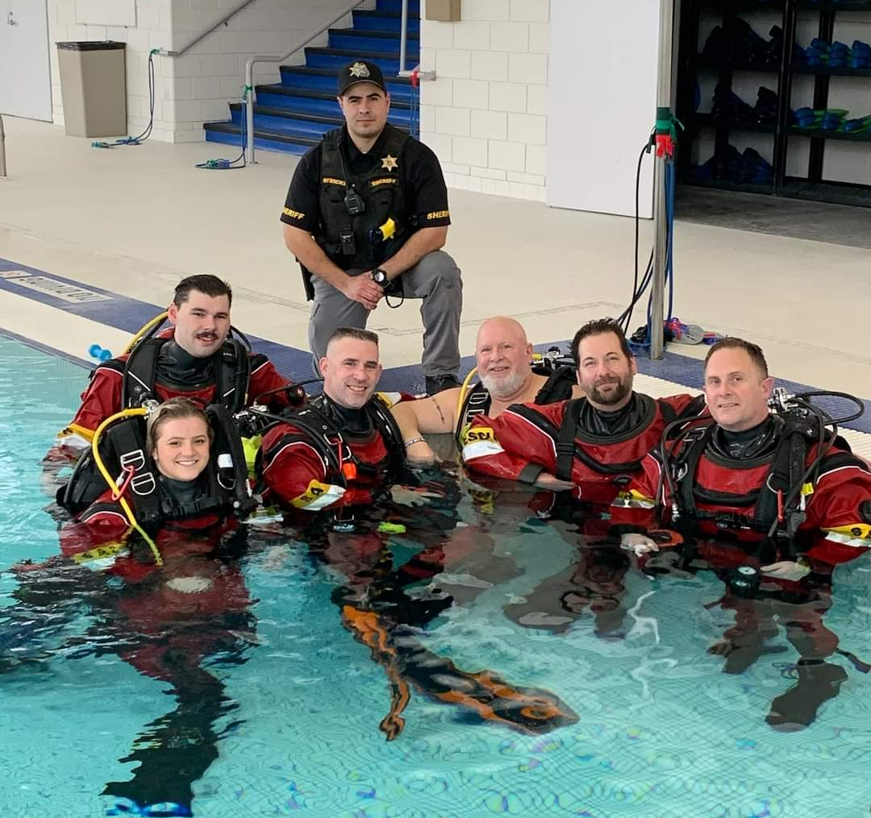
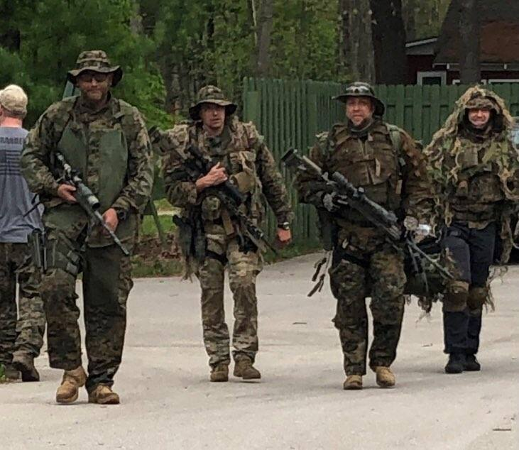
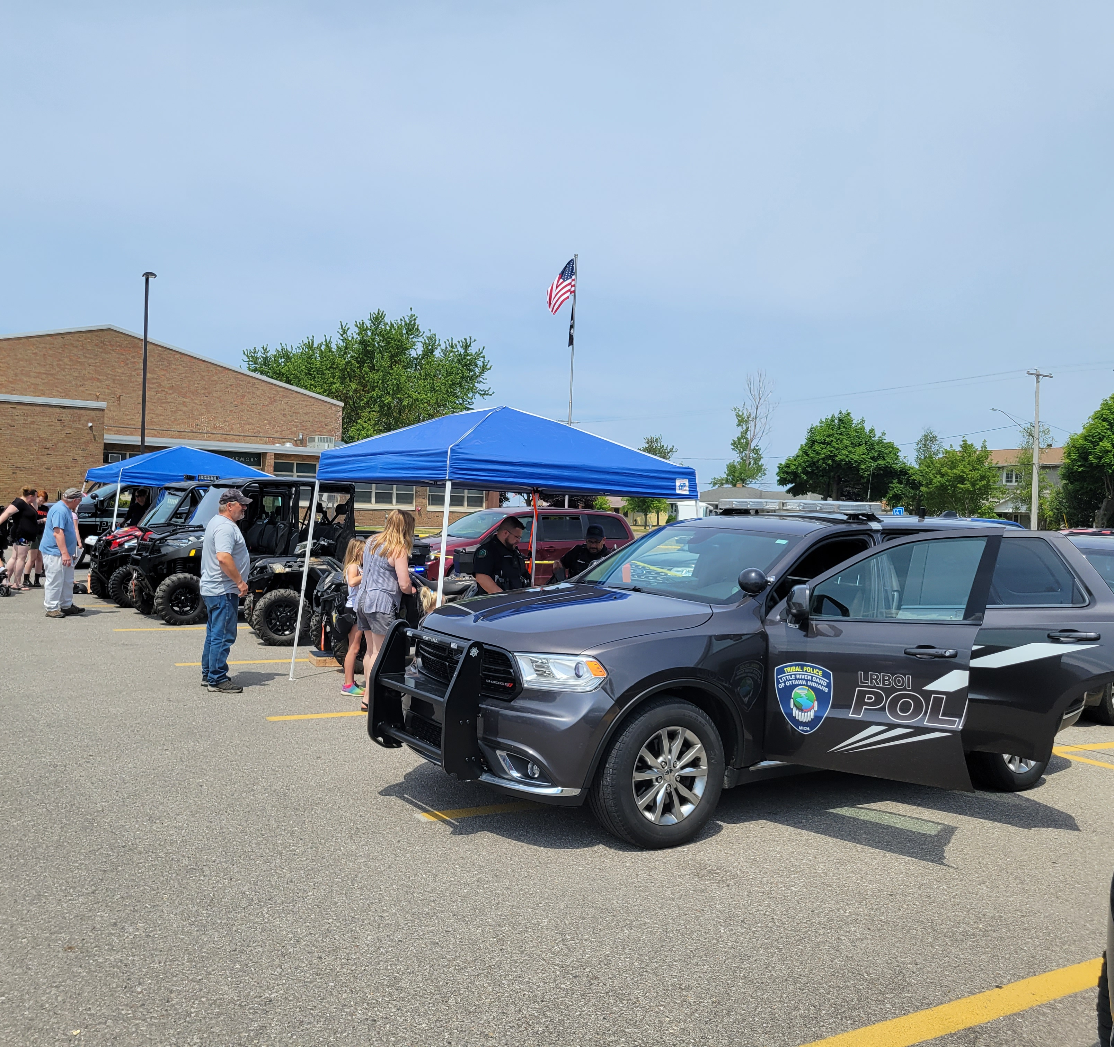
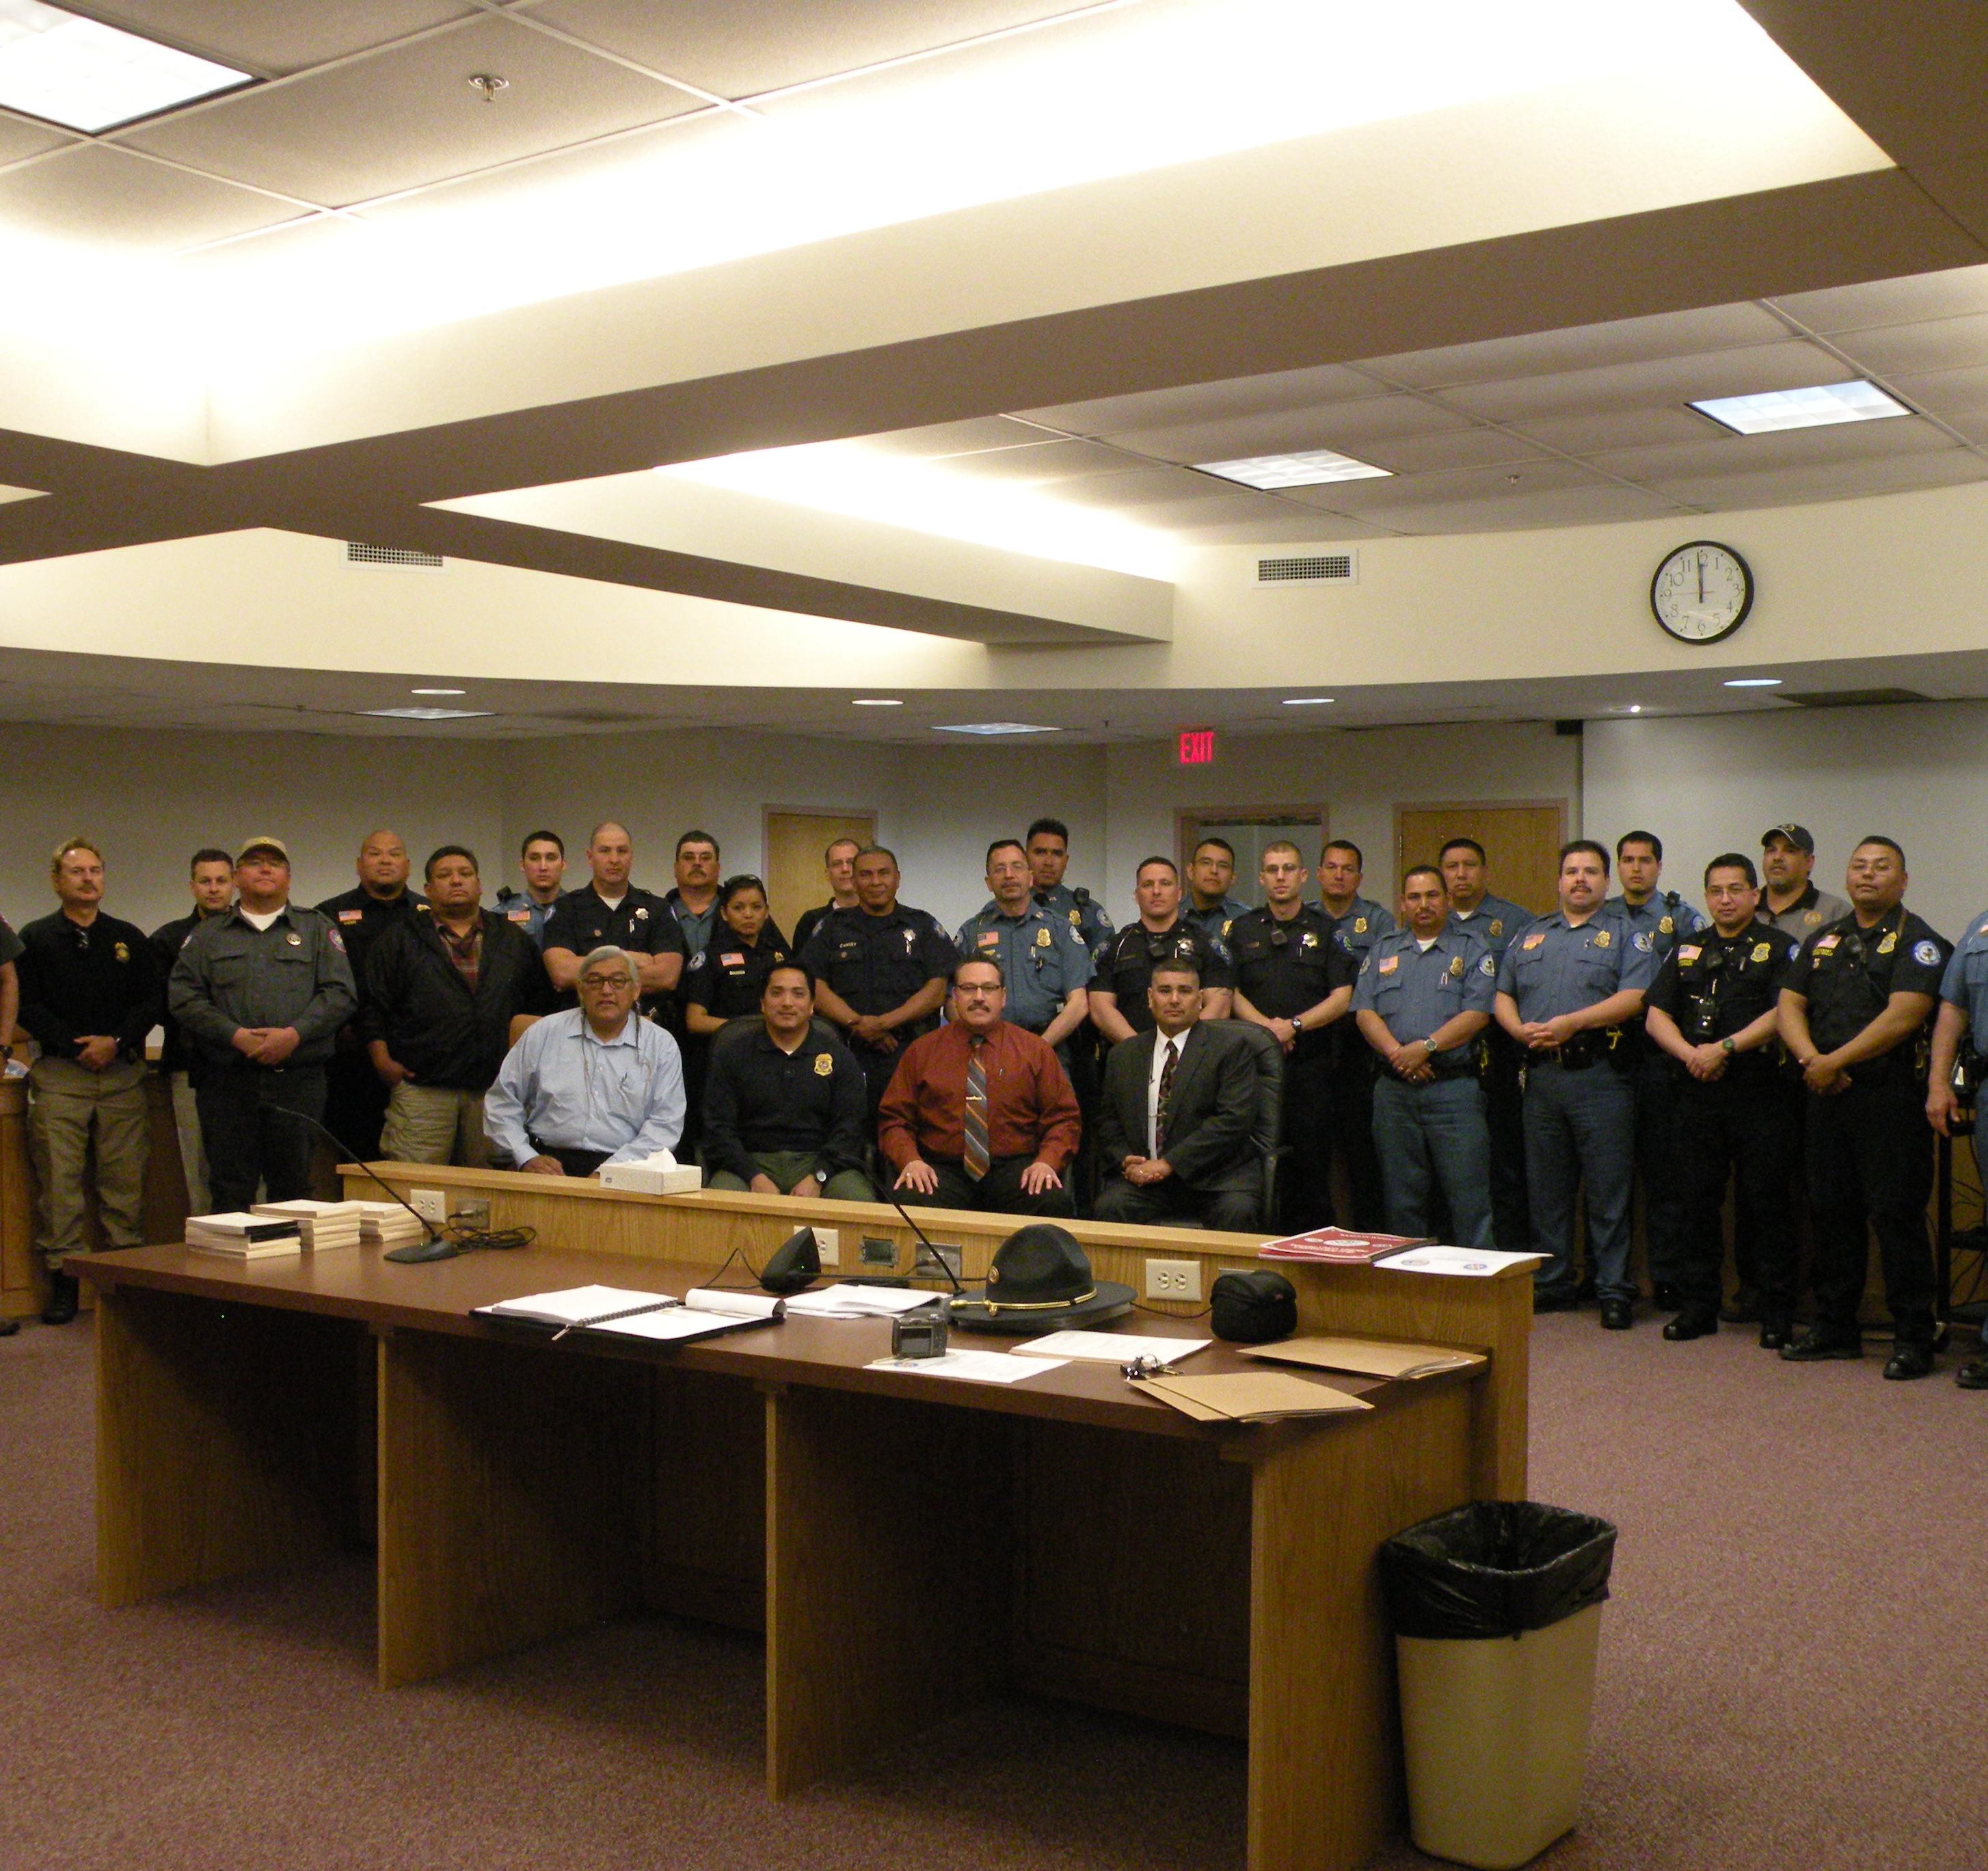
Partnerships
Multi-Jurisdiction Teams
Victim Centered Tasks Force
Tribal Partnerships

Slide 11
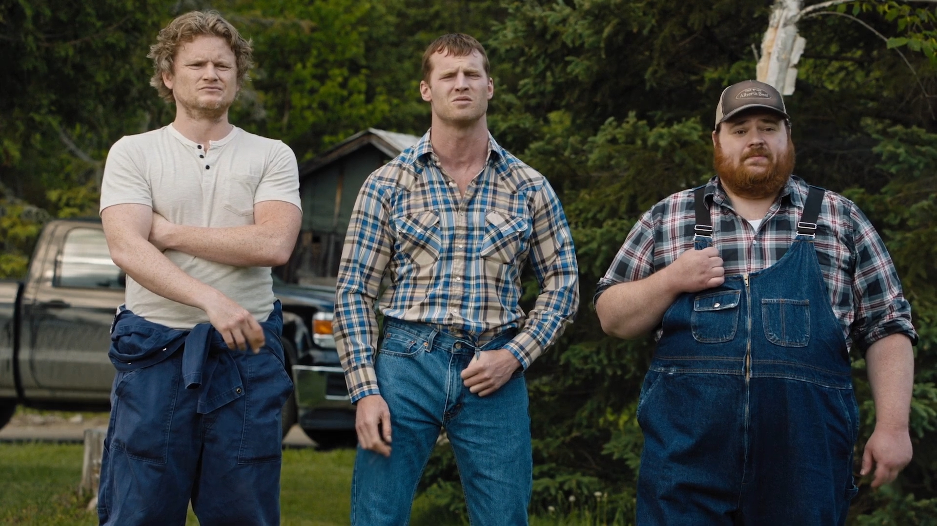
Benefits
“More Hands Equals Less Work”

Slide 12
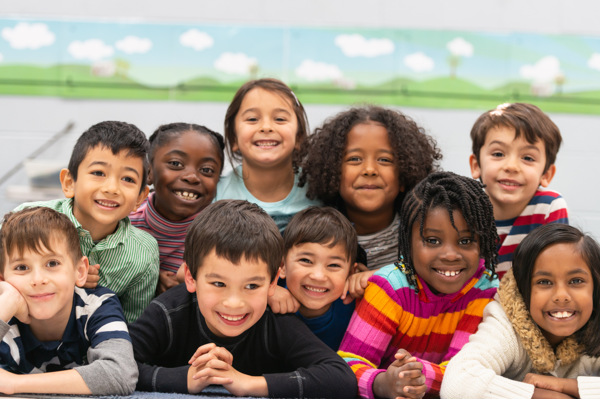
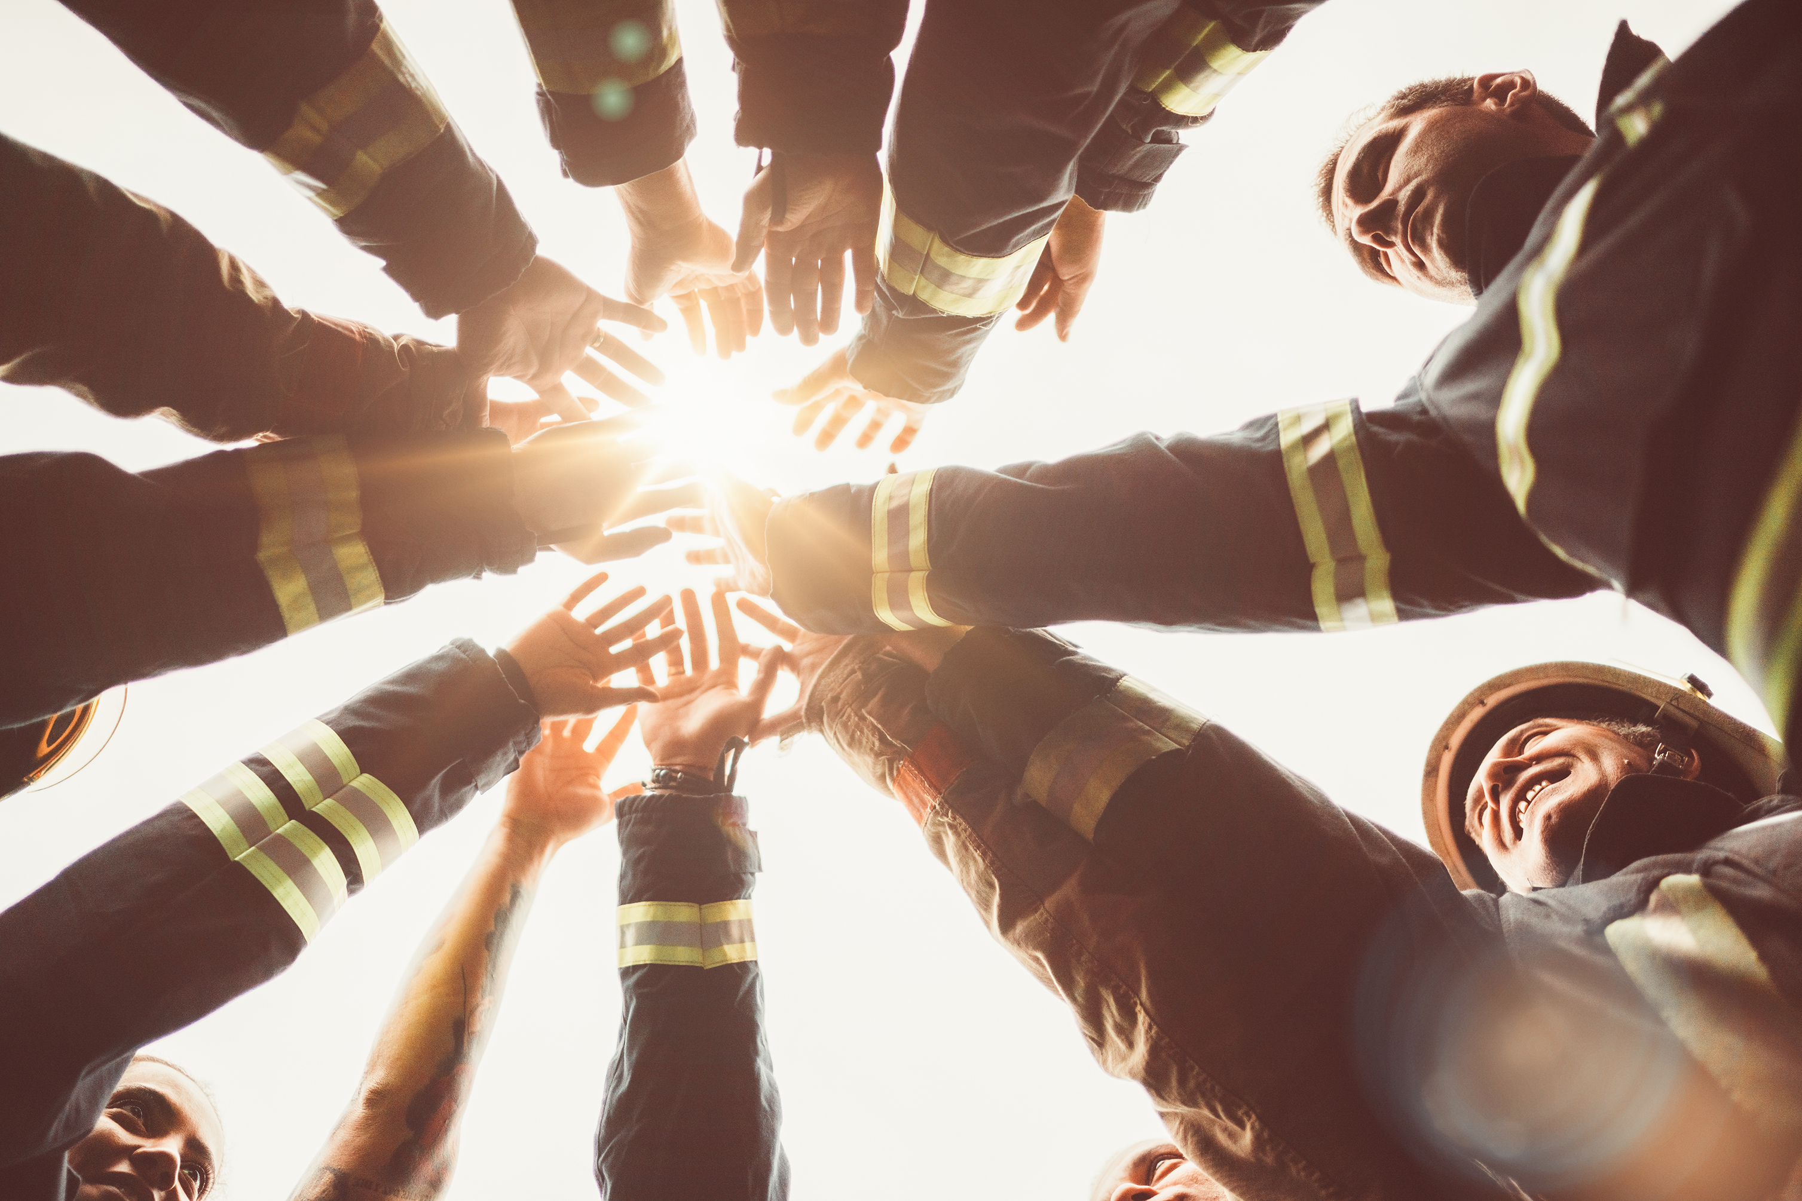
Summary
Small communities must build strong partnerships to tackle big tasks. There is not enough manpower in one agency alone. Like Crazy Horse’s vision for seven generations, we must work in unison towards a common goal of a truly peaceful community.

Slide 13
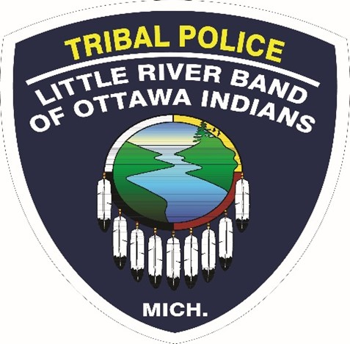
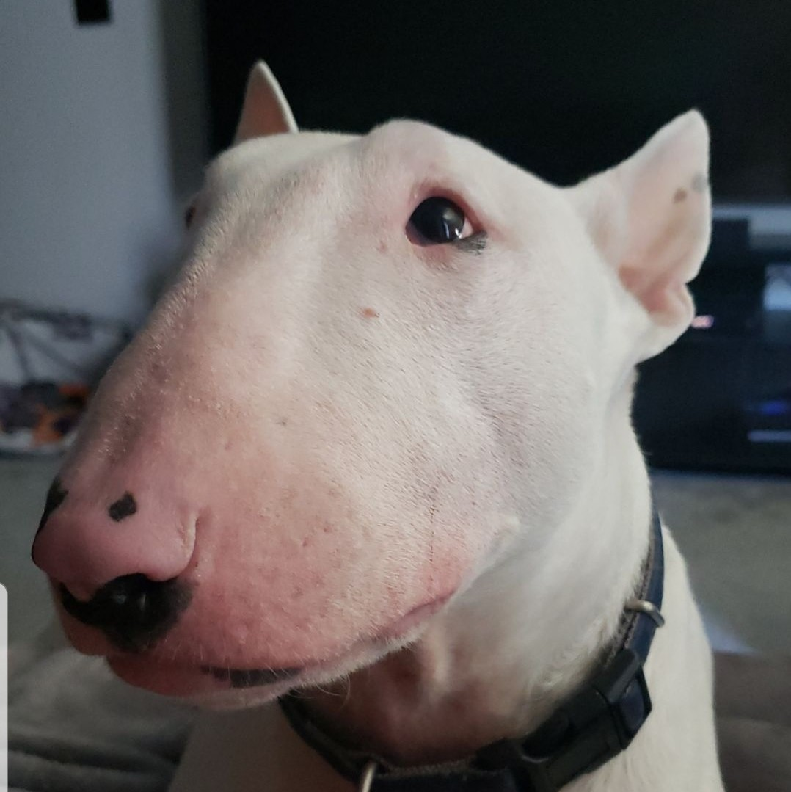
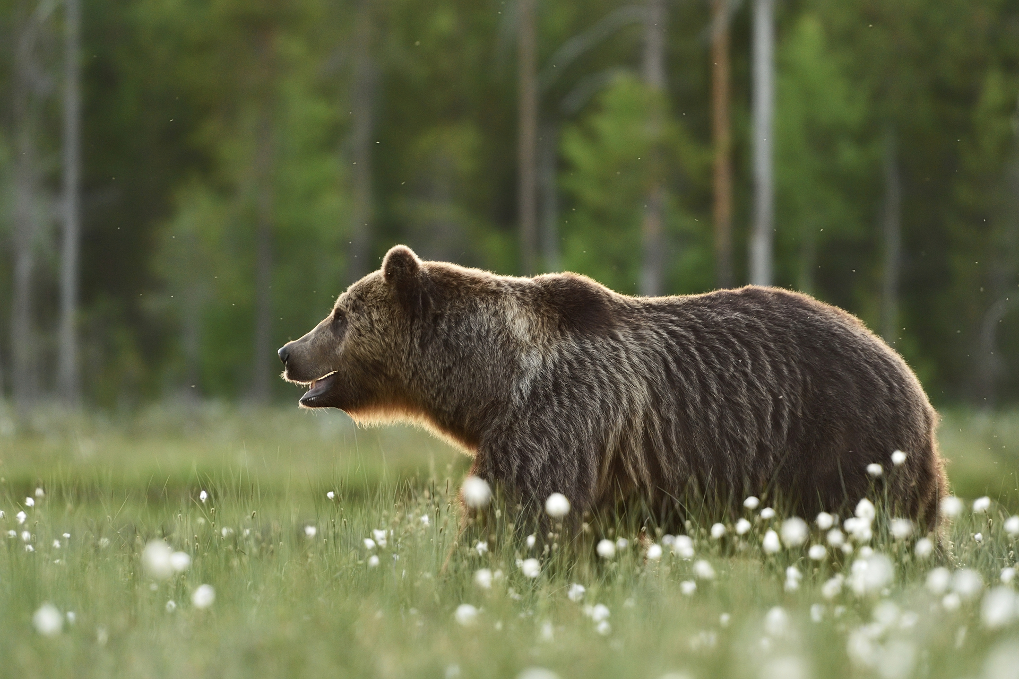
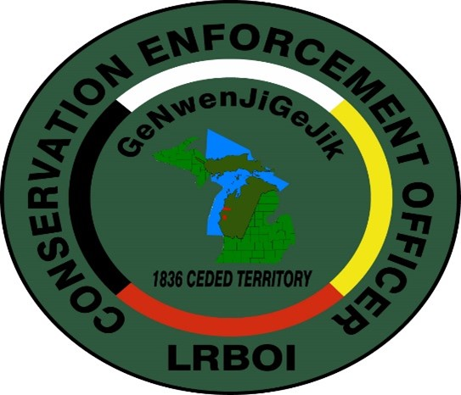
Thank you
Robert R Medacco
robertmedacco@lrboi-nsn.gov
www.lrboi-nsn.gov

