Slide 1

2023 Regional Summit

Slide 2
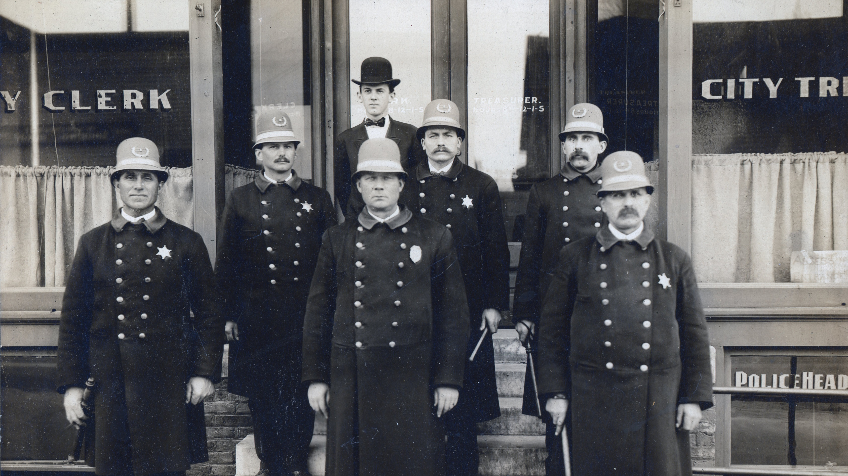
Established in 1869

Slide 3
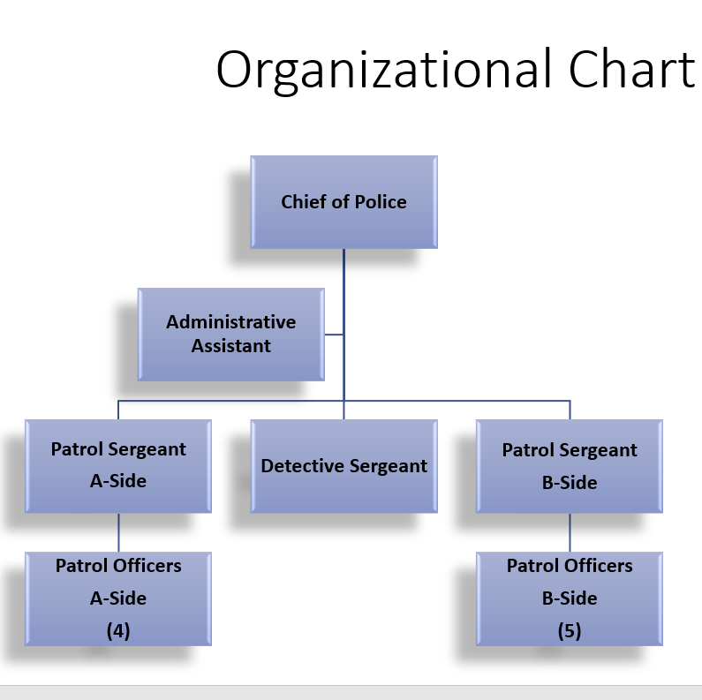
Manistee City Police Department
Authorized for 13 officers.
Currently employee 10 officers.
Last year dispatched to 5,950 calls for service.
Multi-jurisdictional assignments:
    Dive Team
    Drug Team (SSCENT)

Slide 4
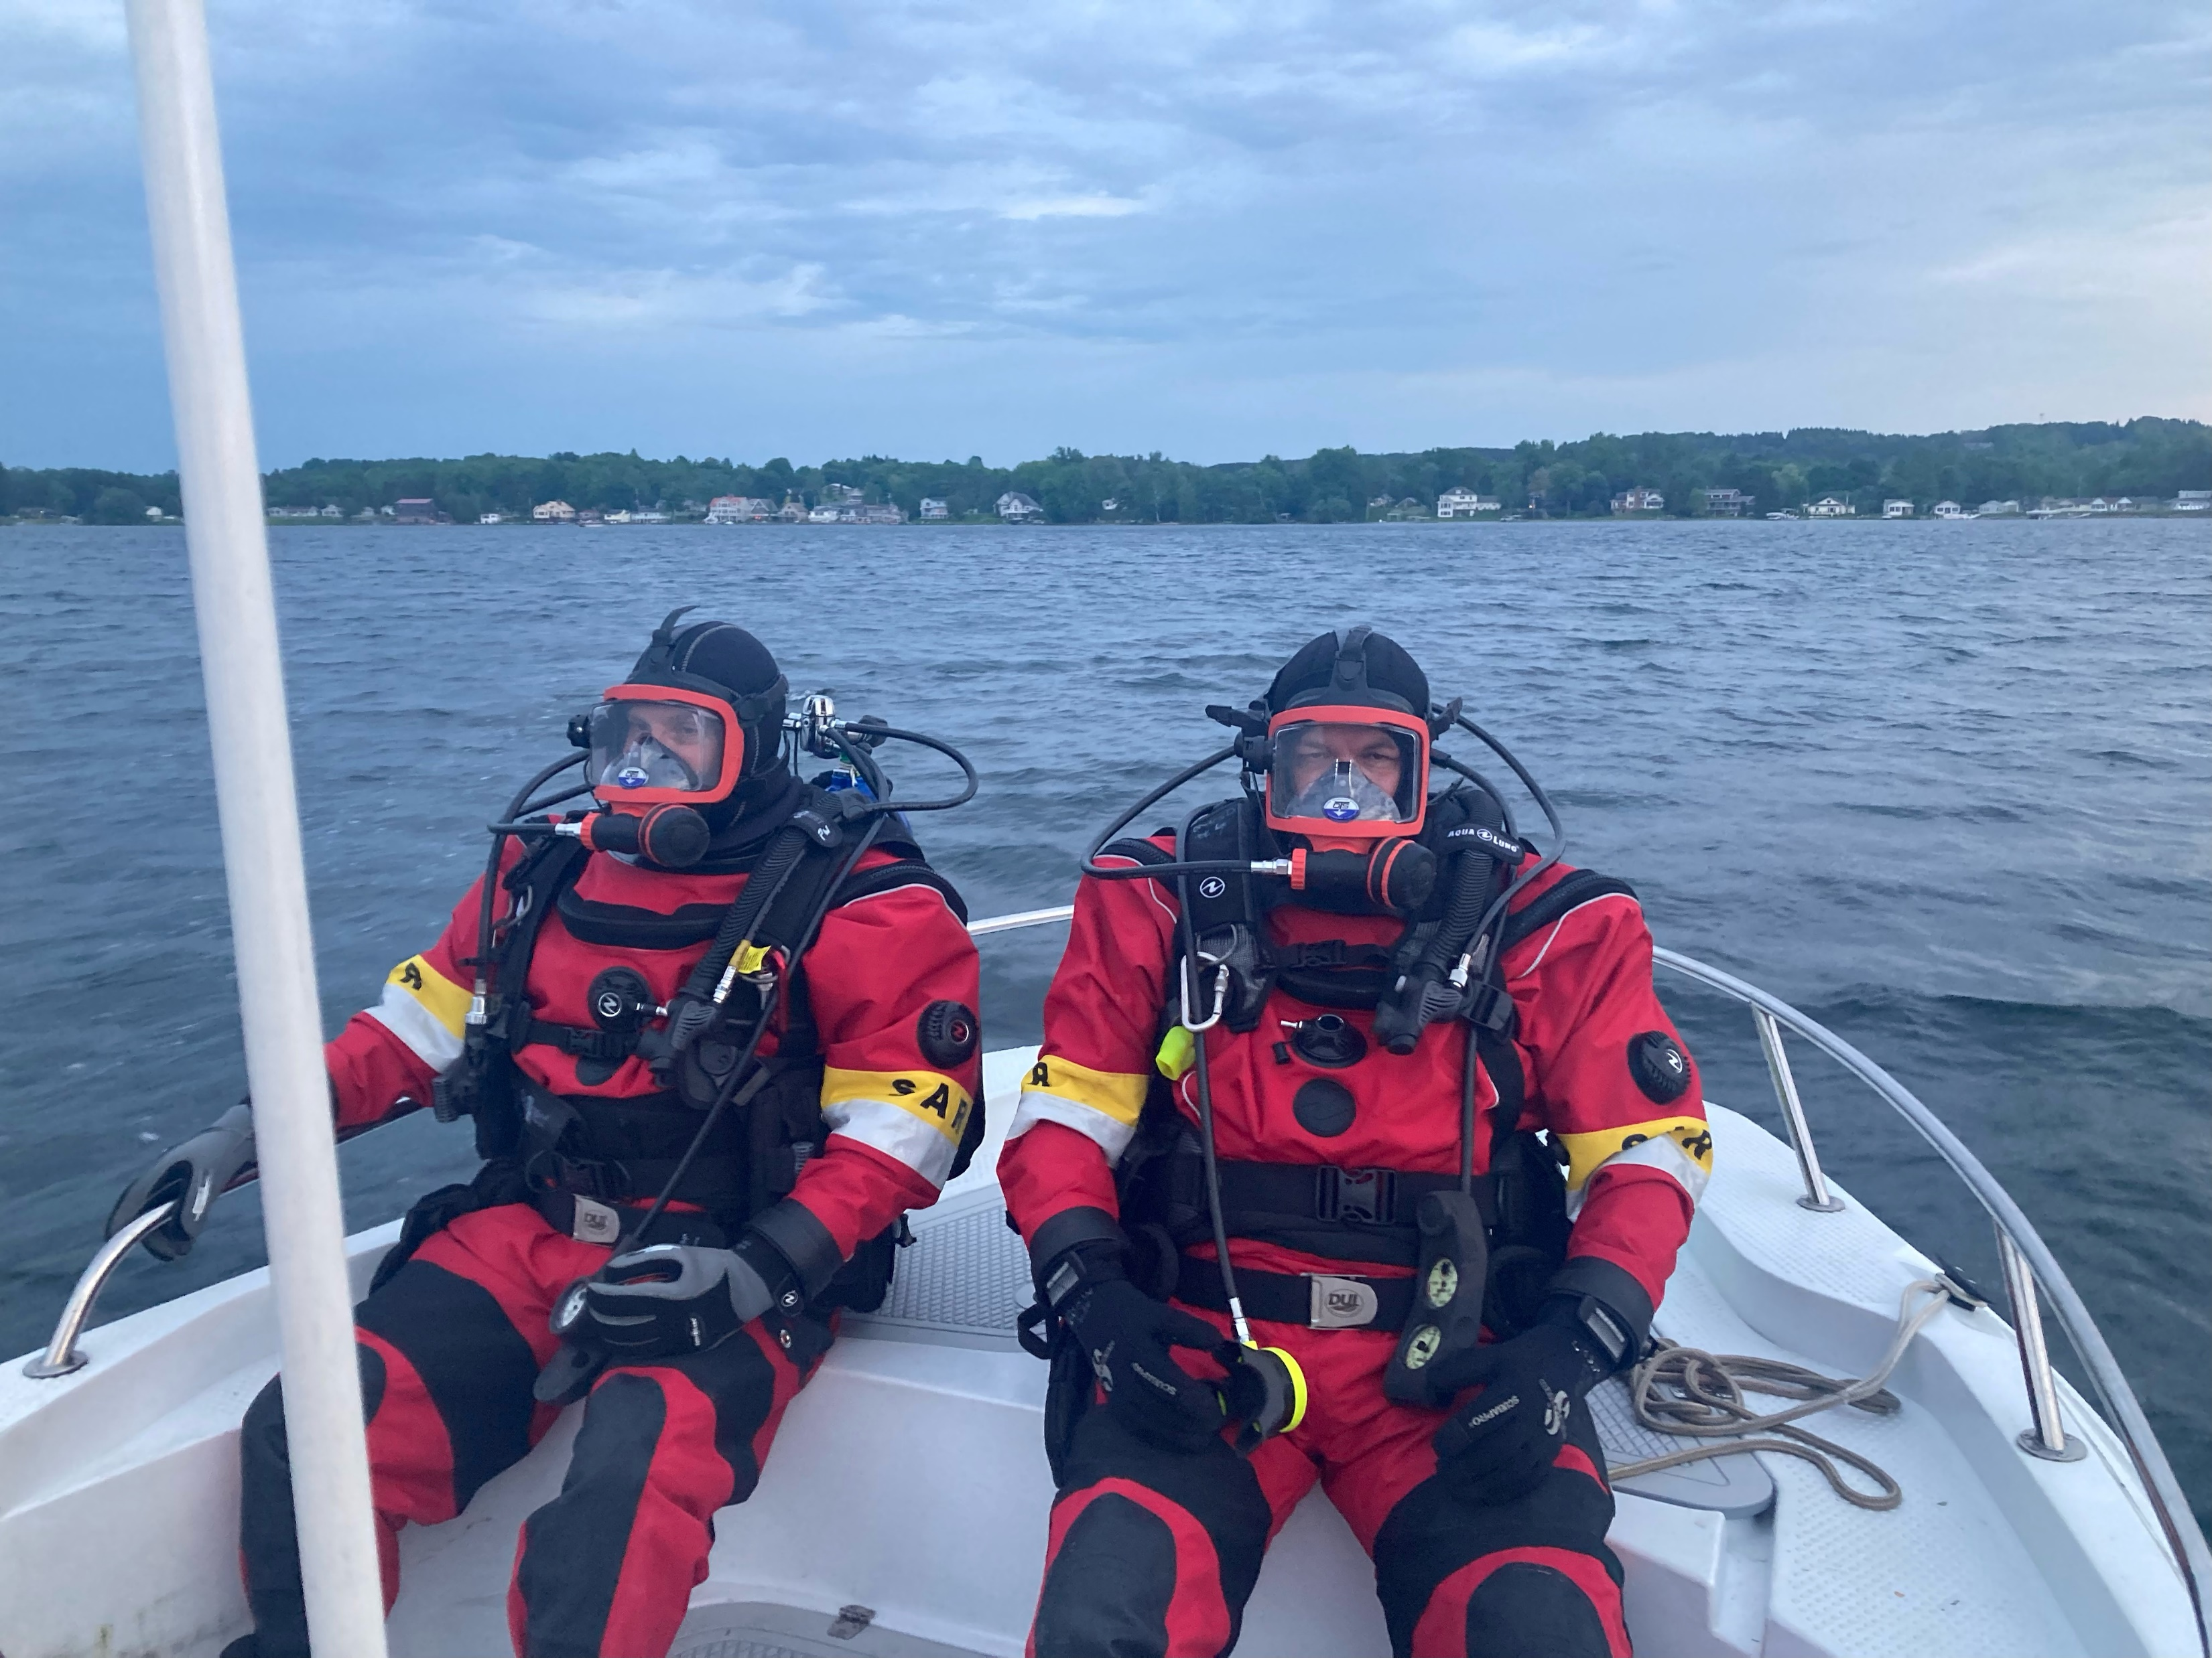
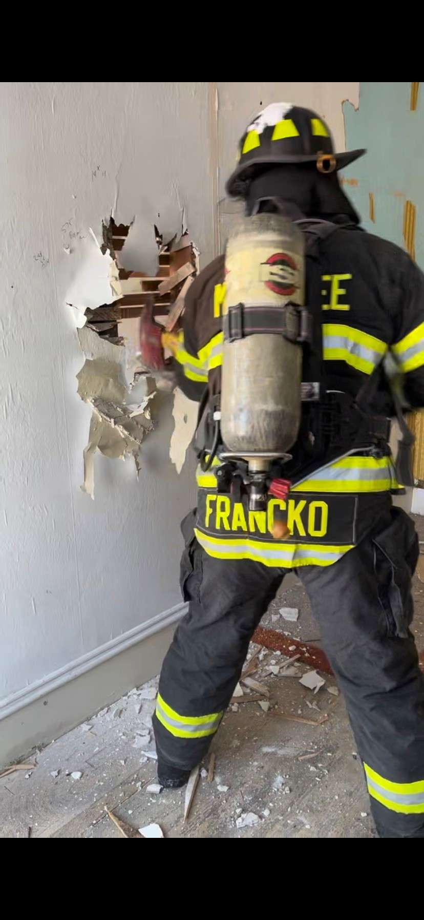
Manistee County Dive Team Manistee City Fire Dept.

Slide 5
Mental Health
Total Mental Health Dispatched Calls | 87
Total Number Written Complaints | 38
Total Number of Hours Spent on these 38 Complaints | 1,117

Slide 6
Mental Health
21 out of these 38 complaints took 3 hours or more. Some of these complaints lasted days to provide transport to hospital for mental health evaluation, hospital security and/or transport to a mental health facility.
Continued Collaboration with CMH and Munson Healthcare Manistee Hospital.

Slide 7
School Safety
Lock down exercises
Monthly School Safety Meetings
Tabletop Exercises

Slide 8
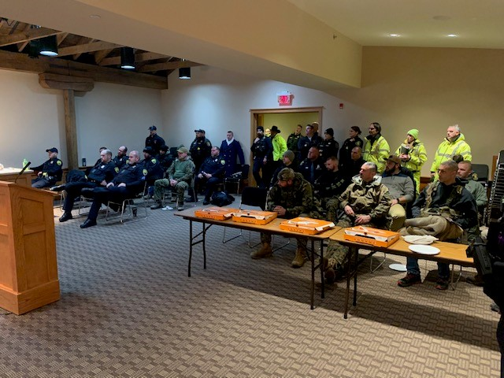
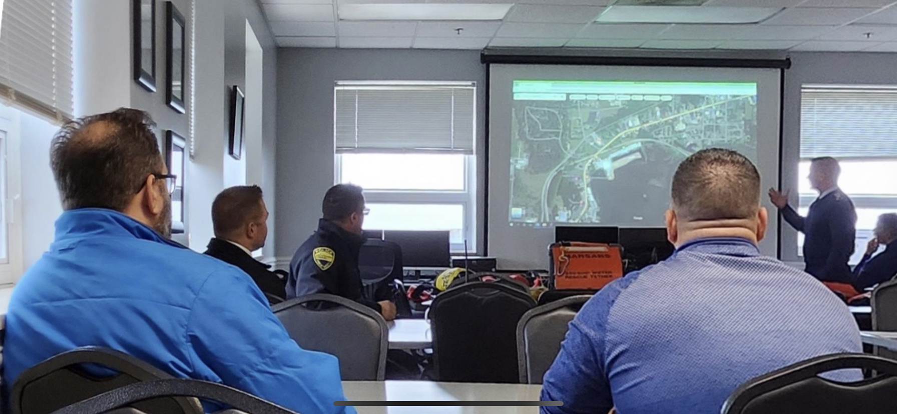
Sleighbell Parade briefing

Slide 9
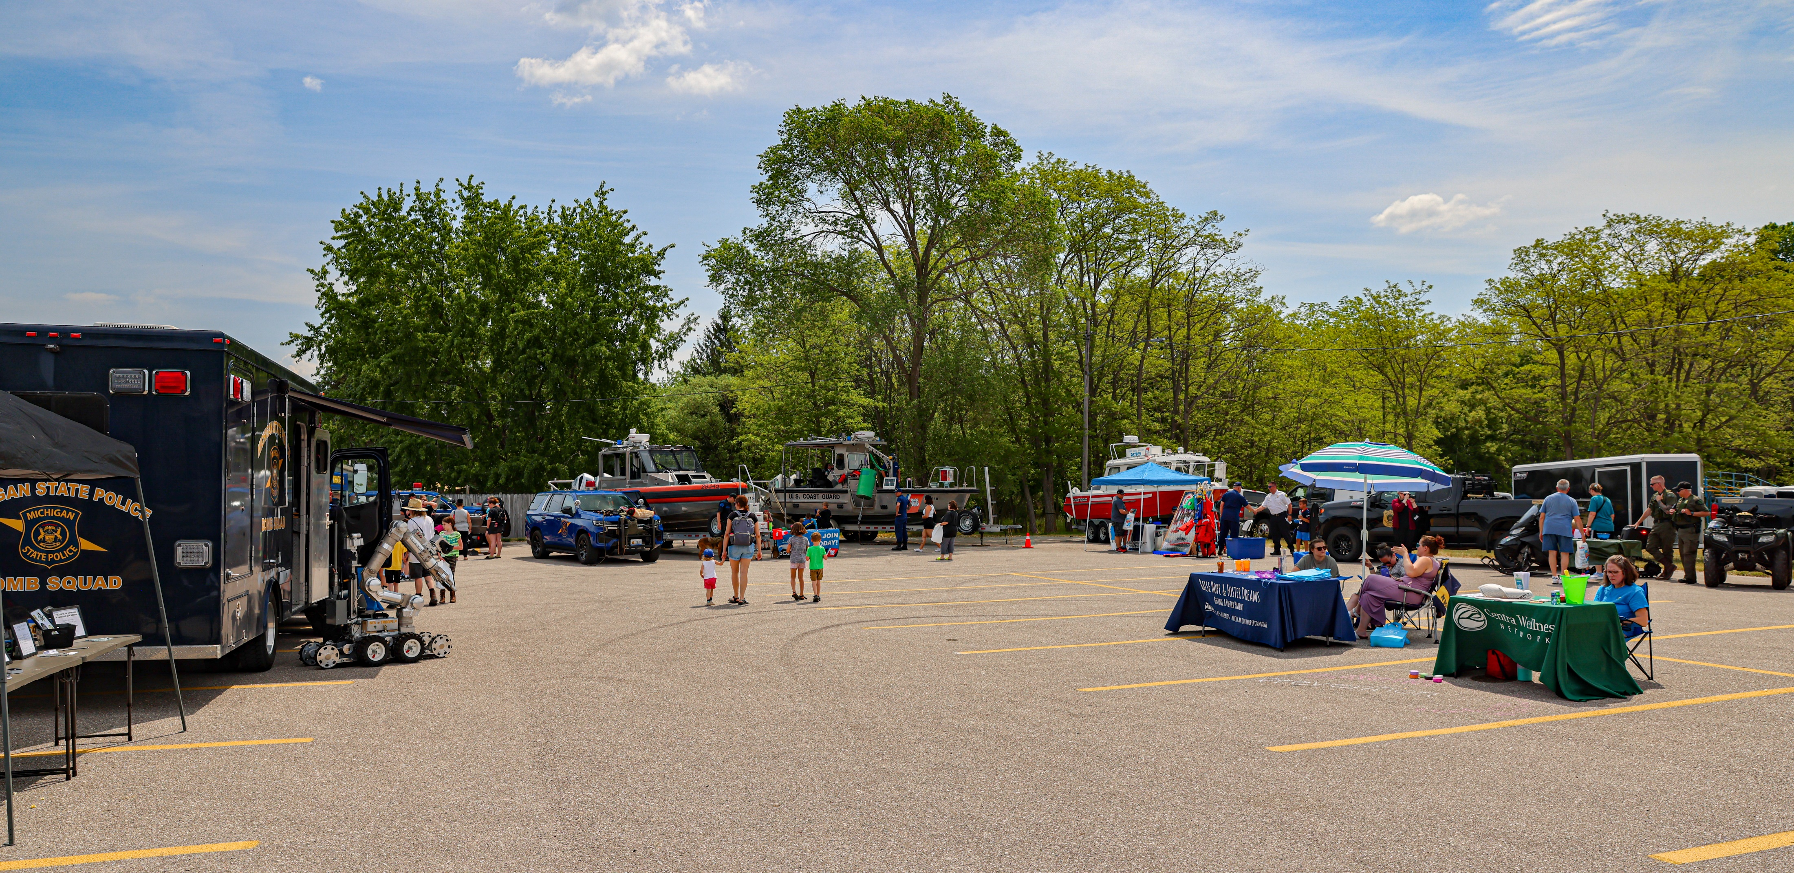
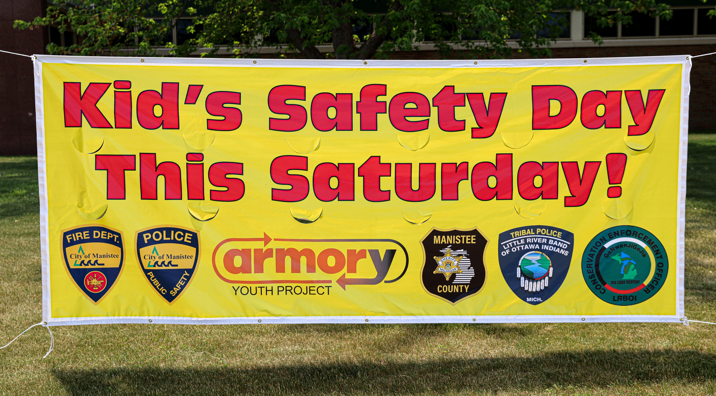
Kids Safety Day

Slide 10

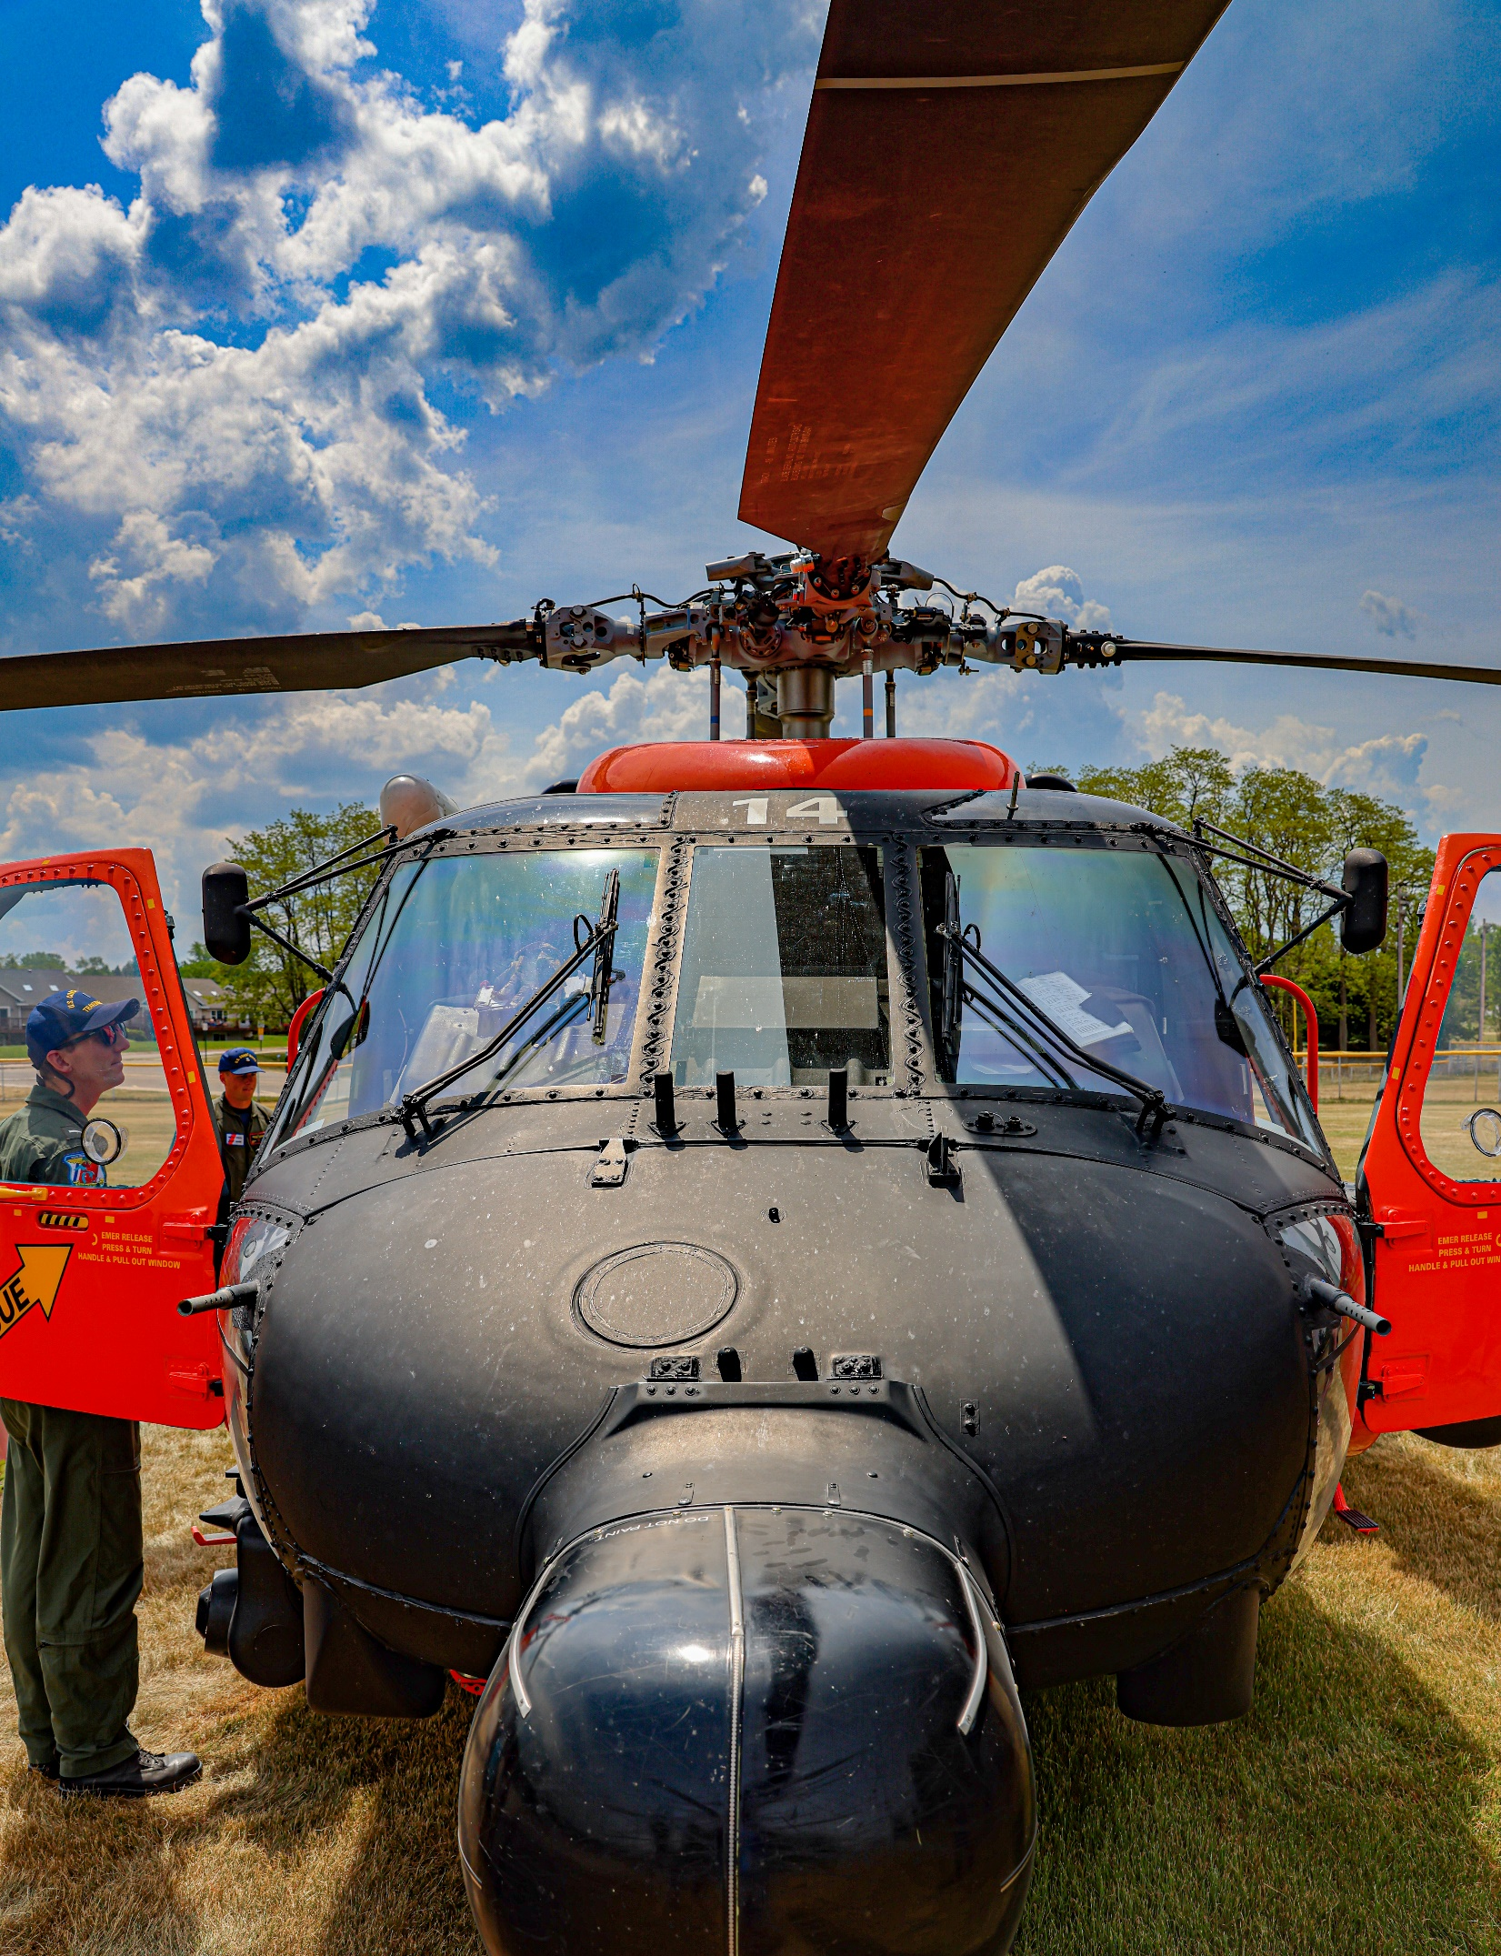
Kids Safety Day

Slide 11
5th St Shooting
Initial Response:
MPD
MCSO
LRBOI
Additional Response:
Over 15 different organizations from 6 counties.

Slide 12
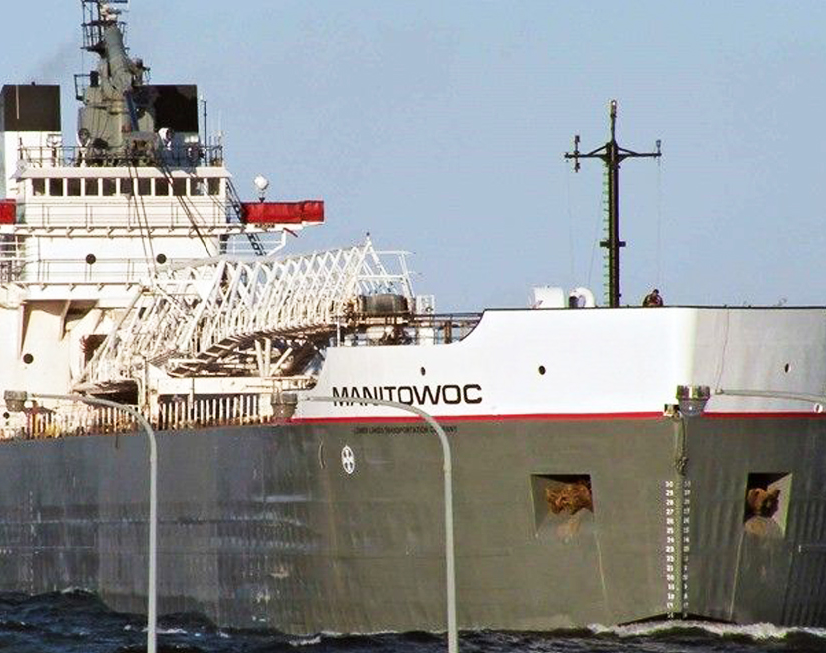
Manitowoc Incident
Internal / External Collaboration
Local, County, State, Federal organizations
Unified Command

Slide 13

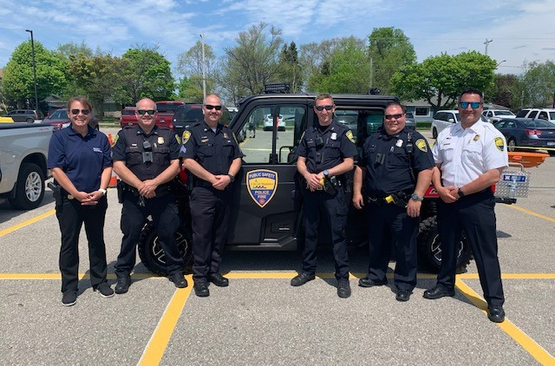
Thank you for your continued support.

