Slide 1




Manistee County Summit 2023
OVERVIEW OF THE NEW & UPCOMING MANISTEE COUNTY BUSINESSES
ManisteeChamber.com

Slide 2
What is Economic Development
Economic Development can be defined as a program, group of policies, or set of activities that seek to improve the economic well-being and quality of life for a community by creating and/or retaining jobs that facilitate growth and provide a stable tax base.
Some of the Roles an Economic Development Organization (EDO) Might Play:
Analyst
Gap Filler
Visionary
Educator
Catalyst
Advocate

Slide 3
Themes and Goals
A PUBLIC - PRIVATE PARTNERSHIP FOR ECONOMIC DEVELOPMENT
First Point of Contact
Positive Incremental Change
Make Doing Business Easier in Manistee County
Attract, Retain, and Grow Year-Round Businesses -Jobs, Investment, Development
Create a Community of Choice
Manistee County’s EDO is the Manistee Area Chamber of Commerce, and the effort is supported by a diverse mix of private-sector businesses and public-sector governments. It is guided by an Economic Development Council (EDC), a sub-committee of the Chamber Board of Directors. Members.

Slide 4
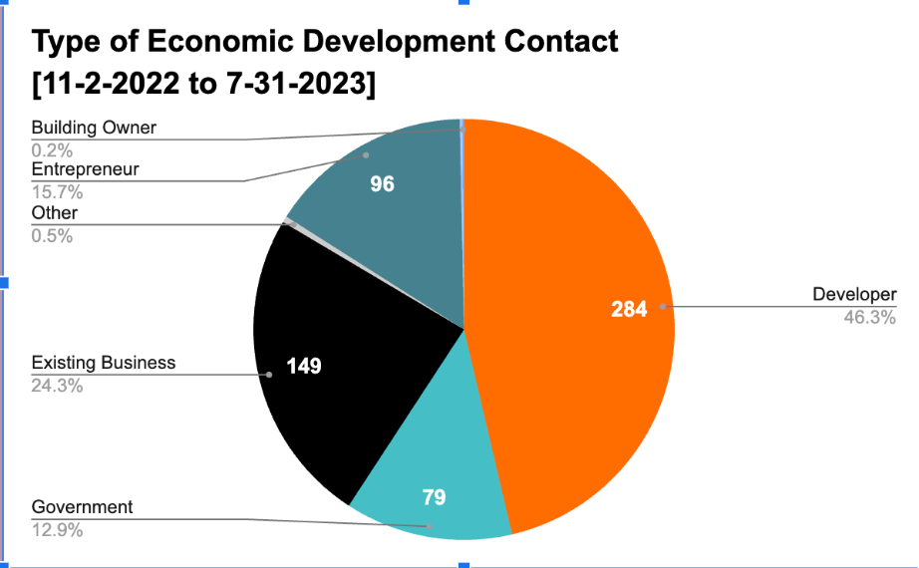
WHAT DOES ECONOMIC DEVELOPMENT
WORK LOOK LIKE?
  Development Projects/Attraction
  Business Retention Visits and Tasks
  Supporting Entrepreneurs/Start-up Assistance and Referrals
  Government Contacts

Slide 5
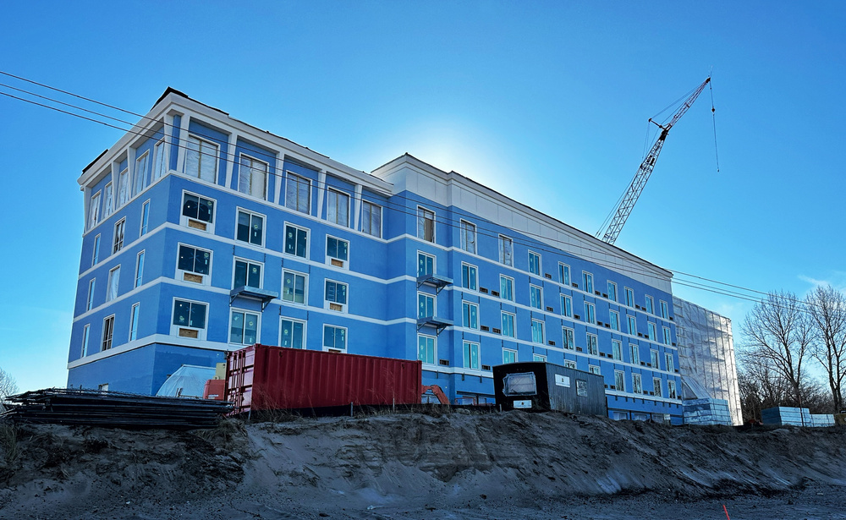
Economic Development
Examples & Success:
Alpine Chocolat Haus
Amigos Mexican Restaurant
Bee Smooth
Bellsprouts
Bigby
Black Lotus Salon and Wellness
Domino’s Pizza
Fricano’s Manistee River
The Golden Stag
Speckled Goat
The Outsider
Third Coast Boutique
Third Life Brewing
Trophies Cafe
U-Haul Storage
UP North Collectors
WellNested
Z’s Cart Rentals
Hampton Inn and Suites
Hillcrest Apartments
J&L Sammwich Shop
Mangiardi Films
Nu Vu Fuels
Purple Paintbrush
River Street Sports Bar & Grill
Salt City CPA
Searchlight Title
Notes:
NuVu Fuels...
Hampton Inn & Suites Manistee Waterfront
Beesmooth
*Also, should these be alphabetized

Slide 6
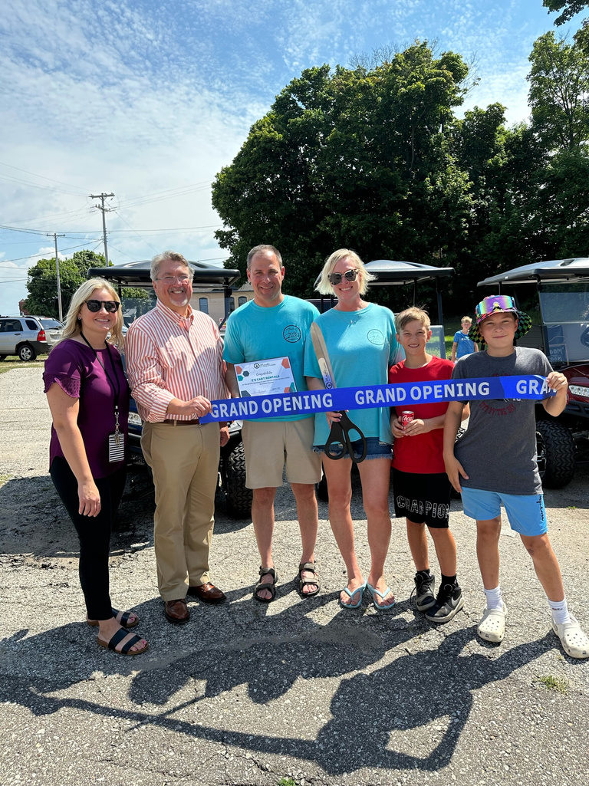
Economic Development Examples Continued:
Adding manufacturing jobs:
  Amptech/Myotek
  M R Products
Anticipated to open or start construction in next 12-18 months
  Arcadia Diner
  Culver’s
  Emerald Cove/The Mill Restaurant
  Gateway Project
  Lakeside Social Restaurant
  Riley Apartments
  Others

Slide 7
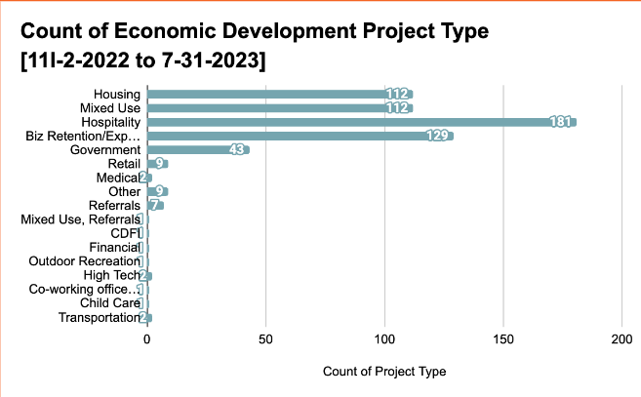
What does Economic Development
work look like?
Top 5 Contacts by Project Type:
  Hospitality
  Business Retention
  Housing
  Mixed Use
  Government

Slide 8
CHALLENGES FOR ECONOMIC DEVELOPMENT
  Creating new jobs: Available, adequate housing and childcare
  Where can you put development? Water Infrastructure! (and others)
  Also, how much? Other Construction Costs - Gap problem and older buildings
  Perception about the County - Easy or Hard to work with?
  Use of Available Tools
  Valuing this Work

Slide 9

CHILDCARE IMPACT AND CHALLENGES
  14% of parents left a job in the past six months due to childcare.
  52% of parents needed to make a significant adjustment to their school or work training due to childcare issues in the past 12 months.
  Childcare issues result in an estimated $2.88 billion loss annually for Michigan’s economy.
  Michigan loses an estimated $576 million annually in tax revenue due to childcare issues.

Slide 10

RAISING MANISTEE COUNTY CHILDCARE CROSS-SECTOR COLLABORATIVE
Mission: To preserve and develop strong, coordinated early childhood infrastructure in Manistee County
  Respect, recruit, and revitalize the early childhood care and education workforce
  Increase community investment in the early childhood system and build a network of support.
  Increase community education around the early childhood system and develop a universal, community-based system of childcare marketing.
  Promote and increase access to existing support opportunities for childcare businesses and increase the available childcare supply.
rmc@manisteefoundation.org

Slide 11

SOLUTIONS
  Bolstering Tri-Share to increase access
  Creating and expanding Childcare Facilities and Personnel Capacity
  Building Workforce Flexibility

Slide 12
Housing Impacts and Challenges
  New employees/candidates cannot move to the area because lack of options - apartments and homes (Fact: 2,296 work here, but live elsewhere)
  Seniors need options for the next stages of their lives (Demographics in the next 5 years: 65 to 74=+5.1% and over 75=+17.1%)
  Employers cannot grow the workforce with good jobs because of these problems.
  Housing needs are great and get at underlying problems:
    Rental household growth → balanced market, vacancies, step-down needs, commuters, new jobs → Manistee County needs 525 units!
    For sale household growth → Replacement, commuters, new jobs, vacancies, available stock → 1,377 units or homes

Slide 13

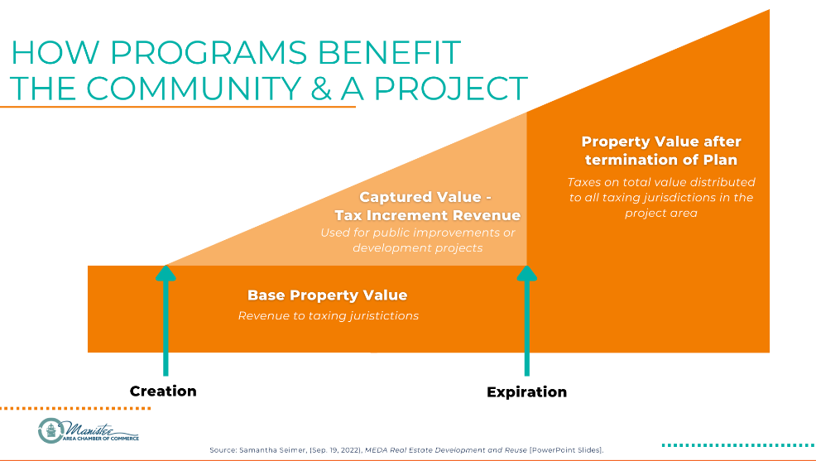
USING AVAILABLE TOOLS

Slide 14
Questions

Slide 15




THANK YOU
STACIE BYTWORK
President & CEO
Stacie@ManisteeChamber.com
MARC MILLER
Director of Economic Development
Development@ManisteeChamber.com
"Making business easier in Manistee County"
(231) 723-2575

