Slide 1
Manistee County
2021
Regional Summit
Planning Department Zoning Contracts

Slide 2
TABLE OF CONTENTS
01
02
03
STAFF
A SHORT HISTORY
Services
04
05
06
VALUE ADDED
TESTIMONIALS
QUESTIONS
Planning Department
Staff
A Short History of Zoning
Services
What are we providing?
Additional Services
Provided
Hear from some of our
customers.
A couple of minutes for
Q & A

Slide 3

Meet our Staff
Manistee County
Planning Department

Slide 4
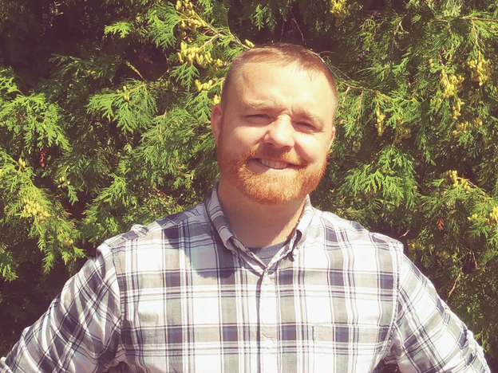
Planning Director
Mike Szokola
Father of 3 (Aurora, Aiden, and Thomas),
husband to 1 (Kayla)
Grew up in Oscoda, Michigan
Central Michigan University Graduate (Fire Up!)
Army Veteran
Been with the Planning Department since 2019
Manistee County
Planning Department

Slide 5
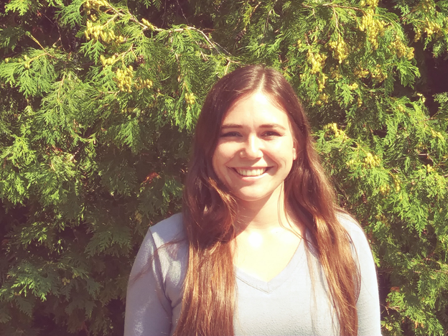
Staff Planner 1
Katie Mehl
BS in Environmental Studies & Sustainability from Northern Michigan University (NMU)
Recently purchased a home in the City of Manistee
Enjoys hiking, kayaking & skiing
Likes watching crime/investigation tv shows
Has two cats named Squeak & Marley
Manistee County
Planning Department

Slide 6
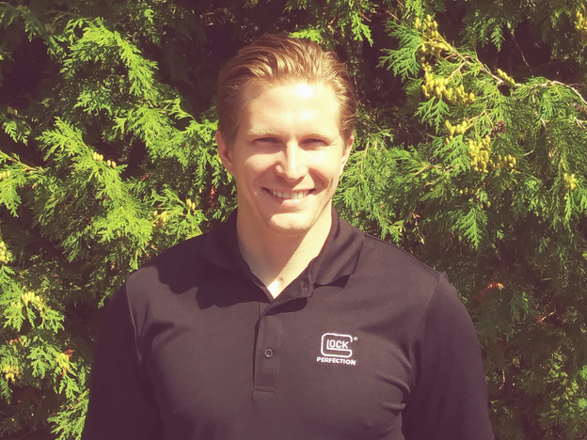
Staff Planner 1
Zachary Sompels
Degrees in Natural Resources Management and Urban and Regional Planning from GVSU & MSU
Recently married
Avid outdoorsman
Dog lover (Brittany’s are the best)
Owns a boat
Manistee County
Planning Department

Slide 7
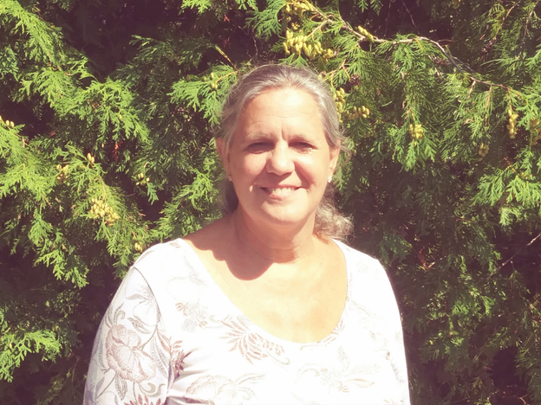
Asst. to Planners
Nancy Baker
Longest serving member of the Planning Department (10 Years as of Sept.)
Has 1 daughter and 1 Son (Carey and Todd)
Runs the County Soil Erosion and Sediment Control program.
Loves traveling to exotic beaches
Loves peach wine and golf cart rides
Manistee County
Planning Department

Slide 8
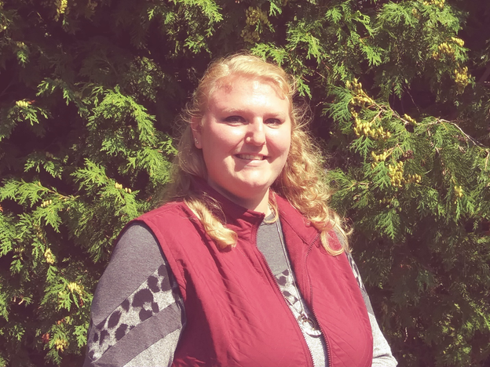
Planning Assistant
Jessica Sorensen
Graduate from Lake Superior State University
(BS in Geology, Associates in Liberal Arts)
Born and raised in Mason County
Been with the Planning Department for a little over a year
Has a cat named Trouper
Favorite television series is Game of Thrones
Manistee County
Planning Department

Slide 9
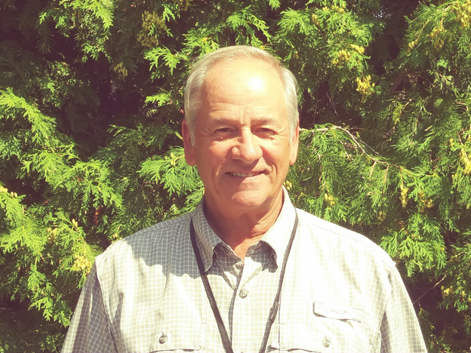
Code Enforcement
Larry Gibson
Retired Police Officer with over 25 years of experience
Oakland County Police Academy firearms instructor from 1991-2011
Little River Band Of Ottawa Indians Gaming Commission Background Investigator from 2007-2017
Loves golfing and fly fishing
Manistee County
Planning Department

Slide 10
So why Planning and Zoning?

Slide 11
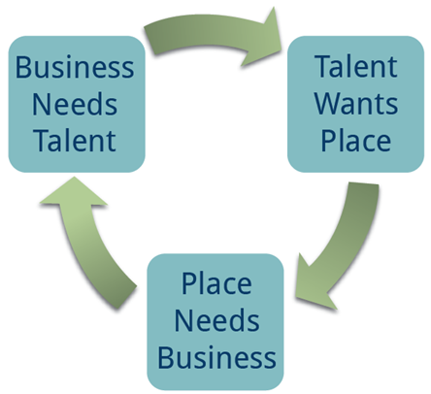
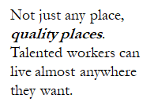
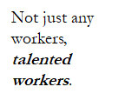
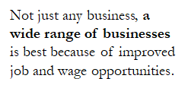
Attract Talent, Attract Business, We have Quality Places
Slide Source: from MSU Extensions and Mary Reilly, AICP

Slide 12
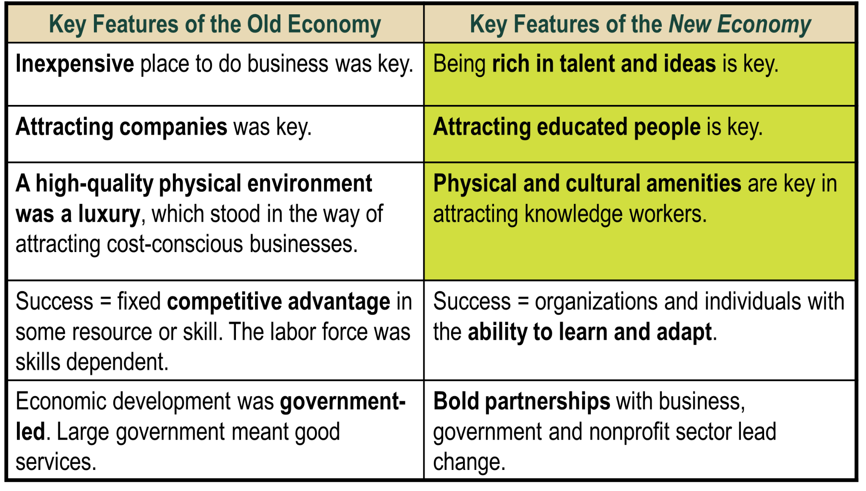
Old Economy/New Economy
This slide provided by Mary Reilly, AICP, MSU Extensions
Notes:
The next two slides explains the difference between the old and new economy. The yellow highlighted areas are key placemaking features.
Relevant assets in the Old Economy were:
Major manufacturers, low wages, low taxes, etc.
Relevant assets in the New Economy are:
Talent (Knowledge Workers), Quality of Life, Creativity, Green infrastructure

Slide 13
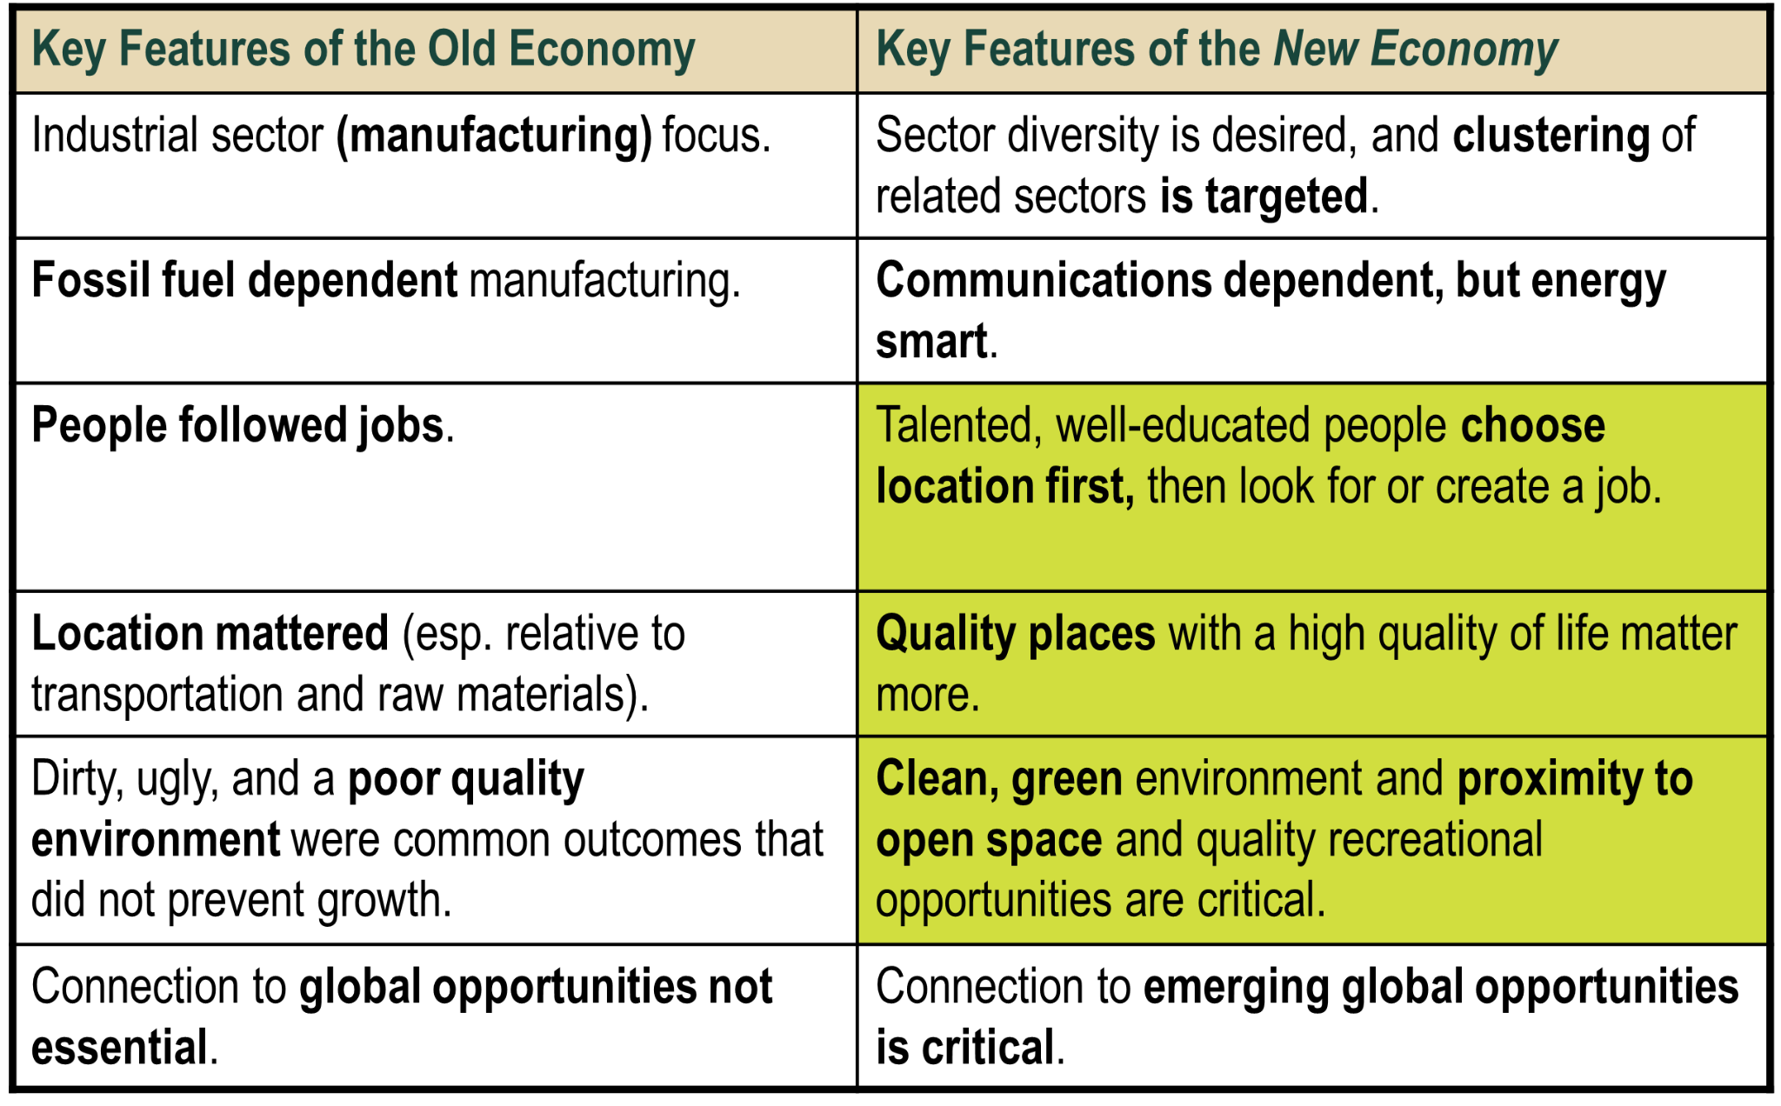
Old Economy/New Economy
This slide provided by Mary Reilly, AICP, MSU Extensions

Slide 14
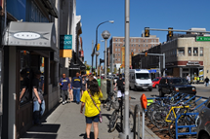


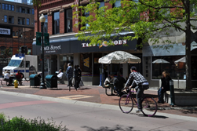
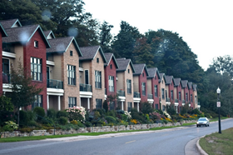
Quality Urban Places are….
Walkable & Bikeable
Pedestrian Oriented
Mixed Use
Transportation Friendly
Full of Housing Options
This slide provided by Mary Reilly, AICP, MSU Extensions
Notes:
Walkable: people traveling, animated, lively (Ann Arbor)
Pedestrian Oriented: window shopping, active (Harbor Springs)
Mixed-Use: people friendly, variety of options and uses (Boyne City)
Transportation Friendly: variety of ways to travel- bike, walk, public transit (Kalamazoo)
Full of Housing Options: (Marquette)

Slide 15

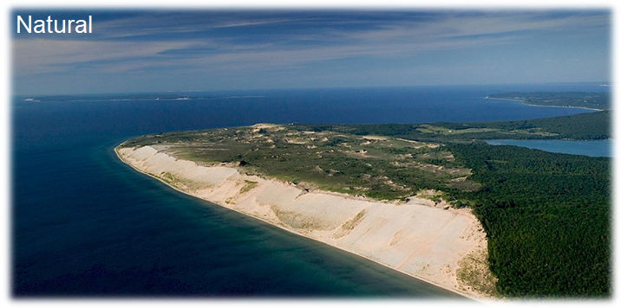

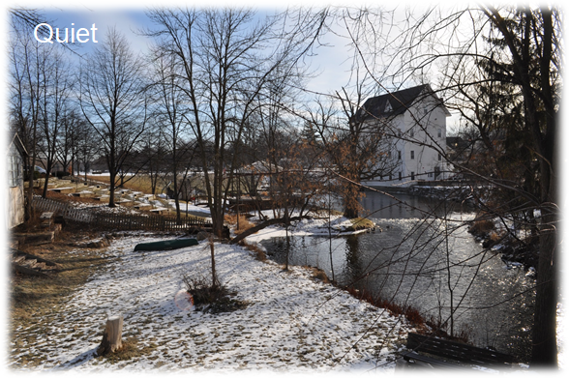

Quality Rural Places are….

Slide 16
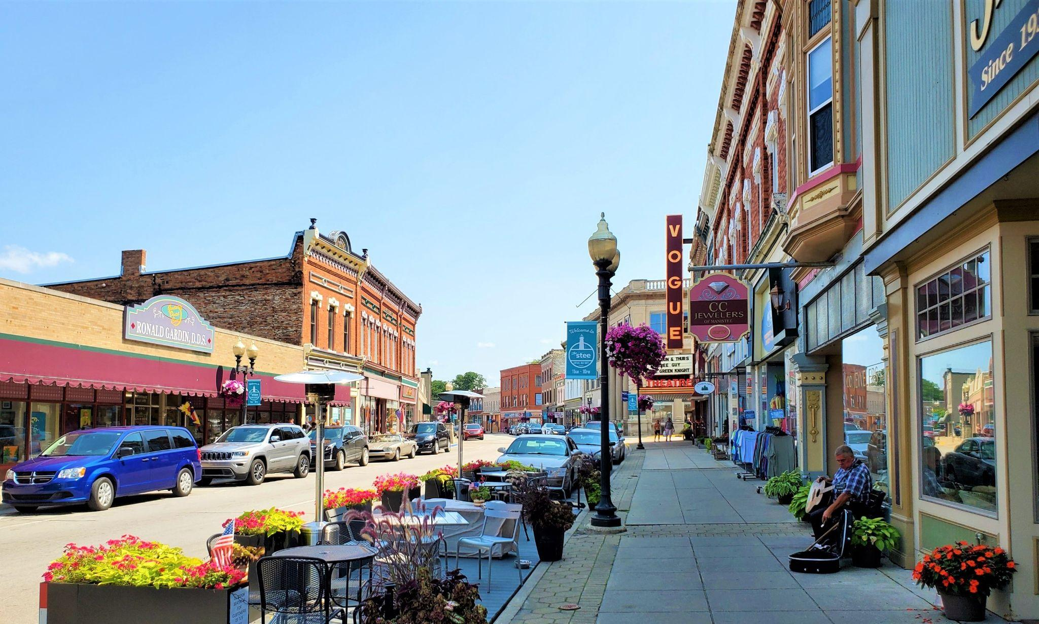
Planning and Zoning
PLANNING
Better placemaking
High environmental quality
Orderly growth, development, and redevelopment
Avoid wasteful spending
Contribute to economic development
Zoning
Protect property values
Prevent incompatible land uses near each other
Adequate public improvements during development
Fair equitable enforcement
Prevention of blight
Public health, safety, & welfare
Manistee, MI
Slide template provided by Mary Reilly, AICP, MSU Extensions
Notes:
PLANNING
Better placemaking
High environmental quality
Orderly growth and development
Avoid wasteful spending
Contribute to economic development
ZONING
Protect property values
Prevent incompatible land uses near each other
Adequate public improvements during development
Fair equitable enforcement
Public health, safety, & welfare

Slide 17
Zoning Service Contracts in Manistee County
2018-19: At request of the Manistee County Board, the Planning Department entered into a contracted service agreement with the City of Manistee. This initial agreement was for five (5) years.
2019-20: This service was expanded to several Townships and Villages. The initial contracts were for one (1) year trial contracts. This allowed for many of the communities to try the services without fully committing to a longer term contract. Additional Planning Department Staff were added to help with the increased workload.
2020-21: The Planning Department entered into three (3) year agreements for Planning and Zoning related services, retaining all Townships and Villages that had initially signed onto the trial contracts.

Slide 18
OUR EVOLUTION
2018
2019
2020
2021
Manistee County Planning Department contracts with the City of Manistee for Zoning Services.
Two additional Staff Planners are hired to help with the additional Zoning Service Contracts, Kyle Storey and Mike Szokola.
Covid - 19 saw Planning Department Staff report to work and function at a high capacity throughout the pandemic.
Departure of Director Rob Carson and Staff Planner Kyle Storey, addition of Katie Mehl and Zach Sompels as Staff Planners. Added Jess Sorensen as Clerical Assistant and Larry Gibson as County Code Enforcement Officer.
Smooth transition of new staff and legacy staff into new positions, while maintaining high quality planning and zoning services.
And still going strong!

Slide 19
Communities Currently Under Contract
Arcadia Twp.
Bear Lake Twp.
Onekama Twp.
City of Manistee
Bear Lake Village
Copemish Village
Eastlake Village
Onekama Village
8 Total Communities Currently Under Contract

Slide 20
WHAT SETS US APART?
Fully Staffed
Professional Planning Office
Availability
Process
The Planning Department is staffed by 3 professional planners and support staff dedicated to economic, environmental, and equitable friendly development.
Staff is available 5 days a week, excluding major holidays to answer questions from citizens or community Staff.
Professional staff that understand the process, can facilitate training and or script development to ensure that the right procedure is followed by community staff.

Slide 21
Services Provided
ZONING
ADMINISTRATION
Three levels of Service to choose from.
FLOODPLAIN
ADMINISTRATION
Help answer Floodplain questions for your community.
LAND
DIVISION
Ensure the requirements of Zoning and Land Division are being done correctly.
CODE
ENFORCEMENT
Works within your community to eliminate blight, junk, and zoning violations.
PLANNING
SERVICES
When time allows and separate contracted service

Slide 22
Zoning Administration (Level I)
ZONING
ADMINISTRATION
Level I Services:
Use by Right Approvals
Accept and review application for completeness
Coordinate with applicant if application is incomplete
Accept and process payment
Issue/deny permit as regulated by the Zoning Ordinance
Special Use & Planned Unit Development Approvals
Accept and review application for completeness
Accept and process payment
Perform application review for items required through the zoning ordinance
Provide application materials to other agents of the community for Legal, Engineering or other professional review as needed.
Submit complete/accepted application with review memo to the Elected Clerk of the community.
Issue permit upon notification from the community that the use was approved by the respective body.
Variance Requests
Accept and review application for completeness
Accept and process payment
Submit complete application to the Elected Clerk of the community
Issue permit upon notification that the variance was approved by the respective community body.
What is not included in Level I Services:
Any of the services outlined in Level II and Level III
Legal interpretation or legal opinion requested of an attorney
Securing legal representation
Covering legal and court costs
Title or Deed Research
Costs associated with approvals that require engineering, surveying, or other professional opinions
Does not include recording of meeting minutes
Does not include public hearing preparation, mailing and newspaper advertisements as required for activities
No meeting attendance included in base contract
Notes:
Under a Level I Service Contract:
The Planning Department will do Use by Right or Permitted Uses approvals.

Slide 23
Zoning Administration (Level II)
ZONING
ADMINISTRATION
Level II Services:
Zoning Application Activities
Special Use & Planned Unit Development
In addition to Level I Services outlined above, staff prepares memo detailing submittal, public hearing notices, newspaper advertisements and mailings, as necessary
Variance Requests
In addition to Level I Services outlined above, staff prepares memo detailing submittal, public hearing notices, newspaper advertisements and mailings, as necessary.
Zoning Text Amendment Requests
Accept and review application for completeness
Accept and process payment
Write memo to Township concerning request, prepare meeting packet
Coordinate with Clerk to set meeting date, staff prepares public hearing notices, newspaper advertisements and mailings as necessary
Zoning Text Interpretation Requests
Accept and review application for completeness
Accept and process payment
Write memo to Township concerning request, prepare meeting packet
Coordinate with Clerk to set meeting date, staff prepares public hearing notices, newspaper advertisements and mailings as necessary
What is not included in Level II Services:
Any of the services outlined in Level III
Legal interpretation or legal opinion requested of an attorney
Securing legal representation
Covering legal and court costs
Title or Deed Research
Costs associated with approvals that require engineering, surveying, or other professional opinions
Text Amendment request for large portions of the Zoning Ordinance, i.e.: sign ordinance rewrite or fence ordinance rewrite.
Does not include recording of meeting minutes

Slide 24
Zoning Administration (Level II) Continued
Level II Services:
Other Services Provided
Attendance at Planning Commission/Zoning Board of Appeals meetings where a Variance Request, Special Use Permit or Planned Unit Development Application is being deliberated.
Coordination of meeting and public hearings with the community when this is initiated by a request.
Coordination will include:
Identifying the appropriate timeframe for scheduling the hearing to meet State guidelines for notices.
Preparing a memo for the appropriate board/commission that outlines the request and includes the application materials.
Mailing List Identification, Letter Preparation & Mailing
Per State Statute, Special Use Permits, Planning Unit Development Requests, Variance Requests, Zoning Map/Text Amendment Requests often require a mailing to all property owners within 300’ of the subject property. The entirely of the service for mailings will be completed by the County Planning Department
Public Hearing Notice & Other Necessary Newspaper Notices
Per State Statute, Special Use Permits, Planning Unit Development Requests, Variance Requests, Zoning Map/Text Amendment Requests often require a notice be placed in the newspaper
The cost of mailing will be billed separately to the Township or Village.
ZONING
ADMINISTRATION
What is not included in Level II Services:
Any of the services outlined in Level III
Legal interpretation or legal opinion requested of an attorney
Securing legal representation
Covering legal and court costs
Title or Deed Research
Costs associated with approvals that require engineering, surveying, or other professional opinions
Text Amendment request for large portions of the Zoning Ordinance, i.e.: sign ordinance rewrite or fence ordinance rewrite.
Does not include recording of meeting minutes

Slide 25
Zoning Administration (Level III)
ZONING
ADMINISTRATION
Level III Services:
Level III Services Summary: Level III Services capture the services outlined in Level I & Level II, but also include handling of the meeting packet preparation for all required Planning Commission and Zoning Board of Appeals meetings and writing of necessary text amendments
Services Provided
Meeting attendance at 6 Planning Commission meetings outside of those required for Special Use or PUD approvals. Meeting attendance must be scheduled and approved at the beginning of the calendar year.
Preparation of Agendas for Planning Commission and Zoning Board of Appeals meetings with sound communication with communities Planning Commission members and Elected Officials to ensure all agenda requests are made and included within agenda.
Handle correspondence of the public and official commissions and boards.
Preparation of zoning Text Amendments and the required legal notices for such amendments
Following the approval of a Text Amendment or Zoning Map Amendment, placement of the amended language into the Zoning Ordinance, or editing of the Zoning Map (This necessitates that the community have an up-to-date zoning district GIS layer, and an editable Zoning Ordinance).
Appendix B Included “Land Division Services”
Appendix C Included “Code Enforcement Services”
Appendix D included “Floodplain Administration
What is not included in Level III Services:
Legal interpretation or legal opinion requested of an attorney
Securing legal representation
Covering legal and court costs
Title or Deed Research
Costs associated with approvals that require engineering, surveying or other professional services
Text Amendment request for large portions of the Zoning Ordinance, i.e.: sign ordinance rewrite or fence ordinance rewrite.
Does not include recording of meeting minutes

Slide 26
Floodplain Administrator
FLOODPLAIN
ADMINISTRATION
ZONING
ADMINISTRATION
Floodplain Administration:
Summary: The County Planning Department will act as Floodplain Administrator for communities that wish to include Appendix D within the Contract
Floodplain Administration Services Covered Under Contract
Respond to questions pertaining to floodplains and floodplain requirements.
Provide floodplain maps and identify if properties/structures are within floodplains
Utilize LIDAR GIS data (EGLE/FEMA Approved Elevation Data) to determine threshold elevations of structures within floodplains
Provide digital map and statement of floodplain elevations at structure thresholds for use with certificates of elevation.
Relay information regarding location of floodplain and structures, to property owners, lending institutions and insurance companies
What is not included in Floodplain Administration Services:
Preparation/Drafting of Letters of Map Amendment
Preparation of Certificates of Elevation
Research of Deed/Title for any purpose

Slide 27
Land Division Services
LAND
DIVISION
Land Division Services:
Summary: The County Planning Department will act as the Land Division Officer for communities that wish to include Appendix B within the Contract. If they do not, the Planning Department will work with the Land Division Officer to ensure that Zoning requirements are met, and signed off by the ZA prior to any Land Division being approved.
Land Division Officer Services (Covered Under Base Service):
Lead contact for land division questions.
Maintain up-to-date application
Maintain catalogue of parent parcel maps for each community.
Receive application & payment
Process application and deny/approve land divisions as they are received
Provide approved application to applicant
Transfer approved digital application and payment to contracted community
Maintain digital files
What is not included in Land Division Services:
Completing of application for applicant
Providing survey services
Providing legal description services
Providing title or deed research for applicants

Slide 28
Code Enforcement Services
CODE
ENFORCEMENT
Code Enforcement Services:
Summary: Provide base administrative services for code enforcement, relying on primarily elected/appointed officials to notify the County of violations and to provide pictures and an address or parcel number. Investigation will occur upon complaint with pictures and the process will then be handled by the County. Citizens wishing to file a complaint will have to do so via by turning in their complaint to the Township or Village hall.
Code Enforcement Services Covered Under Contract :
Receive complaints of violation, pictures and written complaint required (will rely upon local officials to confirm a violation exists)
Upon review of pictures, perform site visits to confirm violations exist
Make contact with property owner or occupant of property
In person (if able), by mail, or via electronic means, (i.e. email or phone)
Seek to remedy violations prior to issuing of citations, if consistent progress is made a ticket will not be issued
Follow Codified Ordinance Procedure for prosecution of violations
Sending letters
Coordinate with clerk to schedule meetings/hearings as necessary
Coordinate with community for removal of blight/junk according to the Ordinance
Officer is present while blight/junk removal operations are commencing & underway as ordered by Codified Ordinance
Communicate and participate with Community Attorney for prosecution of cases
What is not included in Code Enforcement Services:
Providing legal representation for prosecution of cases
Covering of legal costs, and court costs for prosecution of cases
Scheduling blight/junk removal and hiring/payment of/to contractor for removal of junk/blight from properties that are found in violation
Recouping of costs involved with junk/blight removal

Slide 29
Code Enforcement Services
PLANNING
SERVICES
Planning and Other Services:
Summary: Services not covered in contract either based on level or additional services.
Mailing Preparation $300.00 per request, plus $1.00 per letter to be mailed (Level I Service Mailings)
Individual Attendance at meetings, outside of those required by the level of service, and as requested by the community $90.00 for the first hour, $30 each additional half hour (rounded up to the half hour)
GIS Mapping, Zoning Text Amendment Drafting, Zoning Ordinance Editing: $60 per hour
Master Plan Revisions, Master Plan Development, Park and Recreation Plan Development, Large Zoning Ordinance Rewrites, i.e. (sign ordinance, fence ordinance, etc): Quoted Estimate based upon an agreed upon Scope of Work
What is not included in Code Enforcement Services:
Providing legal representation for prosecution of cases
Covering of legal costs, and court costs for prosecution of cases
Scheduling blight/junk removal and hiring/payment of/to contractor for removal of junk/blight from properties that are found in violation
Recouping of costs involved with junk/blight removal

Slide 30
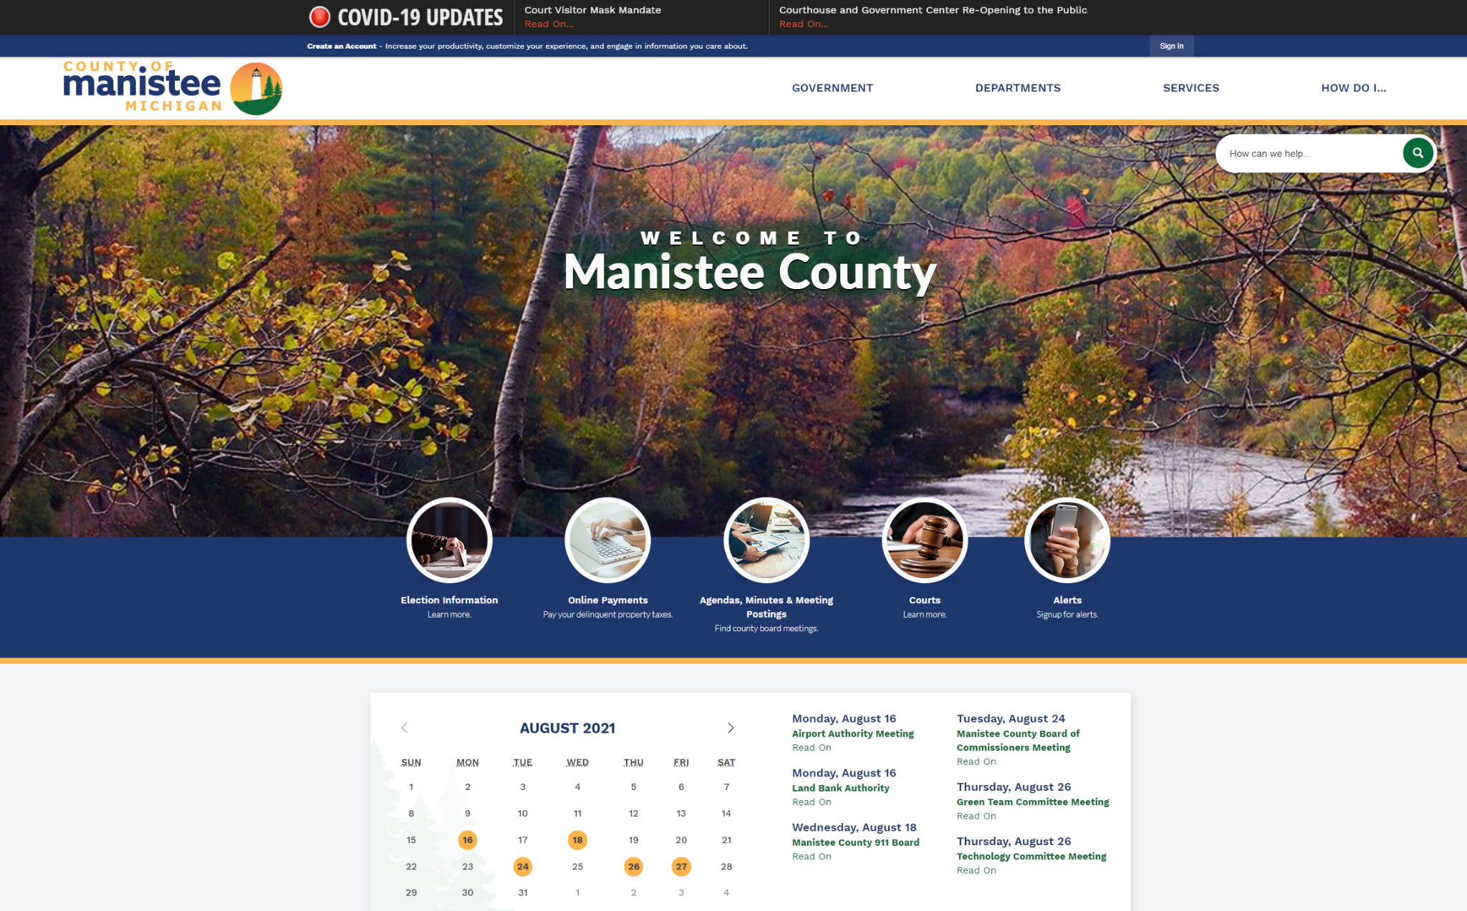
Website
In late 2019 the County transitioned to a new County website.
As part of that transition the County Planning Department added the communities it services to the website.
The Planning Department also hosted important forms and ordinances on the website for the communities we provide zoning services to.

Slide 31
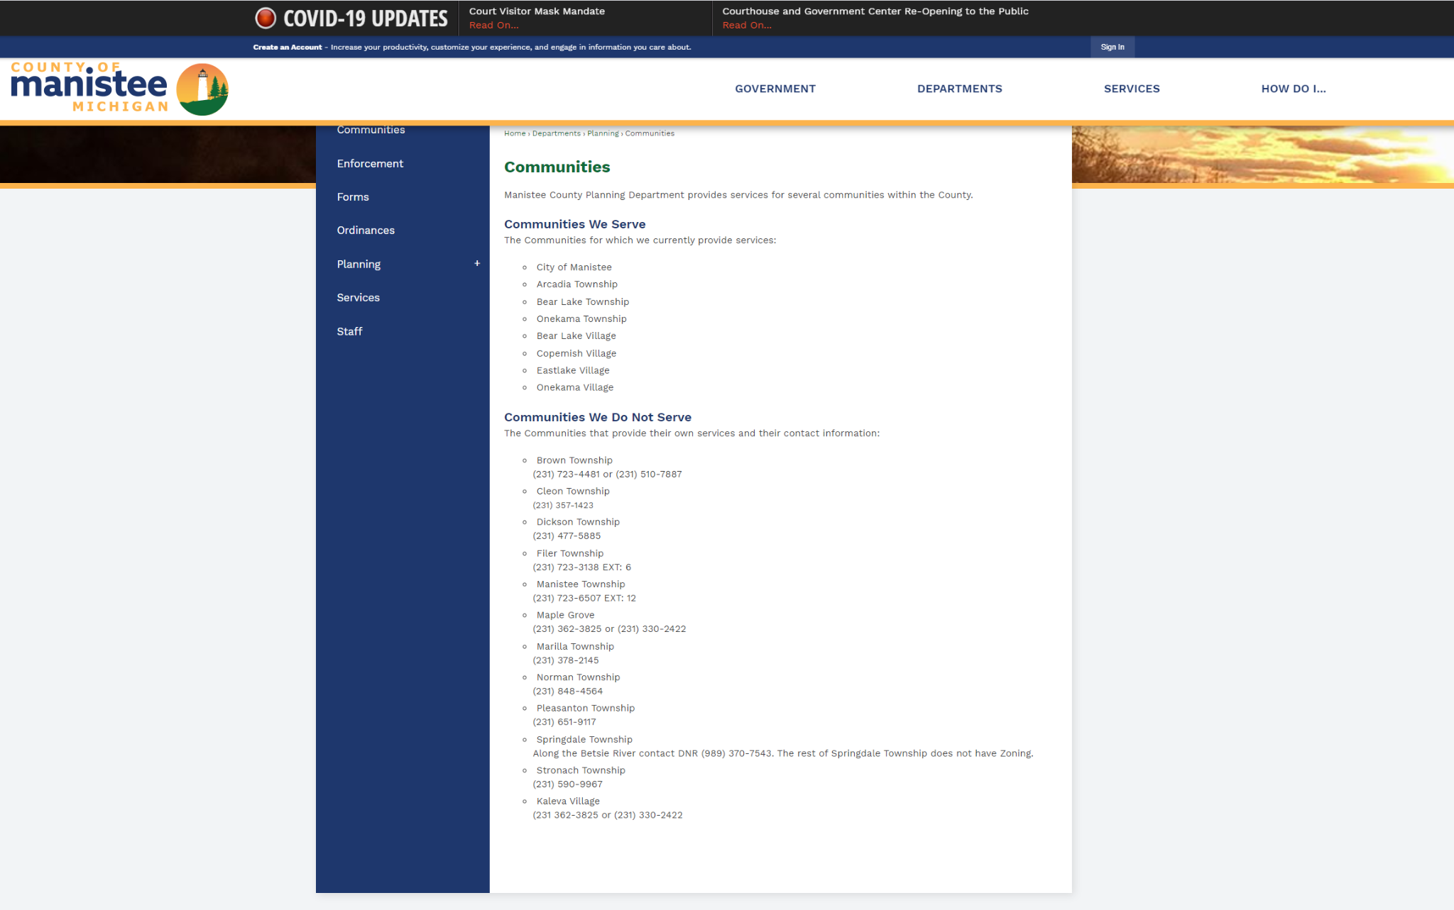
Website (Communities)
Within the website the Planning Department provides a list of communities we provide services for.
If the community is one in which we do not provide services, a phone number is provided to the local Township or Village hall.

Slide 32
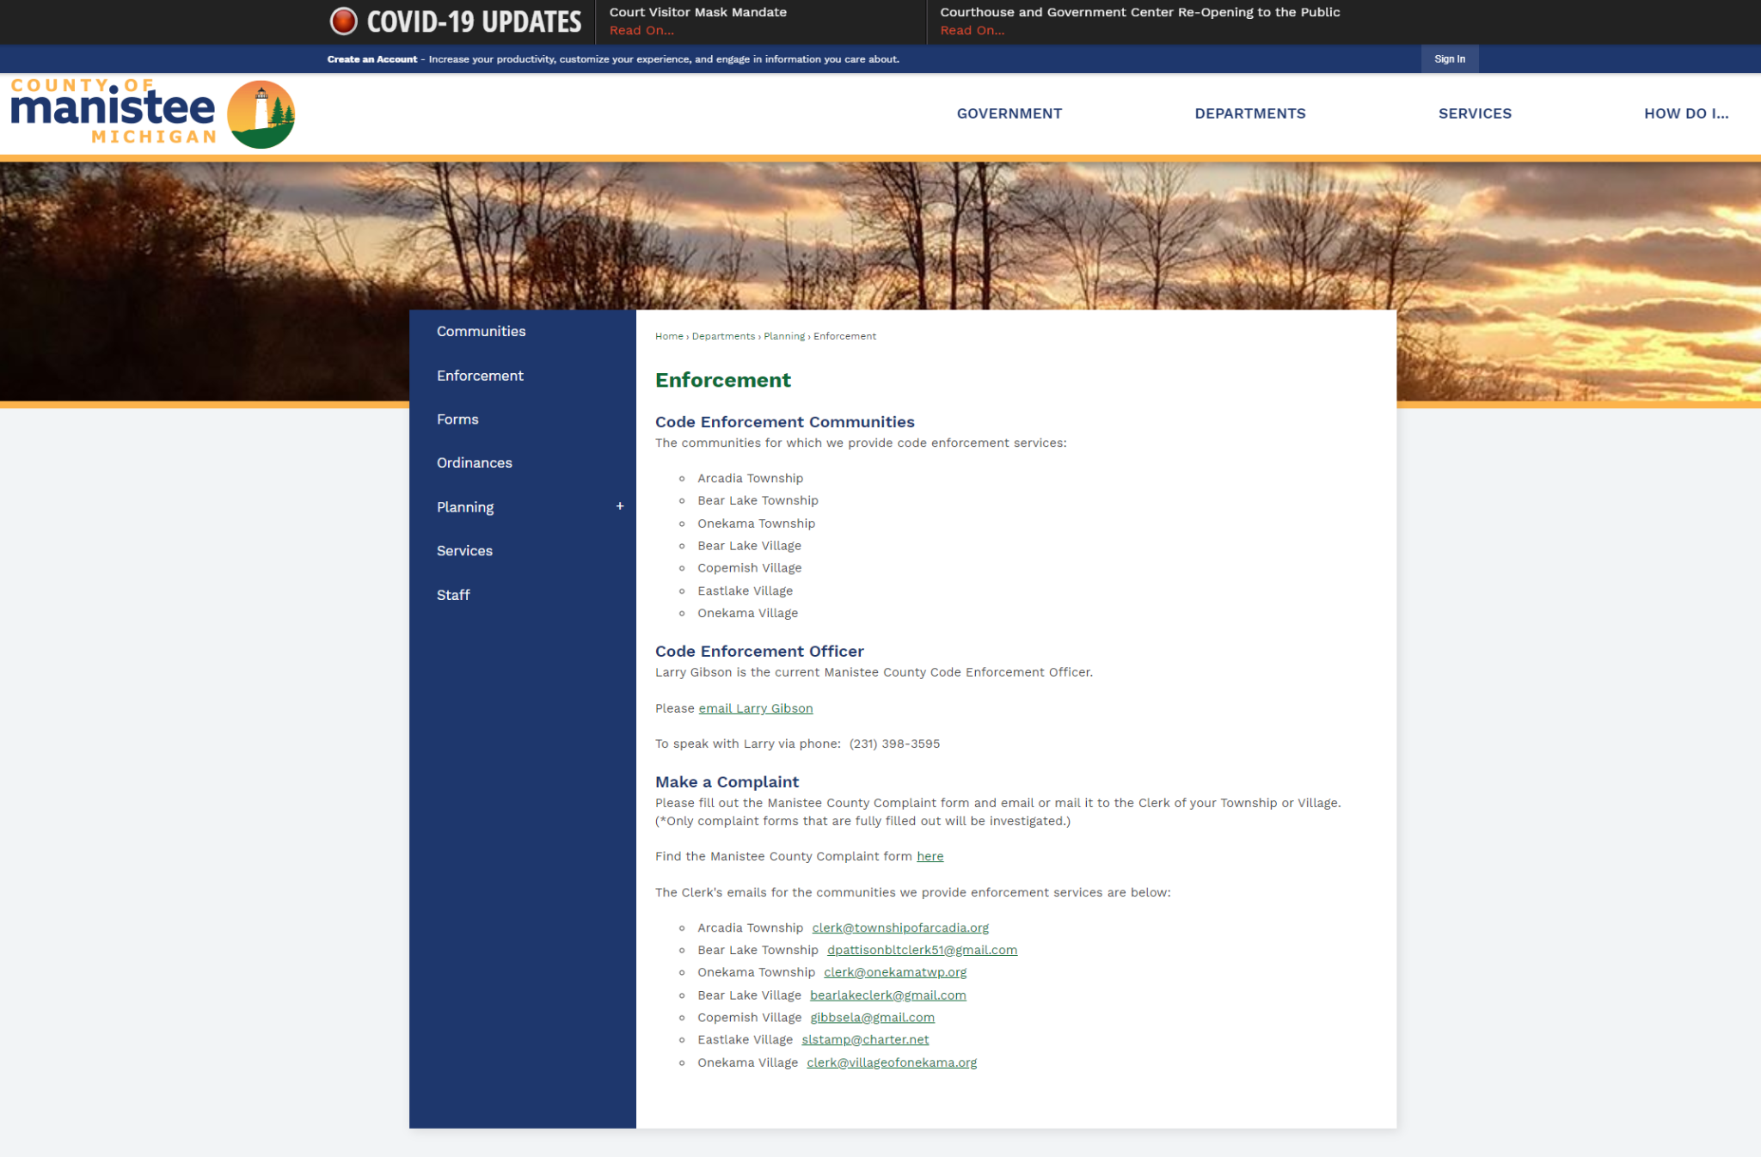
Website (Enforcement)
The County Enforcement page can also be found on the website.
Within the page a resident can find the complaint form, email and phone number for the Code Enforcement Officer.
Only complaints that come from the Village or Township will be investigated.

Slide 33
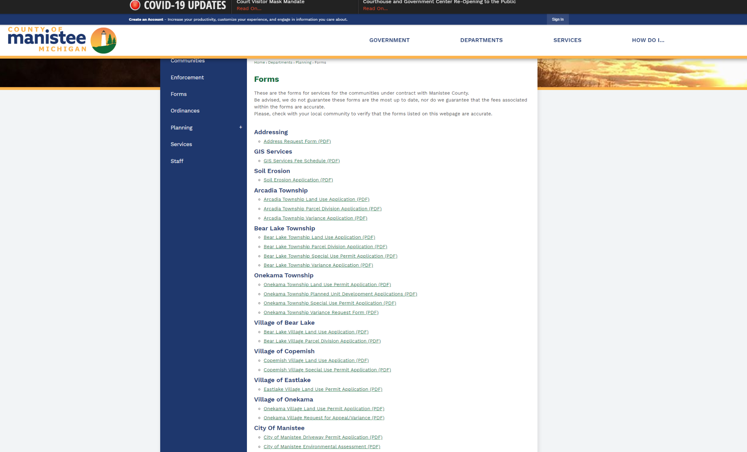
Website (Forms)
The County Forms can be found on this page.
Within the page a resident can find the commonly used forms for the communities we provide services for.
Other forms including County Address Request Forms, GIS Services Fee Schedule, and Soil Erosion Application can also be found on this page.

Slide 34
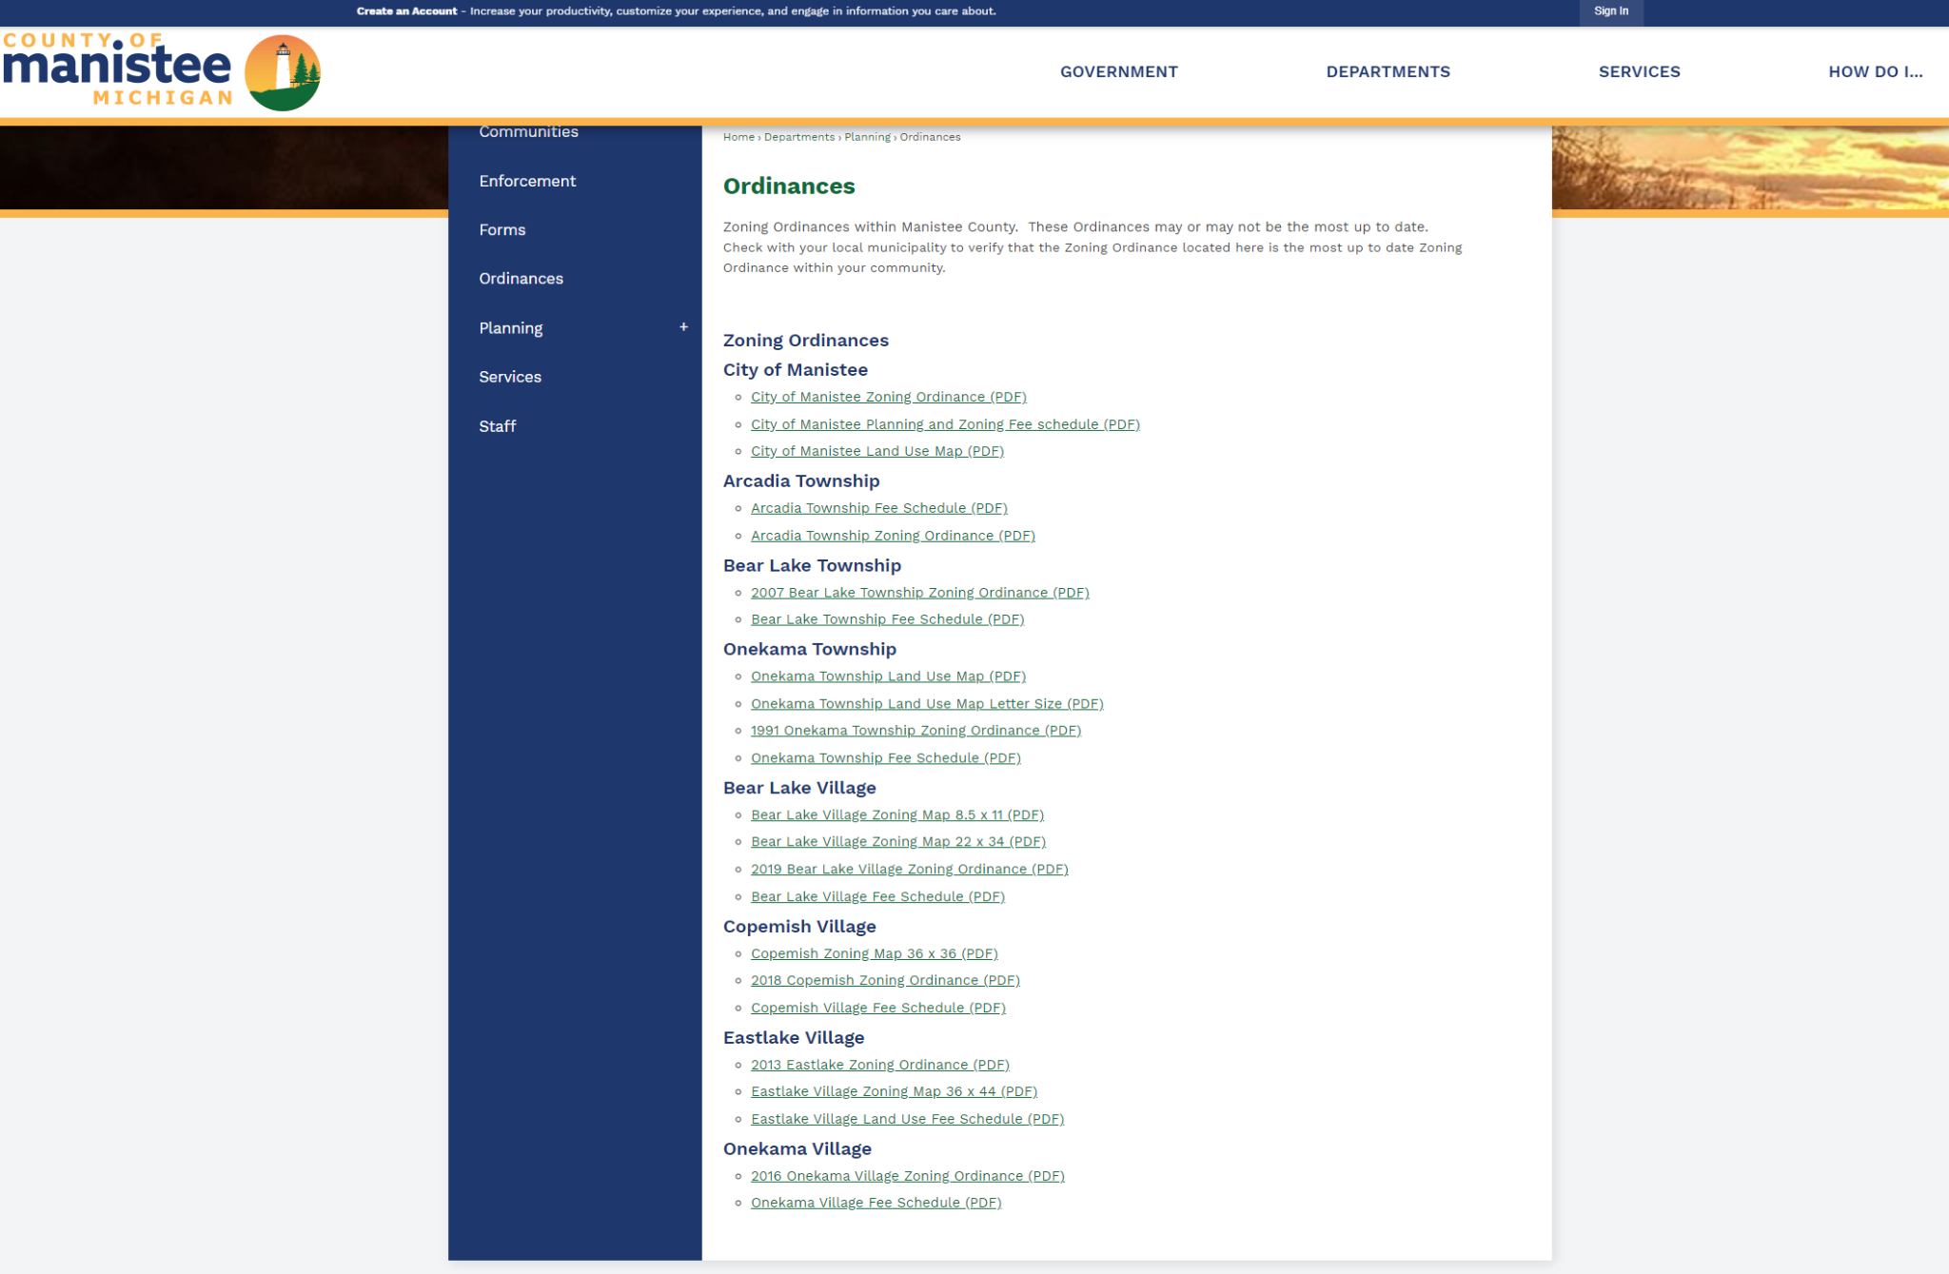
Website (Ordinances)
The Zoning Ordinances for communities we provide Zoning Services for can be found on this page.
Recently a request for a digital copy of all Zoning Ordinances within the County went out.
When the Planning Department receives all copies another page will be made to house all ZO and blight/junk ordinances within the County.

Slide 35
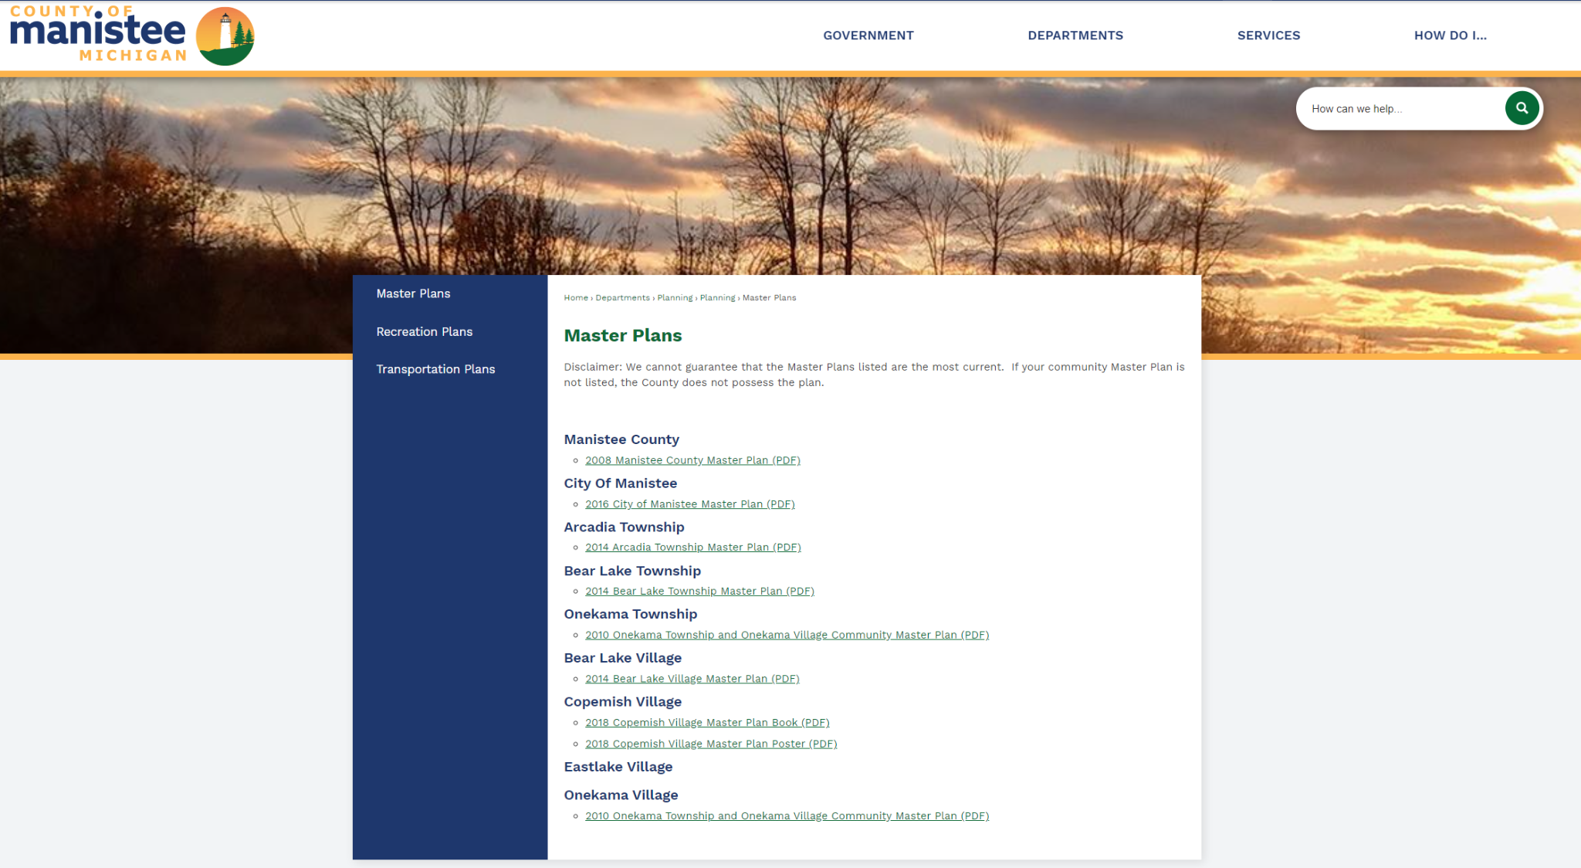
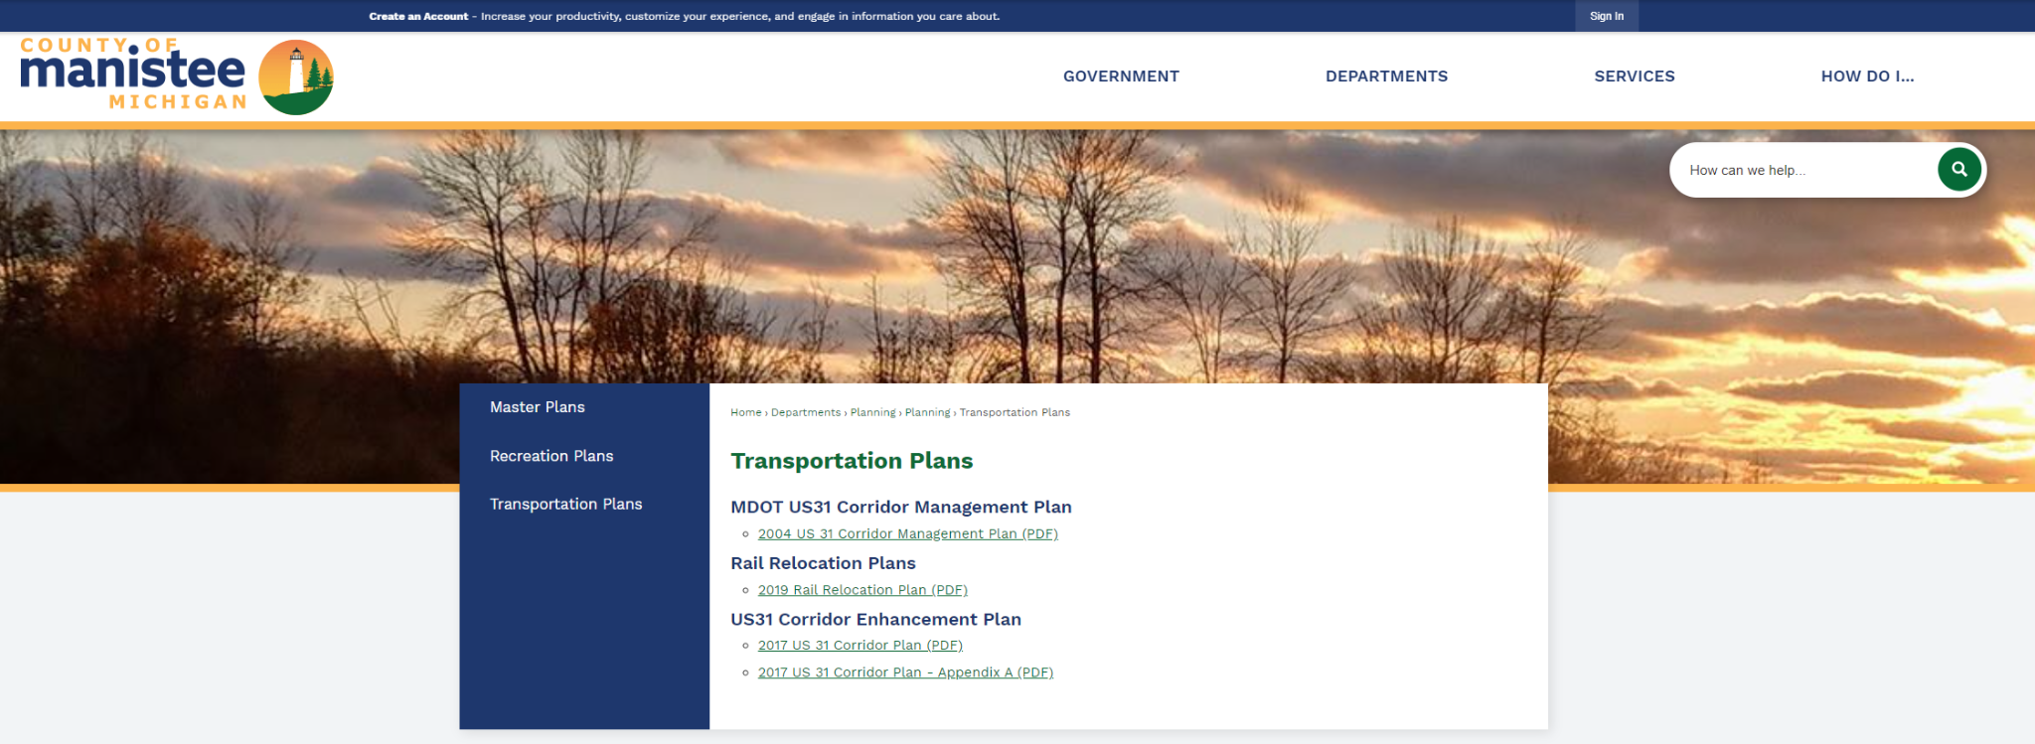
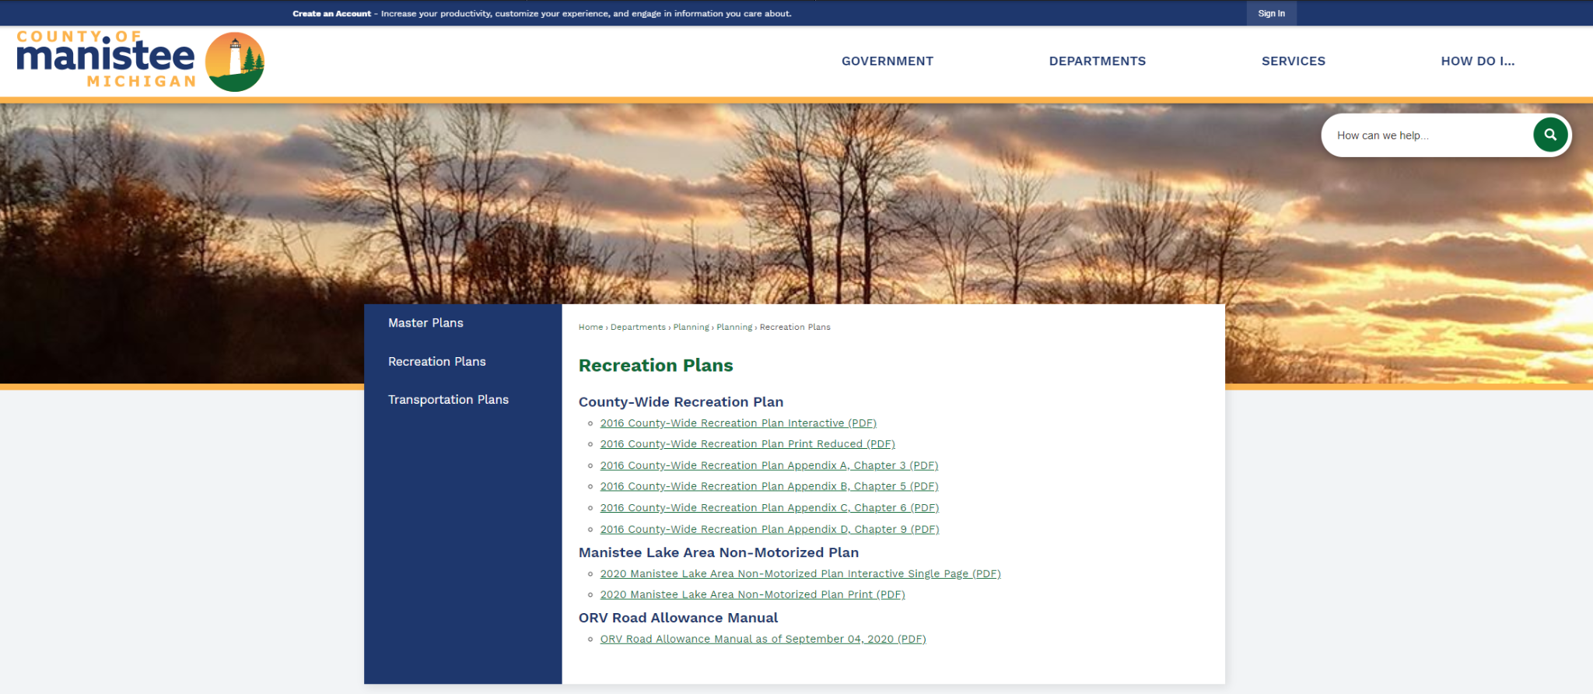
Website (Planning/Plans)
Many recent plans can be found on the website to include, Master Plans, Transportation plans, and Recreation plans.
If your community would like to share their most recent Master Plan, we would be willing to host it on the website.
It is the communities responsibility to ensure that their most up to date ordinance is on file.
What Planning Department Staff will not Provide:
*** Planning Department Staff will not answer any questions from the public in regards to Master Plans or Zoning Ordinances for communities in which we do not provide Zoning or Planning Services for. ***

Slide 36
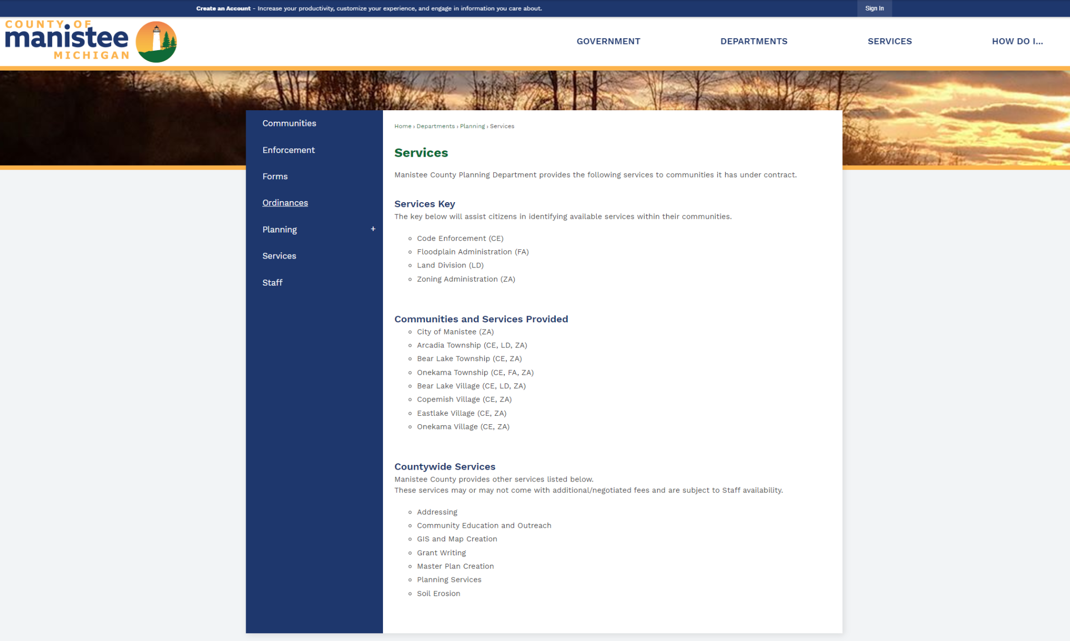
Website (Services)
Services section with a key for communities under contract.
Additional Countywide services are also listed here.
Besides Addressing and Soil Erosion, additional Countywide services are at a negotiated fee and are subject to Staff Availability.
Notes:
Services section with a key for communities under contract. This helps residents easily identify what services are available for communities under contracted services.
Additional Countywide services are also listed here.
Besides Addressing and Soil Erosion, additional Countywide services are at a negotiated fee and are subject to Staff Availability.

Slide 37
Website (Services)
Services section with a key for communities under contract. This helps residents easily identify what services are available for communities under contracted services.
Additional Countywide services are also listed here.
Besides Addressing and Soil Erosion, additional Countywide services are at a negotiated fee and are subject to Staff Availability.

Slide 38
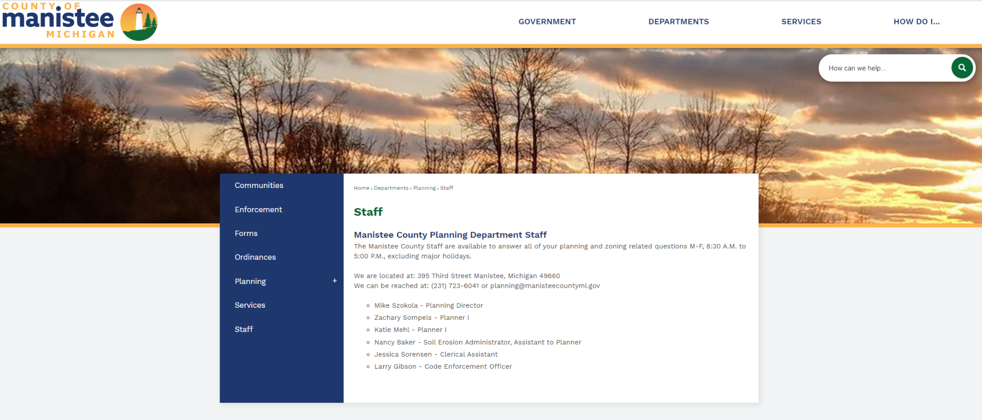
Website (Staff)
All Staff is listed on the website as well the Department address, email and telephone number.
This information is provided as a convenient way for anyone to contact the Planning Department who may wish to.

Slide 39
Value Added Services
Manistee County Planning Department offers additional value added services for communities in which we provide zoning services for.
These include: form development, scripts for meetings, training as needed with regards to major developments, Special Use Permits, and/or Zoning Board of Appeals procedures and questions.

Slide 40
Value Added Services (Form Development)
Staff develop forms that might be missing from Township or Village forms, i.e.: Special Land Use (SUP), Planned Unit Development (PUD), etc.
Based off Ready Redevelopment Community (RRC) forms.
Community’s preference on what forms they would like to utilize.
Notes:
It is rather common for communities to not have forms for everything within their Zoning Ordinance. During these times, staff will develop forms for use, taking the sections of the Zoning Ordinance and implementing them into forms for use by the Township or Village.
The forms developed mirror the requirements for Ready Redevelopment Community (RRC) and are developed off of the
Forms utilized by the City of Manistee, a RRC certified municipality.
Even though this service is offered to communities under contract for zoning services, if the community would rather utilize their own forms, the Planning Department is willing to work with the community’s preference.

Slide 41
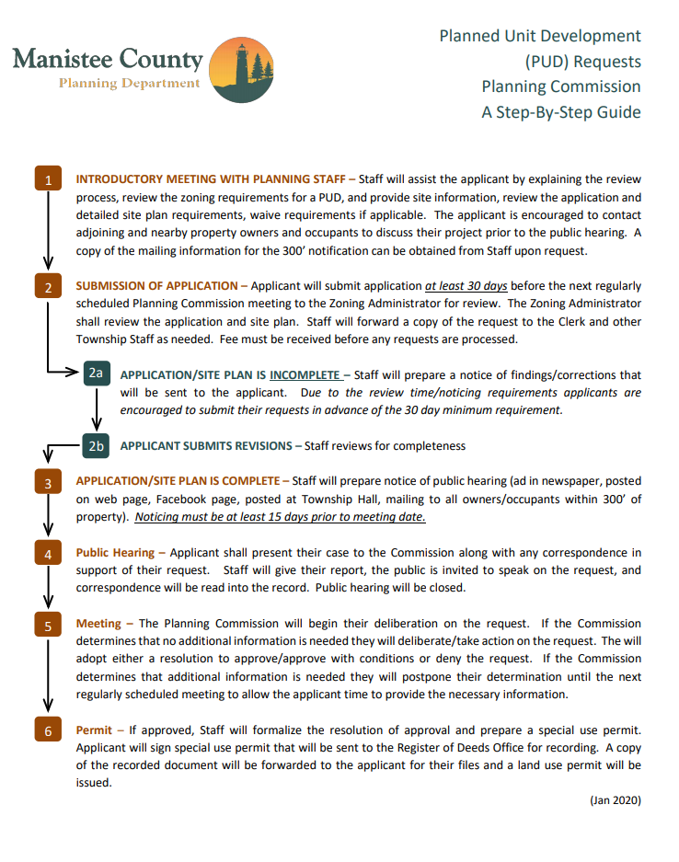
Value Added Services (Form Development, PUD Form for Onekama Twp. )
Notes:
This is a Planned Unit Development (PUD) form developed for use by Onekama Township.
The form pulls the requirements directly from Onekama Township’s Zoning Ordinance.
The form clearly lays out expected timelines and processes. This allows for the applicant to understand the process and what is expected of them.
Also it allows developers or others working with them to understand processes or timelines for submittal.
This is very important when dealing with developers and others from outside the community, region or State.

Slide 42
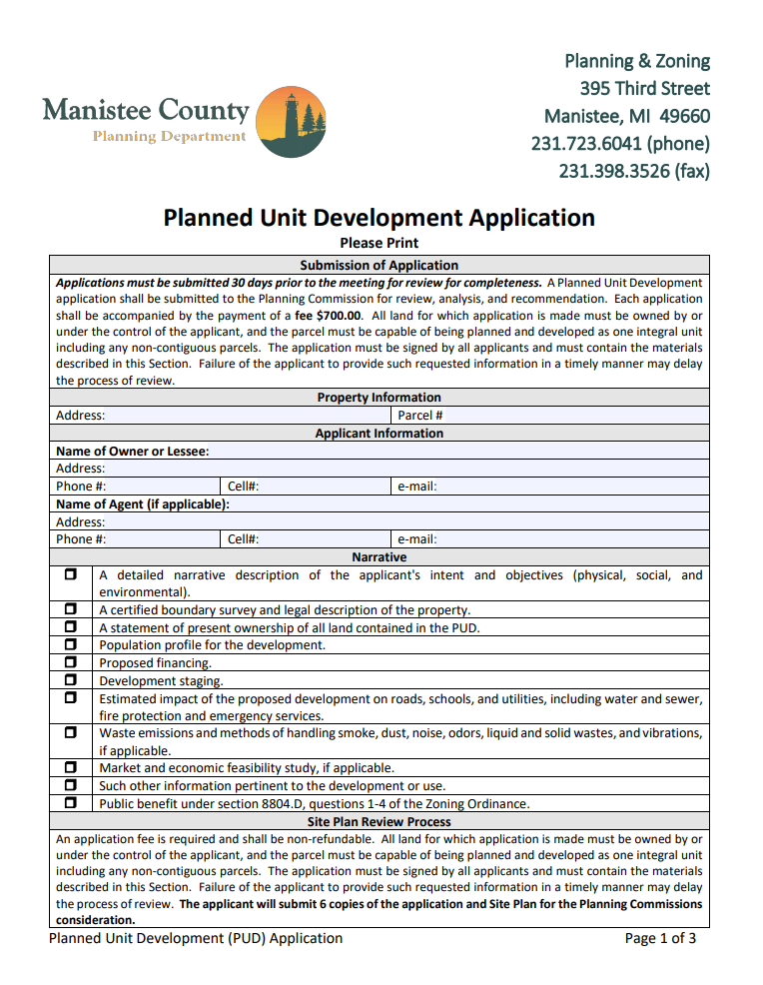
Value Added Services (Form Development, PUD Form for Onekama Twp. )
Notes:
This is a Planned Unit Development (PUD) form developed for use by Onekama Township.
The form pulls the requirements directly from Onekama Township’s Zoning Ordinance.
The form clearly lays out expected timelines and processes. This allows for the applicant to understand the process and what is expected of them.
Also it allows developers or others working with them to understand processes or timelines for submittal.
This is very important when dealing with developers and others from outside the community, region or State.

Slide 43
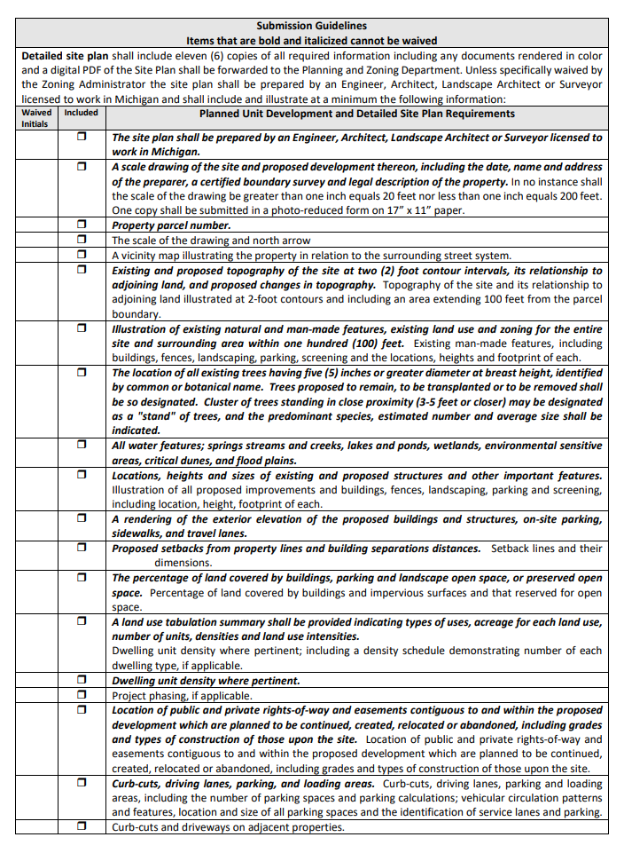
Value Added Services (Form Development, PUD Form for Onekama Twp. )
Notes:
This is a Planned Unit Development (PUD) form developed for use by Onekama Township.
The form pulls the requirements directly from Onekama Township’s Zoning Ordinance.
The form clearly lays out expected timelines and processes. This allows for the applicant to understand the process and what is expected of them.
Also it allows developers or others working with them to understand processes or timelines for submittal.
This is very important when dealing with developers and others from outside the community, region or State.

Slide 44
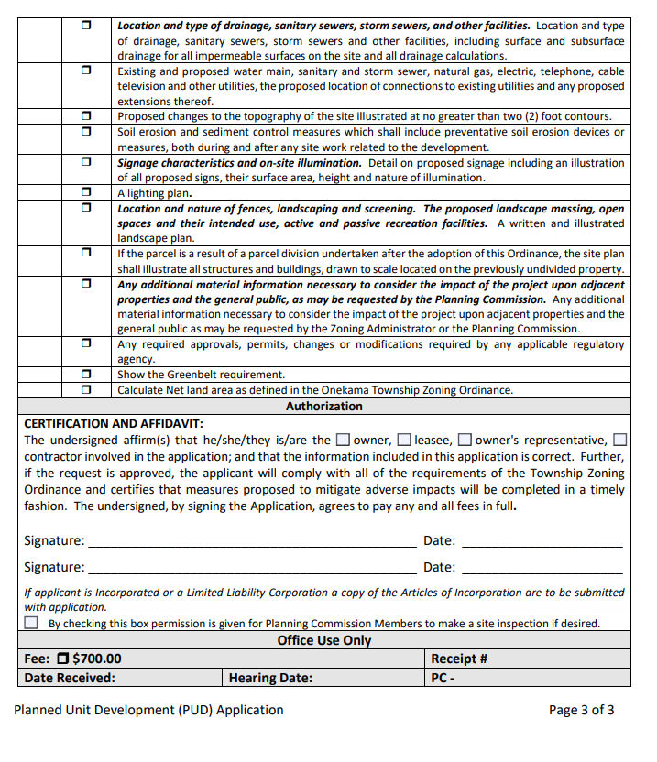
Value Added Services (Form Development, PUD Form for Onekama Twp. )
Notes:
This is a Planned Unit Development (PUD) form developed for use by Onekama Township.
The form pulls the requirements directly from Onekama Township’s Zoning Ordinance.
The form clearly lays out expected timelines and processes. This allows for the applicant to understand the process and what is expected of them.
Also it allows developers or others working with them to understand processes or timelines for submittal.
This is very important when dealing with developers and others from outside the community, region or State.

Slide 45
Value Added Services (SUP script for Public Hearing)
It is common for new members to be on a Planning Commission (PC) or Zoning Board of Appeals (ZBA).
Staff will often create scripts to ensure the legal requirements are met, while also providing an outline of the meeting flow.

Slide 46
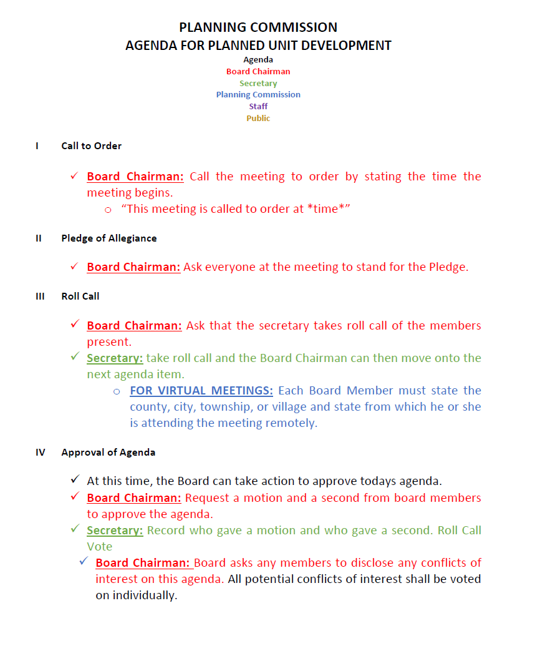
Value Added Services (SUP script for Public Hearing)

Slide 47
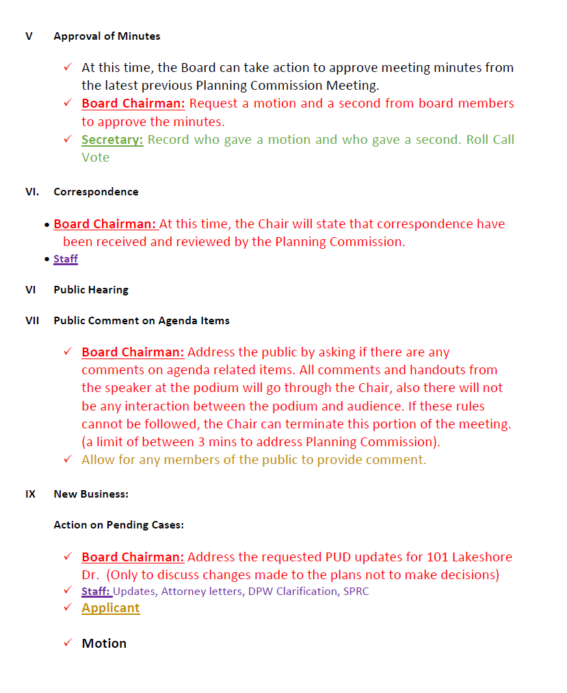
Value Added Services (SUP script for Public Hearing)

Slide 48
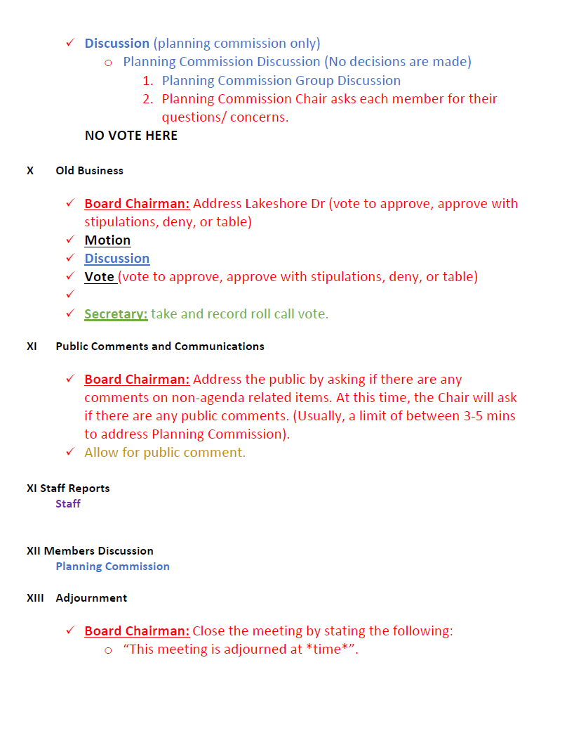
Value Added Services (SUP script for Public Hearing)

Slide 49
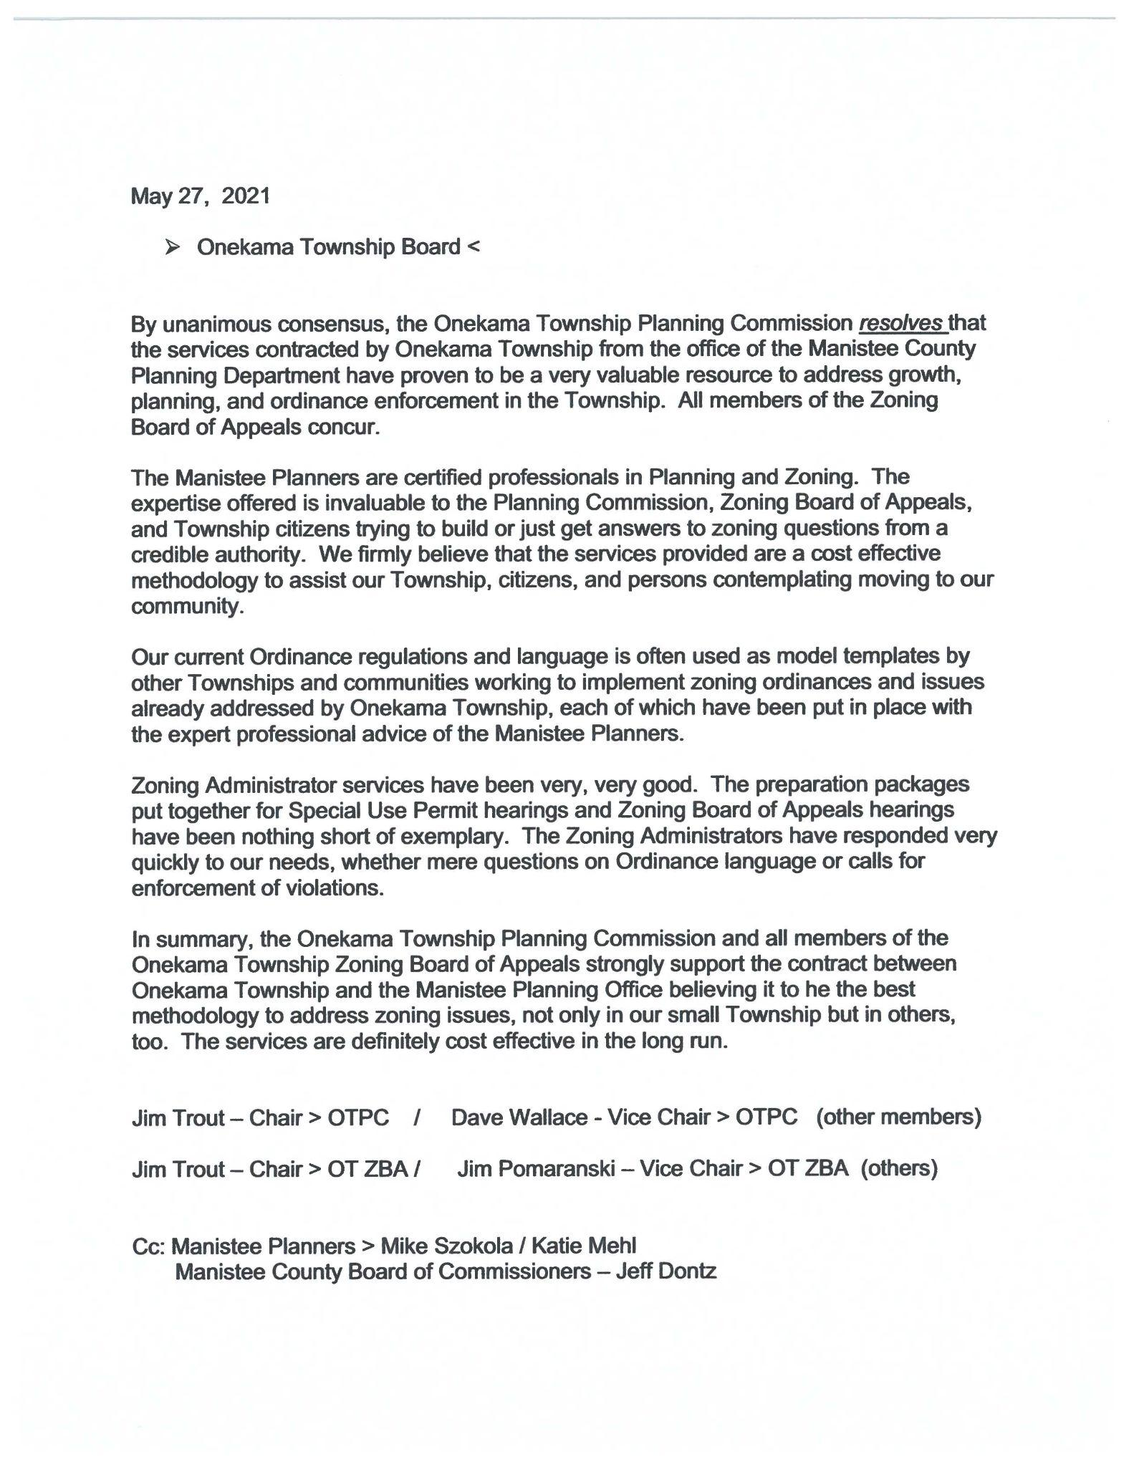
Testimonials (Onekama Township)

Slide 50
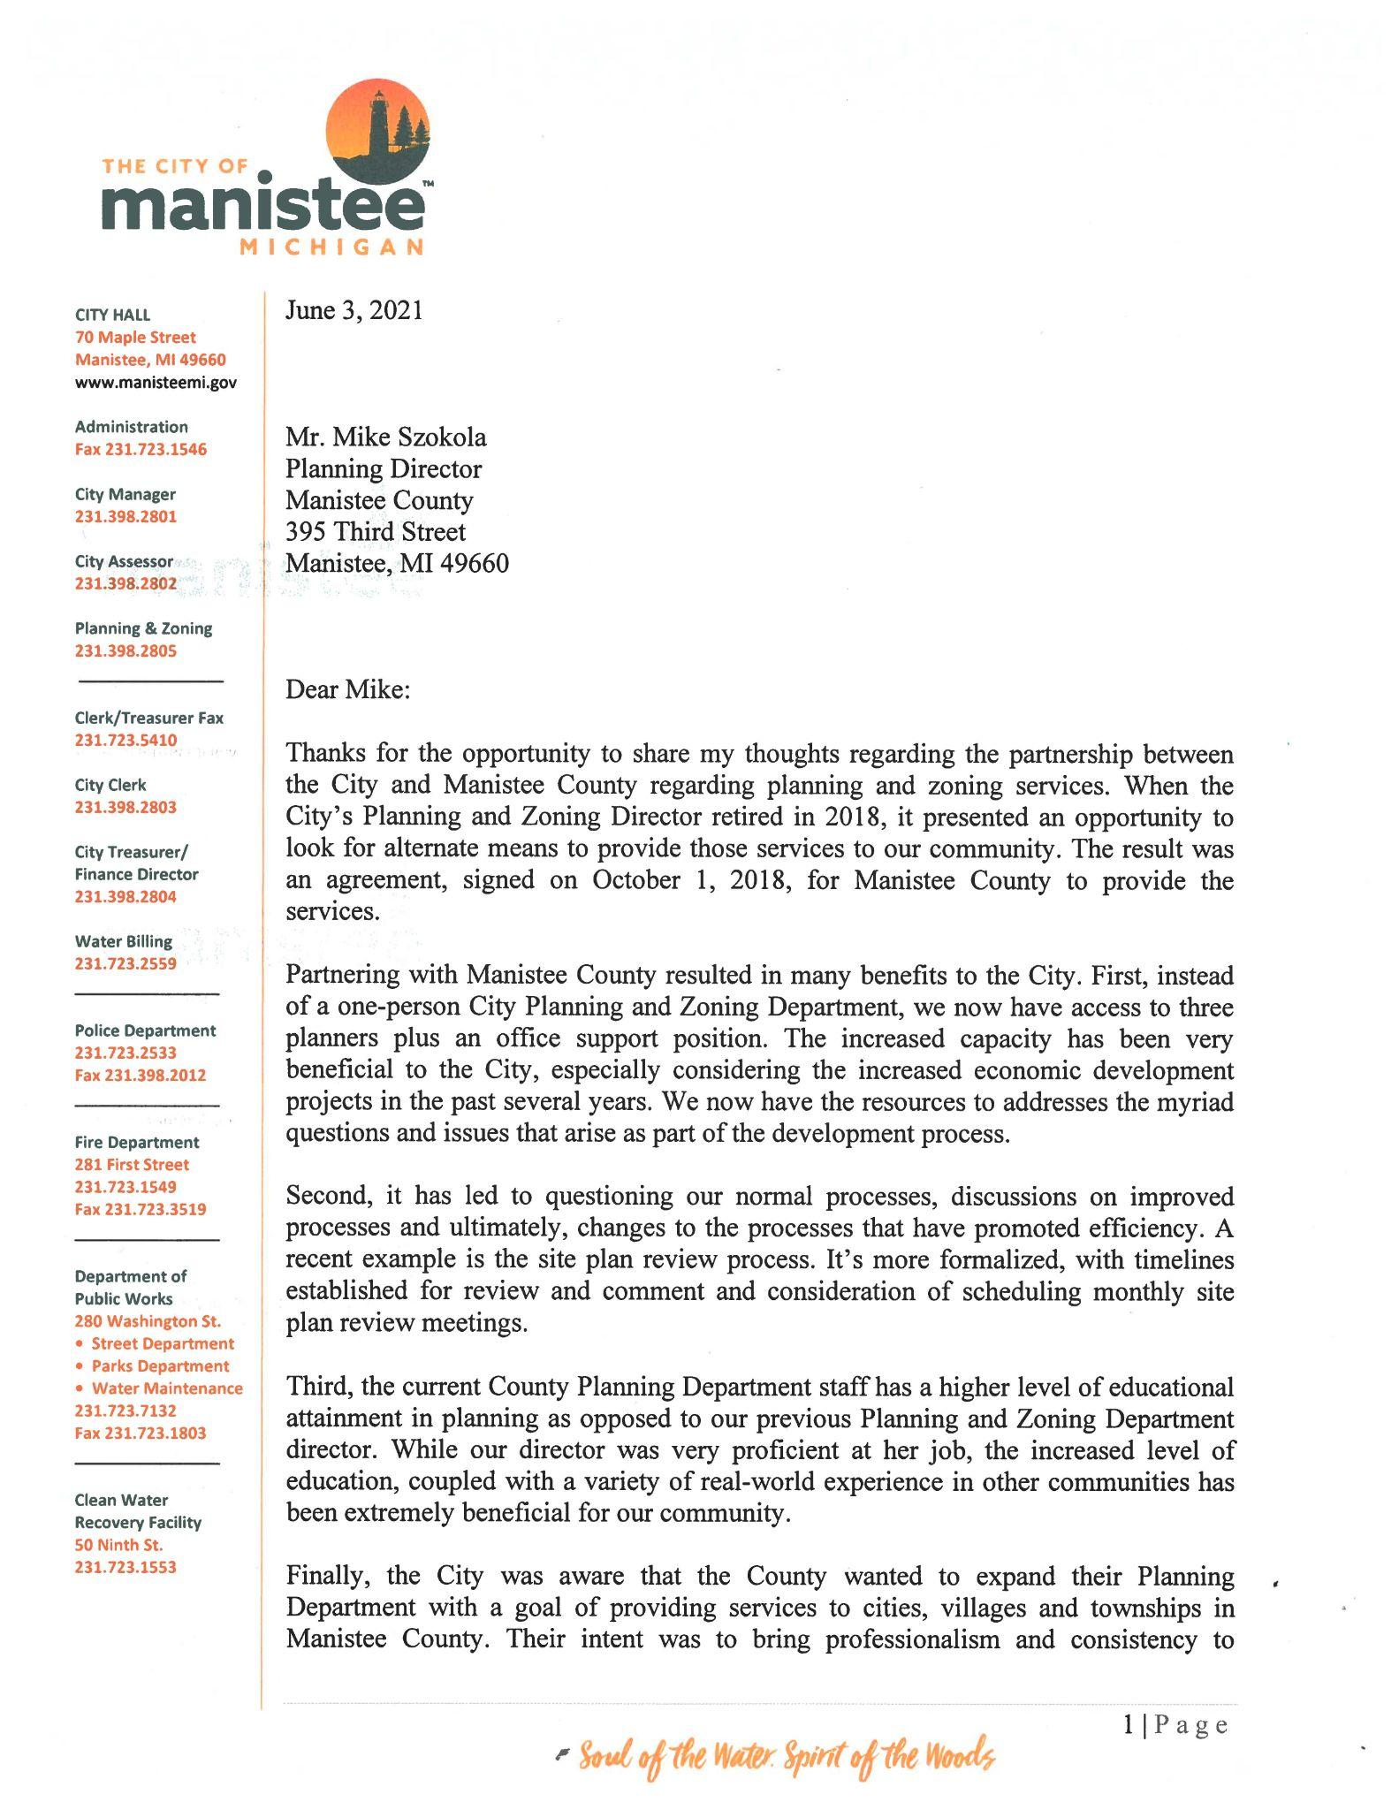
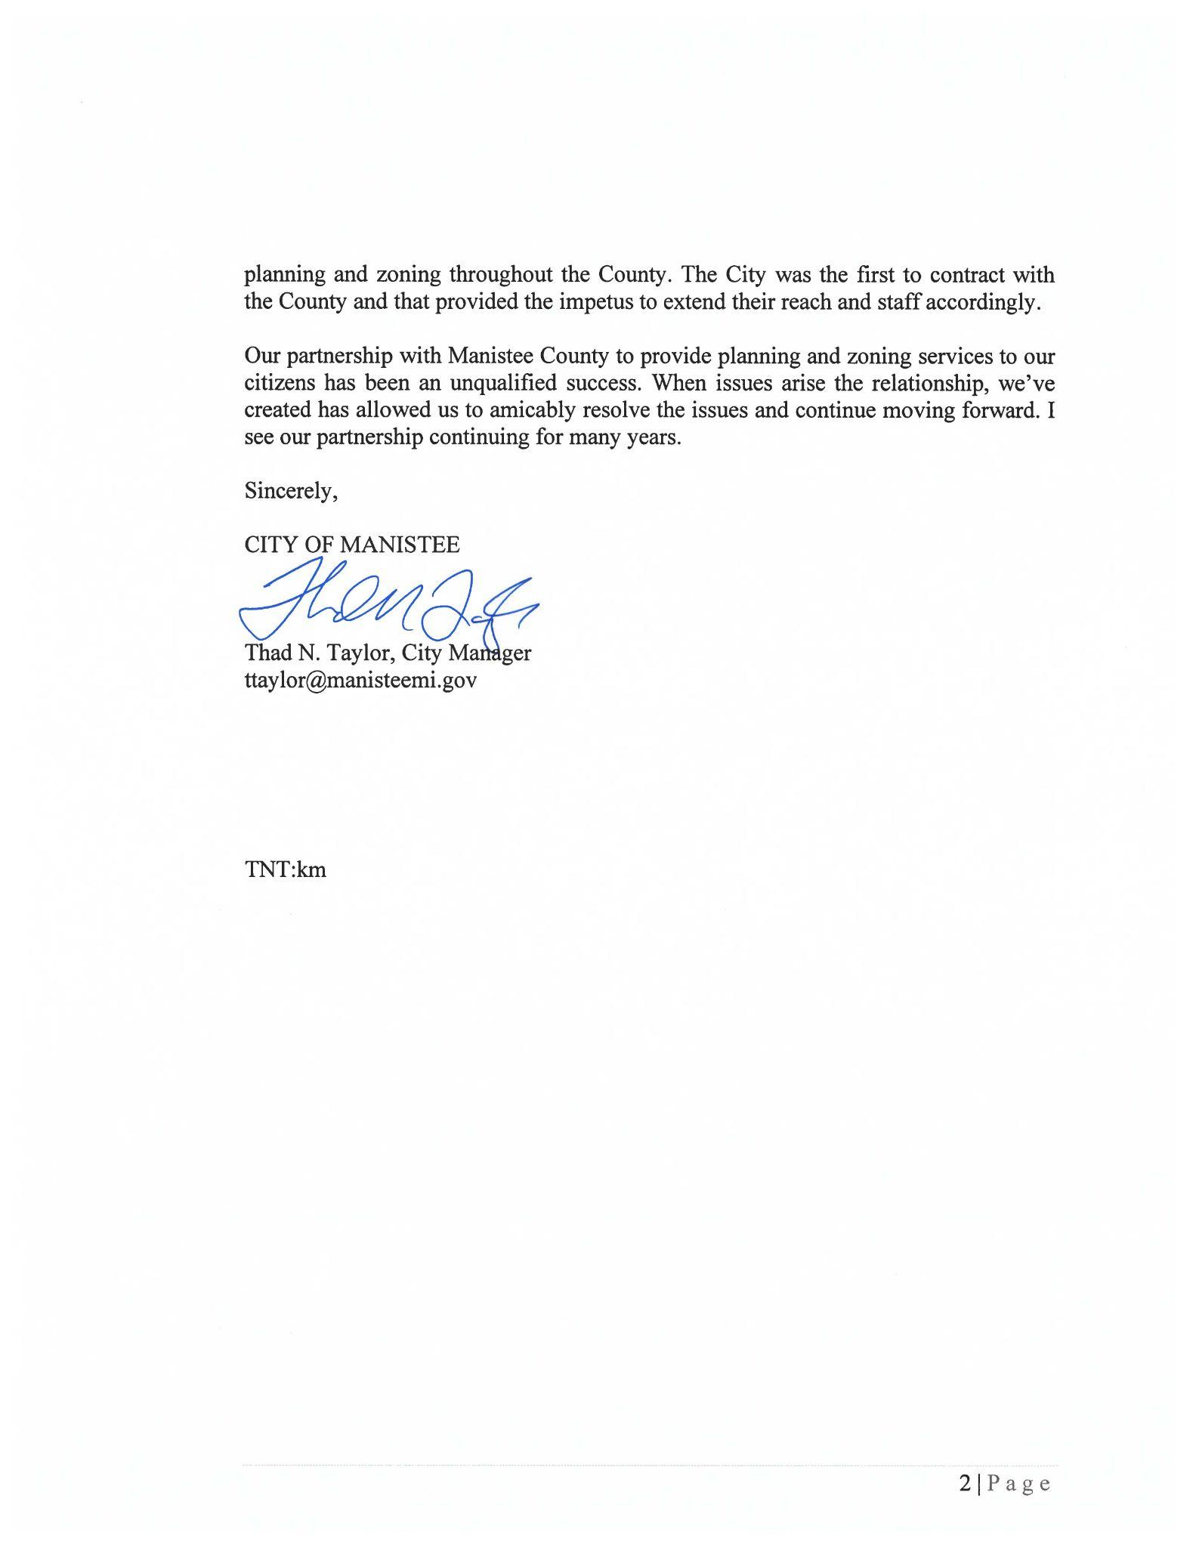
Testimonials (City of Manistee)

Slide 51
—Jeffrey Eugenides, Middlesex
“Planning is for the world's great cities, for Paris, London, and Rome, for cities dedicated, at some level, to culture. Detroit, on the other hand, was an American city and therefore dedicated to money, and so design had given way to expediency.”
“Detroit is largely composed, today, of seemingly endless square miles of low-density failure.”
― Jane Jacobs, The Death and Life of Great American Cities
Notes:
The quotes provided are obviously about Detroit from a well known American novelist Jeffrey Eugenides and from who many consider the Mother of modern urban planning Jane Jacobs.
These two quotes directly reflect on the importance of Planning and as an after effect to that Zoning, but also place making.
When a community looks at their Zoning it should not be looked at as a deterrent to development, but as way to ensure community and place making are left intact, to ensure it is a place people want to visit, live, and work, and not just a place they go to get things.
If we want our County to develop and thrive, we need individuals, like yourselves to take part in the discussion during Masterplan development, sit on Planning Commission and ZBAs, and ensure that for the sake of development we do not lose our identity.
With development we also have an opportunity to build on what makes us great and attract the next great generation to our area, we cannot afford to have a muddied up process and have missed opportunities.
With that said, Thank you for your time and your service to our great County and your communities that make it up.

Slide 52
Questions
Any Questions?

Slide 53
THANK YOU
Follow up questions can be submitted via email or phone to:
Mike Szokola
mszokola@manisteecountymi.gov
231.723.6041
Planning Director
Manistee County Planning Department

Slide 54
Special Thank you...
Mary Reilly, AICP
Government and Public Policy Educator
Northwest Lower Michigan
Michigan State University Extension
385 Third St., Suite B
Manistee, MI 49660
Ph. 231-889-4277 Ext. 1
www.msue.msu.edu

Slide 55
Sources
Adelaja, S., Y.G. Hailu, M. Abdulla, C. McKeown, B. Calnin, M. Gibson, and K. McDonald. (2009). Chasing the Past or Investing in Our Future : Placemaking for Prosperity in the New Economy. Report# LPR-2009-NE-03, Land Policy Institute, Michigan State University, East Lansing, MI. Available at: www.landpolicy.msu.edu/ChasingthePastReport; accessed January 21, 2015.
Reilly, Mary, AICP, Presented: June 24, 2021, “Manistee PC 2021”, Michigan State Extension, PowerPoint can be found by contacting reillym8@msu.edu

