Slide 1

Updating the Manistee County-Wide Park & Recreation Plan
Presented by Rob Carson, AICP
Networks Northwest

Slide 2
Why We Plan for Parks & Rec
Funding opportunities
Opportunity to hear from members of the public
Check-in to see where we are
Consensus building on where we want to go

Slide 3
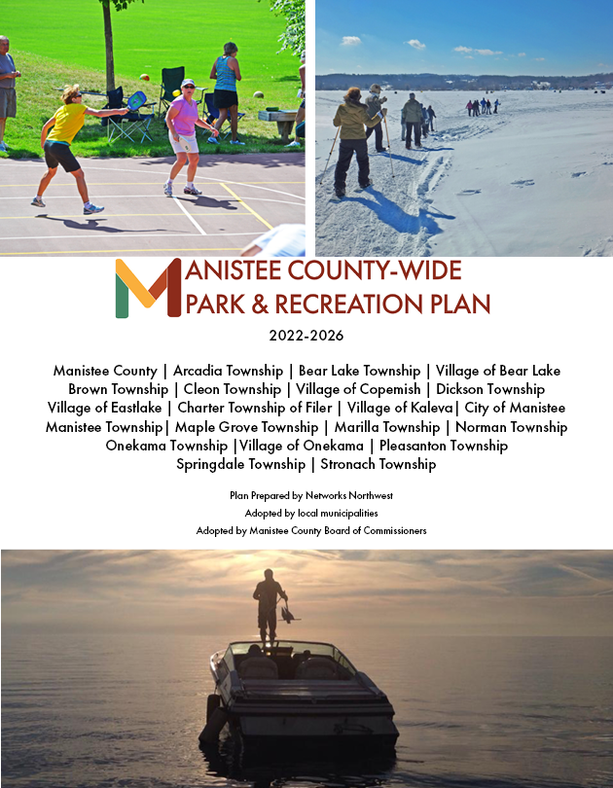
A look inside the draft 2022-2026 plan

Slide 4
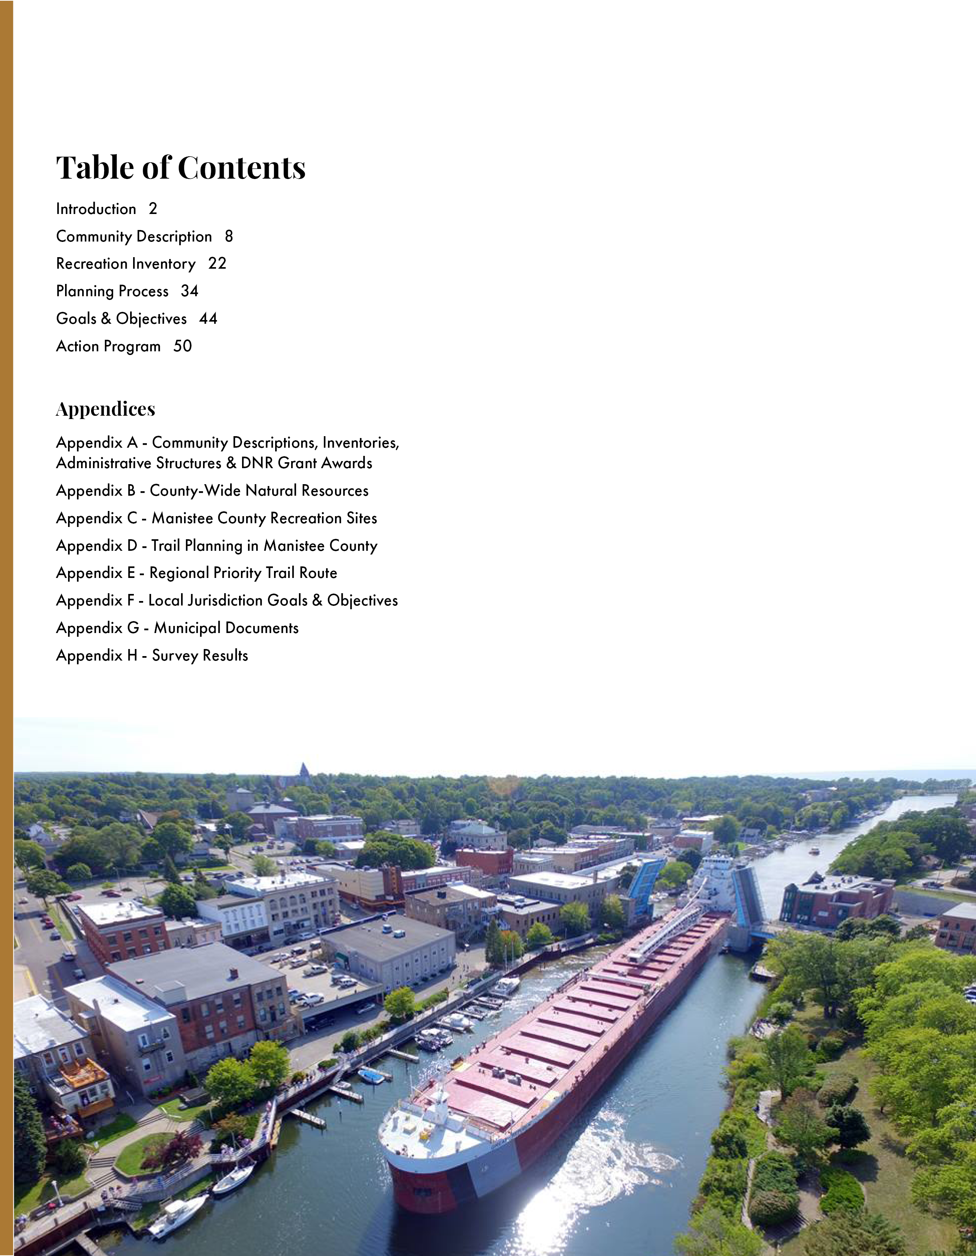

Slide 5
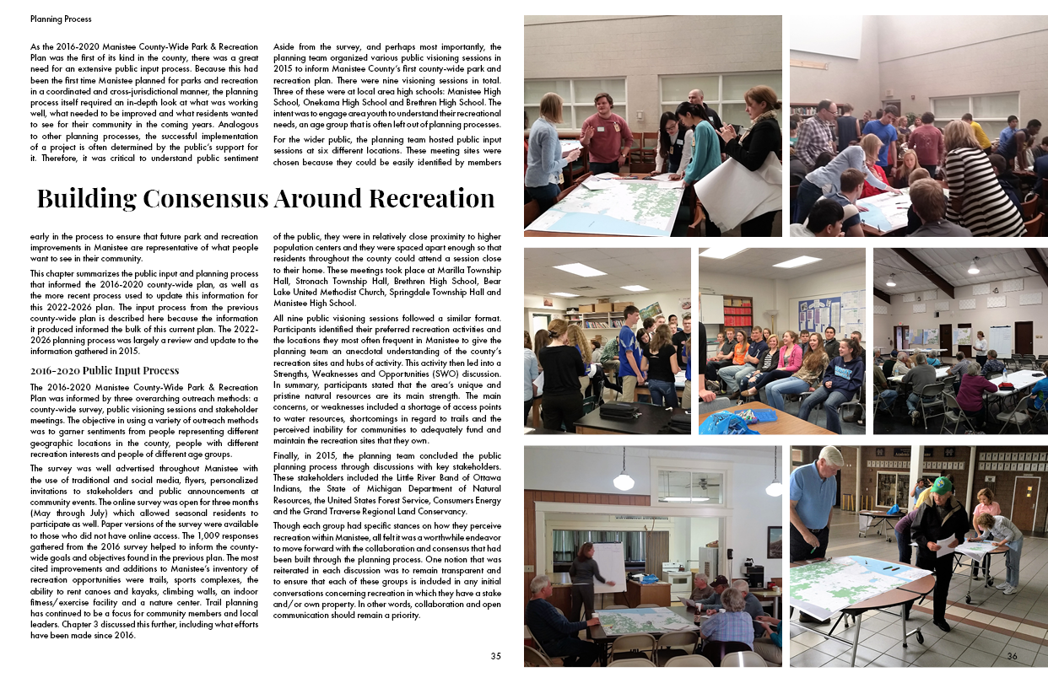
Planning in 2015

Slide 6
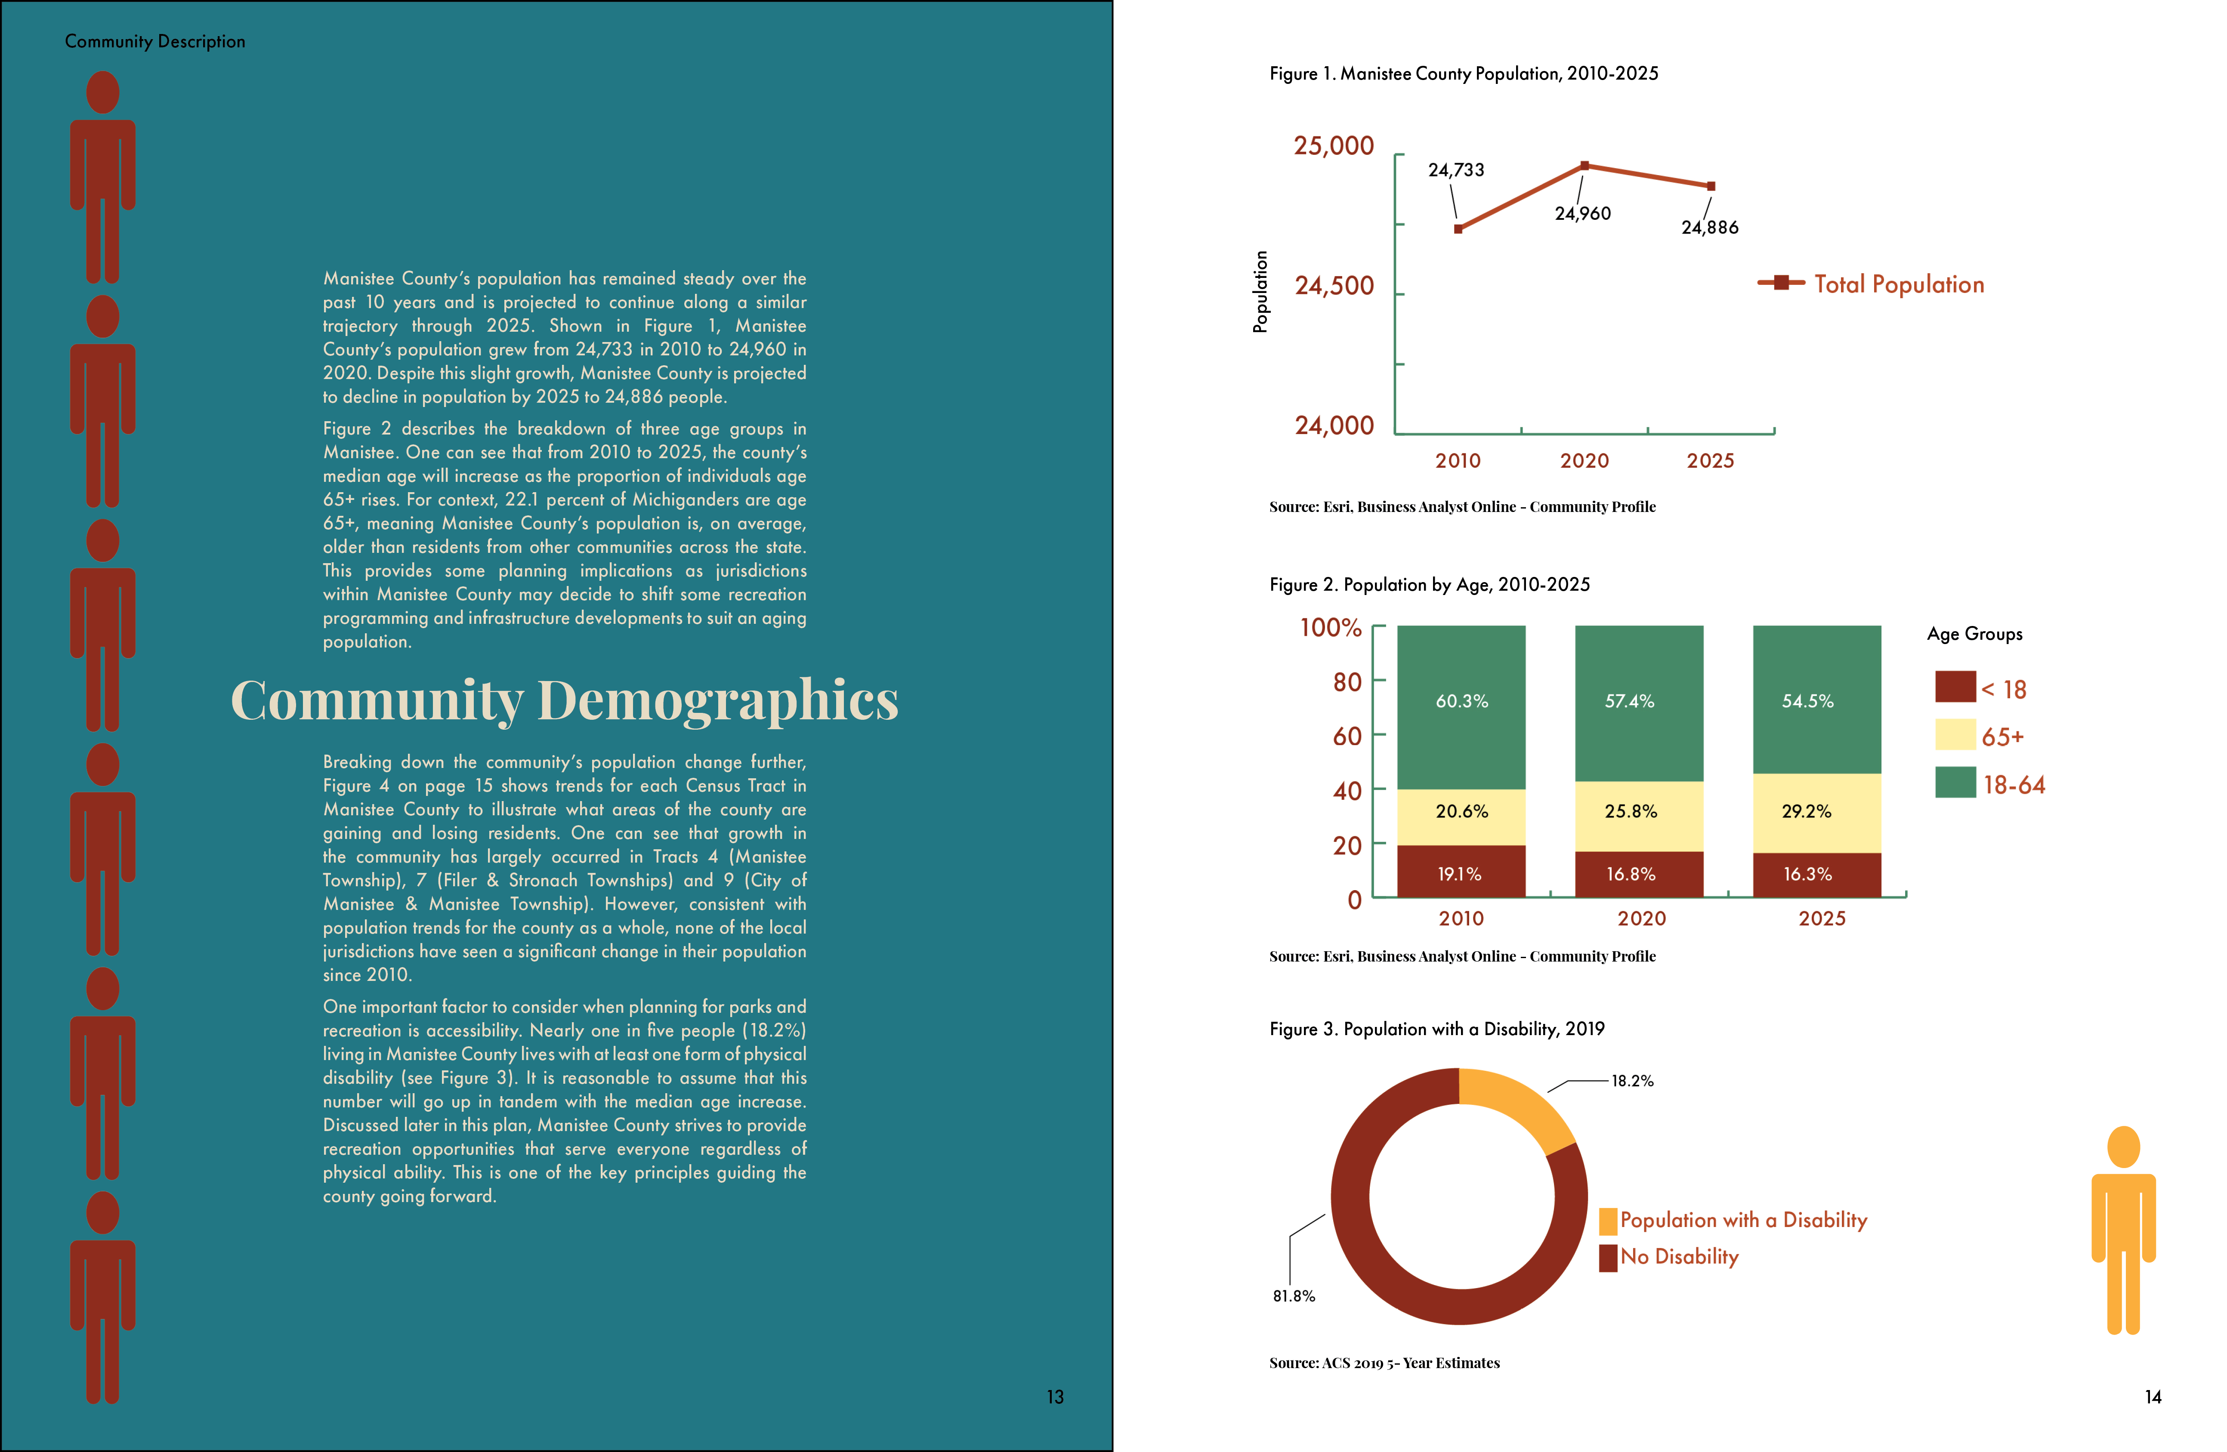

Slide 7
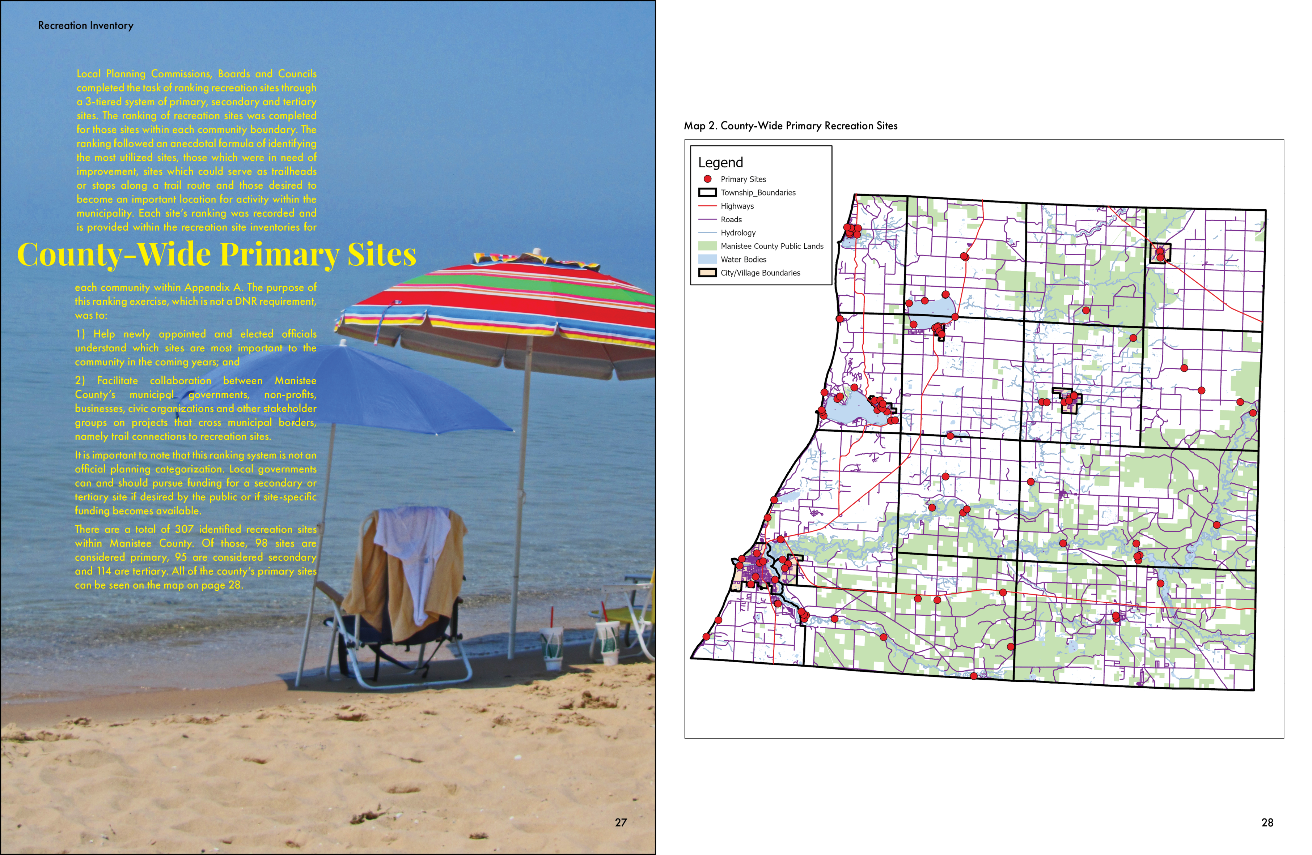

Slide 8
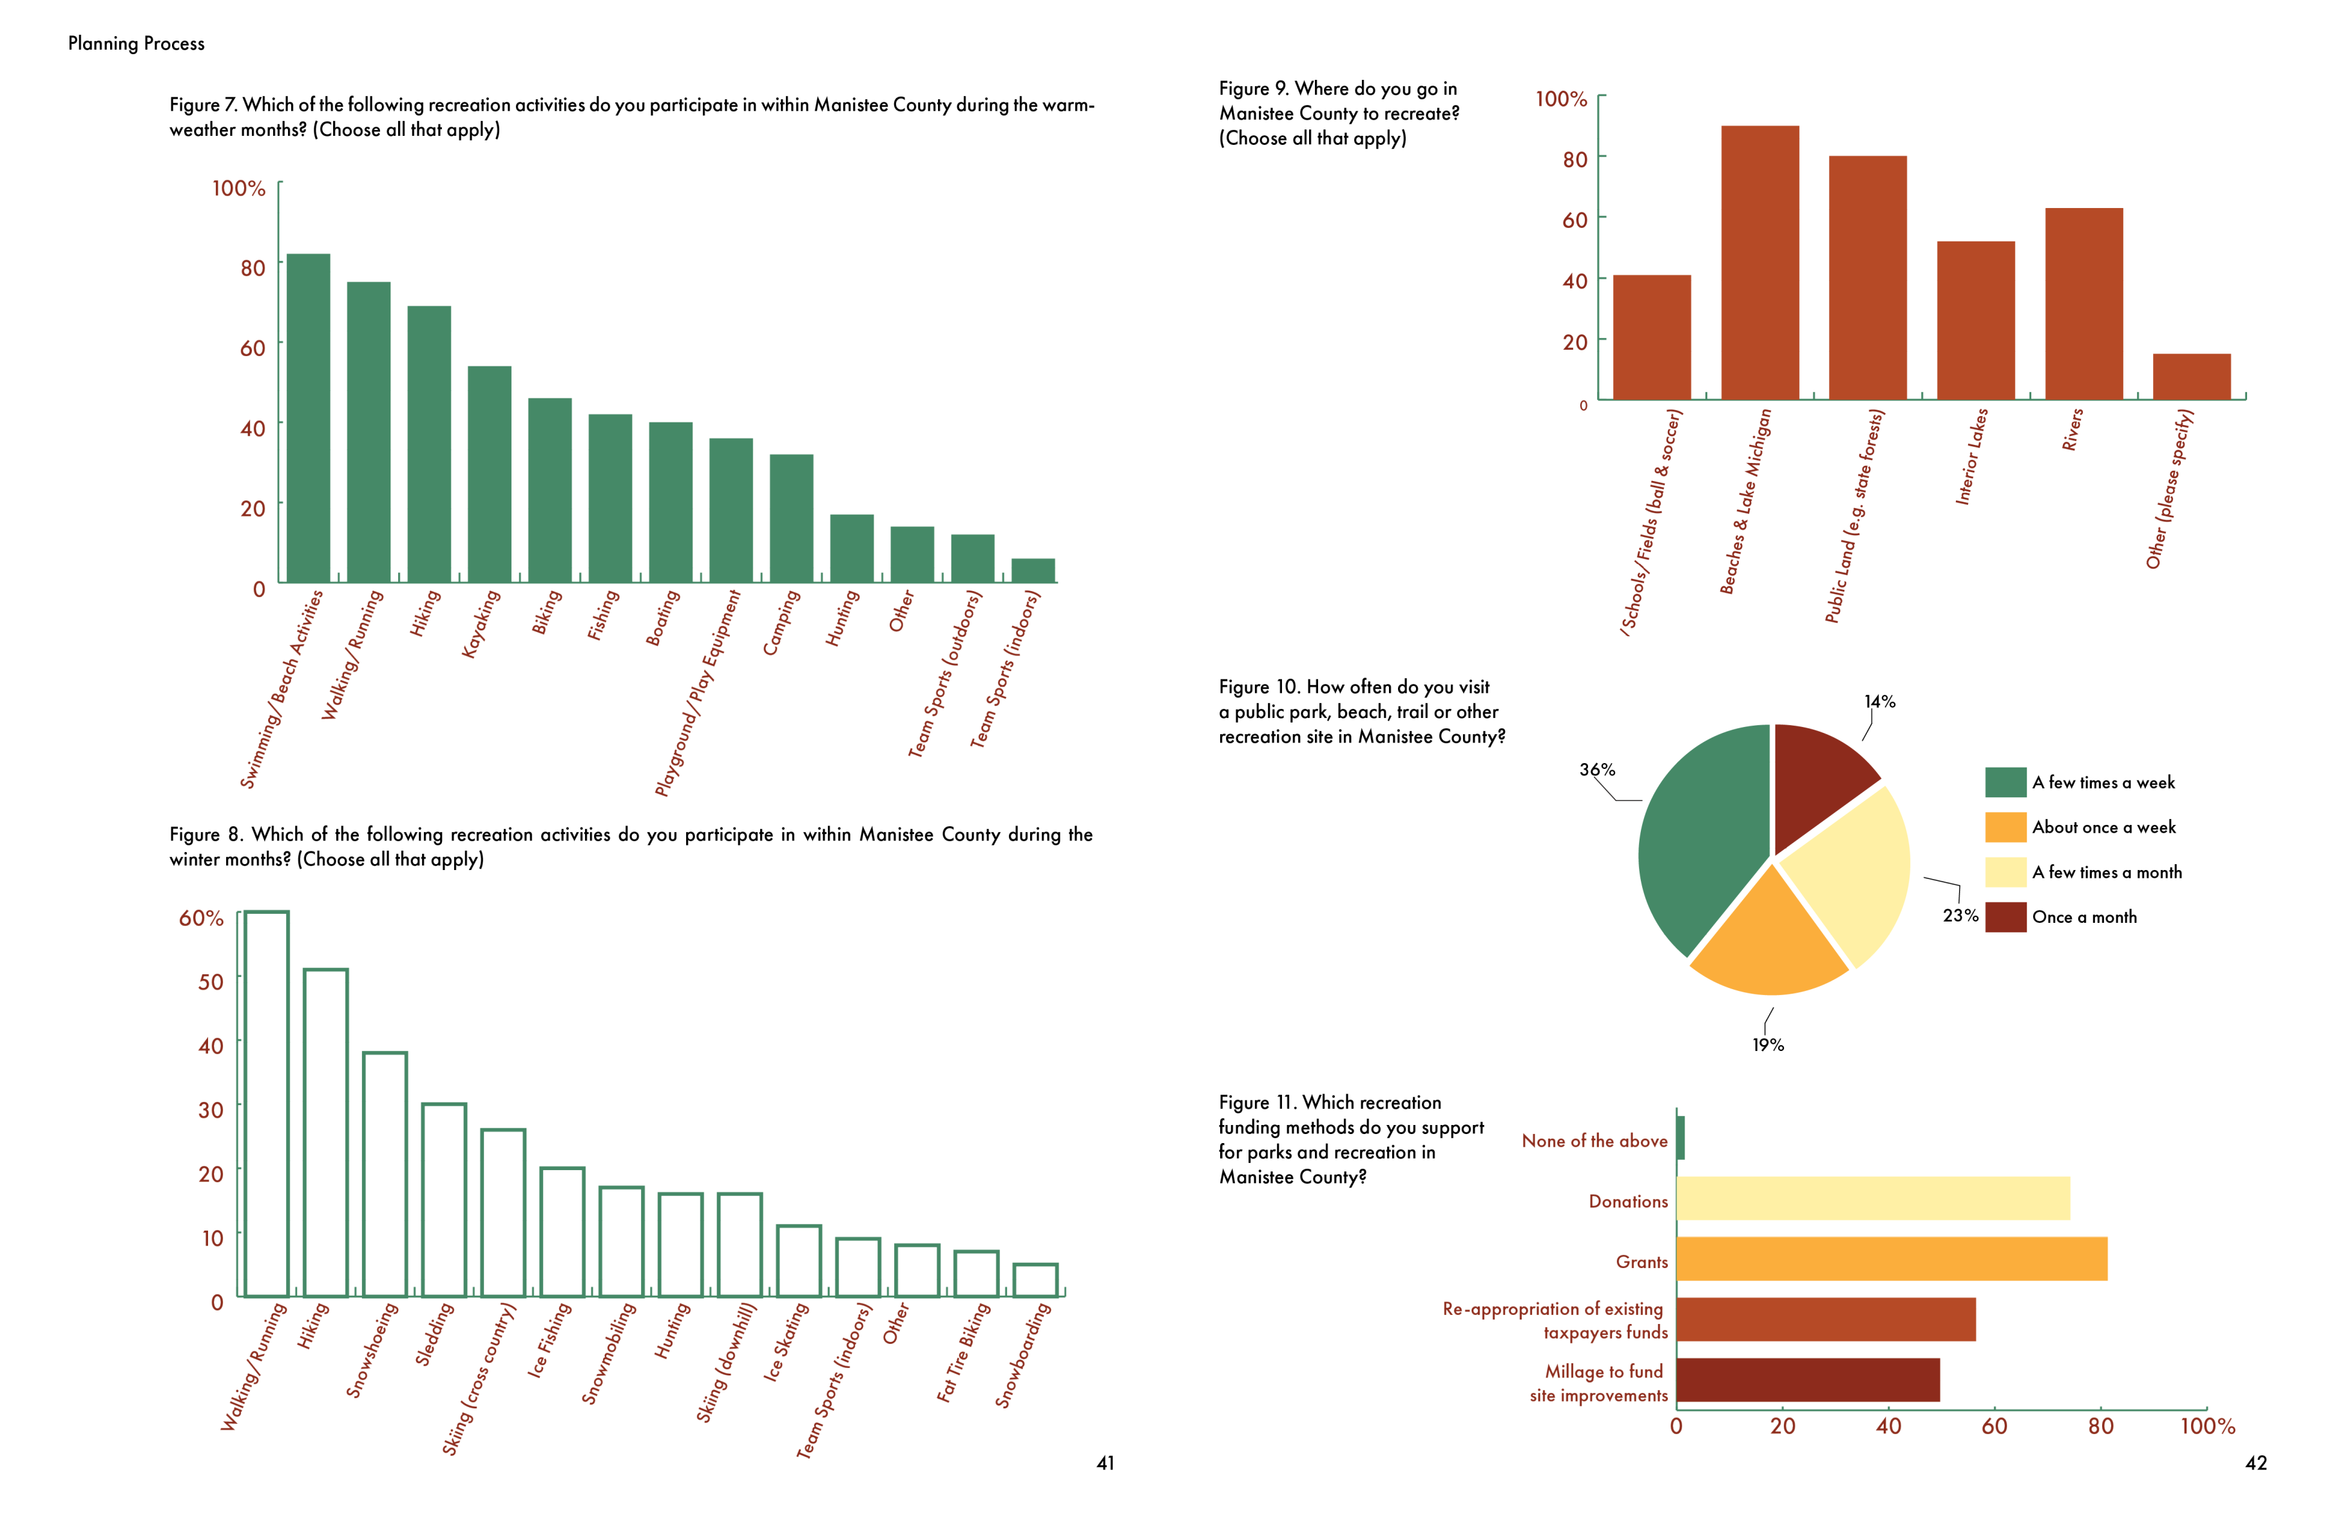

Slide 9
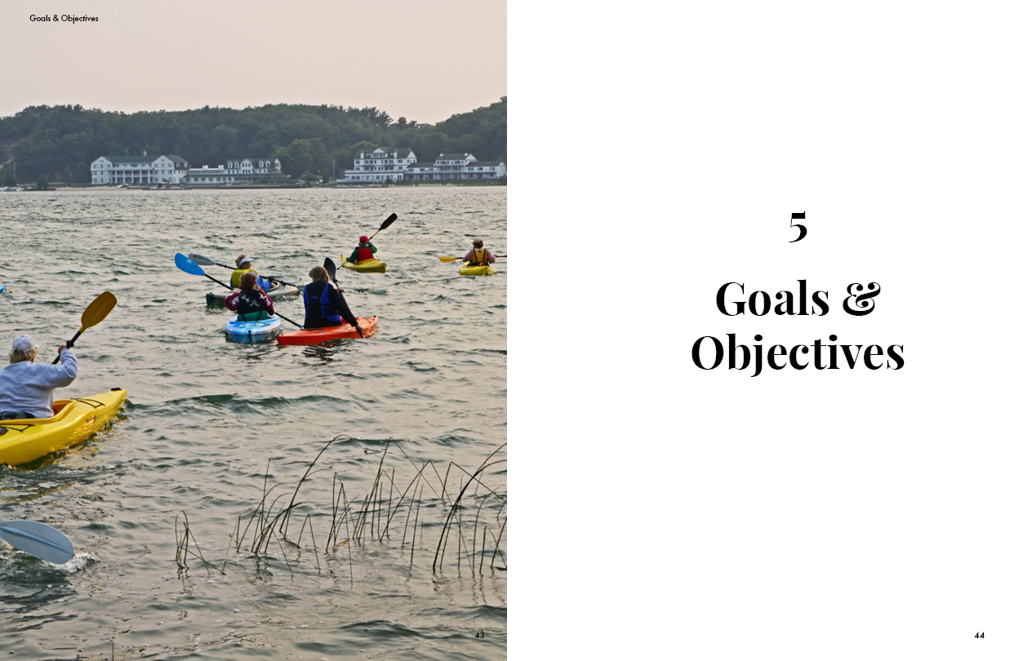

Slide 10
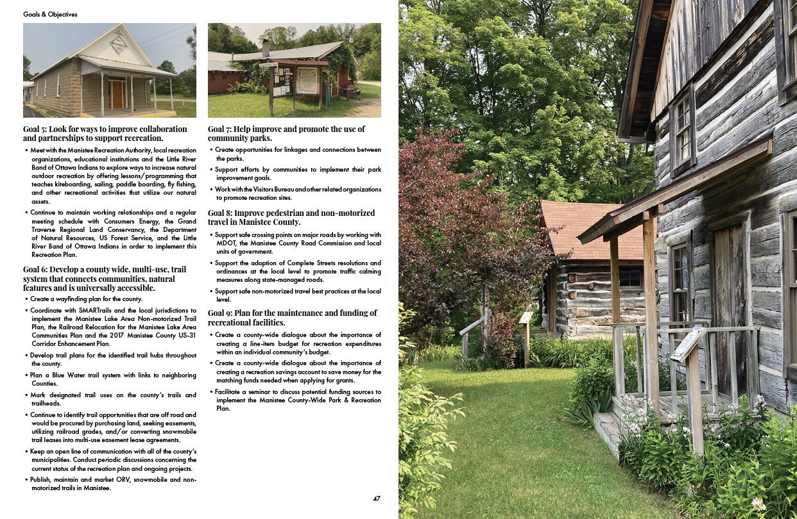

Slide 11
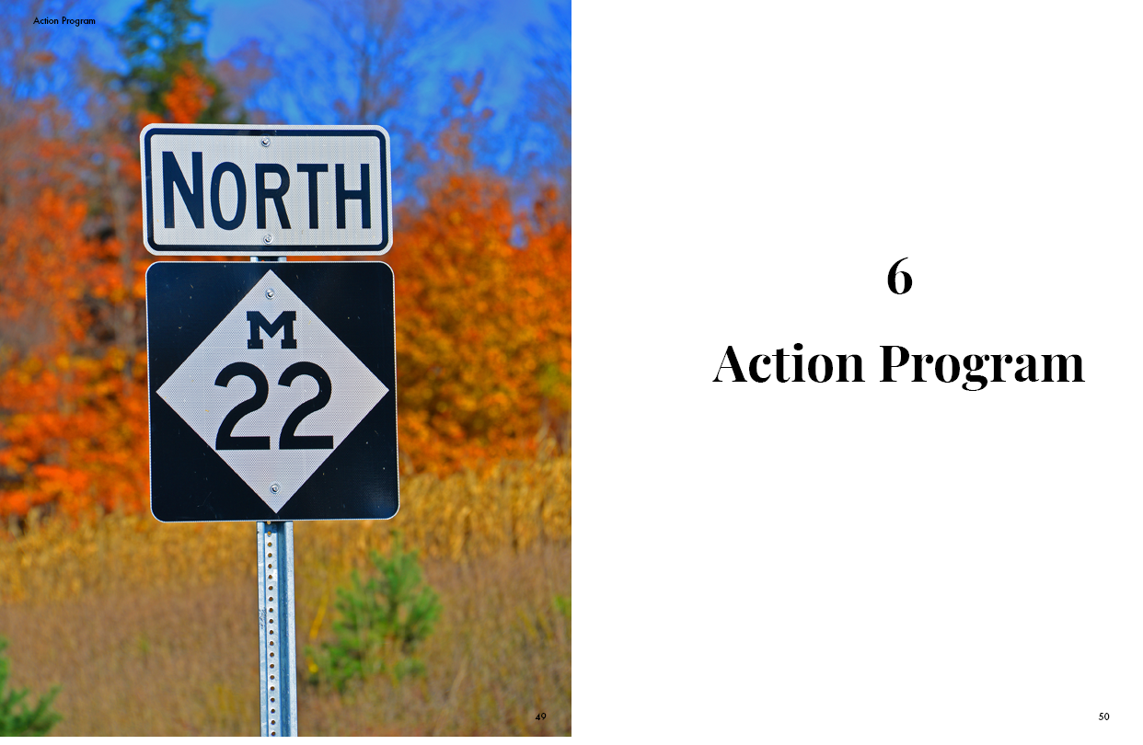

Slide 12
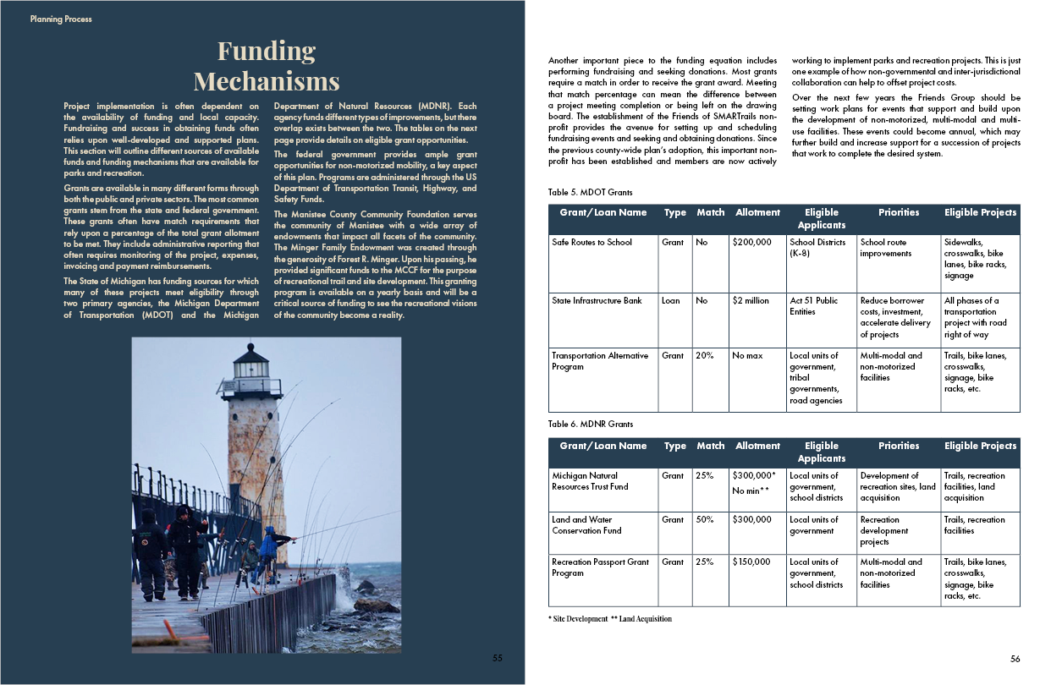

Slide 13
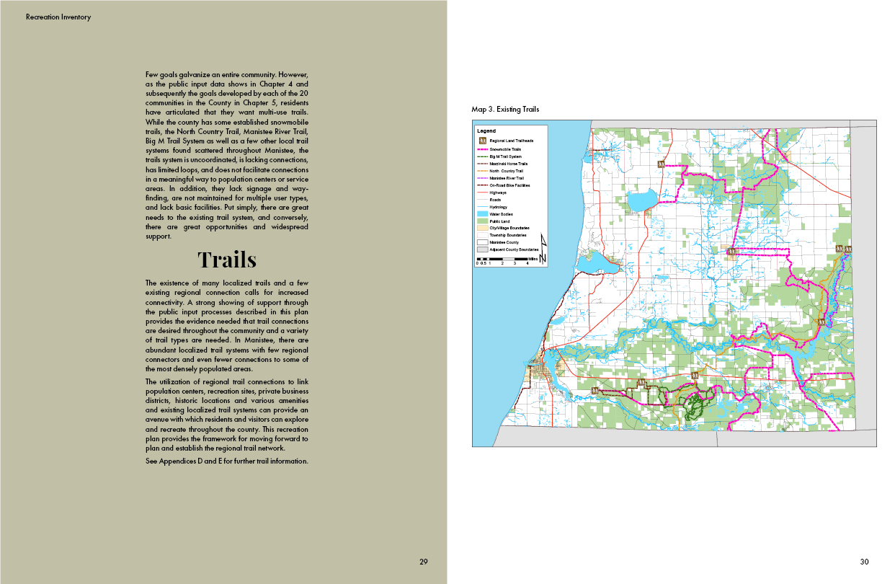

Slide 14
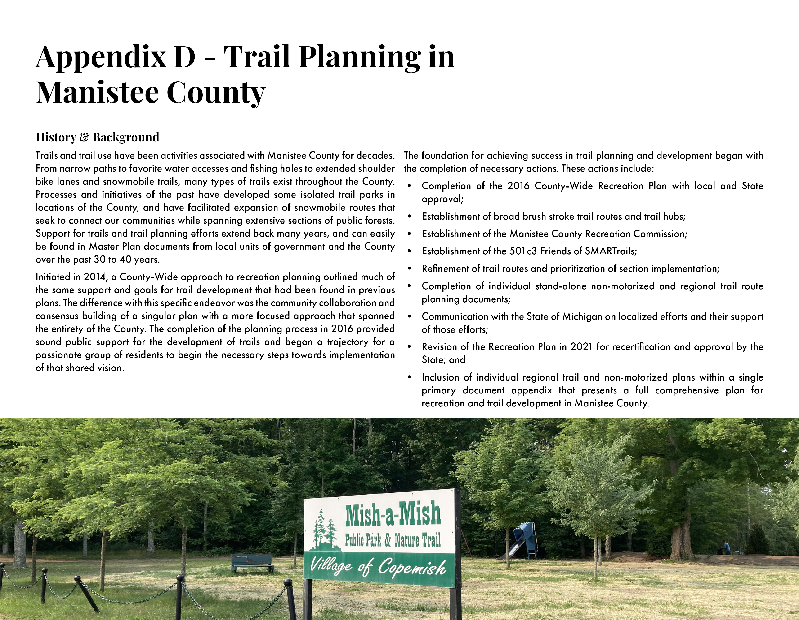

Slide 15
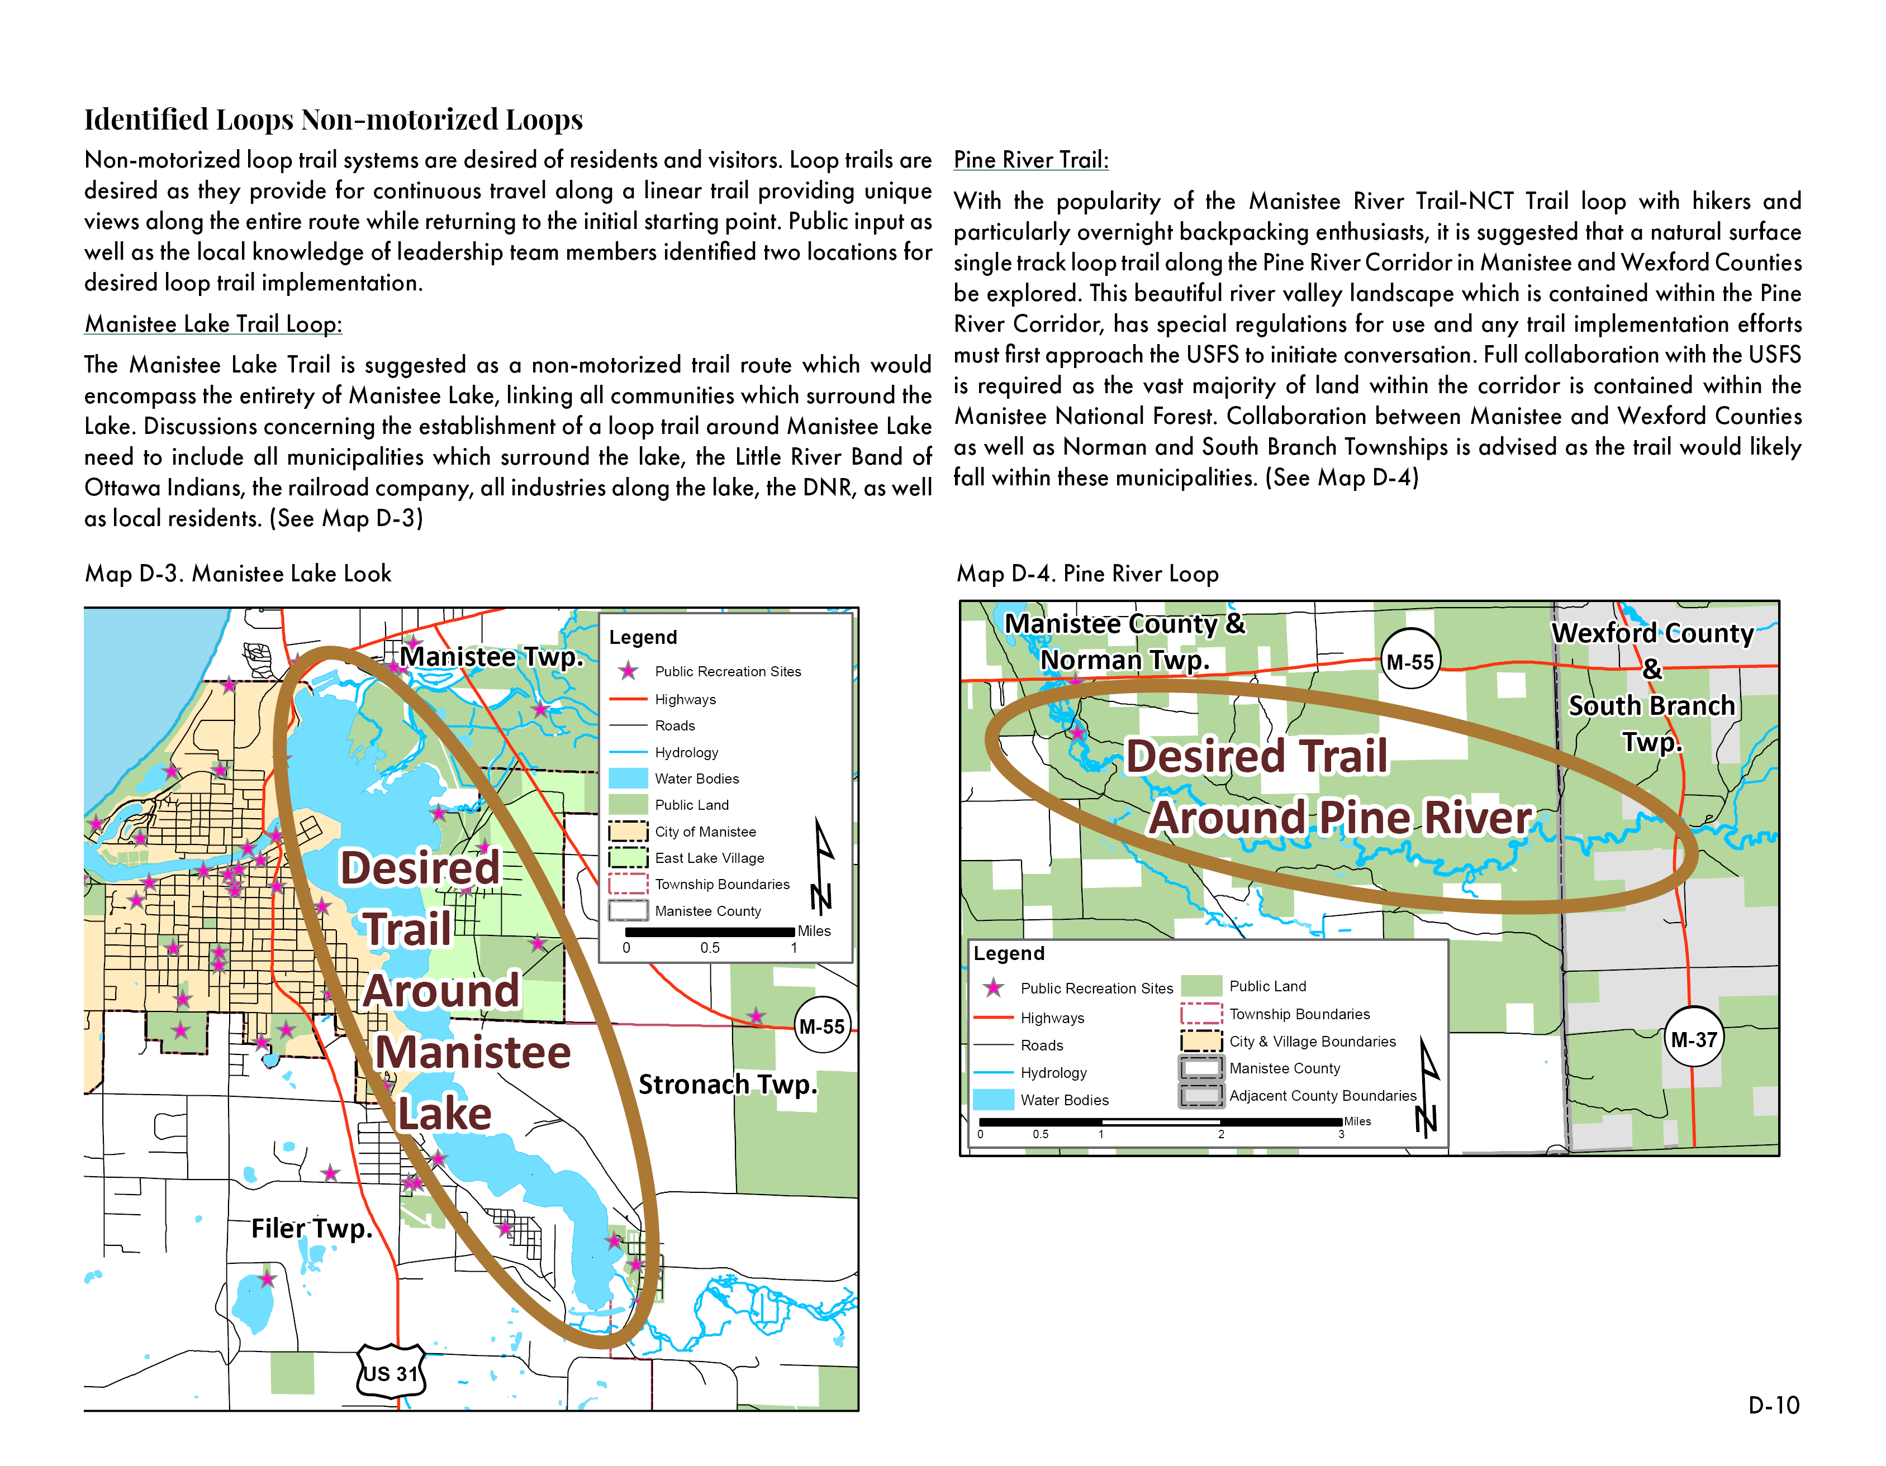

Slide 16
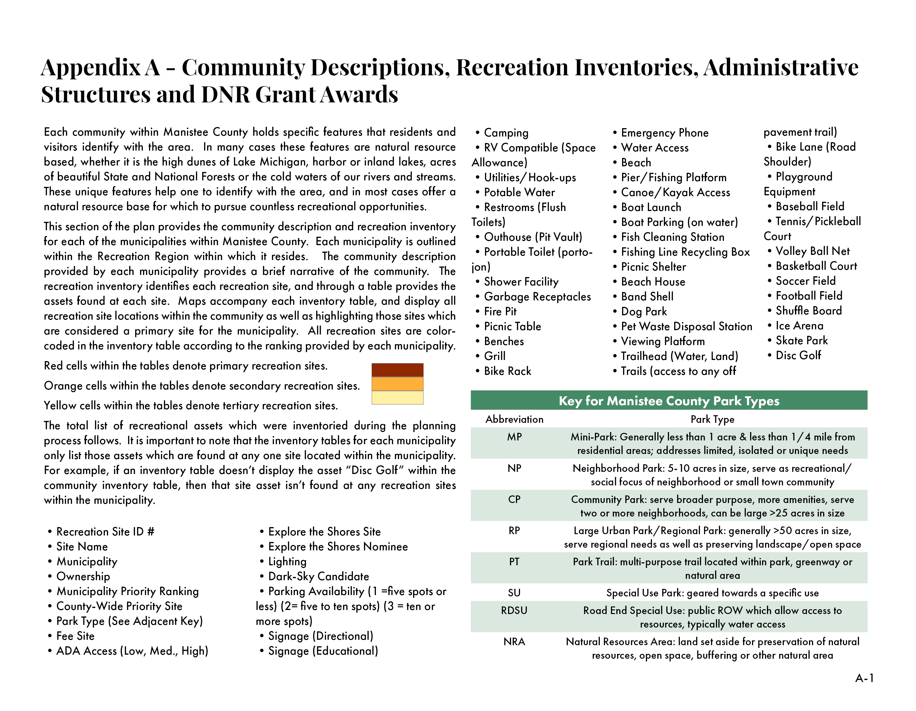

Slide 17
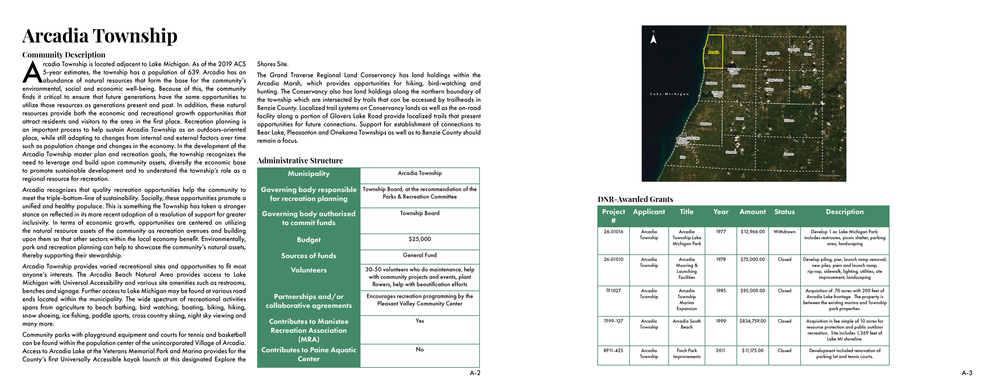
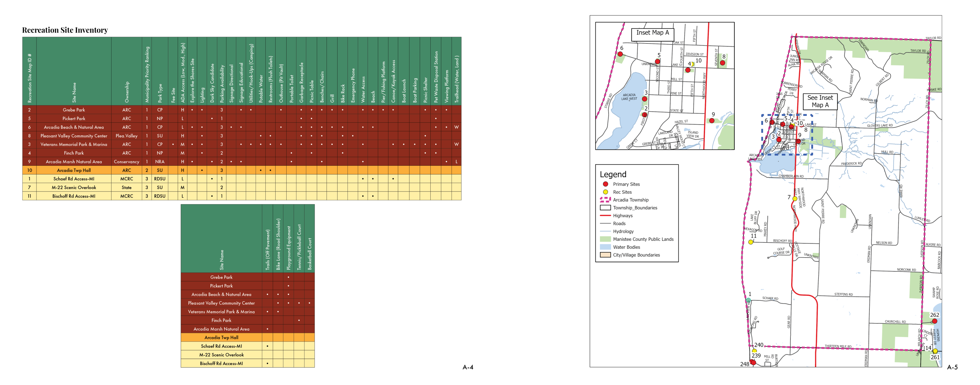

Slide 18
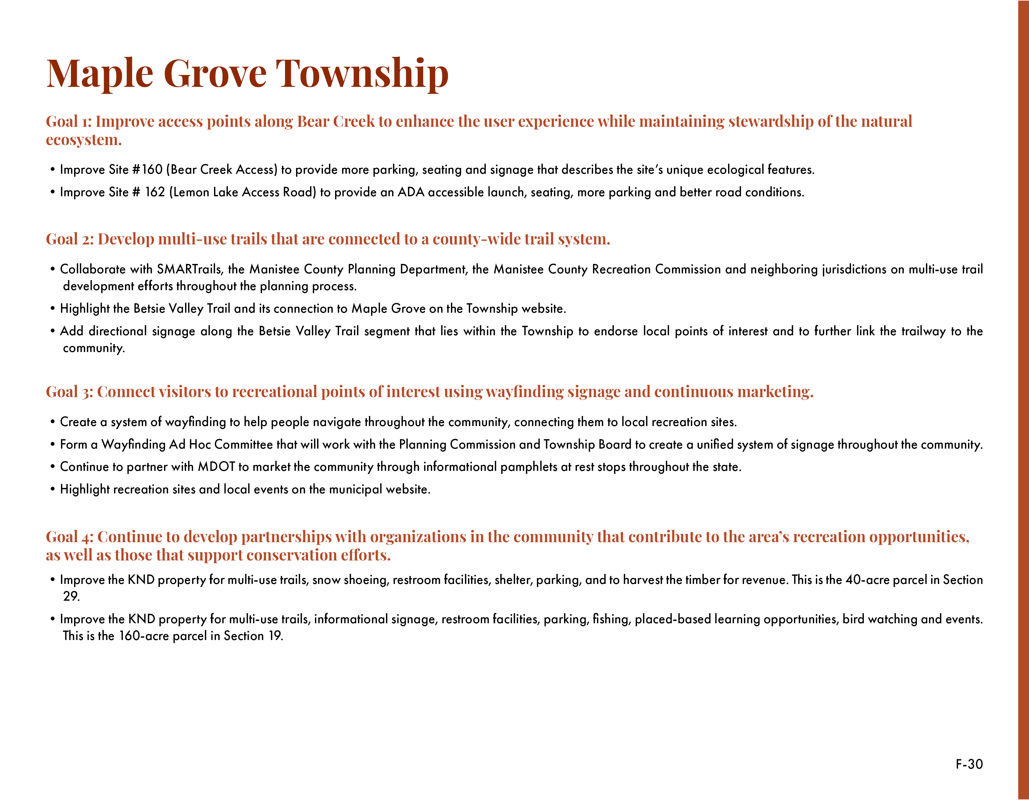

Slide 19
Next steps
Public review periods begin October 1st
Public hearings must be on agendas for November or December
Meeting minutes from public hearings submitted to Networks Northwest
Login to https://migrants.intelligrants.com/ which is the DNR’s submittal website. Follow the submittal instructions on page 16 of the DNR’s Guidelines for the Development of Community Parks and Recreation Plans. If you need help please contact Zach Vega at Networks Northwest.

Slide 20
Contact information
Robert Carson, AICP
(231) 929-5057
Zach Vega, AICP
(231) 342-0903
zach.vega@networksnorthwest.org
Please visit nwm.org/manisteerec to see the full draft plan and to see updates regarding the planning process.

Slide 21
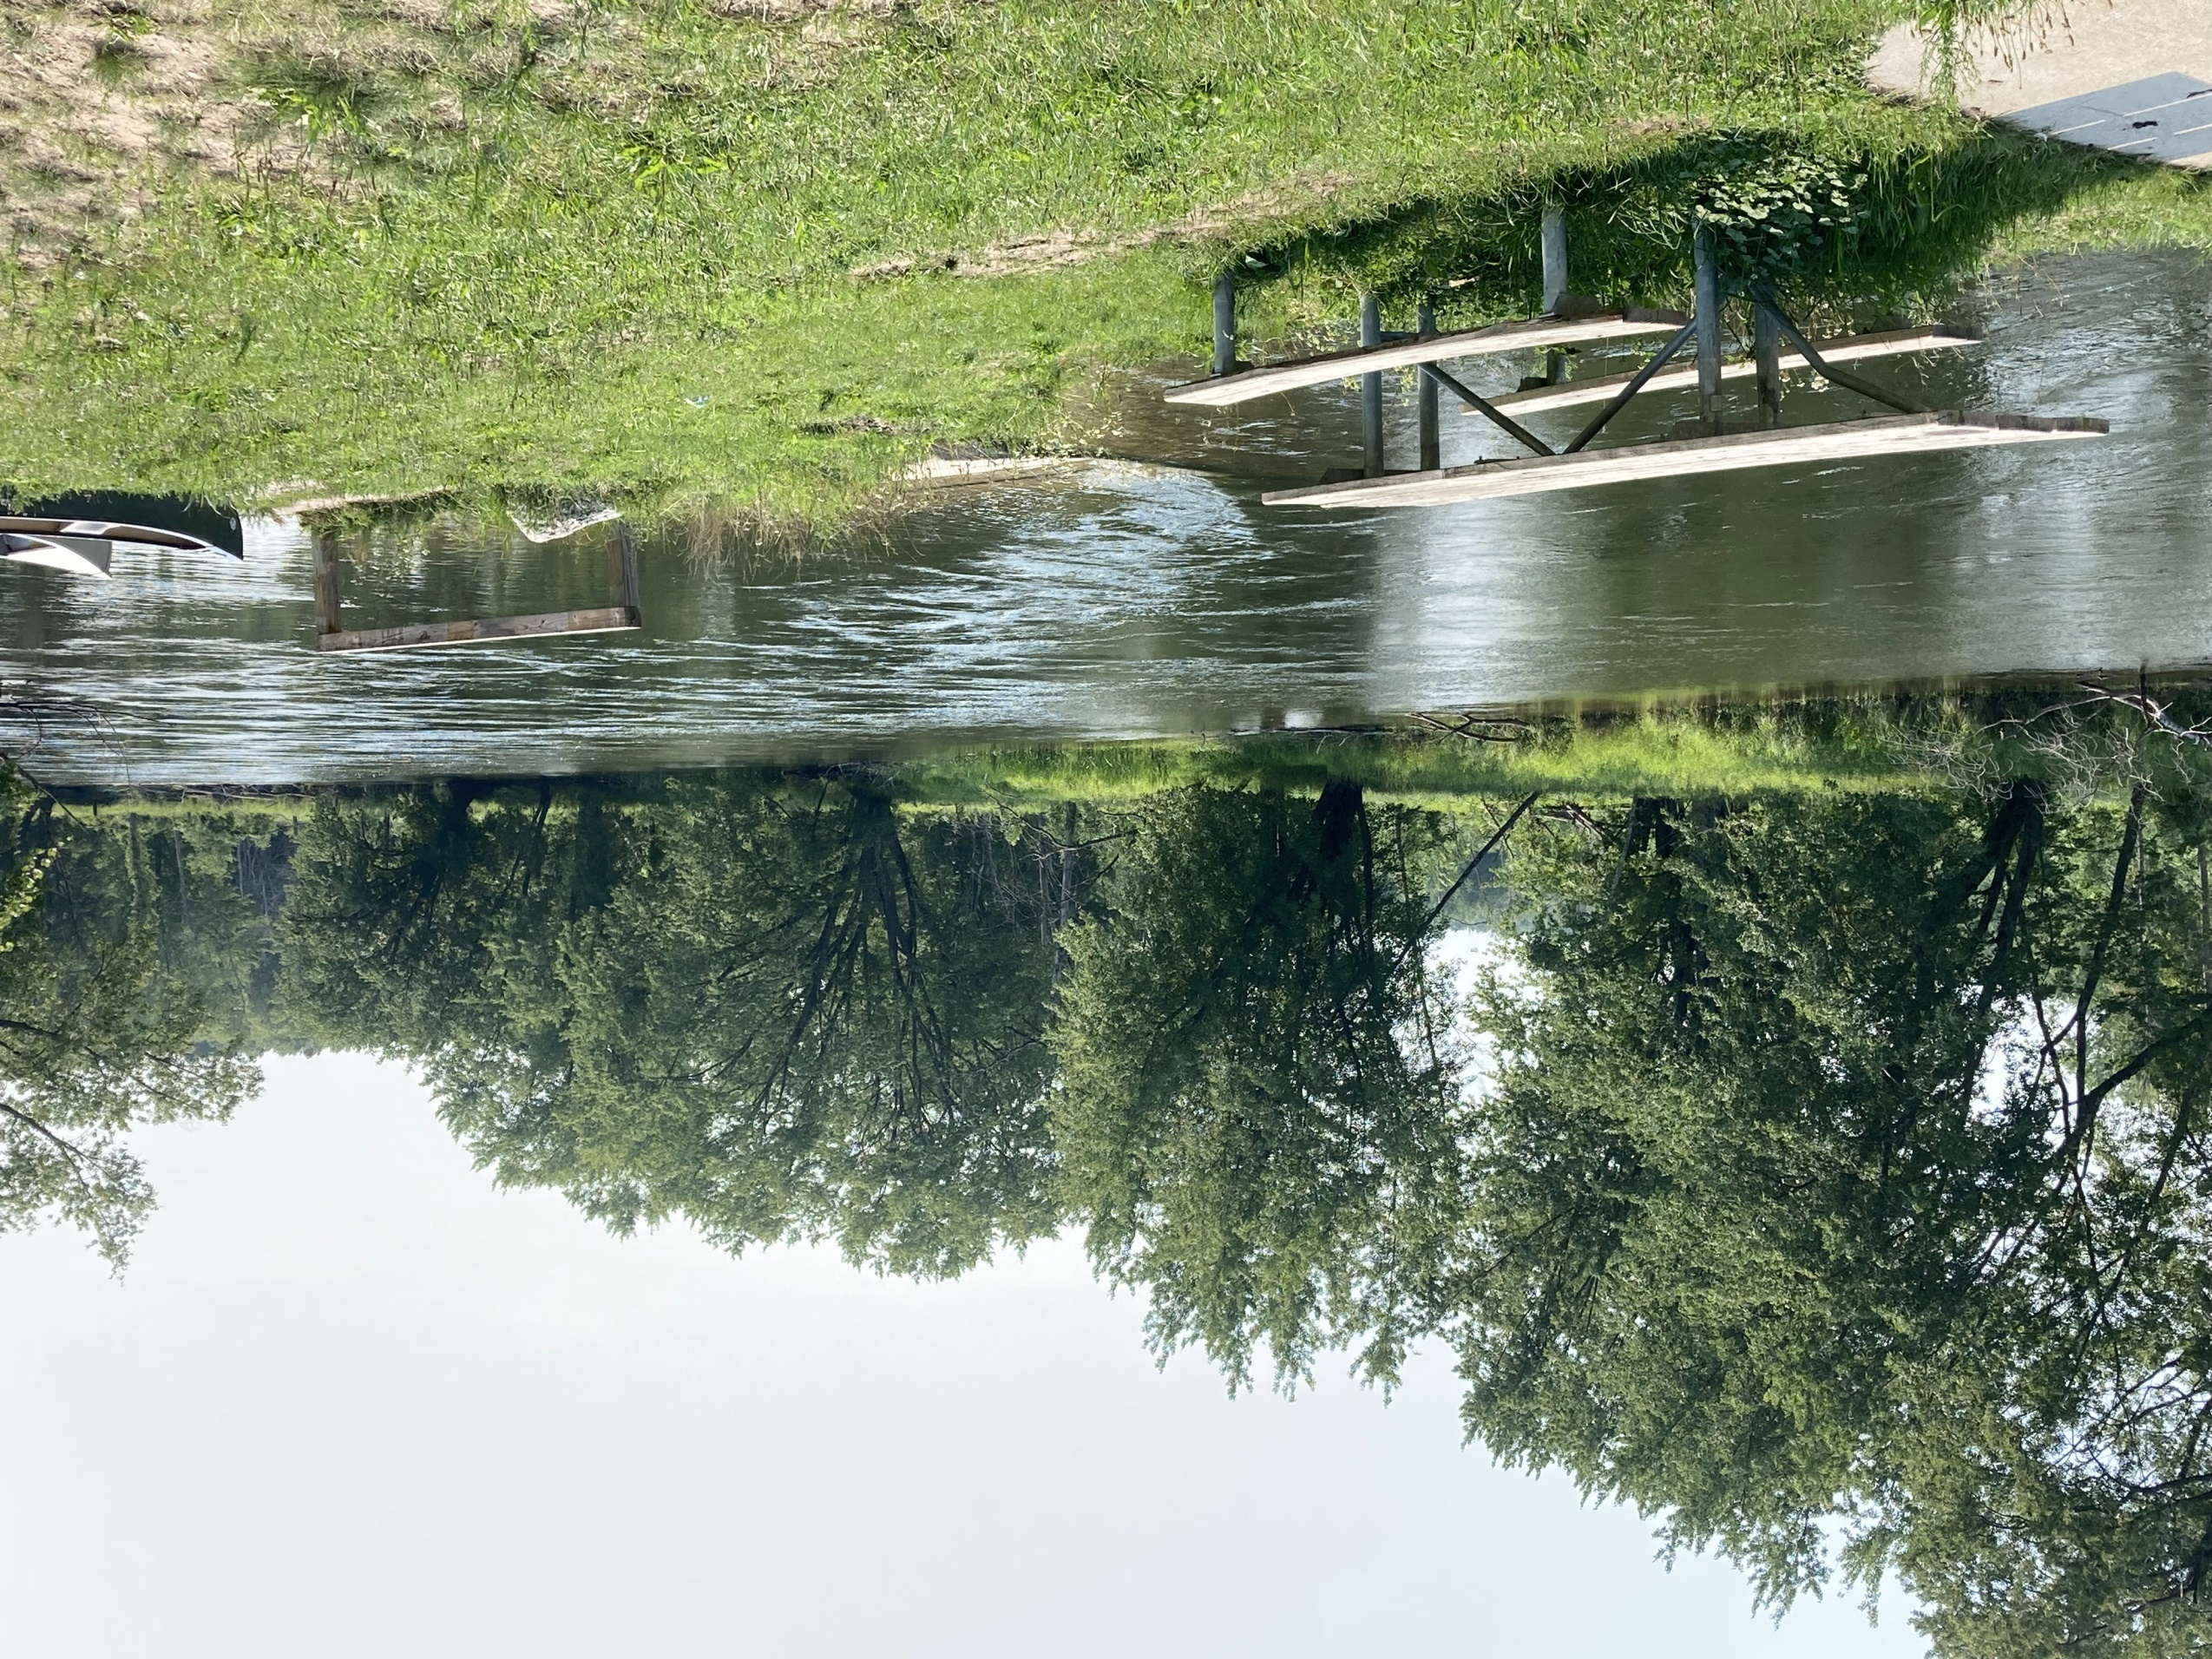
Questions?

