Slide 1
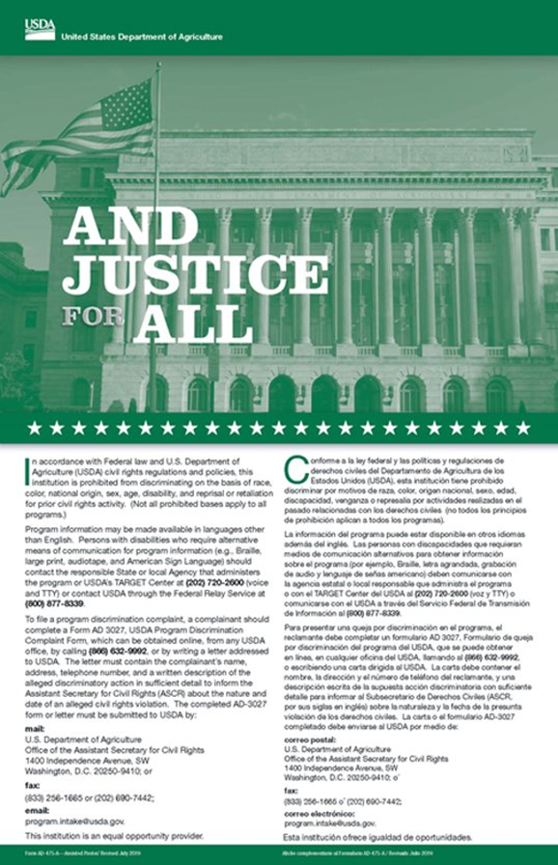
MSU is an affirmative-action, equal- opportunity employer. Michigan State University Extension programs and materials are open to all without regard to race, color, national origin, gender, gender identity, religion, age, height, weight, disability, political beliefs, sexual orientation, marital status, family status or veteran status.
Issued in furtherance of MSU Extension work, acts of May 8 and June 30, 1914, in cooperation with the U.S. Department of Agriculture. Quentin Tyler, Director, MSU Extension, East Lansing, MI 48824. This information is for educational purposes only. Reference to commercial products or trade names does not imply endorsement by MSU Extension or bias against those not mentioned.
This material becomes public property upon publication and may be printed verbatim with credit to MSU Extension. Reprinting cannot be used to endorse or advertise a commercial product or company.

Slide 2

Open Meetings Act: 201
September 2021
Manistee County Summit
Notes:
MARY

Slide 3
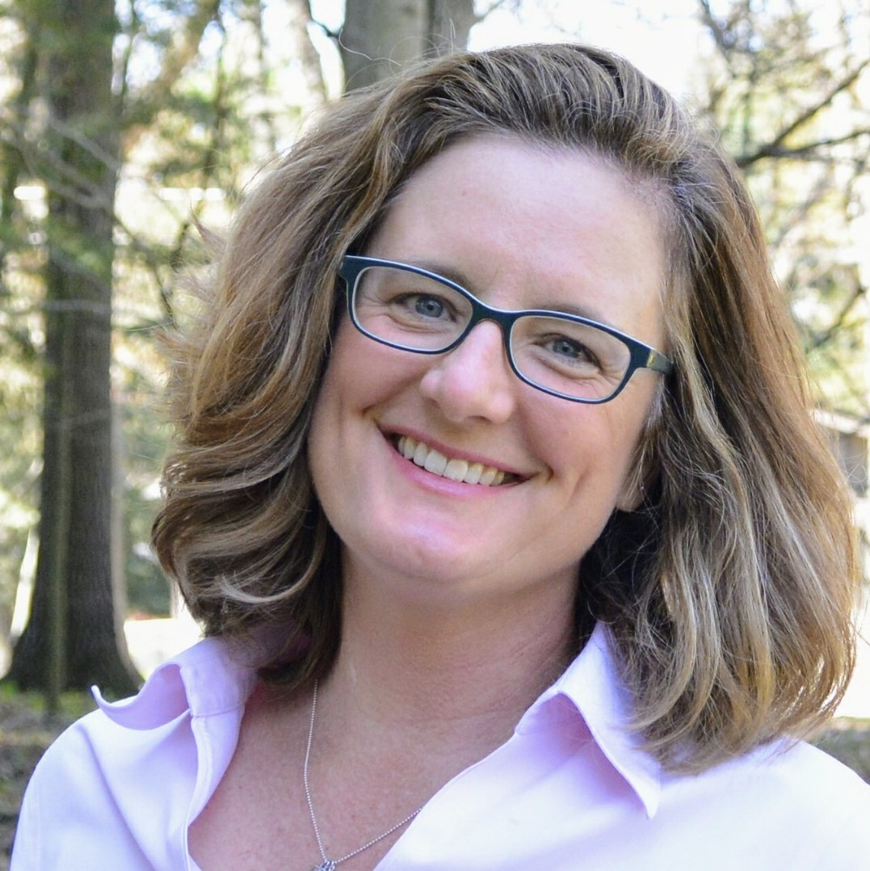
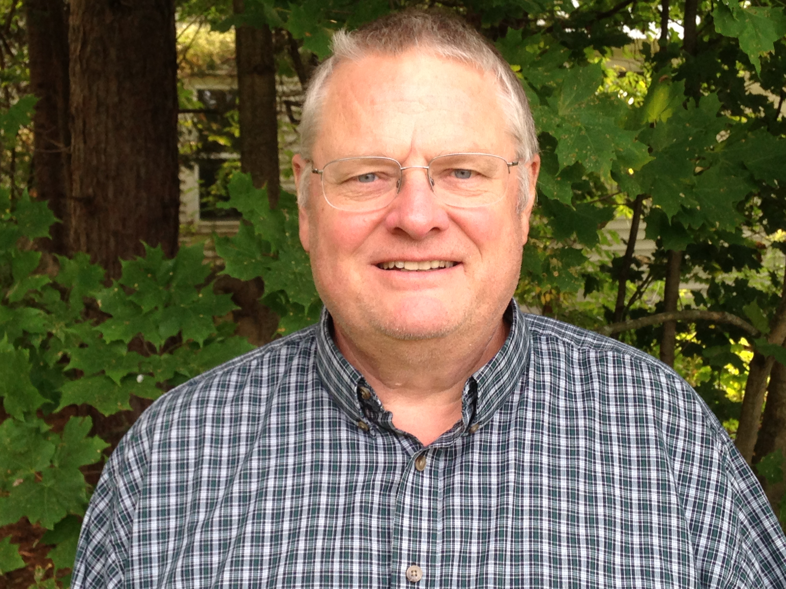
Today’s Presenters
Mary Reilly, AICP
Government and Community Vitality
MSU Extension
Manistee, MI
(231) 889-4277 ext. 1
reillym8@msu.edu
John Amrhein
Government and Community Vitality
MSU Extension
Traverse City, MI
(231)-922-4627
amrhein@msu.edu
Notes:
Introduce ourselves

Slide 4
What We Will Cover
A. OMA Basics
B. Before the Meeting
C. During the Meeting
D. After the Meeting
E. Consequences

Slide 5
A. Open Meetings Act (OMA) Basics P.A. 267 of 1976, MCL 15.261-15.275
Notes:
Two different types of citations, explain need for year when using PA, MCL means Michigan Codified Laws,
and easy search for OMA text and AG handbook which has been updated by every AG for many years.
This is not an exhaustive program on the basics of OMA—this is a refresher—so we can get to the good stuff.
Think of this as OMA 201 rather than OMA 101
If you would like us to come out and do a thorough program covering OMA, we would be happy to do that.

Slide 6
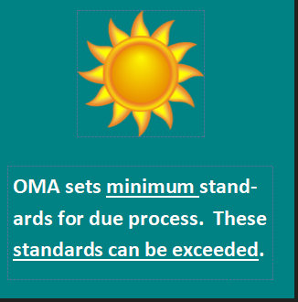
Open Meetings Act
OMA sets minimum standards
OMA standards can be exceeded: culture of accountability, transparency, and integrity.
Judges rule on the side of being open and transparent
Notes:
If hold a committee meeting, and a quorum of the full board is present – because non-committee members are sitting in the audience.
Wise to just post the meeting as a full board meeting.

Slide 7
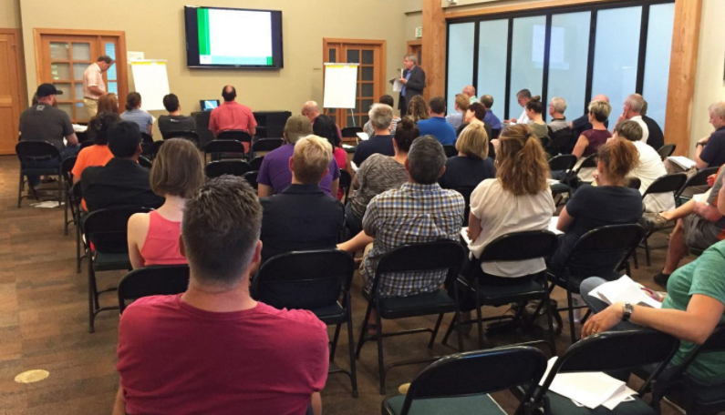
Open Meetings Act
GENERAL RULE: Any person has a right to attend a meeting of any public body at any time unless a statutory exception applies.
Issaquah Highlands
Notes:
statutory exceptions, e.g closed meeting.
Or an emergency meeting – due to immediate peril (read water main break, sewer break)
Remember, we are doing the peoples' business, and have a fiduciary role, for the benefit of the others

Slide 8
Public Body
Public body – “empowered by state constitution, statute, charter, ordinance, resolution, or rule to exercise … governmental or proprietary authority…”
--MCL 15.262(a)
Board
Council
Commission
Authority
Committee of . . .
Subcommittee of . . .
Notes:
Review definition - examples in blue box
Also board of a nonprofit corporation formed by a city under the home rule city act, 1909 PA 279, MCL 117.4o (“valid public purposes for cities”)
Key phrase here is exercising governmental authority
proprietary function is activity (1) conducted primarily for purpose of gaining a pecuniary profit and (2) cannot normally be supported by taxes or fees
Some exceptions related mostly to funding, consult your attorney

Slide 9
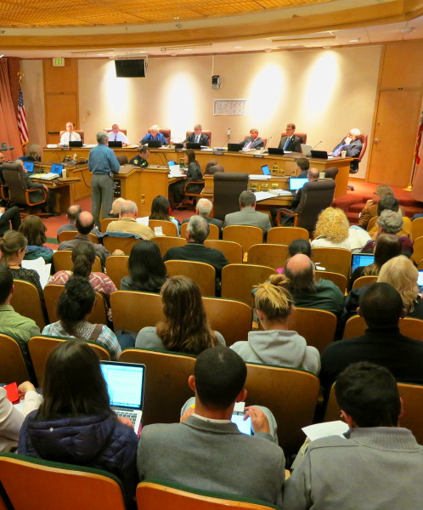
Meeting
Meeting – convening of public body with quorum present for the purpose of deliberating toward or rendering a decision on a public policy. . .
--MCL 15.262(b)
sf.streetsblog.org
Notes:
Deliberation OR decisions make it a meeting.
Conferences - maintaining a spirit of “openness” demands some care when conversing at conferences. Talk about what you learned, talk about the need to discuss this further back home, then save the “deliberation” for your regular meetings with your constituents.
Other exceptions:
Certain public bodies when deliberating merits of case, e.g., worker’s comp and unemployment boards (MCL 15.263(7))
Committee adopting nonpolicy resolution “of tribute or memorial” (MCL 15.263(9))

Slide 10
Decision
A narrowing down of the number of choices
Decision – “determination, action, vote or disposition…on which a vote by members of a public body is required and by which a public body effectuates or formulates public policy.” --MCL 15.262(d)
Upon a:
motion
proposal
recommendation
resolution
order
ordinance
bill
measure
Notes:
Key point is "public policy"

Slide 11
Quorum
Quorum – not defined in the OMA
May be defined in:
Another statute
Bylaws or rules of procedure
Changes due to COVID-19 have allowed virtual presence
Notes:
Found in other applicable statute or rules
Bylaws or rules of procedure not required (by OMA) but recommended

Slide 12
OMA Basics
Section 3:
“(1) All meetings of a public body shall be open to the public…”
“(2) All decisions of a public body shall be made at a meeting open to the public…”
“(3) All deliberations of a public body constituting a quorum of its members shall take place at a meeting open to the public…”
Notes:
Critical to understand the definitions of the words in RED
Will go through each in next four slides

Slide 13

Committee Meeting Scenario
What if:
Committee or subcommittee considers 4 options
dismisses 2
presents 2 to the board for action
Is this meeting subject to OMA?
Committee Decision
Notes:
IF excluding 2 options deprives full body of acting on those options
THEN committee meeting is subject to OMA
Can a group less than a quorum or an individual be a “public body”?
IF:
delegating authority for decision-making
to less than a quorum of a public body
or a single member of a public body
THEN:
those member(s) are a “public body” for purposes of OMA
Booth Newspapers v Univ of Mich Bd of Regents, 507 NW2d 422 (1993)
What is a “decision” of a public body?
IF
Committee/subcommittee empowered to act
Deprives full body of opportunity to vote on it
THEN
Committee is exercising governmental authority
Effectuates public policy
Thus, making a “decision”
OAG 7000

Slide 14

Where are we now?
OMA Amendments (Public Acts 228 and 254 of 2020)
Manistee County Emergency Order in place through December 31, 2021.
Electronic meetings "...may only be held if a member of the board resides in the affected area or the public body at-large holds its meetings in the affected area." (Quote from a presentation at a MAC Conference by Matt Nordfjord, Shareholder, Cohl, Stoker, & Toskey, P.C.)
Credit: Unsplash @cwmonty
Notes:
Manistee County

Slide 15
B. Before the Meeting
Notes:
MARY
NEXT PART OF PRESENTATION

Slide 16
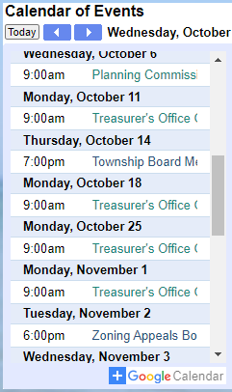
The Township has a new clerk!
She posted a 6:00 PM special (in-person) meeting notice for the Township Board on the bulletin board five days in advance.
The night before the meeting (at 9:00pm), you notice the special meeting and the agenda are not on the Township's website calendar.
What should you do??
Website Woes
Notes:
I am going to offer some options--

Slide 17
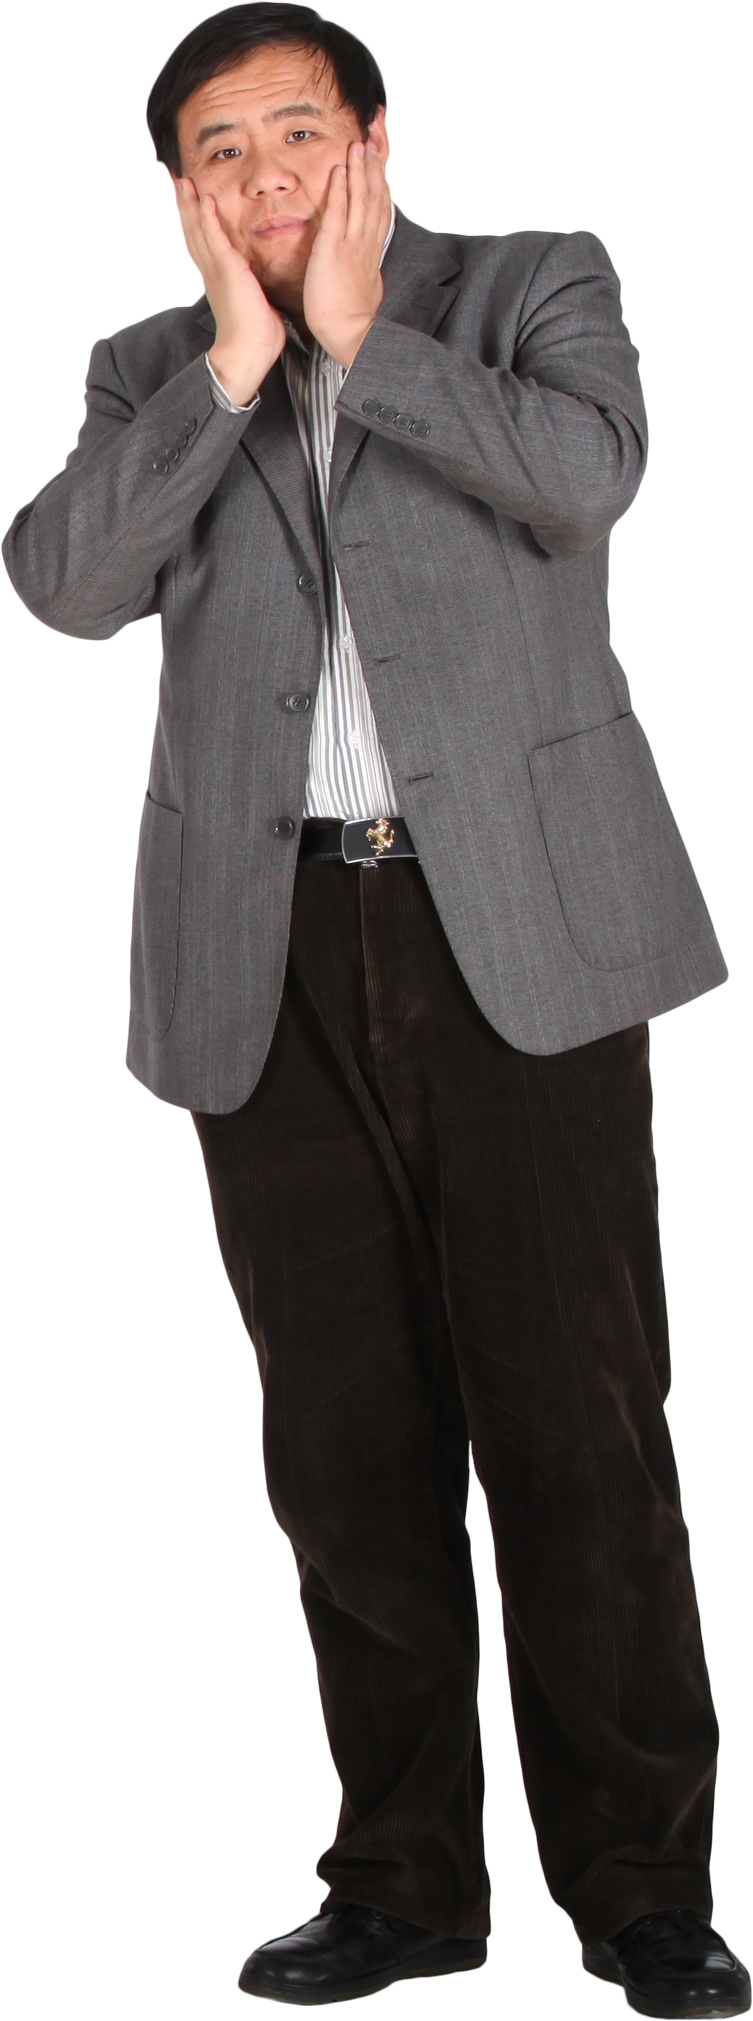
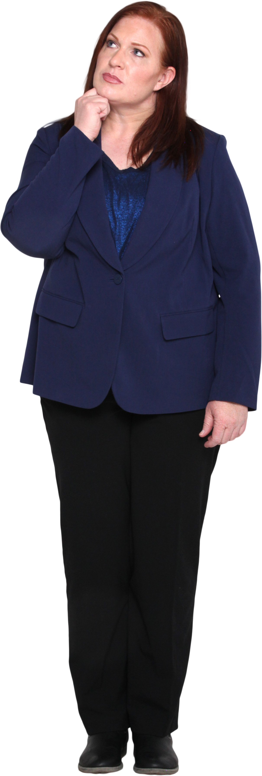
What to do?
The next morning:
Call the clerk and see if she can post it ASAP. Better late than never!
Call or text the chairperson and tell them that they should reschedule the meeting due to lack of compliance with the Open Meetings Act.
Keep quiet and hope nobody else caught it.
Send an anonymous tip to the Township's most concerned citizen so they can tell the board.
Notes:
when I count to three I would like you to hold up your hand with a 1, 2, 3,4 and we will see how we are doing...

Slide 18

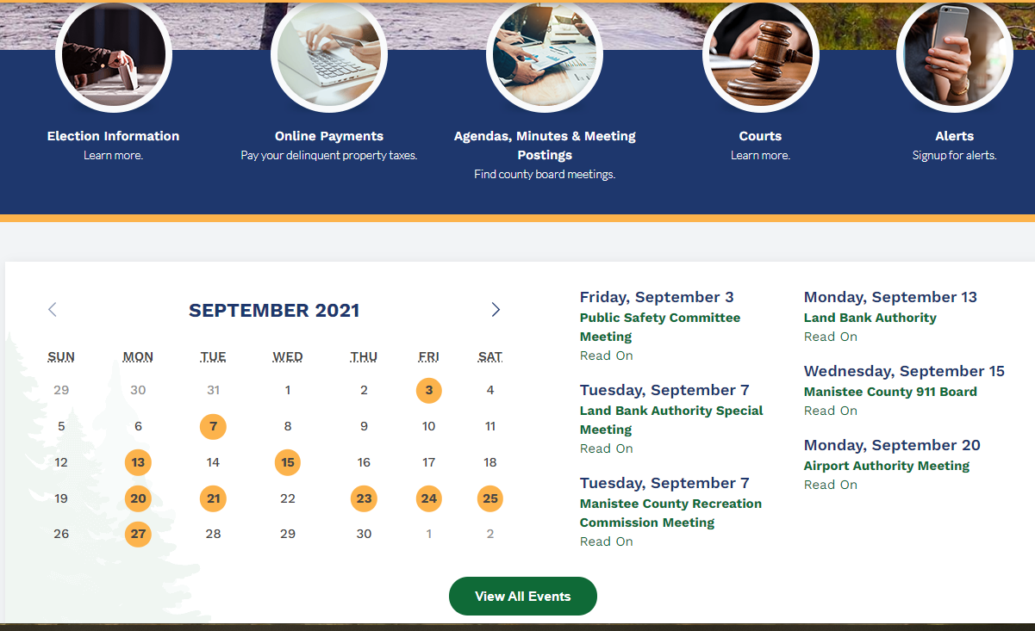
Website Notice- don't forget
For regular, rescheduled, or special meetings:
IF a “dynamic” website
THEN notice shall be put on the website in a conspicuous location (active calendar)
Minimum of 18-hours in advance –MCL 15.264
Notes:
For rescheduled or special meetings:
IF “directly or indirectly maintains an official internet presence that includes monthly or more frequent updates on a portion of the website that is fully accessible to the public of public meeting agendas or minutes,”
“The public notice on the website shall be included on either the homepage or on a separate webpage dedicated to public notices for nonregularly scheduled public meetings and accessible via a prominent and conspicuous link on the website’s homepage that clearly describes its purpose for public notification of those nonregularly scheduled public meetings.”

Slide 19
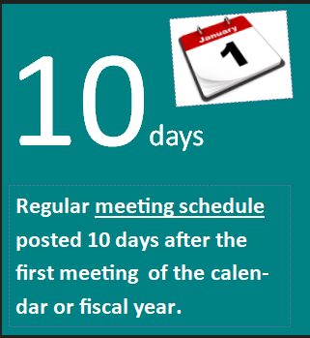
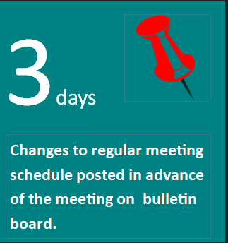
Notices- Timing
Regular meetings
Post annual calendar within 10 days after first meeting
Post changes to regular meeting schedule within 3 days of meeting
--MCL 15.256(2 & 3)
Notes:
Can be calendar or fiscal year

Slide 20
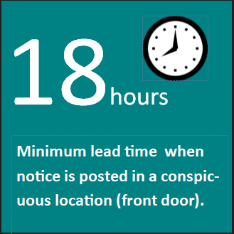

Notices-Timing
Rescheduled regular or special meeting
Post 18 hours before meeting --MCL 15.265(4)
Also applies if recessed more than 36 hours –MCL 15.265(5)
18-hour notice must be accessible (only count hours the building open to public) (OAG 5724)
Can be placed on the front door, viewable from the exterior of the building, to "add" to the accessible hour count.
Notes:
18-hour does not apply to special meetings of subcommittees
A meeting recessed for more than 36 hours– it is required to post the susbsequent meeting within 18 hours.

Slide 21
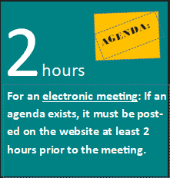
Post Agenda: Electronic Meeting (NEW in 2020)
PA 228 of 2020 requires..."if an agenda exists for an electronic meeting held under this section by a public body that directly or indirectly maintains an official internet presence that includes monthly or more frequent updates of public meeting agendas or minutes, the public body shall, on a portion of the website that is fully accessible to the public, make the agenda available to the public at least 2 hours before the electronic meeting begins. This publication of the agenda does not prohibit subsequent amendment of the agenda at the meeting." --MCL 15.263a (5)

Slide 22

Notice of Virtual Meeting (what's different?)
Reason and authority for remote meeting (Emergency Order)
Phone # or website address and physical address of government body
Refer to website for meeting resources: agendas, reports, etc.
Rules or procedures for public comment in the online format
Phone number to call for questions/issues
Agenda (if it exists—2-hours prior to meeting)
Request for accommodations (ADA Compliance)
Notes:
REWORK—ON E SLIDE
MARY Members of the public body must be considered present – and may participate as if they were present.
*** it was possible prior to Covid-19 to have member participate remotely but few communities did this. It requires careful consideration. For example, some required a quorum of people physically present to conduct business but others could attend remotely as well.
Particularly useful for communities where several retirees are serving on boards that may travel south for several months- they want to stay engaged and could do this remotely.

Slide 23
C. During the Meeting
Notes:
NEXT PART OF PRESENTATION

Slide 24
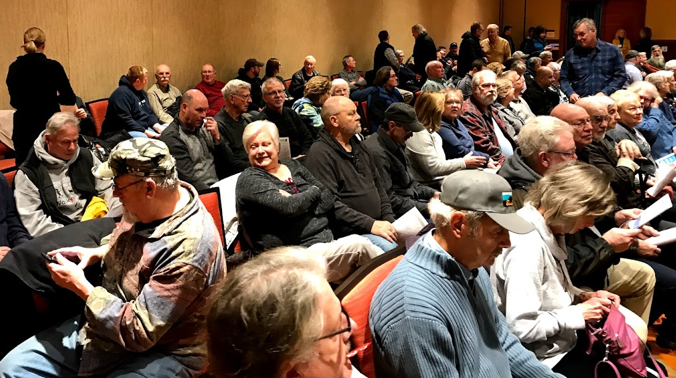
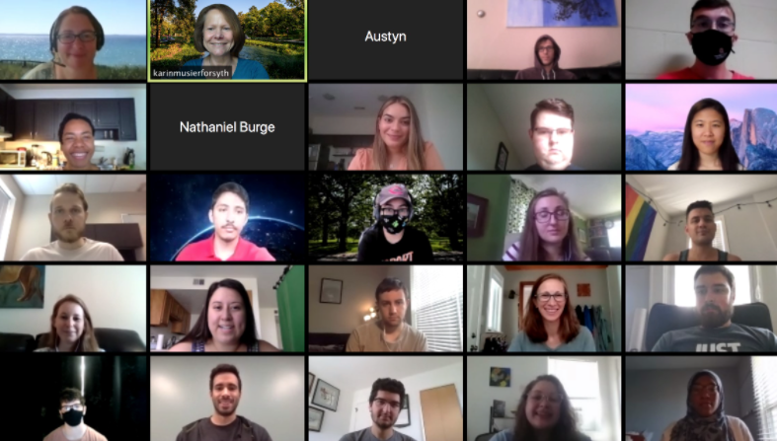
During the meeting (in person and virtual)
Public has right to address public body
May establish written rules governing public comment
So long as everyone is given a right to speak -- MCL 15.263
Notes:
MARY ADD VISUAL FOR VIRTUAL MEETING
Section 3 - General provisions
Public body may establish reasonable rules to minimize disruption of meeting
(Note it does not say “prevent.”)
Cannot require registration as condition of attendance
Public body may establish recorded rules governing public comment
Rules must be written so that everyone is given a right to speak
Rules can be about where the video camera is placed
(Maybe not a good idea to try to charge for use of electricity.)

Slide 25


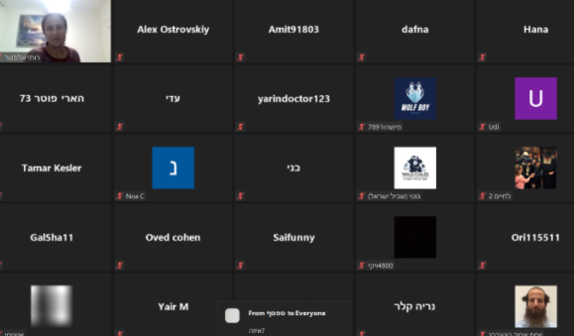
During the meeting (virtual)
OMA requires members to state their physical location if attending remotely. -MCL 15.263 2.a.i.
Etiquette/expectations-- different for board members than public.
Phone vs. video vs. black screen
Mix of in-person and remote brings unique technology and process challenges (roll call votes).
Backgrounds, objects, clothing, body language
Notes:
ADD BLACK SCREEN GRAPHIC
-- all questions and comments will still run through the chair
-- no side conversations
-- chat could be FIOAd– so watch out for personal side conversations on Chat features!
--body language is more difficult– screens on!
--still dress professionaly
--agree to mute or have the host mute unless speaking

Slide 26

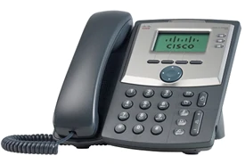
Remote Attendance
Everyone attending can hear remote participants
Remote participants can hear everyone in room-- MCL 125.263a (2)
Notes:
Just as a reminder—whenever there is remote attendance... Whatever we are allowed to do through December 31 when Manistee County's Emergency Order expires....
Some of these old principals still apply.
Extending the December 31, 2021 sunset language in OMA will require legislative action—.
After December 31 as is stands now—with not changes—only those that are absent due to military duty
MCL—FIND IT!
Telephone, skype, facetime, etc. (for member not present)
Everyone = audience also, and recording, TV, etc.
If that is not happening, fix it so it is, or terminate the phone call.

Slide 27

Two members of a board are seen texting during a meeting, but they are not texting each other. They both received texts from home and answered promptly.
Text From Home
The Township supervisor sees this but does not want to draw attention to it during the meeting.
As a fellow board member, how do you think
you would handle this situation?
Notes:
ALLOW TABLE TALK (4 minutes)-- pick one person to talk--
PICK two tables to report out...
Phones and text messages can be subject to FOIA, do not use them as a way around the open meetings act.

Slide 28

TEXTING/E-MAILS (before, during, after a meeting)
CAUTION!!
Texting might be innocent but could be perceived otherwise.
Not the way to deliberate or share information on a matter before the public!!
Cell phones subject to FOIA
Emails: DO NOT click “reply all” (just don't reply.)
Notes:
Includes calls and emails before meeting
Emails to members, notes of telephone calls, are public record
Think first before using social media. While it is your right to express yourself—it is a constitutional right— however, comments by elected or appointed officials can be taken out of context when outside of a public meeting and can be highly disruptive to the functioning of a board. It is usually not worth it to get involved in any kind of debate or discussion on Facebook or other social media.
Using e-mail to distribute handouts, agenda items, statistical information, or other such material during an open meeting should be permissible under the OMA, particularly when copies of that information are also made available to the public before or during the meeting
DO NOT click “reply all” (do not reply.) If you must, then reply only to the one person who was the “sender.”

Slide 29
Closed session
Requires motion in open session
motion and roll call vote
proper purpose to close a meeting
Must take separate minutes –MCL 15.267(2)
Once in closed session, can only deliberate
The decision is made in an open meeting
–MCL 15.267
Notes:
John
Points on slide
Decisions (e.g., all voting) must be rendered in open session (Sec 3(2)).

Slide 30

Closed session
Twelve reasons for a closed session (MCL 15.268):
Six apply to all public bodies (a, c, d, e, f, h)
Six apply to specific public bodies (b, g, i, j, k, l)
Ask for help or work with an attorney on all aspects of a closed meeting.
Notes:
JOHN
An uncomfortable subject that might be awkward to address is not a reason to go into closed session.
The OMA is very specific about reasons to go into closed session—with one exception...
If protected by FOIA from release (such as a legal opinion), then you can talk about that document in closed session.
This is typically done when there is pending litigation, for example.

Slide 31
D. After the Meeting
Notes:
NEXT PART OF PRESENTATION

Slide 32
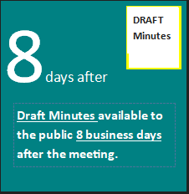
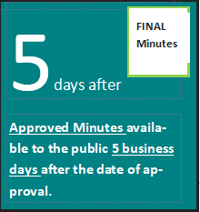
Meeting Minutes
Open to public inspection –MCL 15.269(2)
at address on posted meeting notices
copies at reasonable cost
can post on website to save time and $
Proposed minutes: available within 8 business days of meeting --MCL 15.269(3)
Approved minutes: must be available for inspection within 5 days of approval by the public body --MCL 15.269(3)
Notes:
JOHN
ADD 5 DAYS GRAPHIC

Slide 33
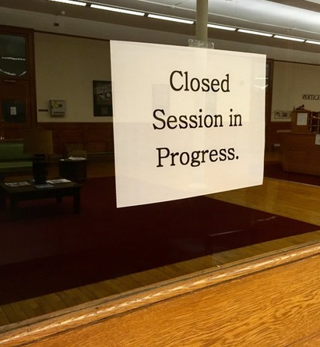
Meeting Minutes- Closed Session
May meet in closed session to approve closed session minutes (OAG 6365)
Minutes are not available to the public! --MCL15.267(2)
Retained by clerk or secretary
in a sealed envelope
a colorful folder taped shut
clearly labeled
May be destroyed one year and 1 day after meeting (unless there is current litigation).
--MCL 15.267(2)
Ask for help or work with an attorney on all aspects of a closed meeting.
Notes:
Note: approval of minutes is not a “decision” by definition of OMA.
Decision is measure on which a vote is required
and
“by which a public body effectuates or formulates public policy.”
Approving minutes does not “effectuate or formulate” public policy.

Slide 34
E. Consequences
Notes:
NEXT PART OF PRESENTATION

Slide 35
Civil Action
MCL 15.270-15.272
Attorney general, county prosecutor, or any person can file civil action in circuit court to challenge validity
Must be filed
Within 60 days of approved minutes
Or 30 days if contracts, etc.
Notes:
Possible Violations: notices, meeting open/public, all decisions public, deliberations public
Time limit - otherwise court can’t invalidate decision
30 days - contract, bids, making assessments, issuance of bonds, indebtedness, or borrowing proposal to electors

Slide 36

Re-enactment
Public body can re-enact decision (do it over correctly)
Does not make any admission
Re-enacted decision effective on date of reenactment
Prompt re-enactment may defeat a claim of attorney’s fees.
Notes:
makes the act essentially self-policing in some cases.
If you realize you did it wrong, you can correct it without penalty.
You get a do-over even if civil action initiated
If the board acts quickly, the reenactment may defeat a claim for attorney's fees, since plaintiffs would not be successful in "obtaining relief in the action" within the meaning of the OMA.

Slide 37

Compelling Compliance
Attorney general, county prosecutor, or any person may file civil action
To compel compliance or stop further noncompliance
IF they win, THEN get costs and actual attorney fees
Notes:
ADD GRAPHIC
A (writ of) mandamus is an order from a court to an inferior government official ordering the government official to properly fulfill their official duties or correct an abuse of discretion.

Slide 38
Penalties $$$
Real penalties for intentional violations
Misdemeanor –MCL 15.272
1st time ≤ $1000 fine
2nd time ≤ $2000 fine or ≤ 1 year imprisonment
Civil Liability –MCL 15.273
Actual and exemplary damages ≤ $500 + court costs + actual attorney fees
Notes:
ADD GRAPHIC
Civil liability - cannot bring more than 1 action under this section against a public official for a single meeting. Must be commenced within 180 days after the date of the violation
May be joined with action for injunctive relief

Slide 39
OMA Resources
MSU Extension http://www.canr.msu.edu/government/
Michigan Office of the Attorney General https://www.michigan.gov/ag/
Open Meetings Act Handbook
Attorney General Opinions (OAG)
Michigan Appellate Court Cases https://www.michigan.gov/som/0,4669,7-192-29701_29703---,00.html

Slide 40
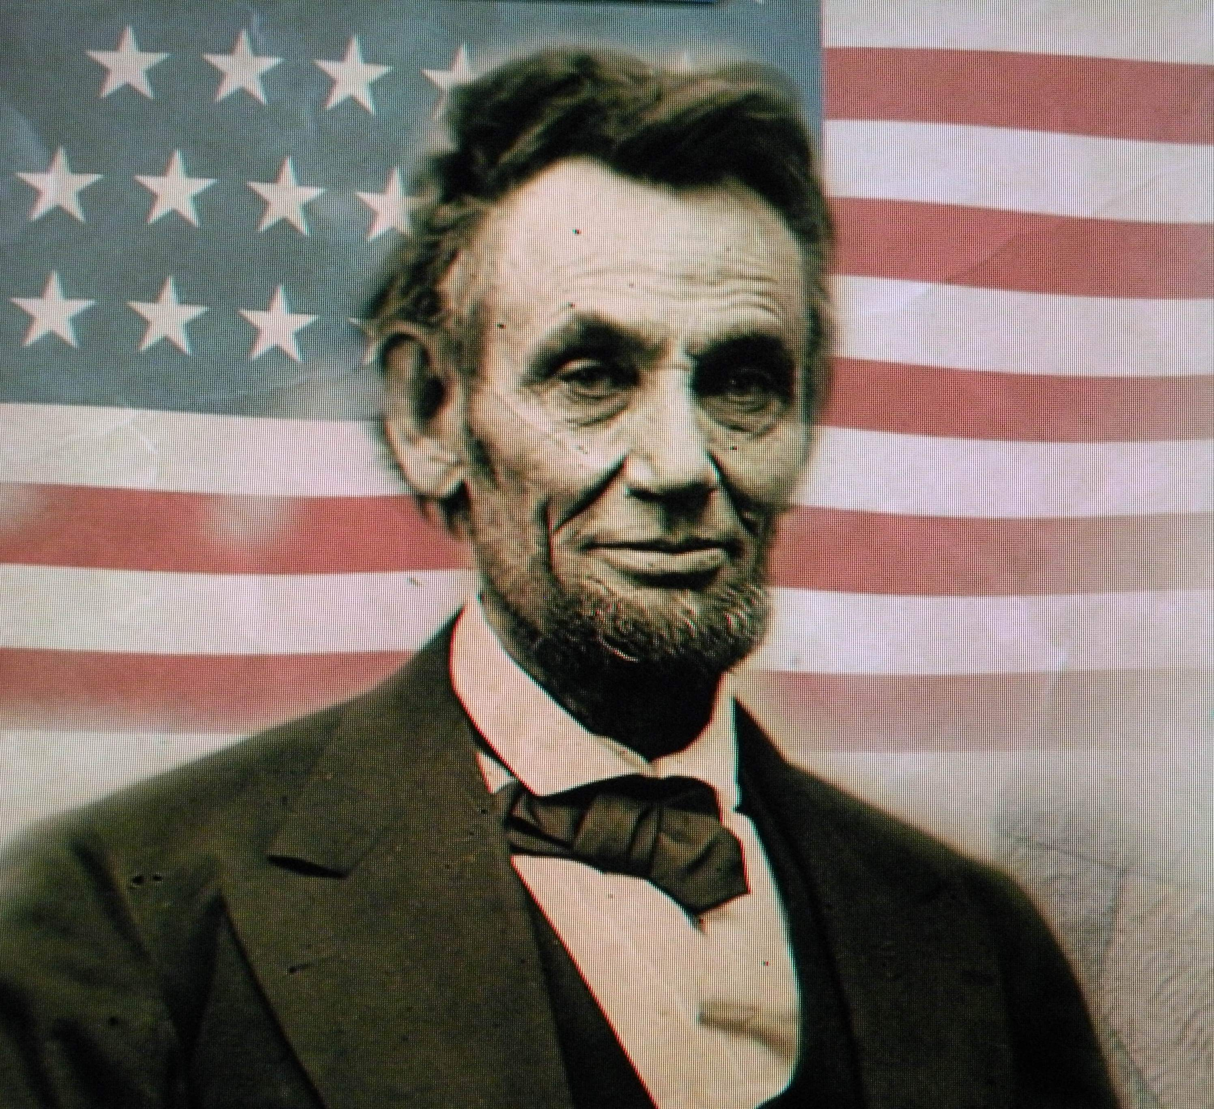
Thank you! Questions?
Mary Reilly, AICP
Government and Community Vitality
MSU Extension
Manistee, MI
(231) 889-4277 ext. 1
reillym8@msu.edu
John Amrhein
Government and Community Vitality
MSU Extension
Traverse City, MI
(231)-922-4627
amrhein@msu.edu
“Government of the people, by the people, for the people, shall not perish from the Earth."
Notes:
Perhaps the most important slide in the set.
Spirit of the law is to make government open and accessible to the people

