Slide 1

Manistee county
2021 Regional Summit
Creating More Affordable Housing
Emily Doerr / Jim Tischler Michigan State Land Bank Authority

Slide 2
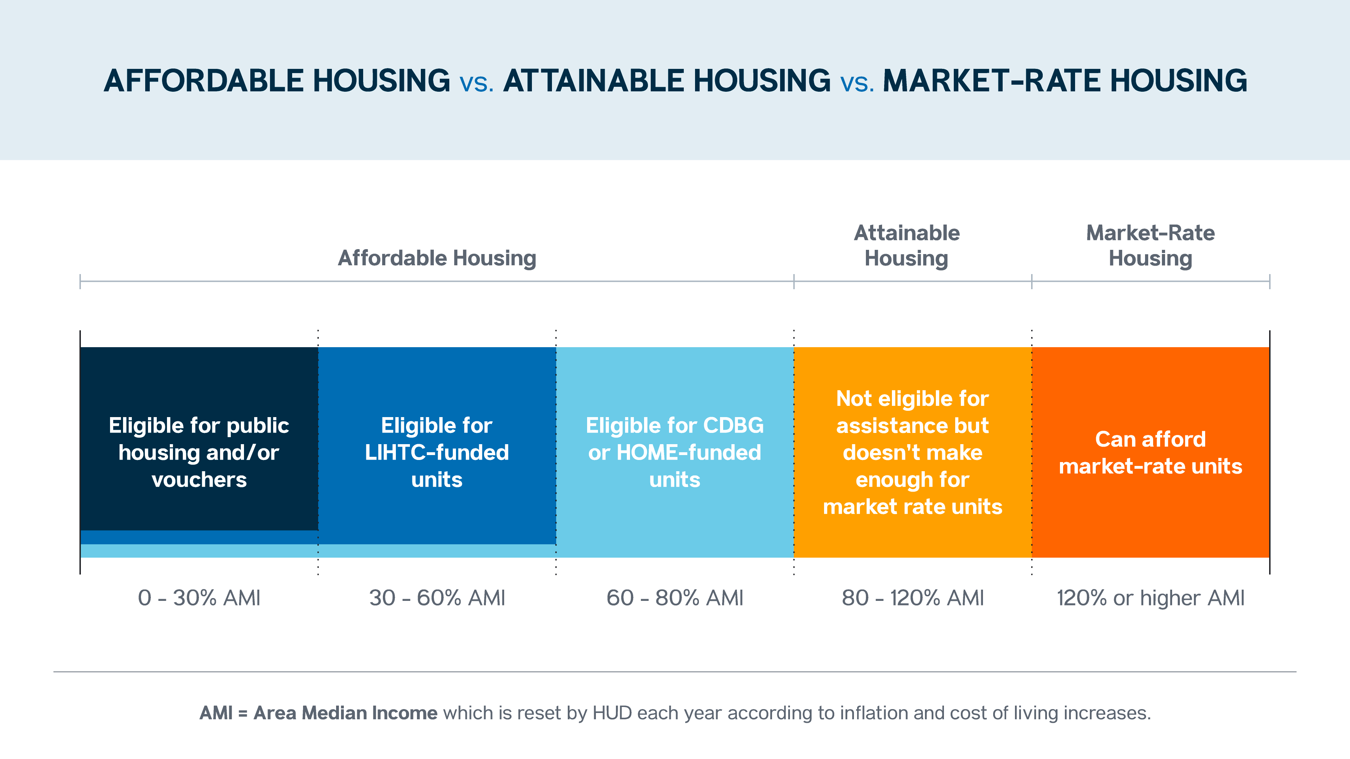

Statutes Collaborating for Redevelopment
Land Bank Act (PA 258 – 2003)
Authorizes counties to establish land banks.
Prescribes LB powers to operate, own, manage/maintain & improve.
Legislative history clearly demonstrates intent to link these statutory powers to broaden and promote economic development.
Brownfield Act (PA 381 – 1996)
Authorizes counties to establish brownfield authorities.
Prescribes BRA powers to operate, own & finance.

Slide 3
Problem: Michigan needs more housing attainable for “workforce” households 80- 120% AMI so our schools and local businesses can operate and expand
Housing developers need a tool to bridge the gap between construction costs and sales value that is available right now that can be used for households between 80-120%
Communities have limited or no capacity – especially out-region/state.
Concerns of Overuse or Hurting Schools: Brownfield Redevelopment Authorities are enabled to make local decisions and no school tax capture to be encouraged now….. Plus properties already in Land Bank inventory currently provide $0 to locals/schools at present, and without offset they will (a) never provide any revenue, and (b) negatively impact current/future tax revenues from adjacent properties.

Slide 4
Statutes Collaborating for Redevelopment
Key detail: Michigan’s Brownfield Redevelopment Financing Act (Act 381 of 1996) says that properties that are owned/controlled by a land bank automatically qualify to utilize tax increment financing (TIF)
Land Bank Act (PA 258 – 2003)
Authorizes counties to establish land banks.
Prescribes LB powers to operate, own, manage/maintain & improve.
Brownfield Act (PA 381 – 1996)
Authorizes counties to establish brownfield authorities.
Prescribes BRA powers to operate, own & finance.
Legislative history clearly demonstrates intent to link these statutory powers to broaden and promote economic development.

Slide 5
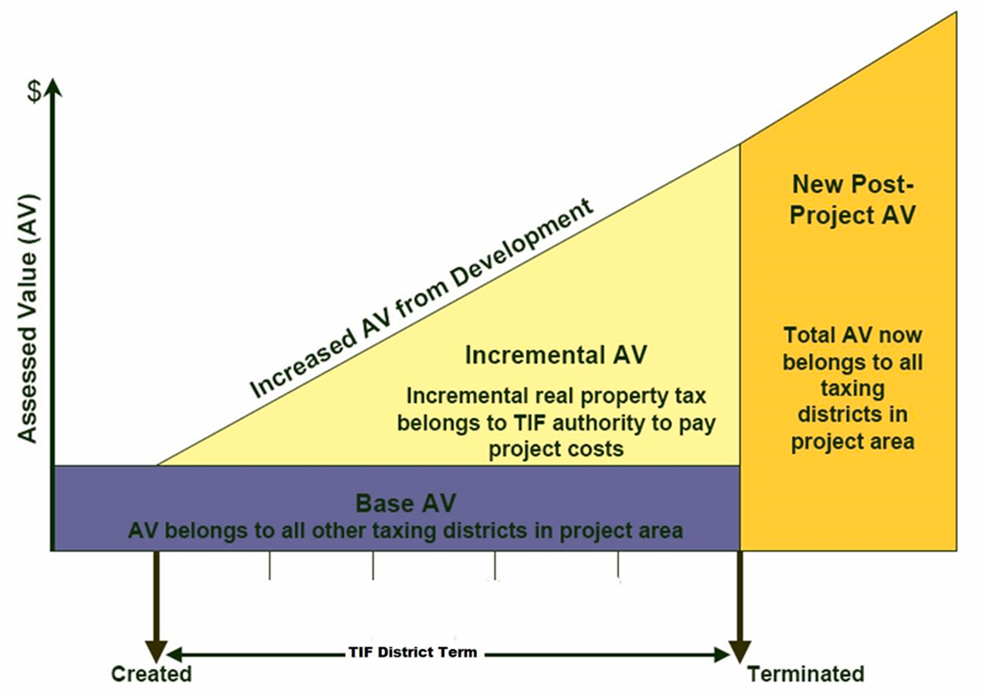
Act 381 “parcel-based” tax increment details (a bit different from Act 57 “district-based” TIF)
Returns properties to the tax rolls at end-of-term
Current taxable amount continues to go to taxing district (partial capture of new taxes is an option)
“New” taxes captured only until TIF Bridge Loan is paid off (limited term)

Slide 6
Land Banks & Act 381 Eligible Activities
ALL Eligible Properties:
1. Environmental Assessment/Due Care
2. Relocation of Public Buildings/Operations for Economic Development Purposes
3. Environmental Insurance
4. Plan Preparation
5. Plan Implementation
6. Demolition
7. Lead/Asbestos/Mold Abatement
8. Reimbursement of Principal & Interest
Eligible properties in a qualified local unit of government, economic opportunity zone, or a former mill:
9. Those described above
10. Infrastructure improvements that directly benefit eligible property
11. Site preparation that is not a response activity
Eligible properties owned by or under the control of a land bank or qualified local unit of government or authority:
Those described above
Assistance to a land bank fast track authority in clearing or quieting title to, or selling or otherwise conveying, property owned by or under the control of a land bank fast track authority or the acquisition of property by the land bank fast track authority if the acquisition of the property is for economic development purposes.
Assistance to a qualified local governmental unit or authority in clearing or quieting title to, or selling or otherwise conveying, property owned by or under the control of a qualified local governmental unit or authority or the acquisition of property by a qualified local governmental unit or authority if the acquisition of the property is for economic development purposes.

Slide 7
“Assistance…in selling or otherwise conveying…property owned or under control of a land bank fast track authority…” Cost of Unit Construction $210,000 Qualified Purchaser – 1st Mortgage $170,000 Unfunded Gap $40,000 To sell the unit, a concession of value (subsidy) is required. The Concession is “assistance in selling” and therefore an eligible expense for reimbursement by the TIF bridge loan.

Slide 8
Identify Community Needs
Conversations with political leaders, housing developers, realtors, other stakeholders
Look at specifics: location, infrastructure, costs, Brownfield Redevelopment Authority (BRA), local buy in, land bank partner – county or state (if no county)
Discuss land sale/transfer and holding property details; at what point does the land bank deed property back; eligible activities by land bank while holding in escrow
Develop an initial budget and brownfield plan table

Slide 9
BRA approves Brownfield Plan
Transfer to Land Bank
Quiet Title by Land Bank (maybe)
Property deeded back
Sales/Rental of units
Development occurs
Tax Capture during years 6 up to year 30 based on the term of the approved Brownfield Plan; after TIF bridge loan is reimbursed, all taxes to local government
Tax capture years 1-5 include Specific Tax to Land Bank (5/50) and balance to Brownfield Plan

Slide 10
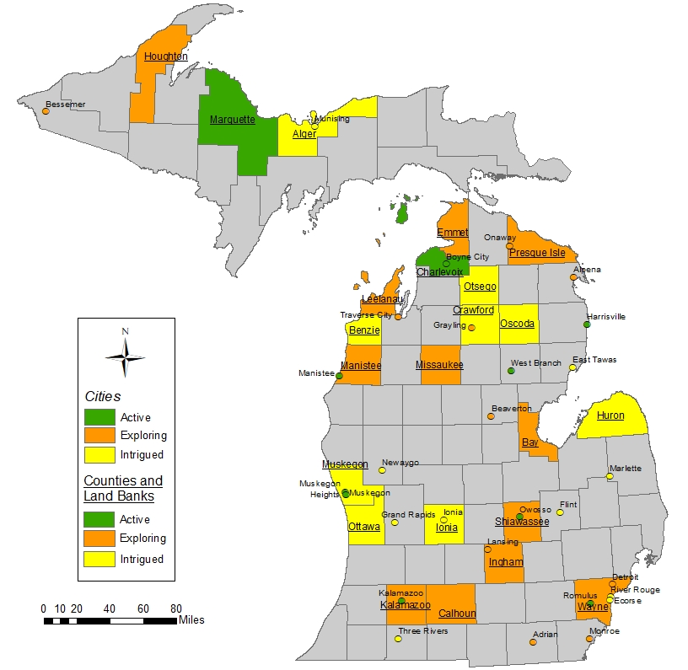
Active | Exploring | Intrigued
Boyne City | Adrian | Alger County Land Bank
Charlevoix County Land Bank | Alpena | Ecorse
Harrisville | Bay City | Huron County Land Bank
Kalamazoo (city) | Bay County | Ionia
Manistee | Beaverton | Mancelona
Marquette | Bessemer | Marlette
Muskegon | Calhoun County | Munising
Muskegon Heights | Cheboygan County | Oscoda Township
Owosso | Emmet County | Otsego County
Romulus | Grayling | River Rouge
West Branch | Ingham County Land Bank | Three Rivers
Marquette Land Bank | Kalamazoo County | Ionia County Land Bank
 | Lansing | Flint
 | Leelanau County | Newaygo
 | Missaukee County | Oscoda County
 | Monroe | East Tawas
 | Traverse City | Muskegon County Land Bank
 | Wayne County Land Bank | Ottawa County
 | Ionia | Grand Rapids
 | Manistee County | Benzie County Land Bank
 | Detroit Land Bank | Crawford County
 | Presque Ile Land Bank
 | Houghton County Land Bank
 | Onaway
 | Shiawassee County

Slide 11
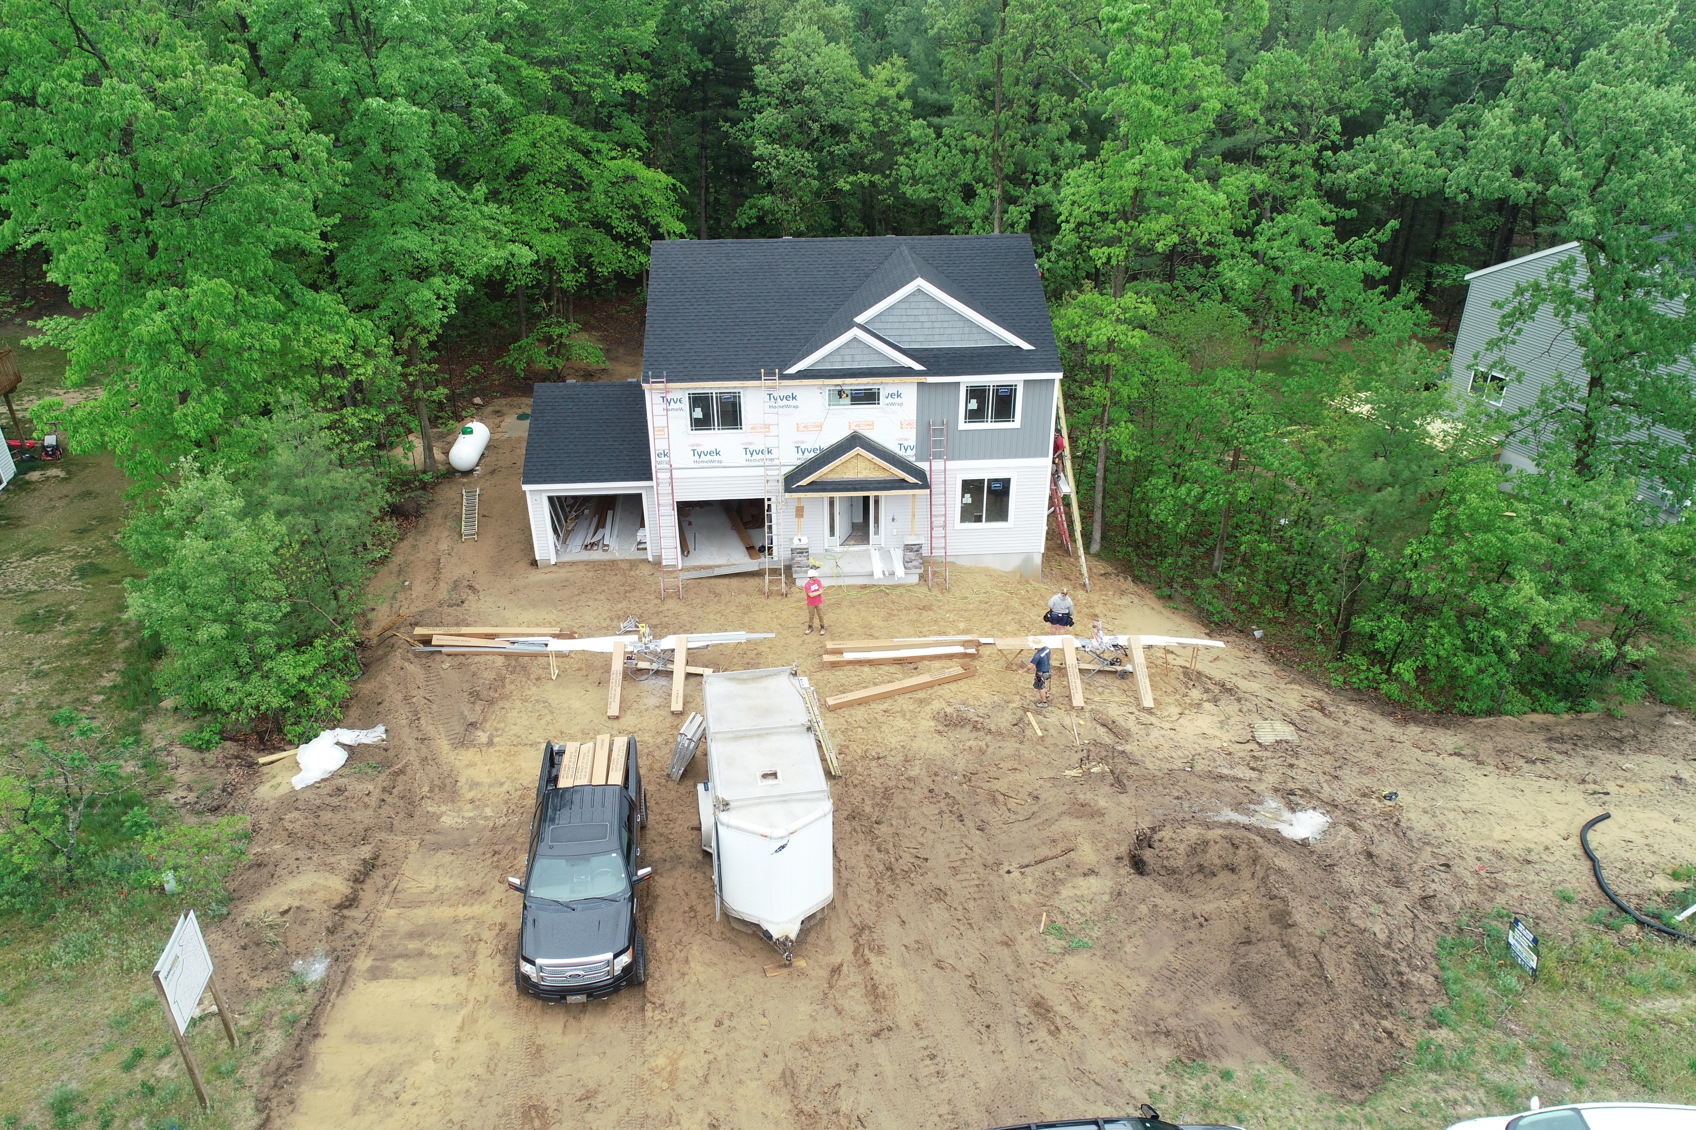
1) City of Newaygo BRA
Newaygo County
(no county land bank)
City North River Hills LLC & Sable Homes

Slide 12
2) Former sand and gravel mine on 159 acres in Commerce Twp, Oakland County * No township BRA so County BRA is working with them * Proposal from housing developer is 203 single family homes * Requires water & sewer (part of the township’s Master Plan), utilities, roads – significant infrastructure costs that would drive housing costs to unattainable levels so those site prep / infrastructure costs are TIF-eligible * In discussion on adding “assistance for sale” eligible activity for lower income

Slide 13
SLBA Resources
Land Holder (parcels via tax foreclosure or direct transfer into escrow)
Housing PreDevelopment Investment Program
Rolling out October 2021 as a pilot program
Housing Development Loan Program
Available to local units of government, land banks, other public organizations
To develop residential property
Short term loan
Paid lump sum at time of property sale
5% simple interest (3% if SLBA receives 5/50 payments)
No Fees
https://www.michigan.gov/leo/0,5863,7-336-94422_96636_91456_91463-490294--,00.html

Slide 14
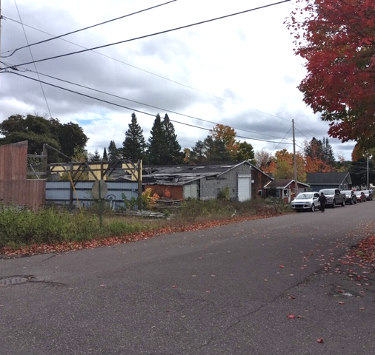
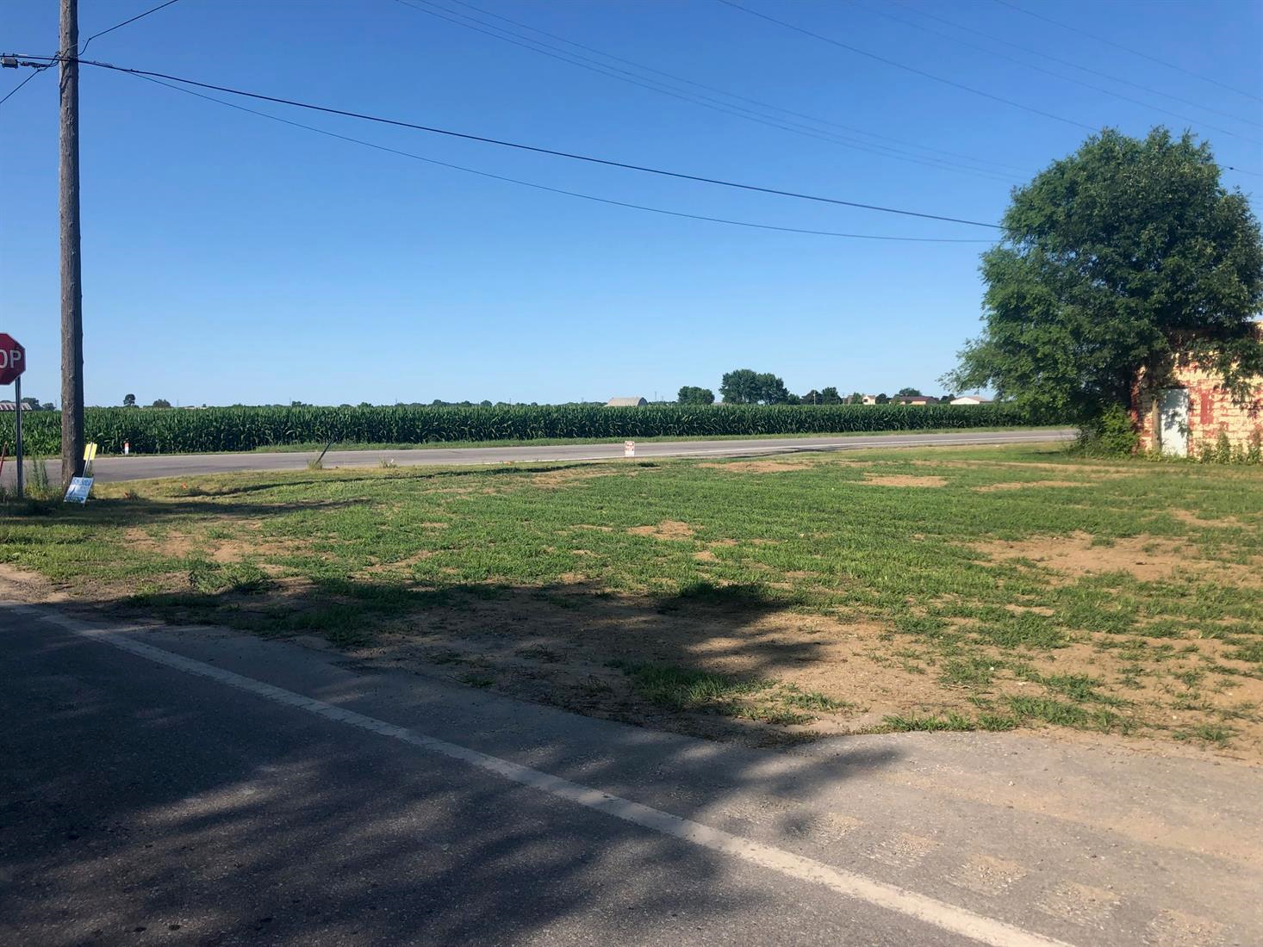
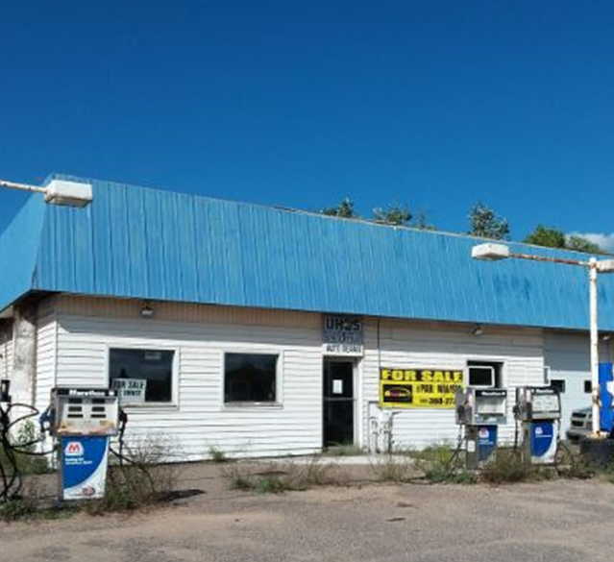
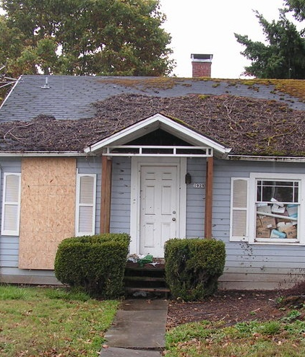
Recycling Land to Productive Reuse
Emily Doerr Executive Director
DoerrE1@Michigan.gov
517.512.0229
Jim Tischler
Development Director
TischlerJ2@Michigan.gov
517.242.4376

