Slide 1


Manistee County Truancy/School Resource Deputy

Slide 2

How things got started
COVID-19
Struggles with consistent truancy issues
Manistee County School Safety Committee

Slide 3
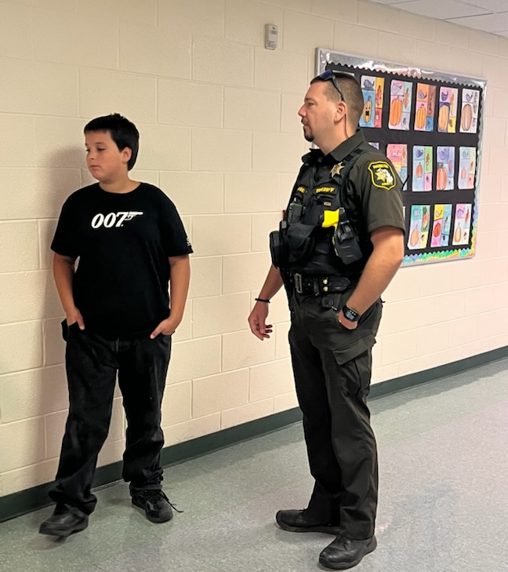
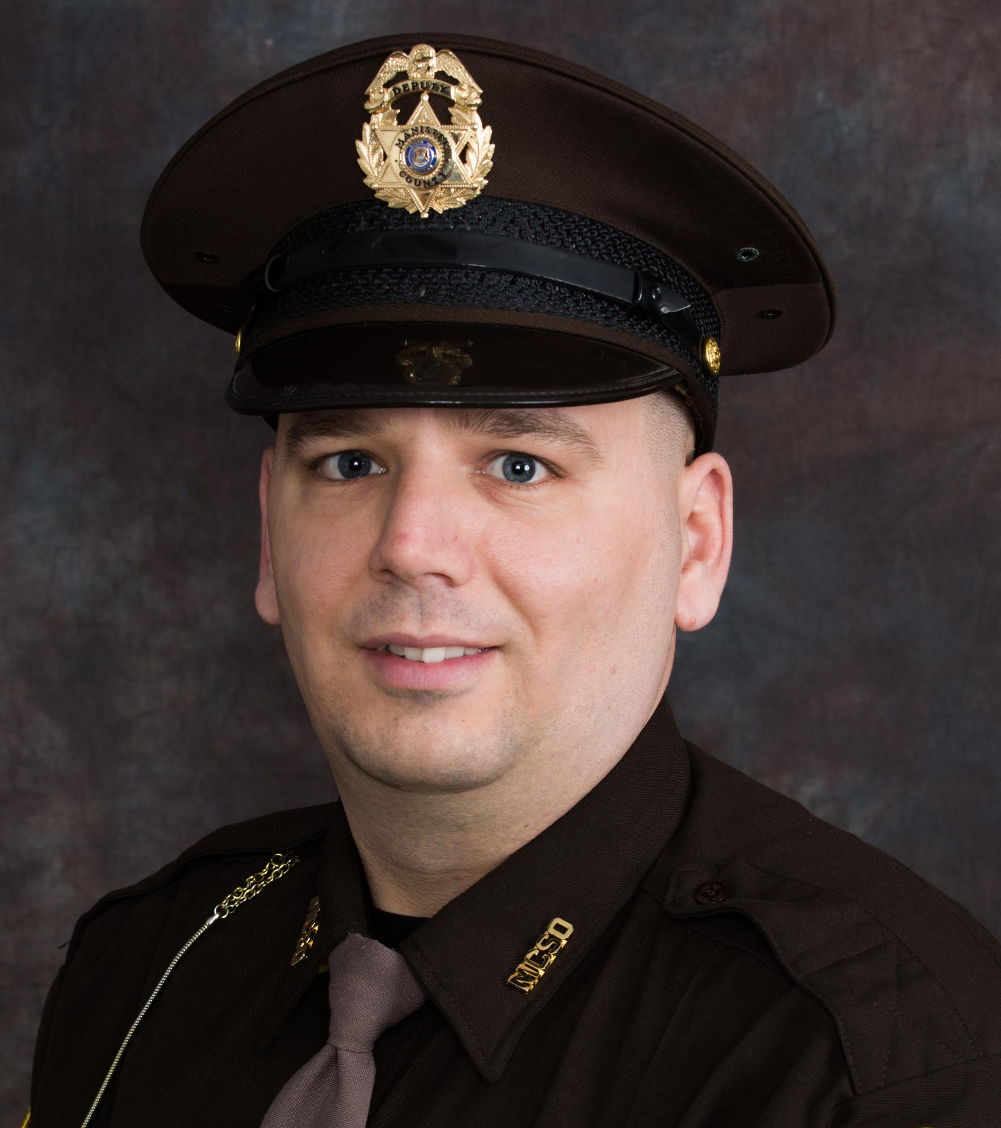
Filling the role
Keeping kids in the classroom
Increasing communication with school administration
Building relationships with students and parents

Slide 4

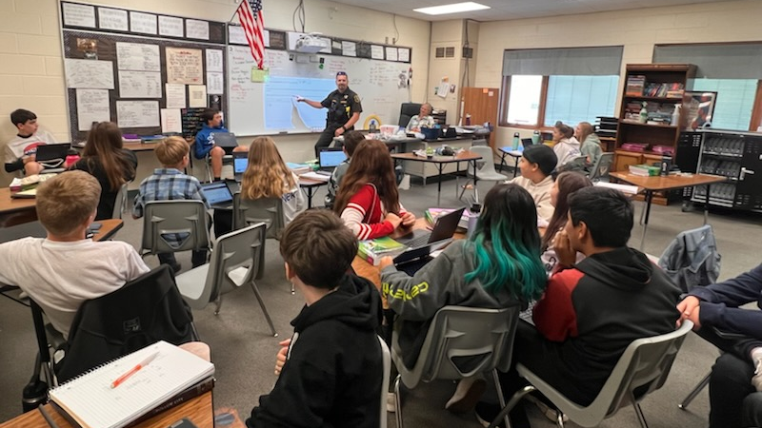
Keeping kids in the classroom

Slide 5
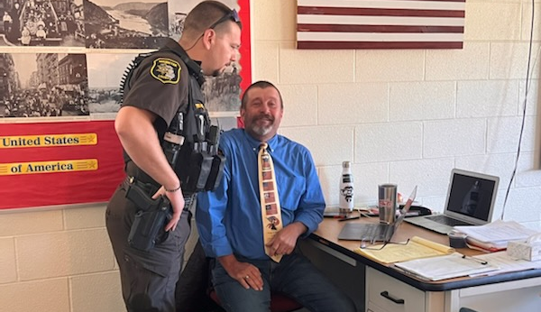
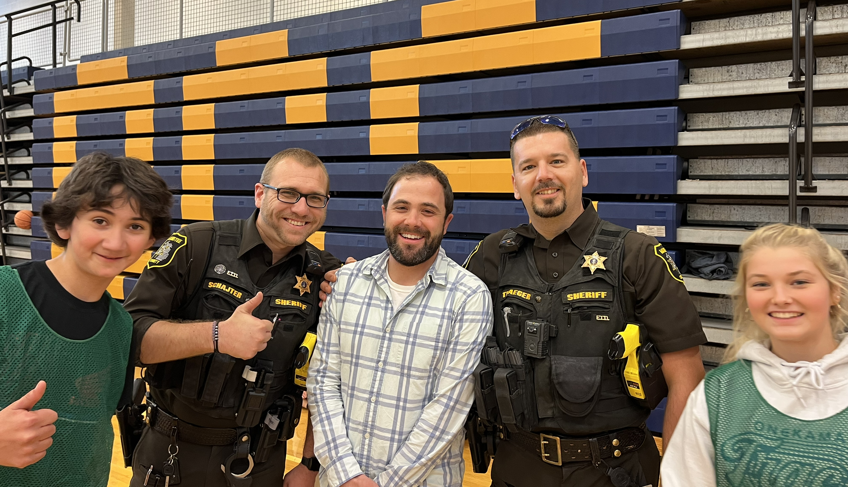
Increasing communication with school administration
Established lines of communication
Defines expectations
Defuses conflict and prevents animosity

Slide 6
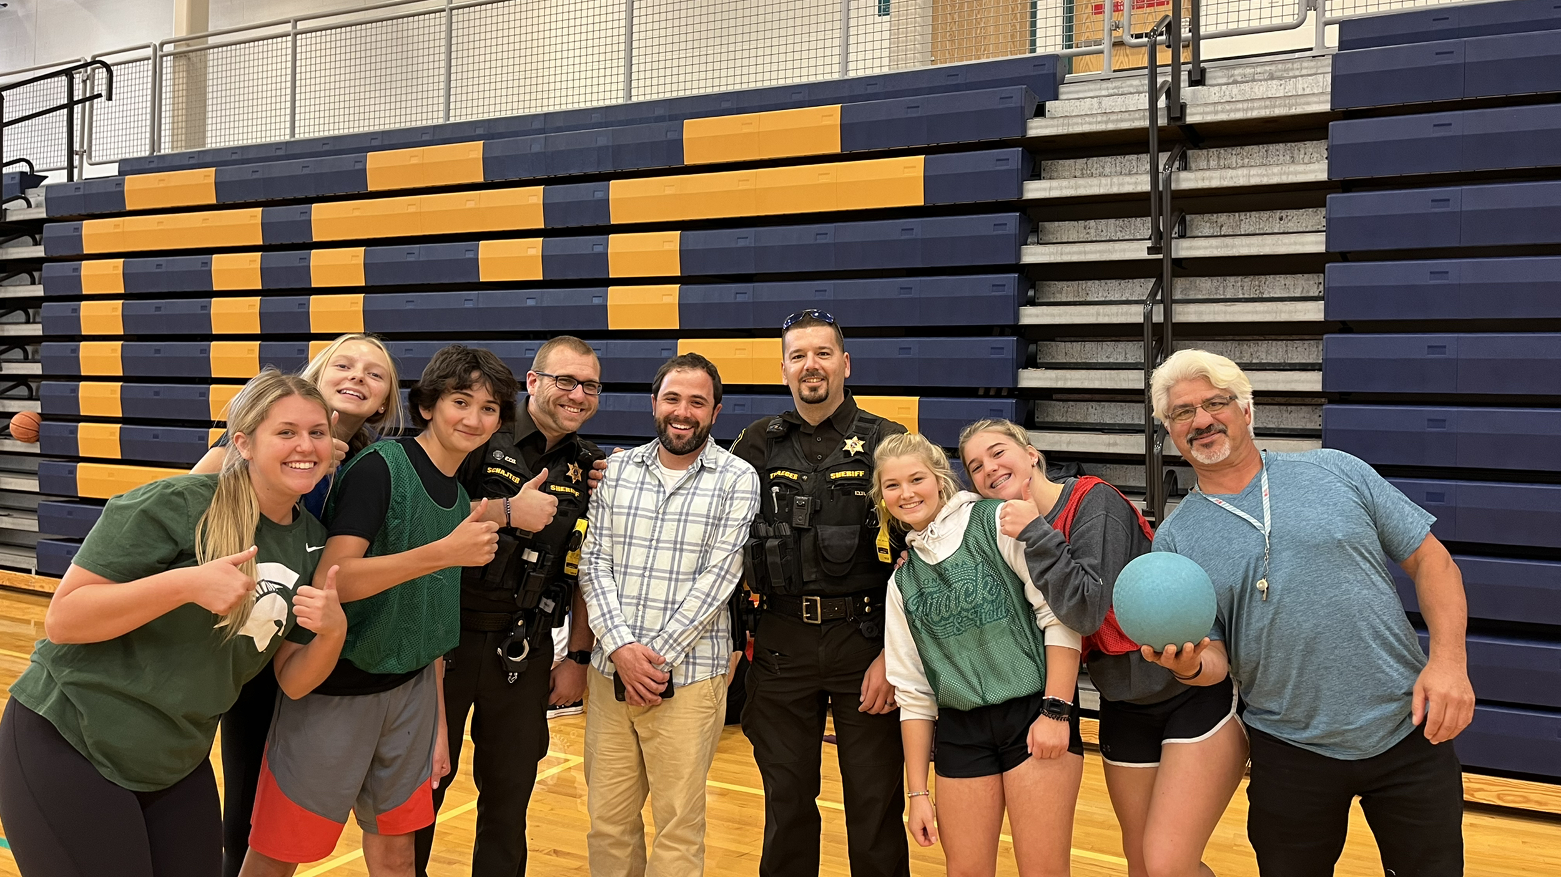
Building Relationships

Slide 7
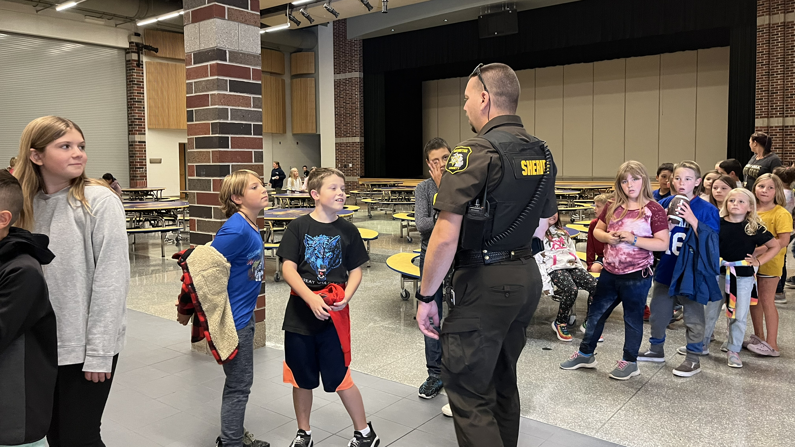
Year in review

Slide 8
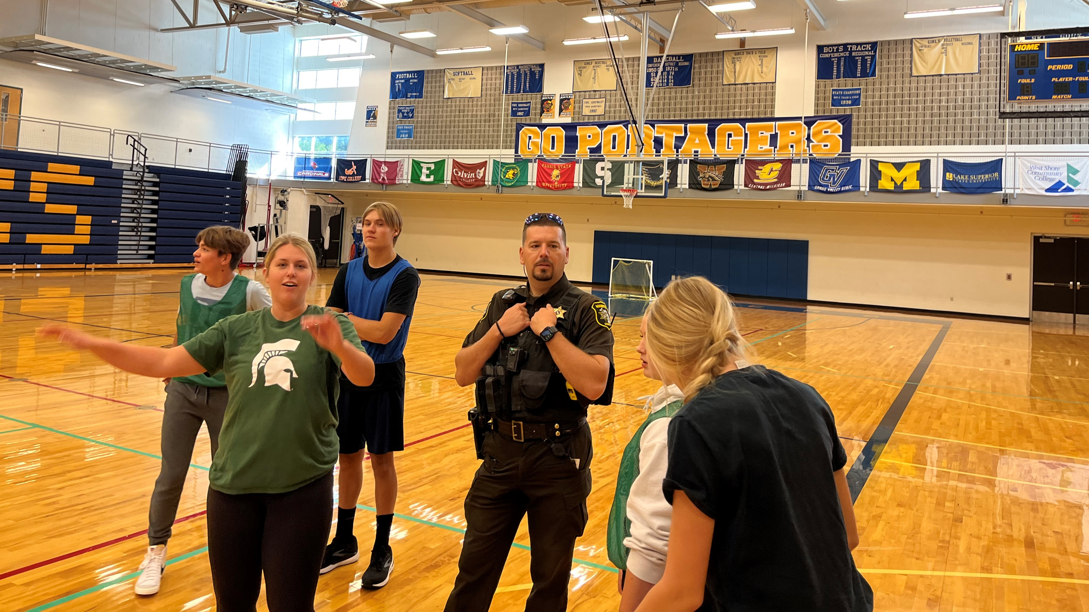
2021 – 2022 Statistics
Bear Lake School – 21 Complaints
4 Threats Complaints
5 Truancy
1 Arson
2 Incorrigible Youth
2 Assault Complaint
2 Assist to CPS
4 MIP
1 Larcency

Slide 9
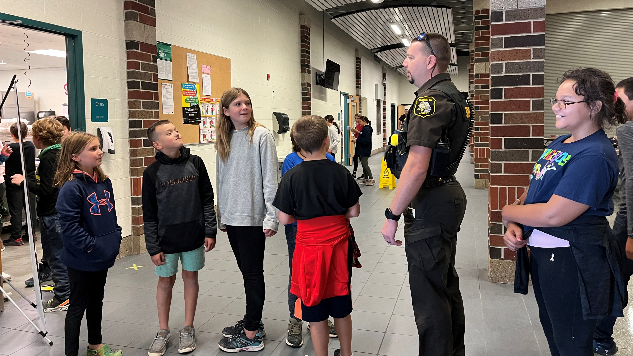
2021 – 2022 Statistics
Onekama School: 23 Complaints
2 Asssists
4 Threats Complaints
5 Truancy Complaints
4 Welfare Checks
3 Incorrigible Youth
2 Suspicious Situation
1 Probation Violation
1 Criminal Sexual Conduct
1 Assist to CPS

Slide 10
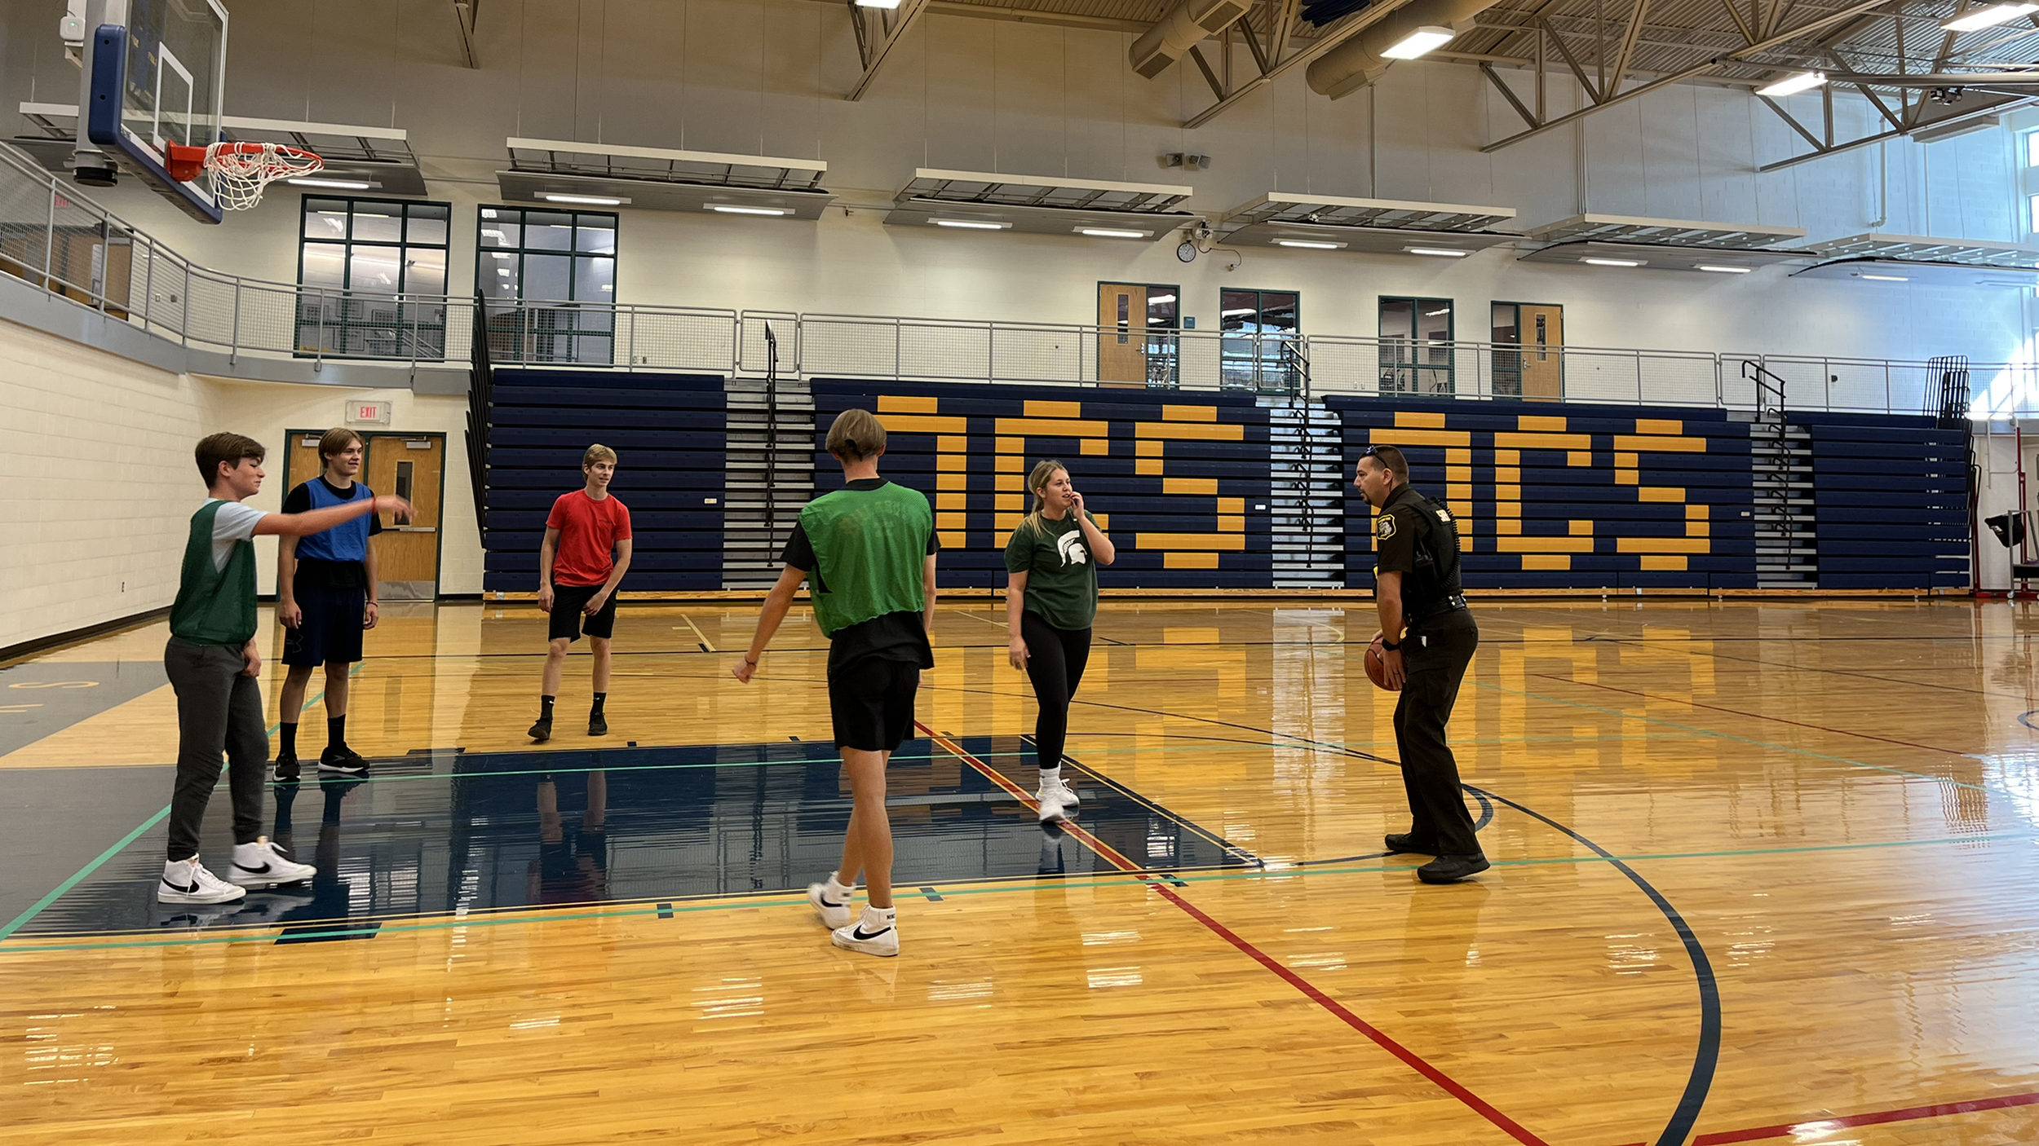
2021 – 2022 Statistics
Kaleva Norman Dickson School: 36 Complaints
23 Truancy
3 Assault
1 Harassment
2 Criminal Sexual Conduct
1 Threats Complaint
1 MIP
2 Assist to EMS
1 Suspicious Situation
1 Student Assist (Non-criminal)
1 Assist to CPS

Slide 11
2021 – 2022 Statistics
Other Schools: 2 Complaints
1 Bus passing violation (Benzie Schools)
1 Truancy (Michigan International Prep School)

Slide 12
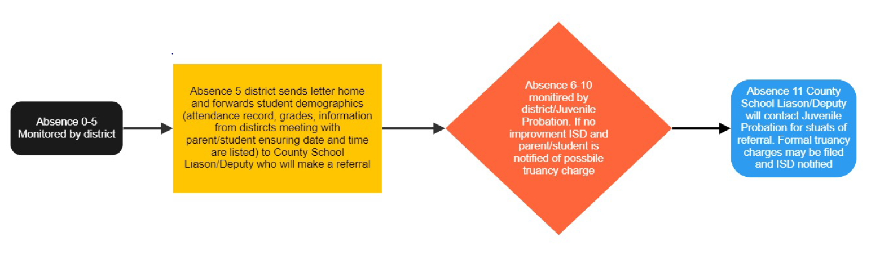
Truancy policy improvements

Slide 13
What’s next?
TEAM (Teaching, Educating, and Mentoring Liaison Program)
30 lesson plans for K-12
School violence, school and community relations, current trends, etc.

