Slide 1

Manistee County Housing Action Team
Manistee County 18th Regional Summit
September 29, 2022

Slide 2
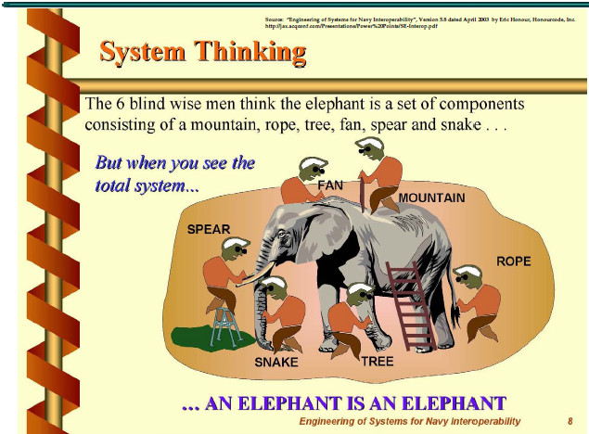
Defining the Manistee Housing Crisis

Slide 3
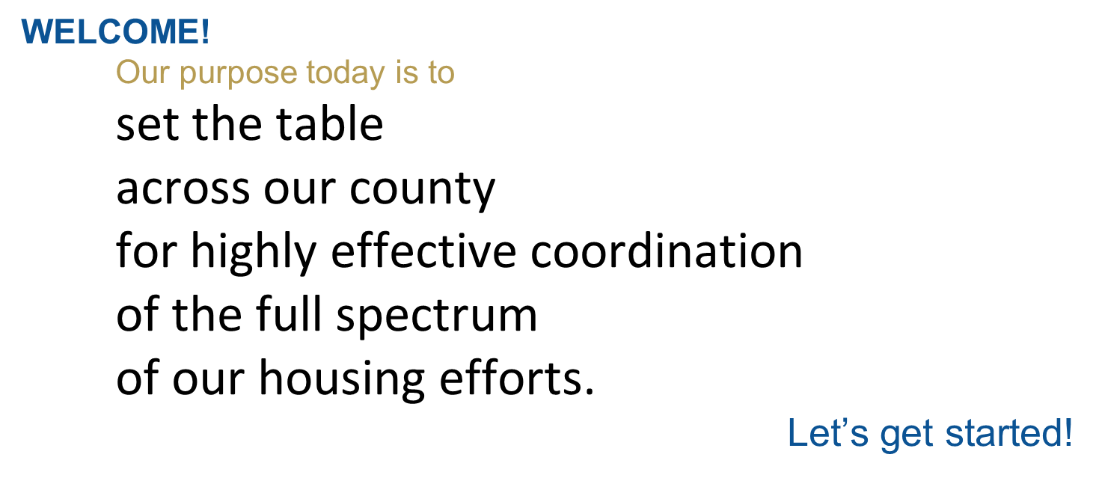
Let’s Find Housing Solutions Together Summit - Purpose

Slide 4
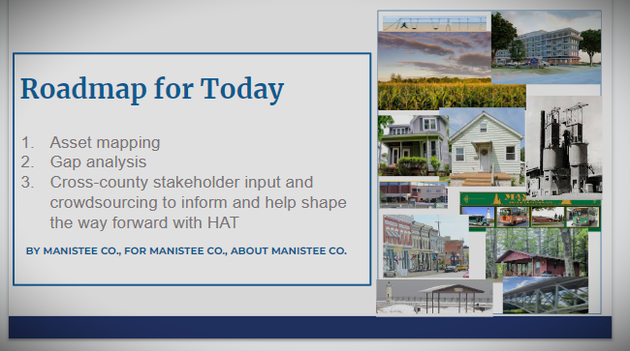
Let’s Find Housing Solutions Together Summit - Agenda

Slide 5
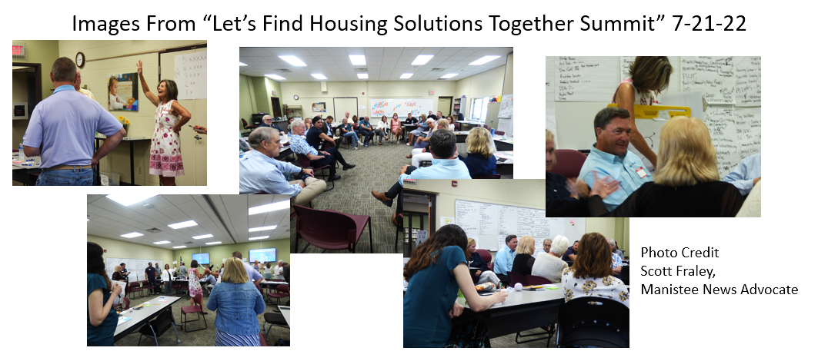

Slide 6
Fishbowl Notes
What Participants Had To Say
Capacity is important to consider before building plans. Lessons Learned from a prior project regarding what it takes to administer a grant, to “do the outcomes”, to “do the tracking”
Tactical knowledge is paramount.
Contractor training in our county will build capacity in our county to meet the knowledge needs of contractors, zoning, code, builders, enforcement etc.
HAT Housing Ready Coordinator must point the way. Not be in the weeds.
Tactical concerns for the HAT Housing Ready Coordinator. Needs office talent support. Someone to support email, office work.
HAT Housing Ready Coordinator is ideally tech savvy
HSBC should focus the Housing Ready Coordinator. “We cannot scare this person away!”
Caution, if we don’t drill down on the homeless, the Section 8, and housing rehab.
Safe and affordable housing is key to success for people new to the area as well as present citizens who are limited
Housing North must quickly understand their local assets and which to leverage for what
We must think big. One case of thinking big in Margaritaville in Florida. Manistee County cannot think “in tens”. We need to think “in hundreds”.
Appeal to the differences among people through options and scale. Affordability does not mean the same to everyone. Different levels meet different needs across types of citizens.
We need to know who really needs housing. How many? Are we 400-500 short?
Does Manistee need an updated study of vacant, available, scale of rehabilitation needed on a property (80% need on one house, 30% on another).
There is too much to be done to take time for another study.
Quality for seniors. Makes available housing for families. We have too many seniors with unused space that would suit young families. We need to increase investing in senior housing to make room for young families.
About MOUs and MOAs. Borrow the best practice processes.

Slide 7
Fishbowl Notes - Continued
Permitting and zoning. Dig up the archaic and the outdated.
Our mindset must be “why we can”. “Yes we can”. “Let us work with you”. “Let us go to talk to this person”. To make this go and grown, someone has to get it done through broad collaboration and mindset.
Get rid of showstoppers. Rules that work against suitable housing solutions. Things that no longer apply and make it possible to comply because they are archaic.
Caution on trailer homes. Without a foundation on a home, non-taxable. Appealing to some but contracts the need for a strong tax base.
We need to get a program together and keep it, as there is no longer state money available for workforce affordable builds nor rehabilitation for rental properties.
Public relations is a critical fundamental for Manistee County housing. We have a culture of being against things that are for the common good and safety of citizens.
Are we really ready for many more citizens? Manistee governments own land.
There are potential citizens who have government-backed loans who want to move into our county. There are visitors who come here and have a “Hallmark Cards experience” who want to move here.
We are not the old game (that held Manistee County down in days before now)
Concern for year round housing purchased and repurposed as vacation home or short-term rental.
If we want people to come here. Multi-family (e.g. duplex, quadplex) is efficient and affordable.
What is the problem we are trying to solve? HAT’s challenge.
Averaging 3 times per week, seniors are reaching out for assistance from United Way to find financial assistance for maintenance of their homes. Things they cannot afford to repair. Assessment of need is important, so that we can fix, meet code to help seniors do what they cannot do alone.
HAT will be most effective by identifying its shared principles, agreements, vision, and ways of operating.
Existing city Housing Action Plan applies to much of the county’s need for an action plan.
City, township and county roles must enable housing. We need to recruit township officers.
Housing Ready checklist. For example, no Housing North Ready Coordinator should be solo in meetings without a local HAT member also present. We have to have shared (local/regional) action, knowledge and influence, not compartmentalized.
Michigan Township Association might be a good partner and resource for HAT endeavors

Slide 8
Fishbowl Recommendations
Recommendation 4.C.1
Fishbowl comments are there to unpack. This is not considered data. It can be used, however, as data-gathering from the minds of future collaborators. Passion was exhibited and sparked cascading involvement of others. Over 30 people worked together to make conversation happen and flow through talk and listen. HAT may wish to refer to the Fishbowl transcript during their forming or planning stage. No longer is there a blank slate on what a large collective of partners has on their minds.

Slide 9
Crowdsourcing
Top 10 ideas
To “move the needle” on Manistee County Housing.
Quality, senior rental housing for all seniors without limits on income. (23)
  this card unscored New senior housing development to free up single family homes.
Home improvement / Home rehabilitation program. (22)
  (21) In collaboration with other organizations, create a local Manistee Housing Fund and launch a fundraising campaign including home rehabilitation. Match with grants.
  (20) Incentives for Rehabilitating existing homes.
  (18) Rehab of homes. Grants/ability.
Emmet County did a study on their Master Plan to determine if their Housing Ordinances regarding lot size and housing square footage was sustainable. Because of the large lot and housing square footage, it was determined the old Zoning was not sustainable. They made changes as a result. We should do that here in Manistee County. (21)
A housing development with safe, affordable housing. Duplex and tiny home. At least 100 homes. Also rehabilitation project to make run down homes safe & livable. (21)
  (16) Fifty (50) tiny homes, 400-700 sq. ft. within a single truck width. Community space recreation center; parking for food trucks; community gardens
Fund Landbank. Immediate development of blighted county properties to build on 11 acres a transitional housing project. Including apartments, tiny houses, duplexes, and a complex that offers common use building space for required (credit toward rental money) educational, skill building, workforce preparation, & social-emotional well being. (20.5)
  Join the new housing position with the Landbank and have quick success! (19)

Slide 10
Top 10 Continued
6. Use existing Plan for Action and Implementation to guide HAT and housing coordinator position. Housing Action Plan, October 2019. (20)
  Use the city's Housing Action plan as the basis for a county-wide plan and identify 3 key strategies to move forward over the next three years. (19)
7. Improve county-wide transportation options, so that tourism workers and aides can reside throughout the county. (20)
8. “Bold” landlord incentives to take on low income families. Recently, NMCAA has been able to pay first-time landlords $1500 to work with our homeless program. This got many homeless folks housed and introduced us to landlords we were not aware of. (19.5)
9. Middle class housing developments with associations, amenities. This allows for new families to move to Manistee and existing families to move up or downgrade. This also will free up different types of housing for low, middle and upper income limits. (19)
10. (three ideas written on this card) Landlord Meeting Association. Tiny home divisions/neighborhoods (1000 sq ft). Landlords cannot buy more property if their current property is not decent. (19)
11. Identify a specific housing need. Appoint a group from this assembly to move the project forward. Use the project as a pilot for future momentum. (19) (tied with other 19 scores)

Slide 11
Remaining ideas in descending order of score
12. Identify blighted homes and create a database and use it to qualify for a community brownfield grant from the state. Identify vacant homes, vacant lots and abandoned buildings and use these as a basic asset for developers. Use brownfield grant funding to allow tax deferment for 20 years for people buying new homes/townhouses. (17)
13. Do it now: Publish the results of this meeting to our public. Explain HAT. Not the organizations that were present (today). Note the scope of housing issues in Manistee County. Segment the needs of groups needing housing. Note employment of Housing (Ready) position and duties. Then: follow up with information as first steps are taken. Maintain downstream communication. (17)
14. Develop housing on existing city-owned parcels and parking lots in the next 2 years. (17)
15. Create neighborhood enterprise zones in various parts of the community! (16)
16. Unity/collaboration was clearly identified by this group as a key success factor toward solving the housing challenges in the county. So, if this HAT and the (new) staff person can be somehow tied to the county governmental units… and itf possible, have HAT focus on being the REPOSITORY for EVERYTHING HOUSING! +benchmark projects and pre-negotiate materials and contractor pricing + proper and successful processes +proper consultants +best zoning/planning processes. (16)

Slide 12
Remaining Ideas Continued
17. Manistee County hires a qualified Housing Readiness Coordinator who is a “hub” then managers a resource list – a 2-1-1 of housing information. When/where there is an issue, concern, roadblock, this person is able to coordinate an effective response/solution. (15)
18. Settle on one place to start to build a success. (15)
19. Property Maintenance Program (code). Addresses exterior issues (blight) which holds homeowners’ feet to the first on exterior maintenance such as paint, broken windows, torn screens. (14)
20. Additional thoughts/resources for traditionally lower-wage occupations that are plentiful/necessary, e.g. hospitality, support workers. (14)
21. Stakeholders from across the housing spectrum from homeless to market rate construction identified and agree to serve on HAT. HAT then works with the Housing Ready position to begin taking action to improve housing in Manistee County. (14)
22. Open dialogue and thinking outside the box to collaborate and make housing happen. Revitalizing the community. (13)

Slide 13
Crowd Sourcing Recommendation
Recommendation 4.D.1
It is recommended to use Crowdsourcing results as serious food for thought. Crowdsourcing has sparked successful change projects, small and large, around the world.

Slide 14
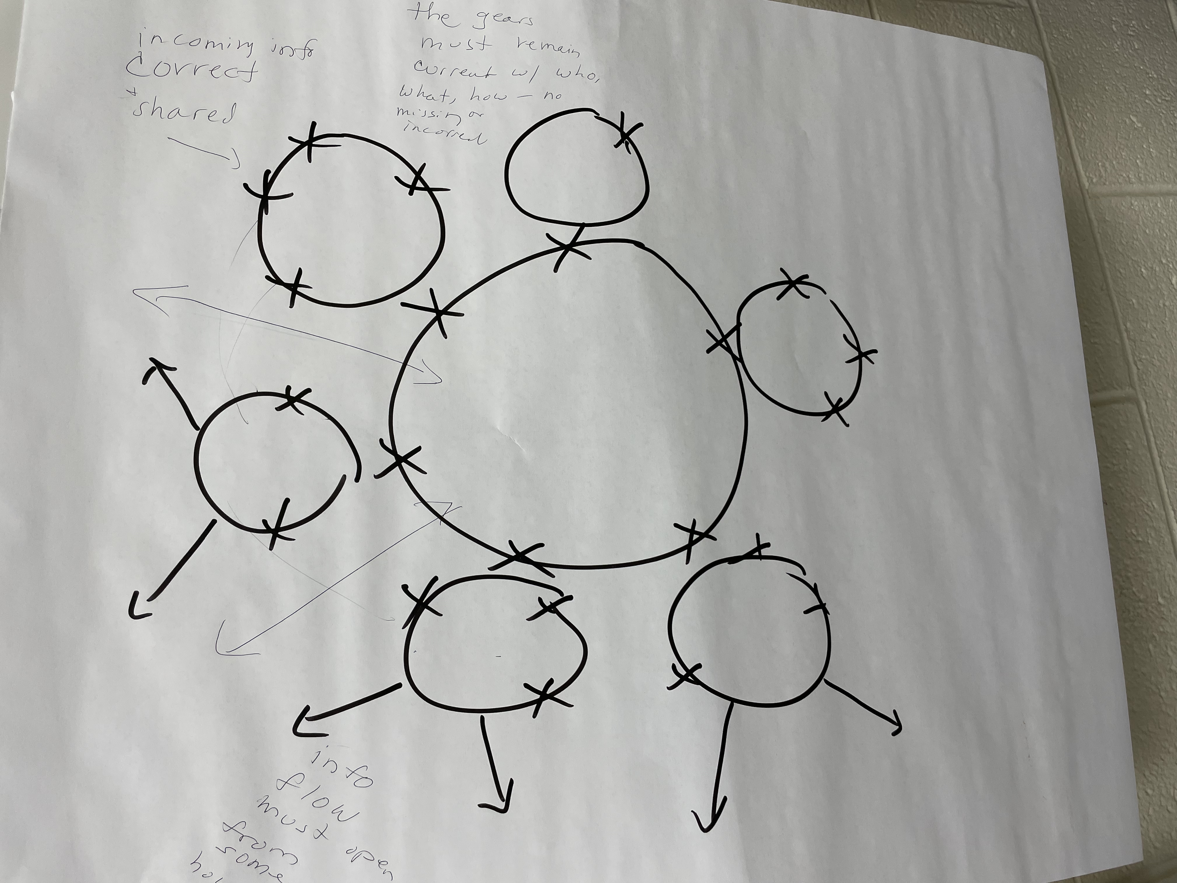
HAT Structure Going Forward?

Slide 15
Recommendations for Operational Excellence
Recommendation 4.D.1
Find at least one tool to engage and develop discipline for formal chartering. High performing teams start with strong onboarding, distribute leadership, follow through with individual and shared responsibilities, use meeting time wisely and respectfully maintain progress checks and balances for accountability. Among the resource for chartering is “Purpose to Practice” ( P2P) found online at liberatingstructures.com. The elements of P2P have relentlessly proven to foster alignment, clarity, collaboration and readiness for SMART goals compared to informal start-ups. No matter the process you engage, seriously consider the 4 elements of P2P and create your process to form.
Recommendation 4.D.2
Another important consideration is “RACI”. This acronym describes an activity management matrix that clearly defines “who is responsible” for something, who is accountable for it, who should be included in communication with about it, and who are others to inform about it.
There is no current recommendation herein, as Housing North is experienced to bring this to the table in relationship to the Housing Ready coordinator position. This process can be learned by HAT to replicate and adapt for anything else it is does. It is incumbent on Manistee County-based HAT members to ensure that RACIs are crystal clear, are a standard reference, and are updated as actions progress or change.

Slide 16
38 Agencies/Organizations Already At Table!!!
Bold Concepts LLC
Century 21 Northland – Manistee
Centra Wellness Network
CHOICES
City of Manistee
City of Manistee – City Council
City of Manistee Housing Commission
DDA – Filer Township
DHD#10 – Community Connections
ECHO His Love – Safe Harbor
FiveCAP
Housing North
Integrated Architecture
Lakeshore Construction
Manistee County Administration
Manistee County Board of Commissioners
Manistee County Commission on Aging
Manistee County Community Foundation
Manistee County Economic Development
Manistee County Habitat for Humanity
Manistee County HSCB
Manistee County Land Bank Authority
Manistee County Planning Dept.
Manistee County Sheriff’s Dept.
Manistee County United Way
McKinney-Vento Homeless Education Grant Coordinator
MDHHS
Munson Health Care
Networks Northwest
Northern Michigan Community Action Agency
Northwest Michigan Health Services, Inc.
Office of Rural Development
Safe Built
Shelby State Bank
Spicer Group
Staircase Youth Services
Tip of the Mitt
West Michigan Mediation Services

Slide 17
Thank you!
Anyone interested can contact
Rose Fosdick at hscbmanistee@gmail.com or
call 231-510-6518
to be added to the HAT mailing list.

