Slide 1

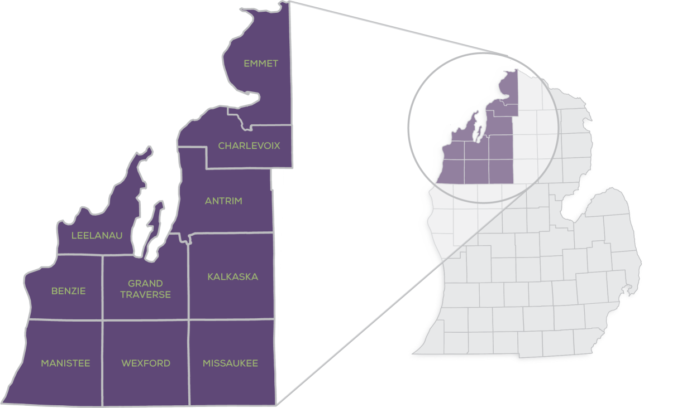



AWARENESS
Outreach, messaging, & communications tools to communities, developers, & other partners.
ADVOCACY
Identify and influence policy that impacts development opportunities in rural Michigan.
CAPACITY & RESOURCES
Work with partners to develop new tools & funding options for housing.
Founding Partners

Slide 2
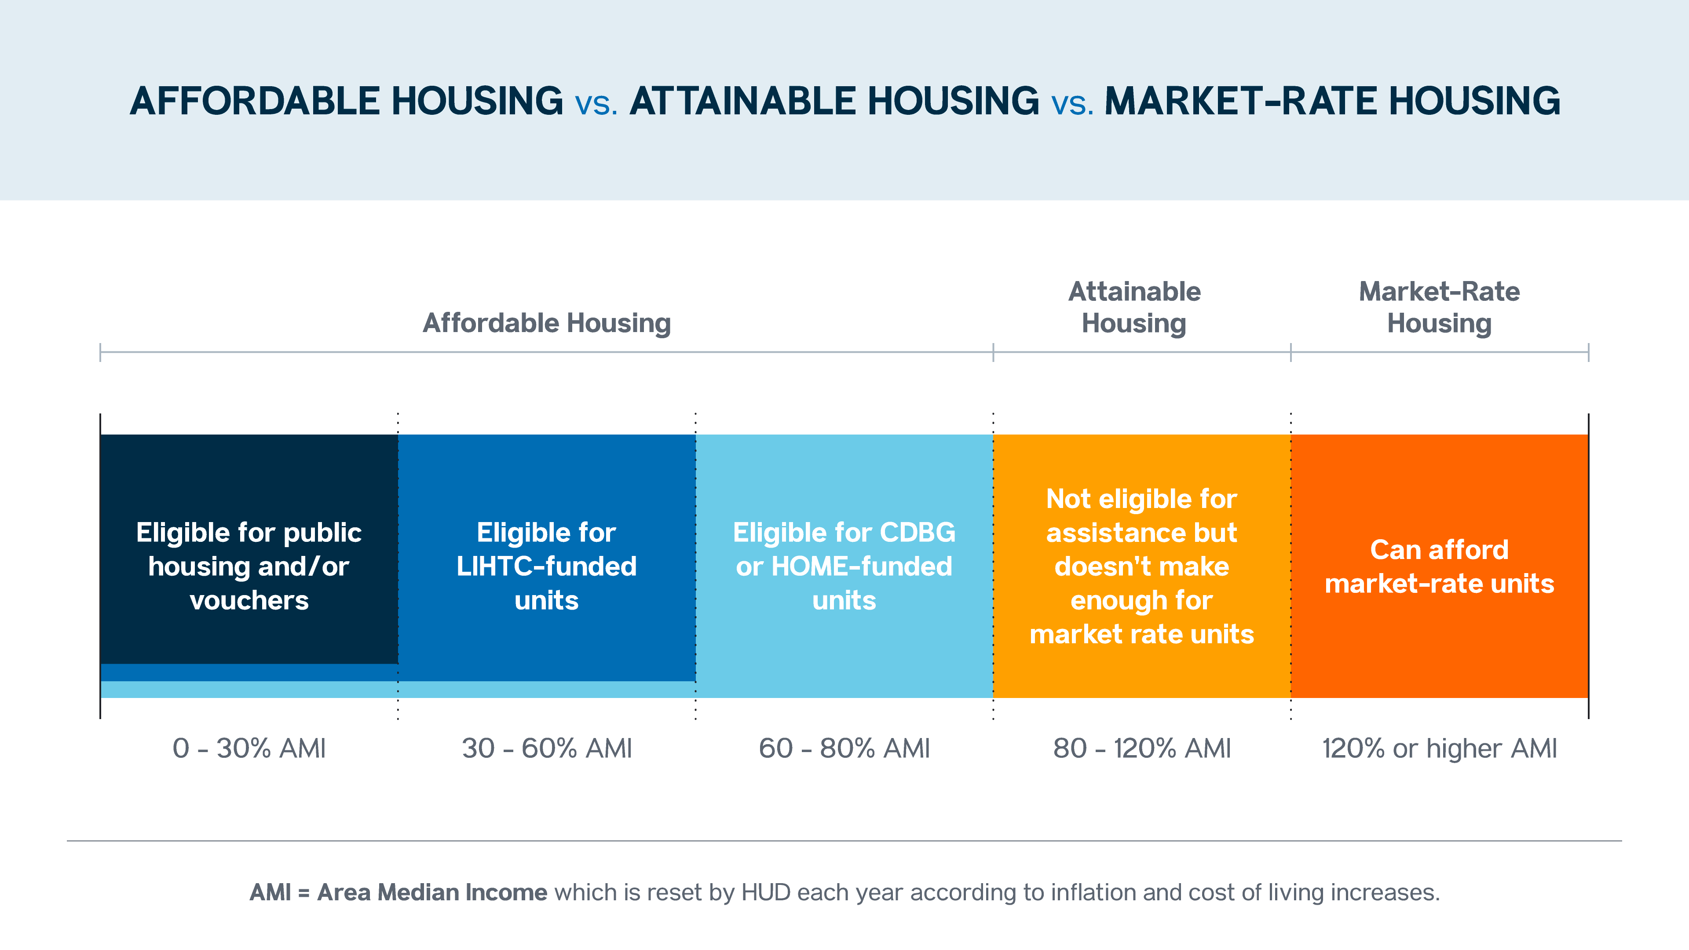
Notes:
……we’re really just talking about any year-round housing)

Slide 3
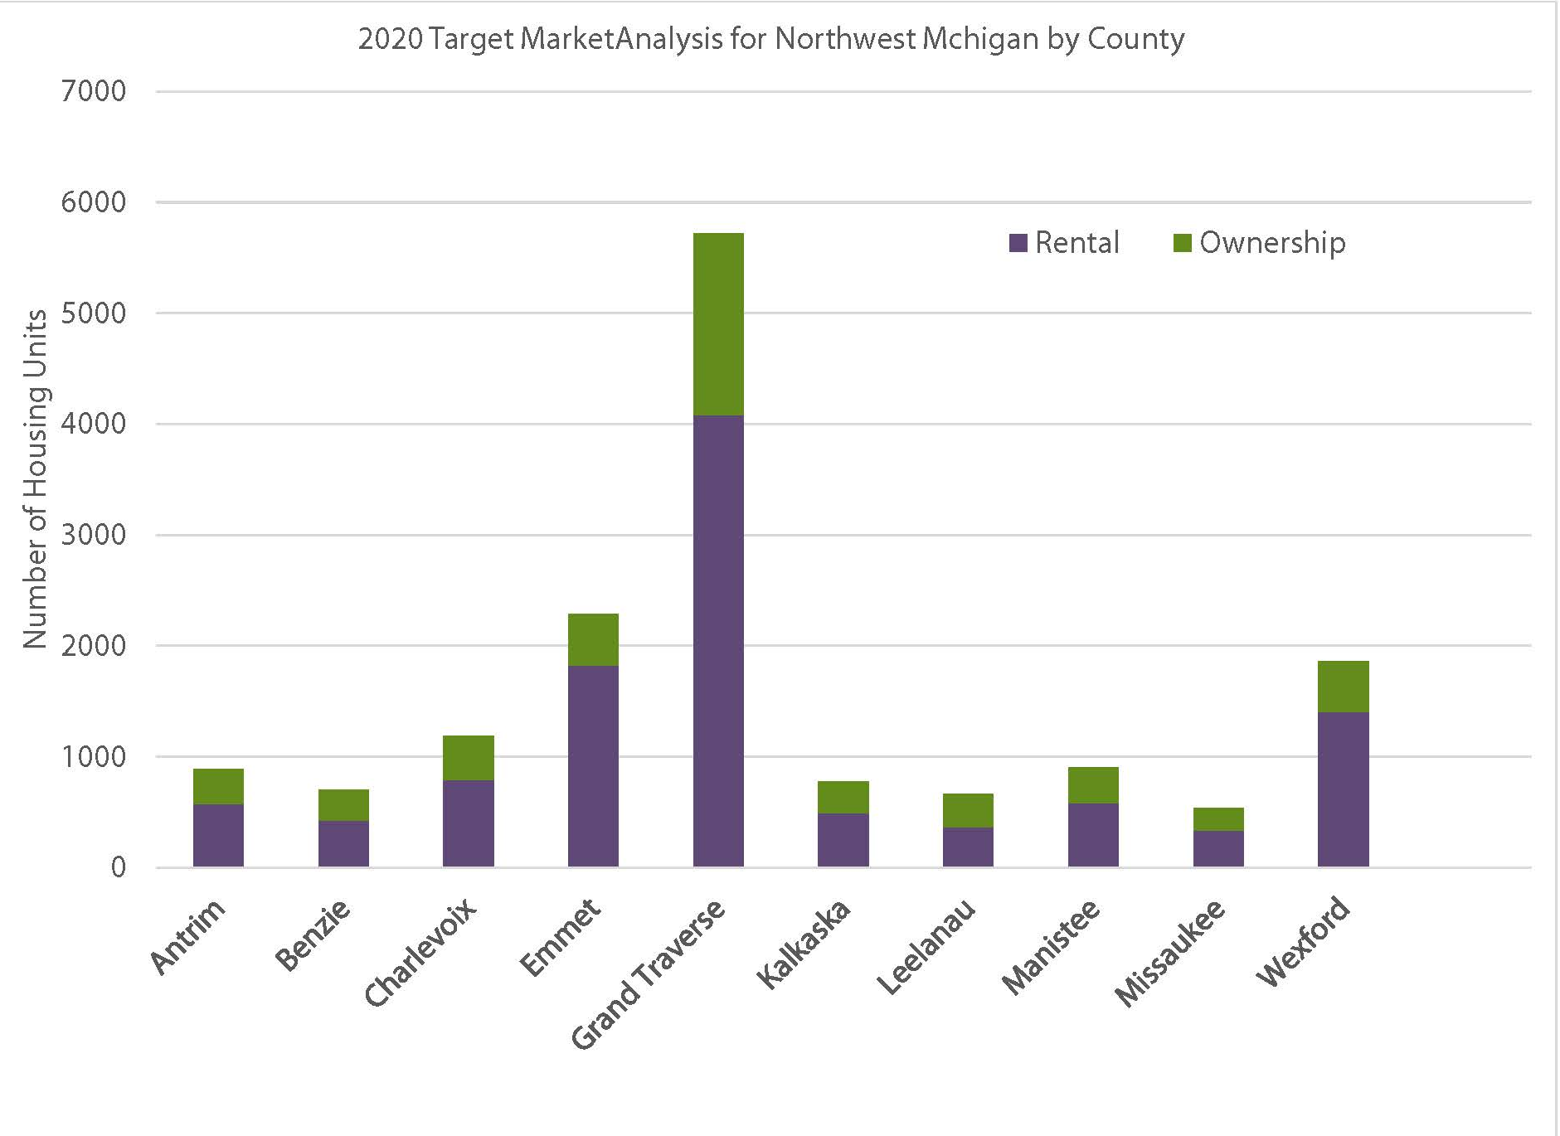
The 2019 Northwest Michigan
Target Market Analysis studied the
demand for housing through 2025
In the 10 counties in NW Michigan. The study showed the potential for demand from current residents moving within the community as well as those who would move here from outside the community.
The study found that the market could support 15,000 additional units through 2025.
10,880 in rental units
4660 in homeownership units
These could be newly constructed homes or apartments or the repair or conversion of existing homes or buildings.

Slide 4
Communications/Advocacy Creating Housing Ready Communities Advocating for zoning changes Helping remove barriers to housing

Slide 5


Housing Ready Communities
Since 2020 #12 Units of Government and more than 30 organizations and local businesses have supported this program
Encourage housing ready checklist to be filled out in each community Develop housing task force for meeting housing goals (at least one per County) Develop a strategy for a Housing Ready Program Coordinator/Director (3 years)

Slide 6
Programs offered by Housing North
Housing Ready Program
Deed Restriction Program for year-round housing
Accessory Dwelling Unit Program
Advocacy Trainings
Educational webinars (monthly)
Annual NW Michigan Housing Summit

Slide 7




Advocacy (Policy Initiatives)
Housing North has developed a state legislative advocacy policy designed to give communities more tools for incentivizing housing development and spurring housing growth. In 2020, we began working with a group of similarly committed regional and statewide organizations dedicated to changing state policies to grow housing development options.
Notes:
Housing Michigan Coalition
Make workforce rentals more affordable
Incentivize long-term rentals (vs use of property as a short-term rental)
AFCI Increase housing credit allocations
Create additional opportunities for access to credits for rural communities
Increase access for hard-to-serve communities like rural, Native American, high poverty, and high-cost areas
Develop a new and innovative tax structure for property owners seeking to provide long-term (greater than one month) rental housing for the workforce

Slide 8
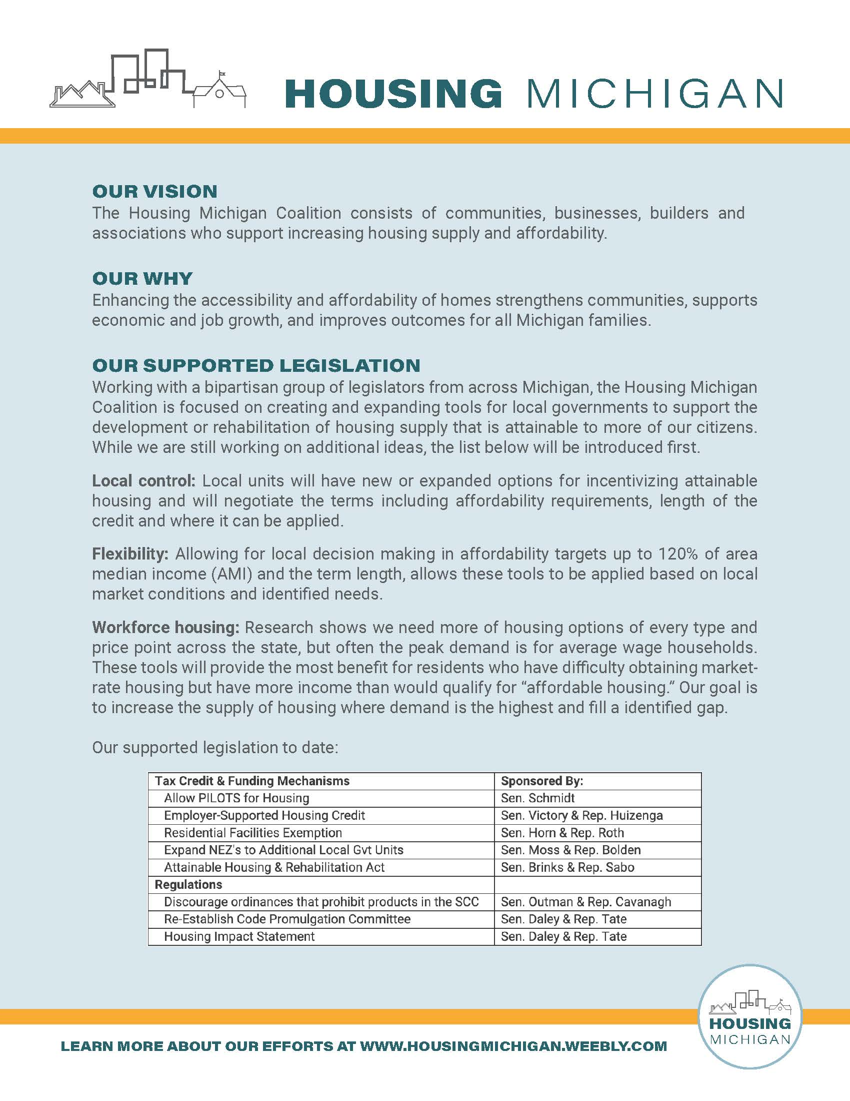

Sign up for the Housing Michigan Coalition We’ve created a simple sign-up to get updates & calls to action. Sign up here! Or type in https://www.surveymonkey.com/r/MIHousingCoalition
Notes:
Working with a bi-partisan group of legislators from across Michigan, we are focused on creating and expanding tools for local governments to support the development or rehabilitation of housing supply that is attainable to more of our citizens. There are multiple reasons for the housing gap.
There is NO Silver Bullet.
We need changes in policy, attitudes, and incentive on multiple fronts.

Slide 9
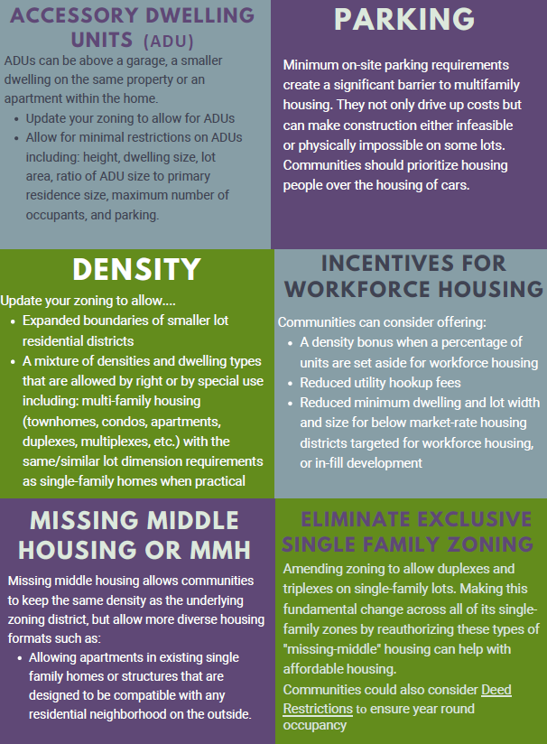
Suggestions for zoning changes to make your communities more ‘Housing ready’
Also Supporting …..
Community Land Trust Legislation
Advocating for the Office of Rural Development
Participating in State-wide coalitions to bring more housing capacity to NW Michigan

Slide 10
Capacity ….bringing technical support and new tools/resources for housing
Housing Ready Program
Public Private partnerships
Facilitating/Coordinating projects

Slide 11
Housing Action Groups or Teams
Antrim County- Elk Rapids Housing Task Force
Benzie County- Benzie County Housing Collaborative (2022)
Charlevoix County- Three Groups in each city with broad representation
East Jordan, Boyne City, City of Charlevoix
Emmet County- Little Traverse Bay Housing Partnership (LTBHP) (2017)
Grand Traverse County- Housing Solutions Network (2021)
Leelanau County- Housing Action Committee (2015)
Kalkaska County- Village of Kalkaska Housing and Blight Committee
Manistee County- Housing Action Team (2021)
Notes:
Land Bank/Brownfield TIF Workforce Housing Program
Housing Ready Master Plan and Zoning Amendments
Supporting Housing Advocacy Teams within local communities
Pursuing Housing Opportunities including projects for 4% and 9% Low Income Housing Tax Credits (LIHTC)
Deed Restriction Program/Accessory Dwelling Unit Program

Slide 12
Introduction- Manistee County Housing Ready Staff
Housing North, the HAT, and the Housing Ready Program Coordinator will work together to outline an Annual Work Plan for the position.
Serve as the primary point of contact for housing related questions and provide referrals to appropriate partners and resources
Work with community partners to effectively communicate the need for housing solutions in Manistee County and help educate locally elected officials and community members about best practices for housing solutions
Support partner efforts to encourage and assist units of government with adopting zoning that alleviates community housing challenges
Work with community partners and the Director of Economic Development (MACOC) to identify priority sites for housing opportunities and garner community support

Slide 13
What will our Housing Ready Staff Do for Manistee?
Work with community partners to assist in building development capacity for housing including rehabilitation programs and supporting new construction within Manistee County
Research, seek and implement grants from local, state and national sources to leverage financial support for addressing Manistee County’s housing challenges
Development of clear guidelines outlying the process, available funding vehicles, and timetables for programs and incentives
Coordinate and build upon the goals and actions of the 2019 City of Manistee Housing Action Plan and other associated housing plans and strategies
Coordinate specific housing related incentives, funding programs and partnership opportunities around specific properties and act as a single point of contact for develops and investor

Slide 14
Contact Information
Yarrow Brown, Executive Director
yarrow@housingnorth.org
Tracy Davis, Manistee County Housing Ready Program Coordinator
tracy@housingnorth.org
Zach Hillyer, Leelanau County Housing Ready Program Director
zach@housingnorth.org
Andrea Jacobs, Emmet County Housing Ready Program Director
andrea@housingnorth.org
Alana McKinnie, Program Administrator
alana@housingnorth.org
Data available at:
www.housingnorth.org

