Slide 1

2022 City Project Updates
Bill Gambill, MPA
Manistee City Manager

Slide 2
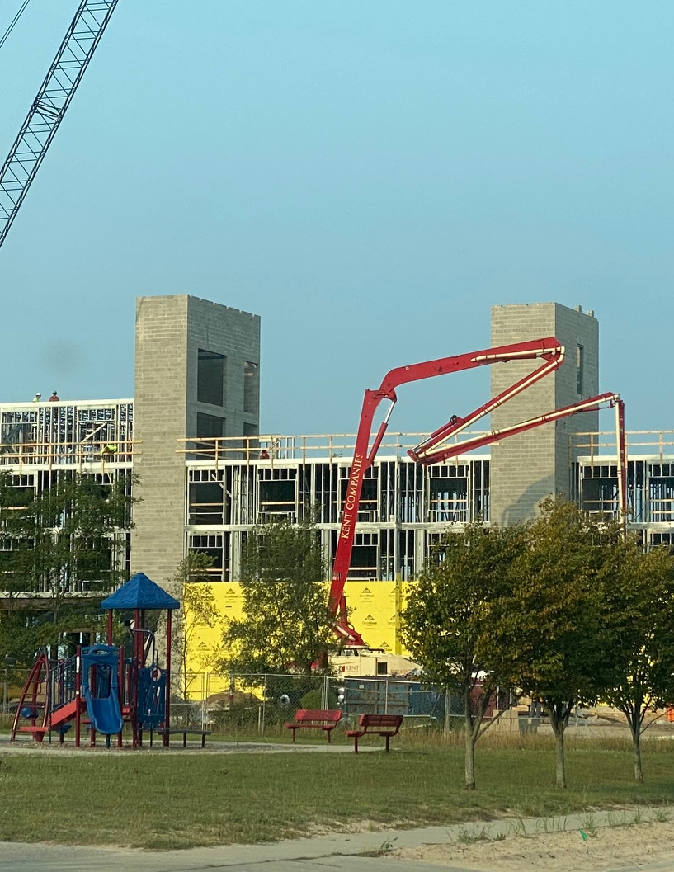
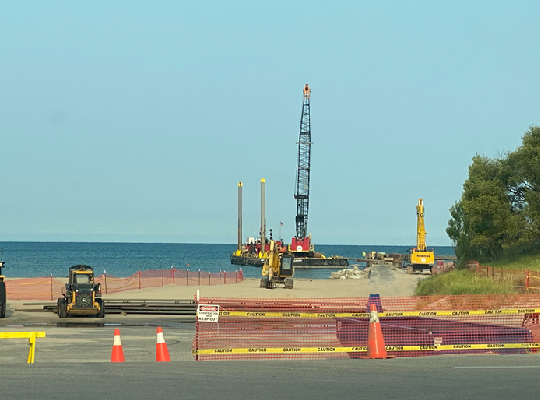
Hotel Projects
First Street Beach Projects
Hampton Inn
Brownfield Plan Improvements
US Army Corps of Engineers
Gateway Project
Demolition

Slide 3
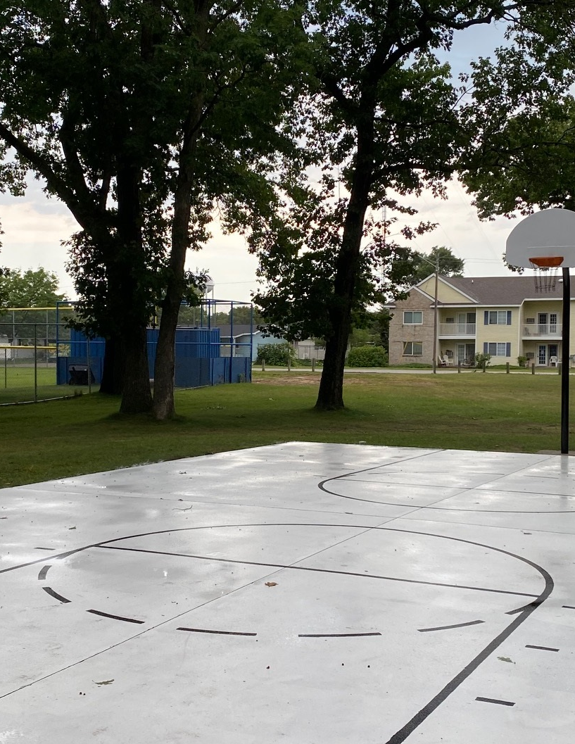
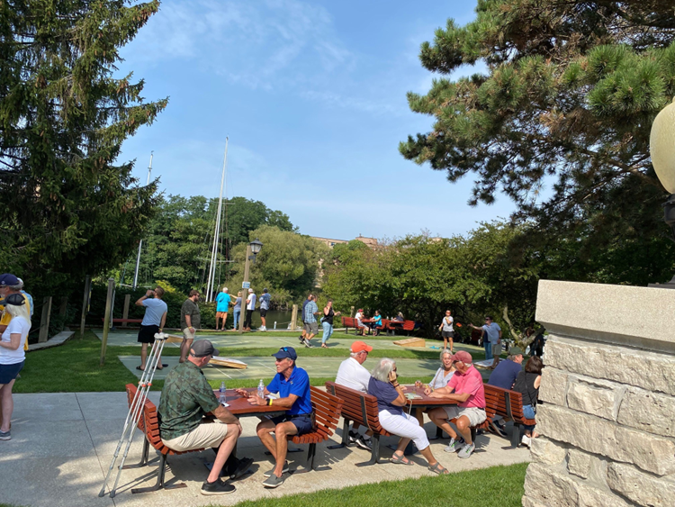
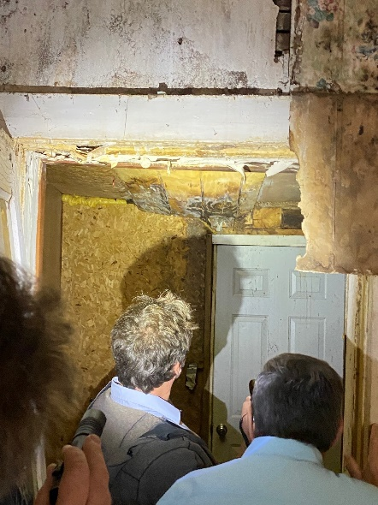
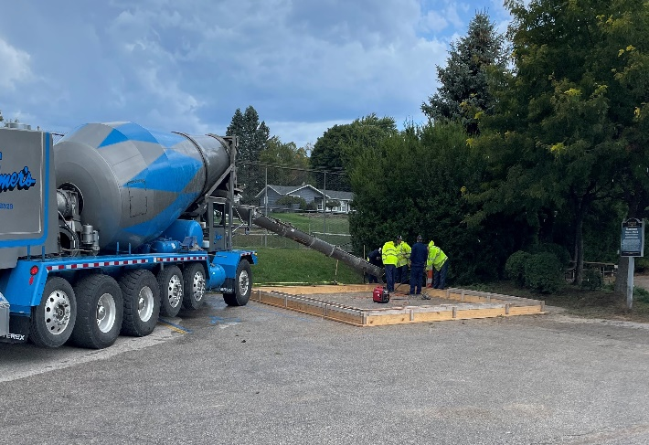
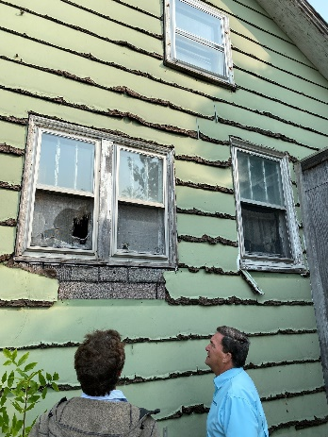
Park Improvements and Beautification
Blight
Non-registered rental enforcement
Neighborhood Restoration and Beautification Commission (NRBC)
Demolitions
DPW Efforts
Volunteer Collaborations

Slide 4
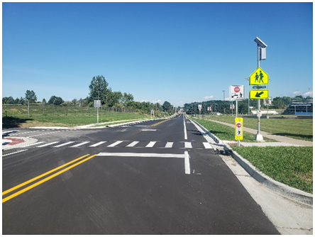
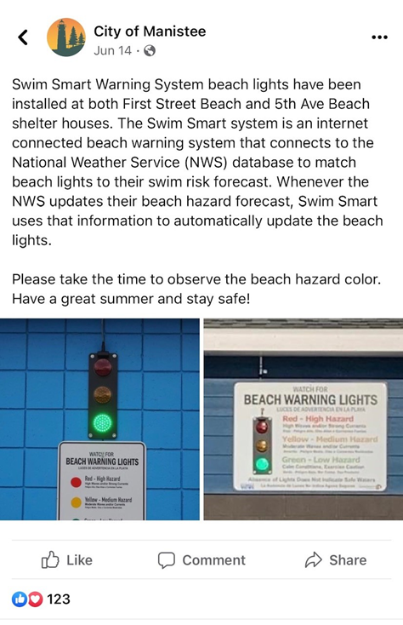
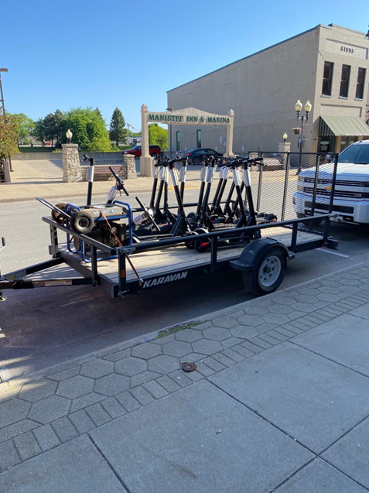
New Technology
Safety Enhancements
Swim Smart – Installed
12th Street Crossing
See Click Fix – in process
Report issues to City through a mobile app
Bird Scooters

Slide 5
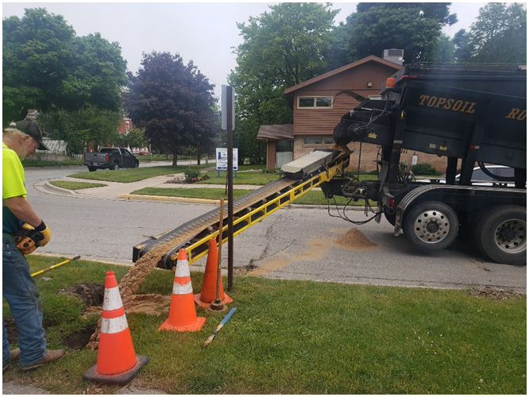
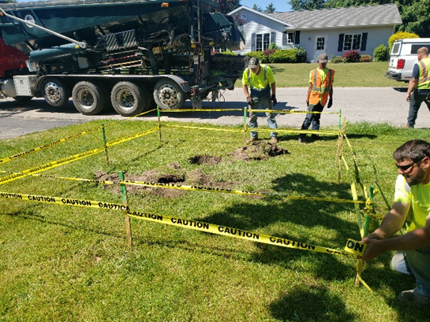
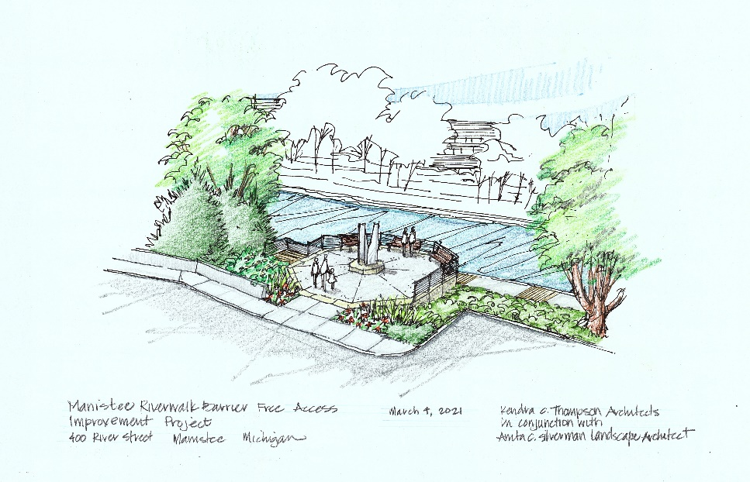
Grant Projects
DWAM Grant – In progress
EGLE Brownfield Grant and Loan Gateway Project – In Progress
South Riverwalk EDA Grant – Recently awarded
North Riverwalk Grant – Received scoring
Lighthouse Park Disc Golf – In progress
Notes:
DWAM Grant Final Contract Cost - $158,000 Status of Project: - Completed all but punch list items - Compiling data from inspections

Slide 6
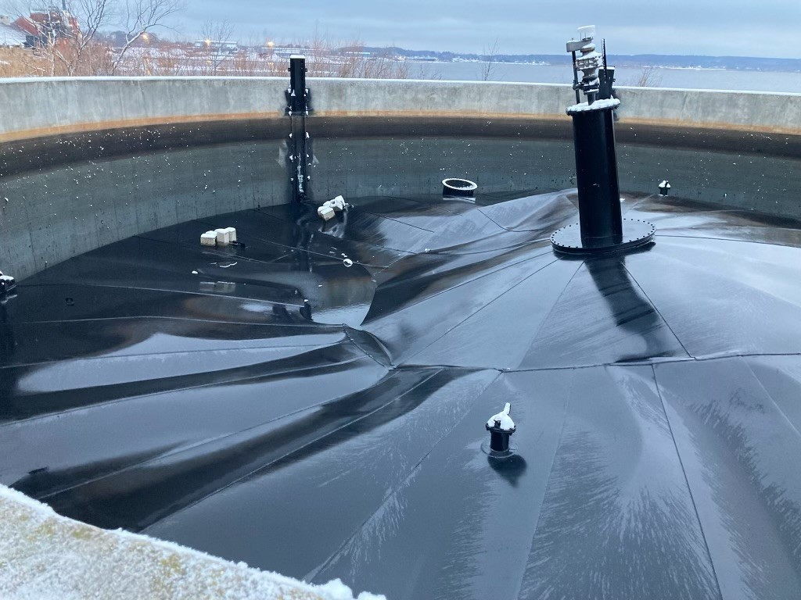
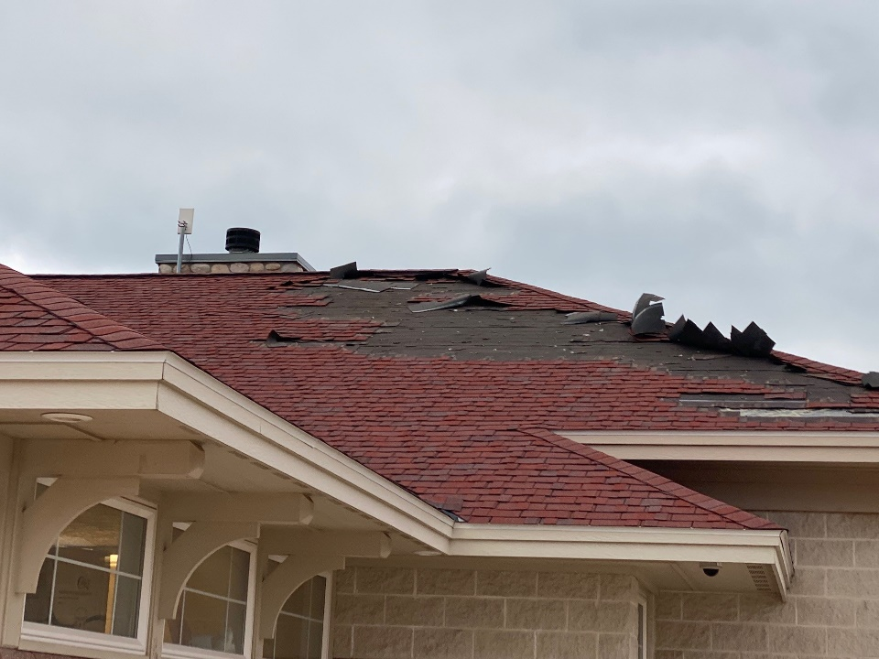
Insurance Claims ☹
Digestor Cover Collapse
5th Ave Beach Concession Roof Shingle Damage
1st Street Softball Field Fence Damage

Slide 7
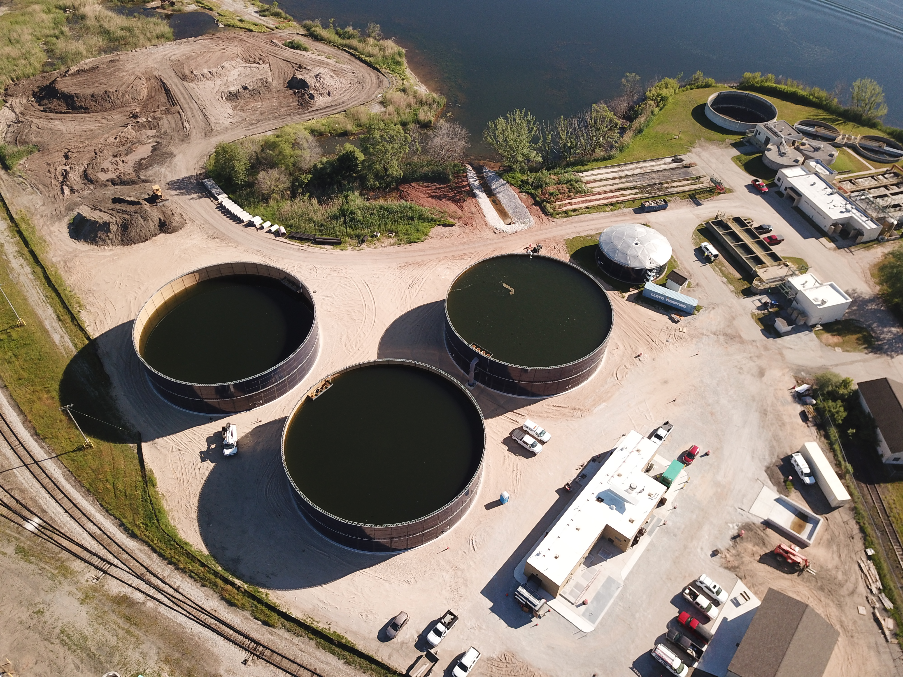

2022 Construction Projects
Notes:
Good Evening
Actually a 2 Year update.

Slide 8
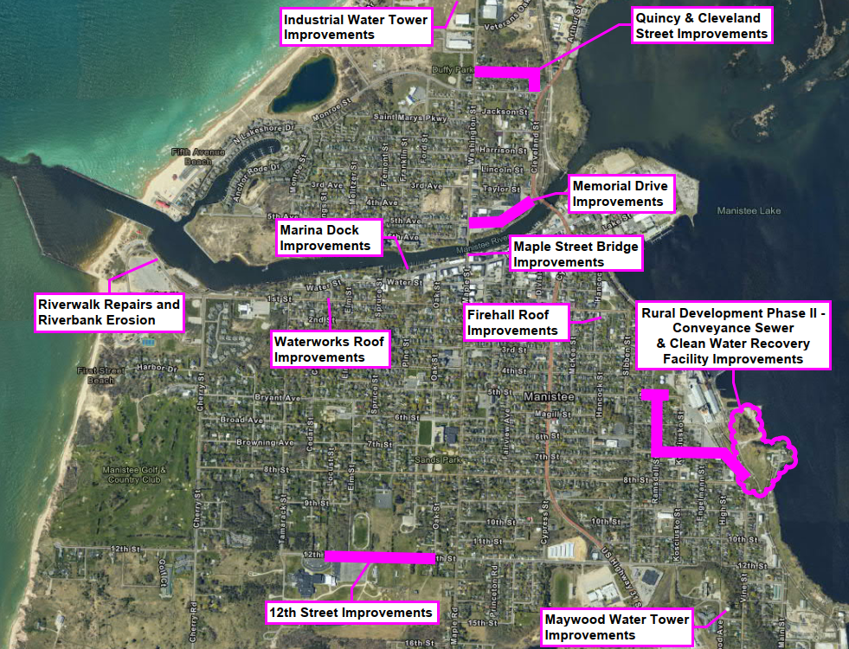
2022 Construction Project Locations

Slide 9
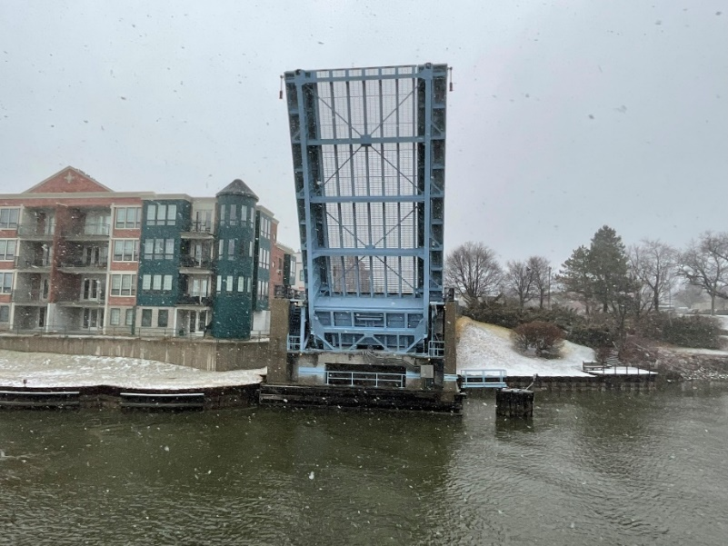
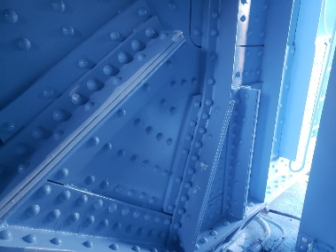
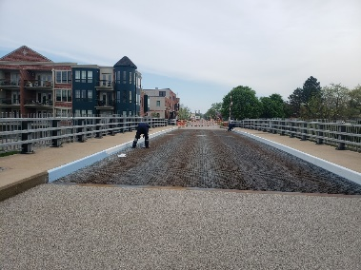
Maple Street Bridge Cost: $823,000 Status of Project: - Completed

Slide 10
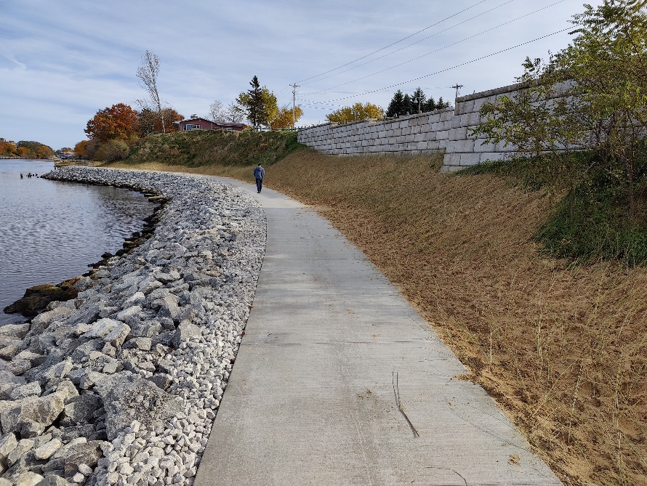
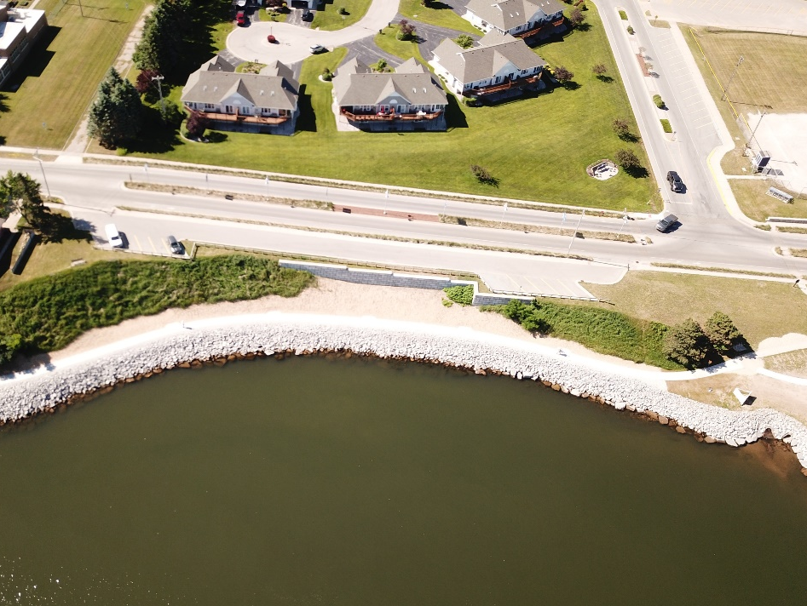
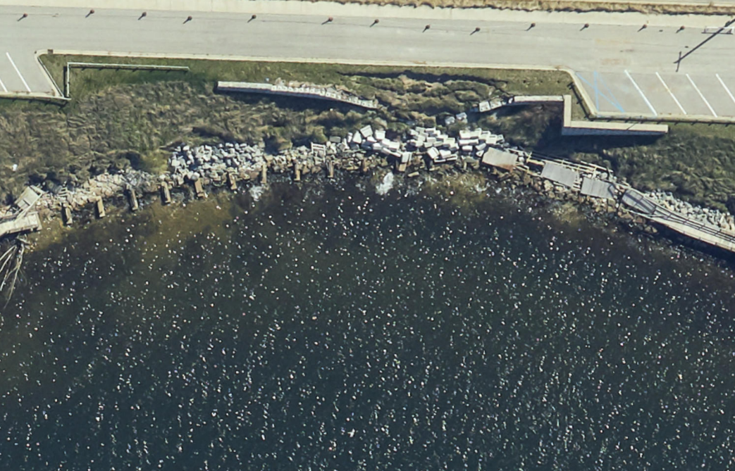
Riverbank Erosion & Riverwalk Repairs Cost: $1,670,000 Status of Project: Monitoring for vegetation growth and Punch List

Slide 11
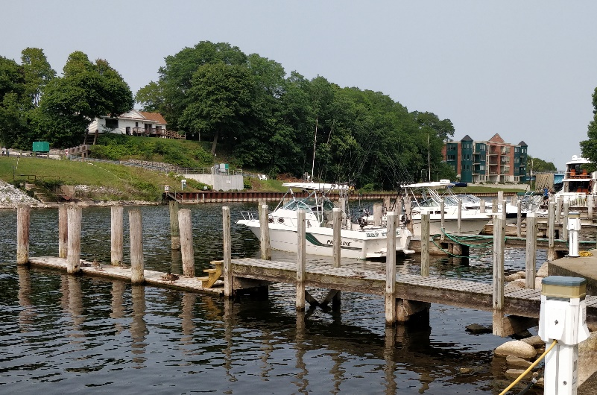
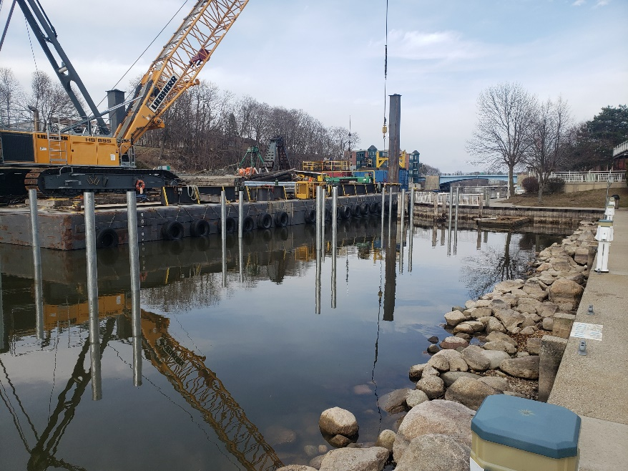
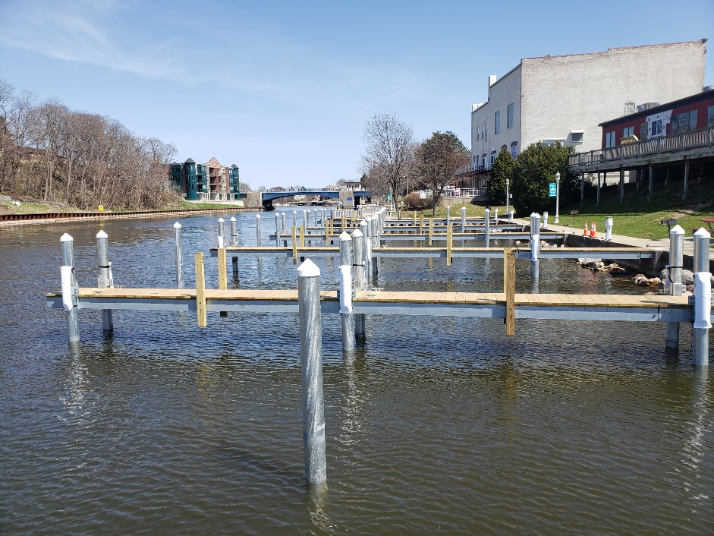
Municipal Marina Dock Replacement Phase 2 Contract Cost: $426,000 Status of Project: Completed

Slide 12
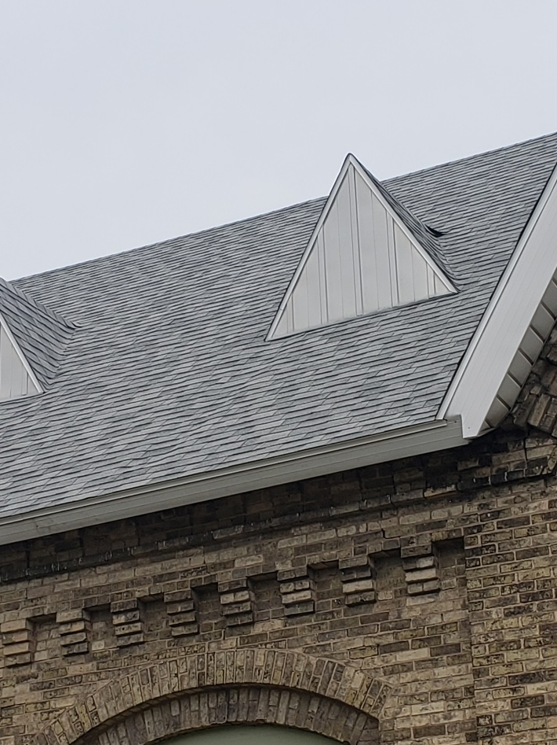
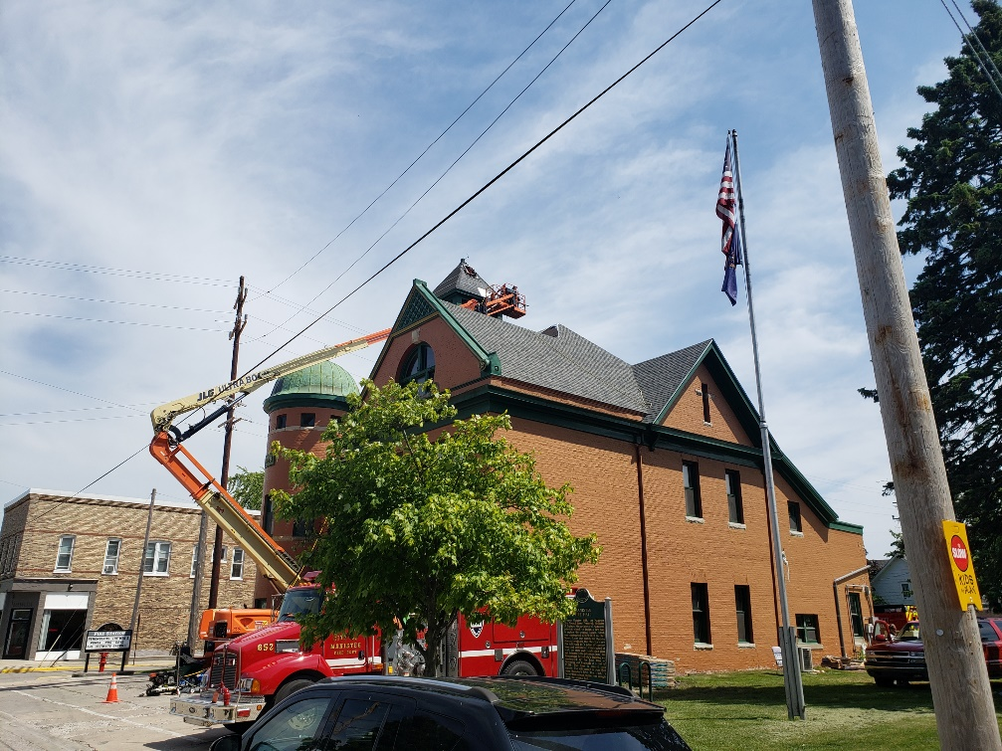
Municipal Roofs Contract Cost: $369,000 Added gutters, new flagpole on City Hall, new roof decking for City Hall and Firehall, new walking pads for City Hall, new entranceway roof at CRWF Status of Project: Completed
Notes:
Garland providing materials and roofing guarantees (20 to 30 years). Ostrander is the contractor.

Slide 13
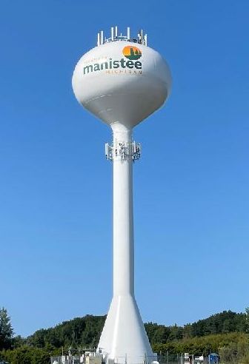
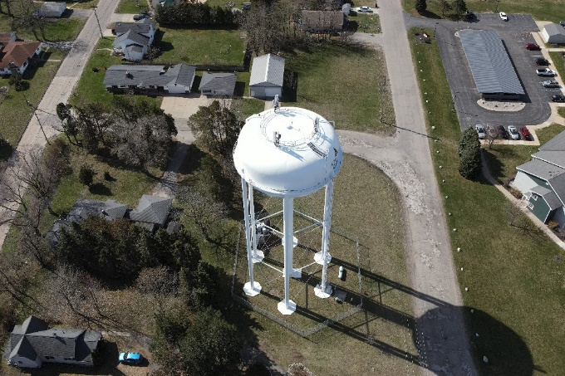
Water Tower Improvements Contract Cost - $304,000 Status of Project: Completed
Notes:
Garland providing materials and roofing guarantees (20 to 30 years). Ostrander is the contractor.

Slide 14
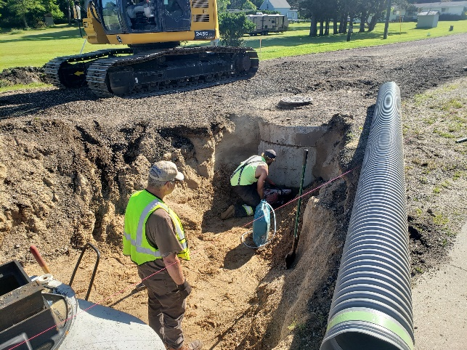
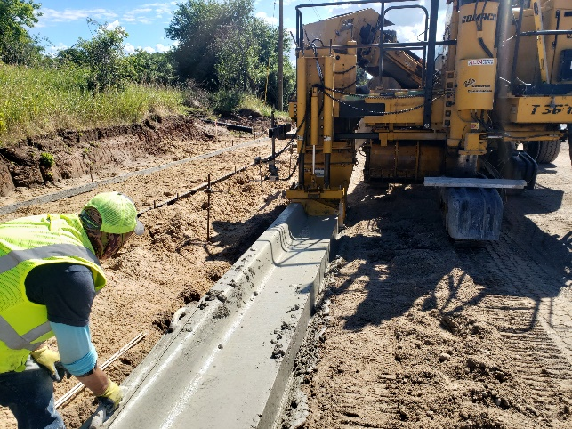
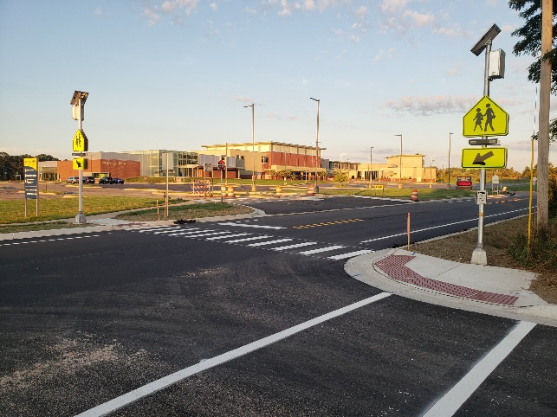
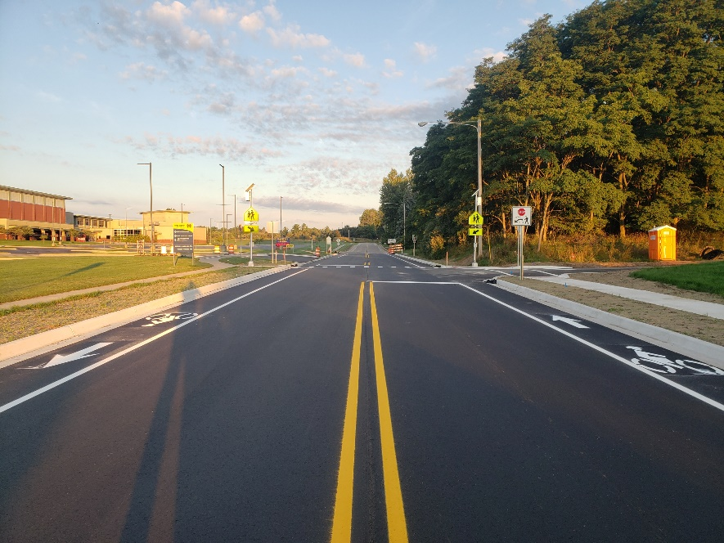
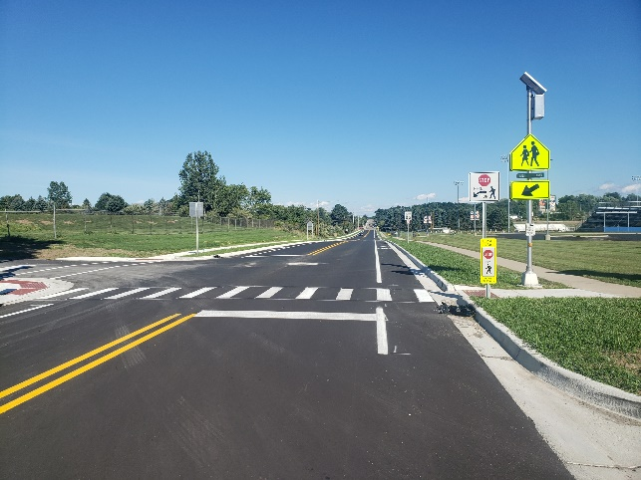
2022 12th Street Improvements Contract Cost: $503,000 Status of Project: Completed all but punch list items

Slide 15
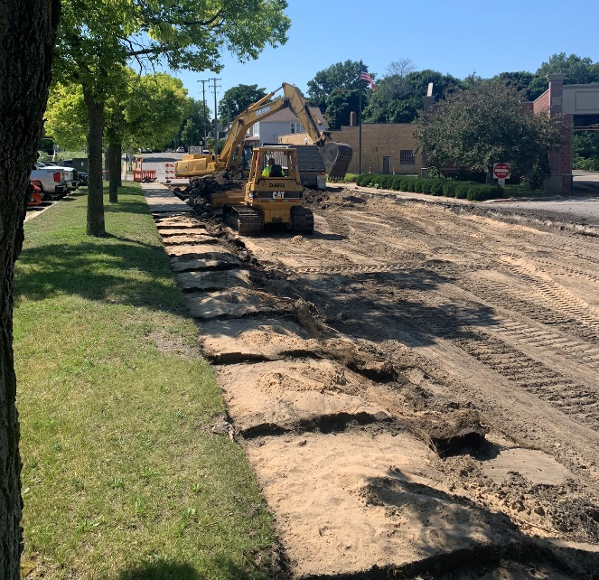
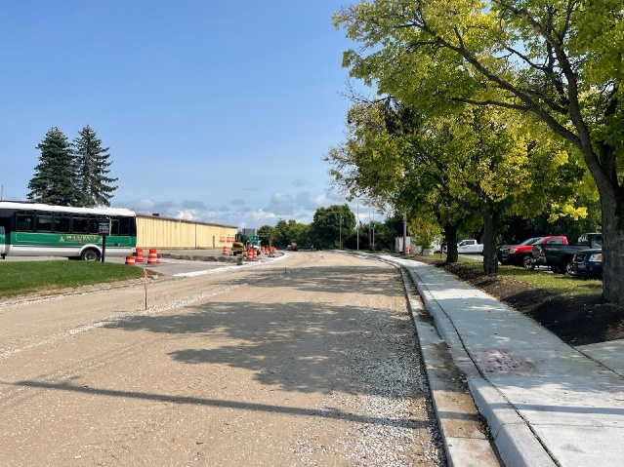
Memorial Drive Reconstruction Contract Cost: $488,000 Status of Project: - Asphalt paved - Punch list Schedule: Opened to traffic 9/20/22

Slide 16
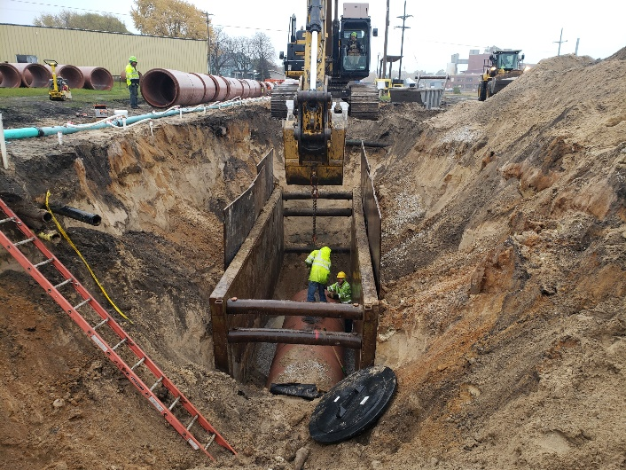
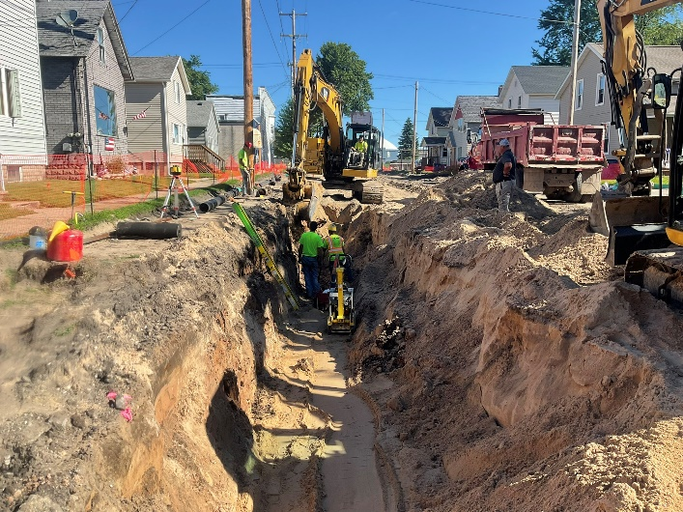
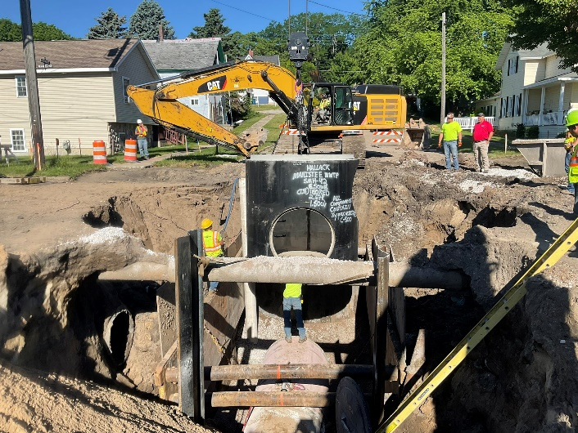
RDIIA - Conveyance Ramsdell Street Original Contract Cost: $ 4,750,000 Status of Project: - Working on final underground work, then concrete curbing, sidewalks, and driveways - Paving to follow once concrete work is completed Schedule: To be completed by October 2022

Slide 17
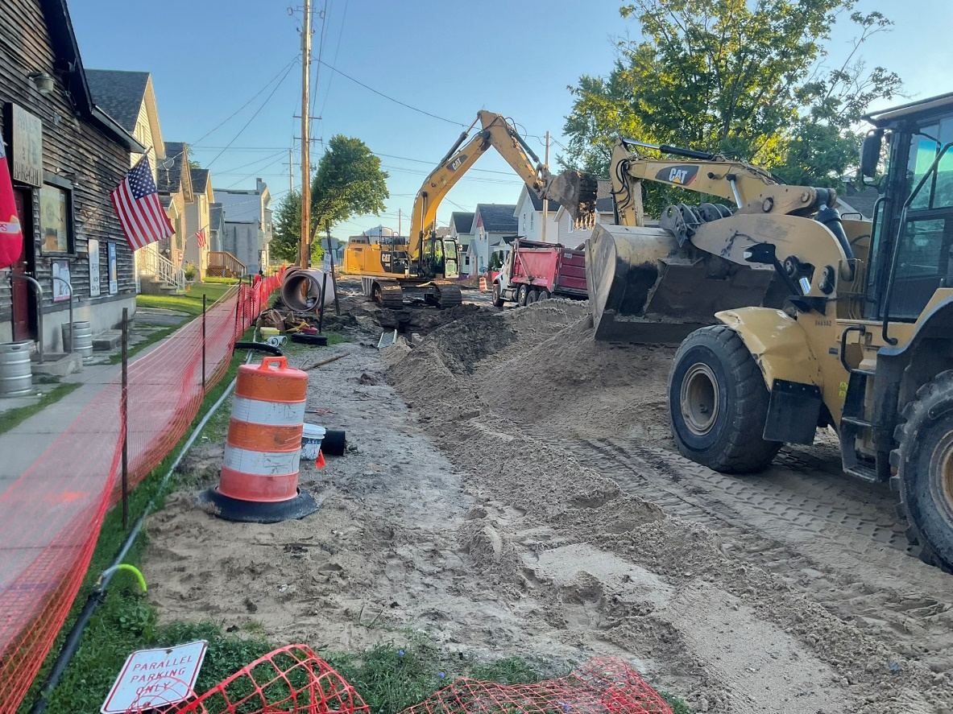
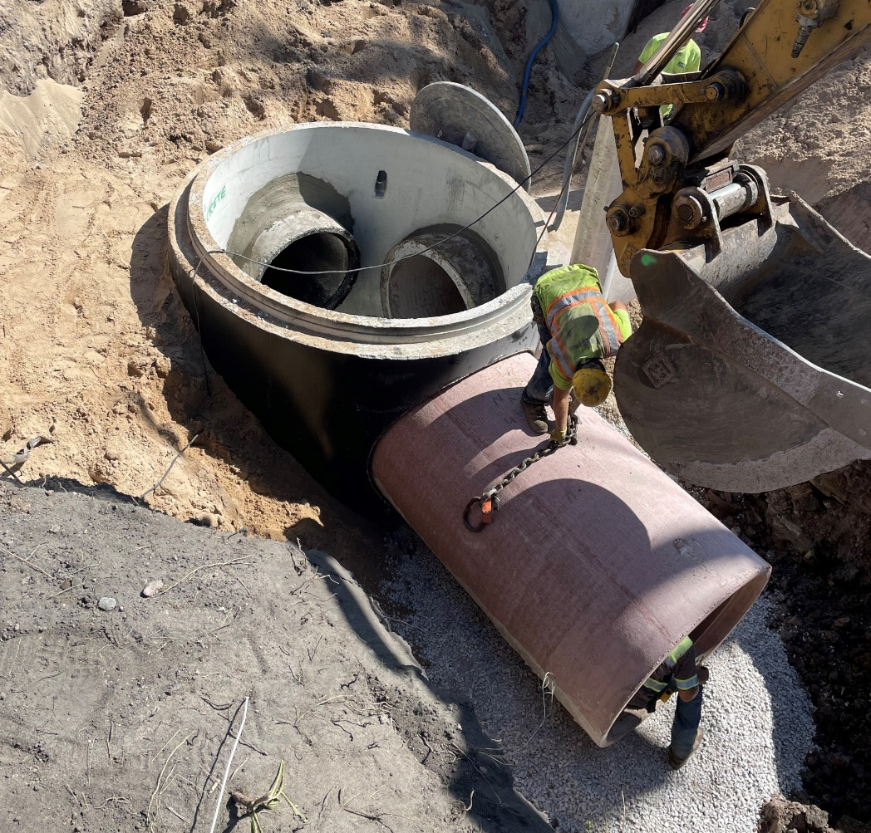
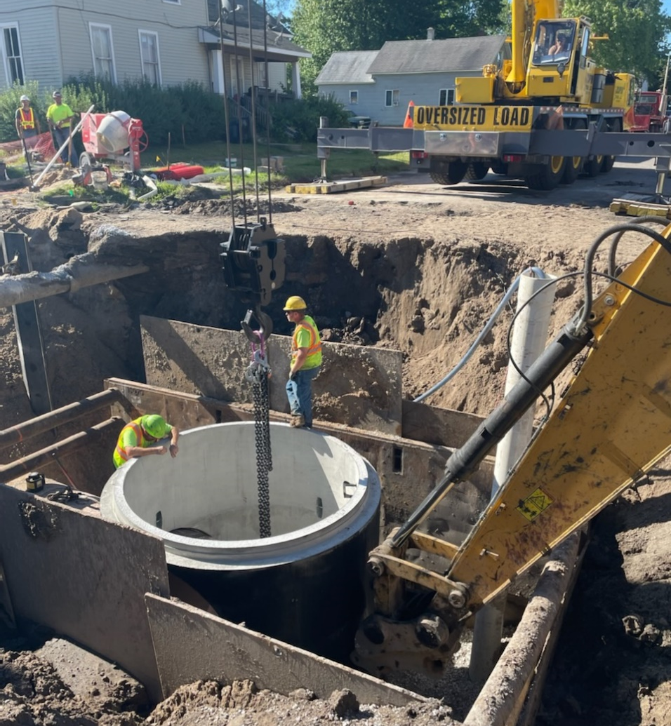
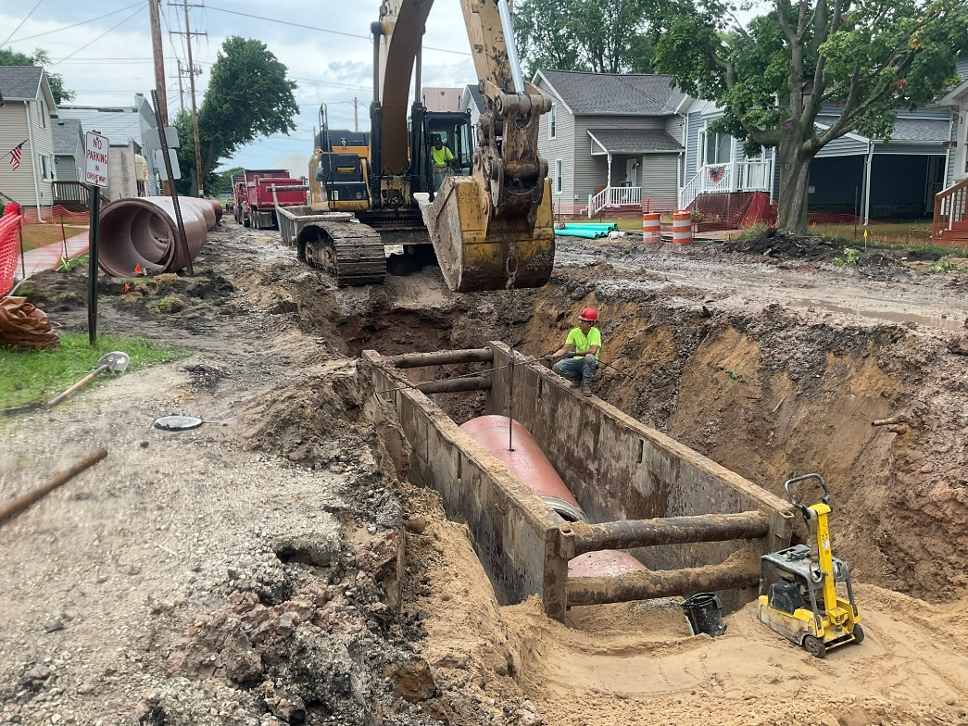

Slide 18
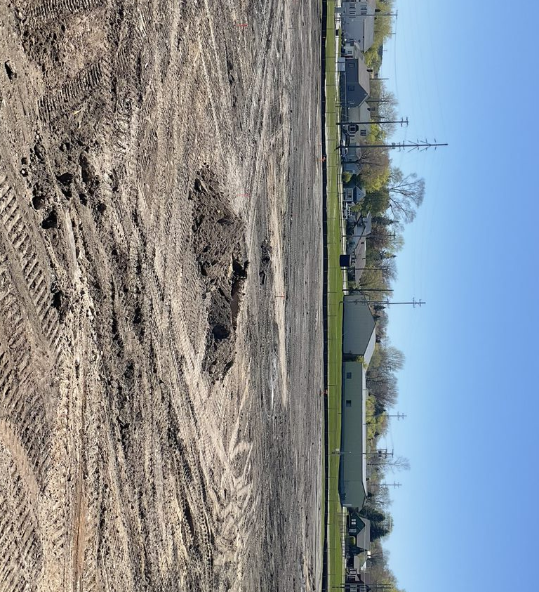
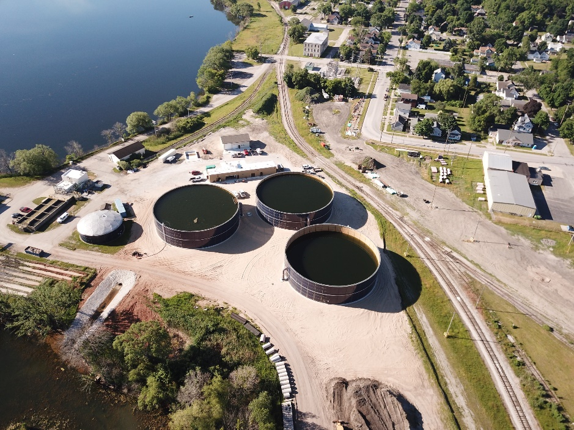
RDIIB – Clean Water Recovery Facility (CWRF) Original Contract Cost: $12,300,000 Status of Project: - Project nearly completed and operational - Working on punch list items and final connection items once the Conveyance sewer is completed
Schedule: Construction to be completed October 2022

Slide 19
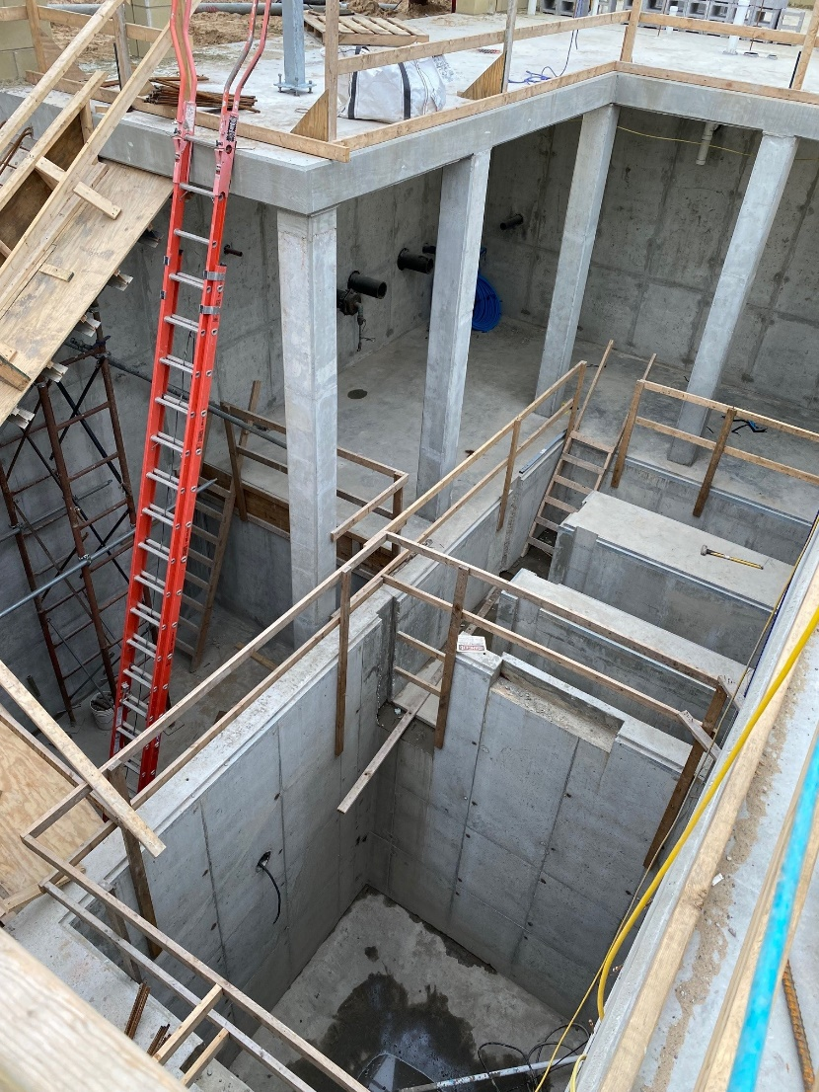
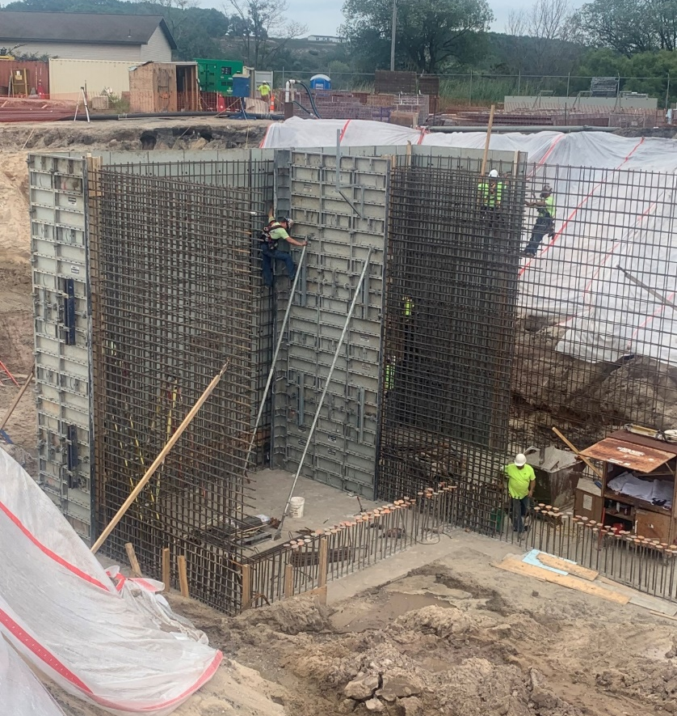

Slide 20
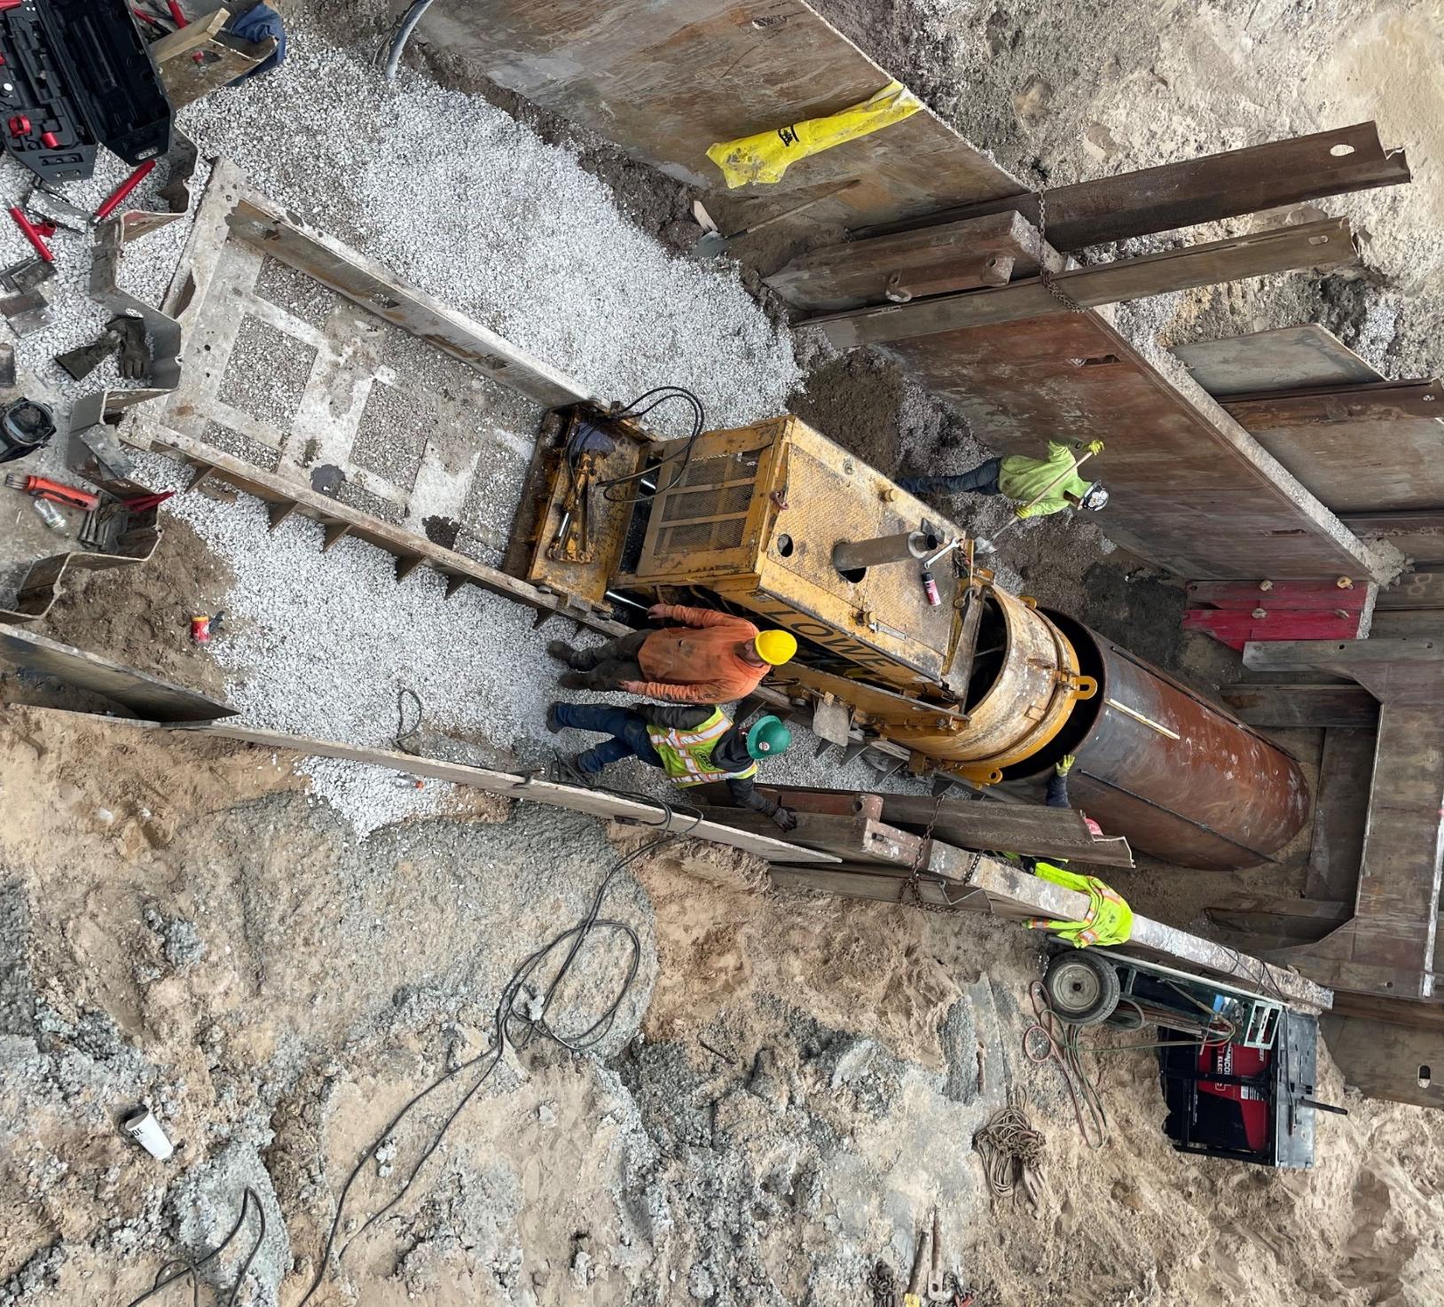

Slide 21
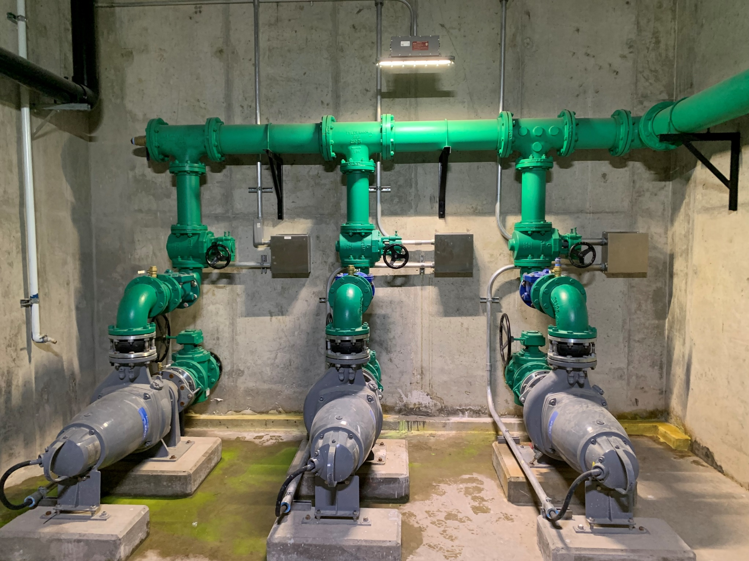

Slide 22


Slide 23



2022 Street Improvements Quincy and Cleveland Original Contract Cost: $978,000 Status of Project: - Neighborhood meeting Sept 19th - Tentatively starting within the next couple weeks Schedule: Tentative to be completed this fall

Slide 24


Upcoming Projects
Fire Hall Exterior and Site Improvements
US-31 Bridge
5th Ave Area Flood Mitigation Work
First Street Relief Sewer
S. Lakeshore Drive Improvements
S. Lakeshore Drive Watermain Loop
PFAS former Landfill site – EGLE approved workplan
Possible Grants
Amphitheater
Rail Relocation (County Lead)
Field Upgrades

Slide 25

Thank you!

